Slide 1

BME 313L – Introduction to Numerical Methods in Biomedical Engineering
Prashant K. Jha
Research Associate
Oden Institute for Computational Engineering and Sciences
The University of Texas at Austin
Lecture: Introduction
August 25, 2021

Slide 2
Goals
Introduction
Grading, assignments, class-type
Syllabus – Briefly looking at all key topics
1

Slide 3
1. Introduction
Instructor: Prashant K. Jha
Ph.D. (2016), Civil Engineering, Carnegie Mellon University
Postdoc experience, Dept. of Mathematics, Louisiana State University
Currently Research Associate at Oden Institute, University of Texas at Austin
My research work is at the intersection of applied mathematics and computational science. Currently, I am working in the areas of mechanics of solids and granular media, computational oncology and biomedical engineering, and multiscale modeling.
2

Slide 4
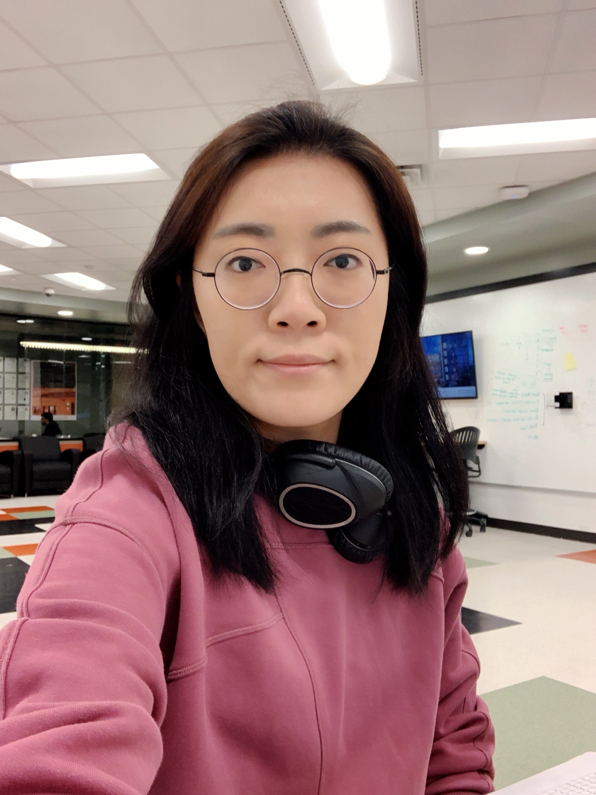
Teaching Assistant: Chungmin Han
I'm a Ph.D. student with an interest in clinical/computational neuroscience. I study brain responses by utilizing non-invasive neuroimaging, fMRI, and MEG. Anyone who's seeking advice in this field is more than welcome to ask me questions.
2

Slide 5
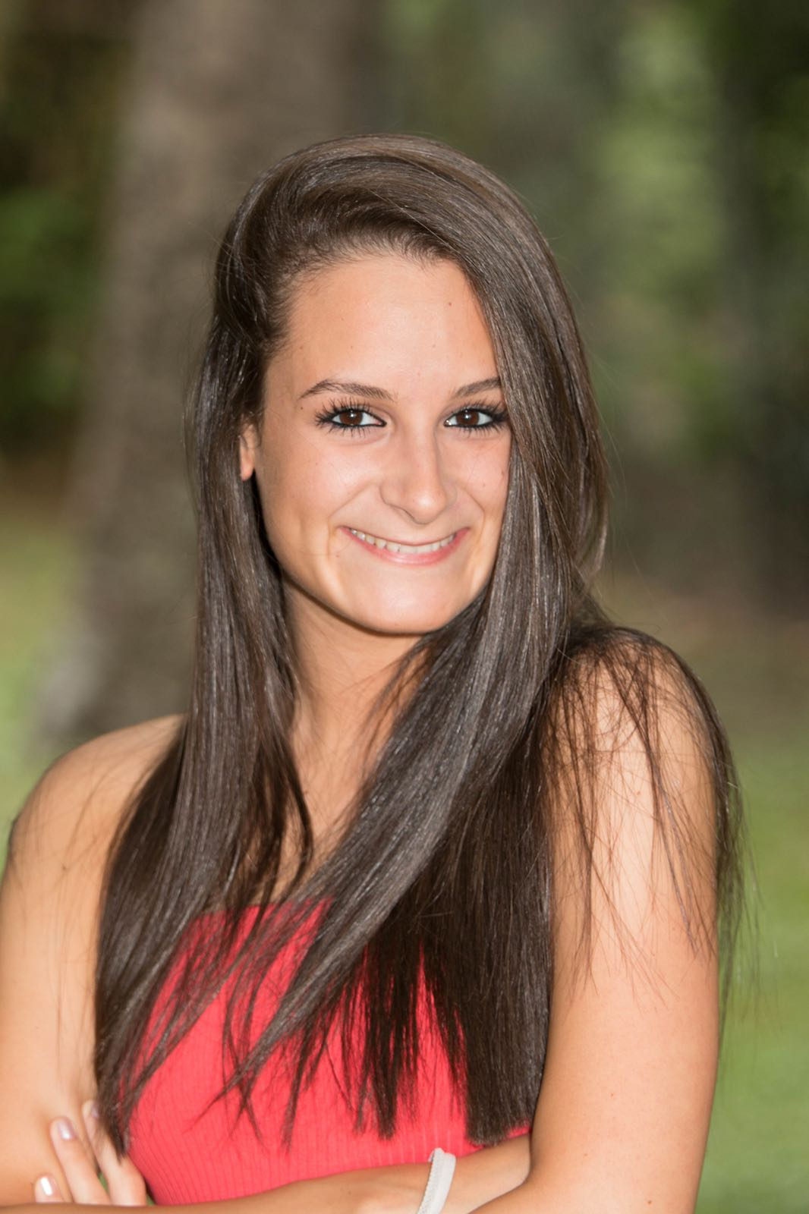
Learning Assistants: Maria Amador
I am a 3rd year Track 2 BME and math major. This semester, I will continue my position as a policy coder for the UT-Oxford COVID-19 Modeling Consortium. I love to travel, play piano, and binge Netflix! After graduation, I hope to go to med school.
2

Slide 6

Learning Assistants: Parth Malaviya
Year: SeniorTrack: BME - Cellular & Bimolecular Engineering
Hobbies: Gardening and playing pick-up basketball
Career Interests: Medical School
Undergrads, feel free to reach out about questions regarding this course or navigating BME during OH or via email/zoom.
2

Slide 7
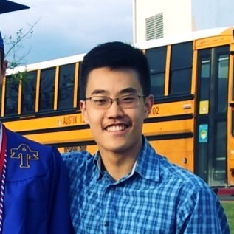
Learning Assistants: Sung Jung
I am a 4th-year BME undergraduate student in the BSBME/MSE integrated program. My research interests are in applying computational techniques to model and simulate atomic and molecular phenomena. This fall, I will be continuing my position in the Henkelman Research Group at Oden to optimize the querying algorithm of a database designed to accelerate adaptive kinetic Monte Carlo simulations of solid-state materials.
2

Slide 8
Objective
Develop the understanding of numerical algorithms to solve various classes of problems frequently encountered in engineering discipline
Develop ability to implement the ideas in computer and perform numerical calculation
3

Slide 9
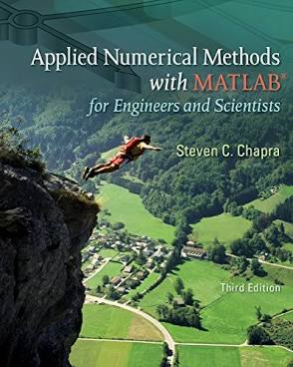
Reference and Topics Covered
Steven C. Chapra, Applied Numerical Methods with Matlab for Engineers and Scientists, 3rd ed., McGraw-Hill, 2012.
*4th ed. could also be used; however, I will use 3rd ed. as main reference.
4

Slide 10
Reference and Topics Covered
1. Introduction to MATLAB (4 lectures) (Ch. 2,3) 2. Sources of Error in Computer Arithmetic and Algorithms (1 lecture) (Ch. 4) 3. Roots and optimization (4 lectures) (Ch. 5 – 7) 4. Linear Systems of Equations (6 lectures) (Ch. 8, 9, 12) 5. Eigenvalues and Eigenvectors (3 lectures) (Ch. 13) 6. Regression, curve fitting, least squares (3 lectures) (Ch. 14, 15) 7. Polynomial Interpolation (3 lectures) (Ch. 17) 8. Numerical Integration (3 lectures) (Ch. 19, 20) 9. Numerical Differentiation (3 lectures) (Ch. 21) 10. Solving Differential Equations, ODE (IVP), ODE (BVP) (4 lectures) (Ch. 22, 24)
5

Slide 11
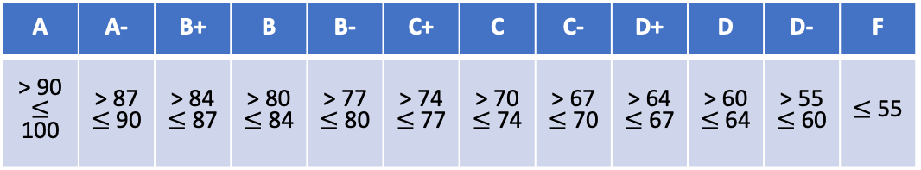
2. Grading
Attendance, active participation, pop-quizzes: 10%
Homework*: 30% (6 assignments)
*we will count best 4 out of 6
Projects: 35% (2 projects, 20% and 15%)
Final Exam: 25%
A | A- | B+ | B | B- | C+ | C | C- | D+ | D | D- | F
> 90 $≤$ 100 | > 87 $≤$ 90 | > 84 $≤$ 87 | > 80 $≤$ 84 | > 77 $≤$ 80 | > 74 $≤$ 77 | > 70 $≤$ 74 | > 67 $≤$ 70 | > 64 $≤$ 67 | > 60 $≤$ 64 | > 55 $≤$ 60 | $≤$ 55
6

Slide 12
Assignments and Projects
1. There will be a total of 6 assignments (best 4 out of 6).
2. Assignment will be due in a week from the day it is assigned.
3. Delay allowed up to 4 days; each passing day you will lose 20% of the marks.
4. Late submission allowed but only if you have secured permission from the instructor.
5. In case of emergency, submit assignment late and inform instructor. If your reasons are not strong enough, it will be considered late submission.
6. Collaboration allowed but assignments must be prepared individually.
7. Codes should also be developed independently; you can, however, collaborate and brainstorm.
7

Slide 13
Assignments and Projects
1. There will be a total of 2 projects (best 4 out of 6).
2. Group of 5 students will be created and each group will finish the project.
3. Reports must be prepared individually.
4. Projects are due in 2 weeks.
Project and Exam Dates
Oct 1: Project 1 assigned
Oct 15: Project 1 due
Oct 29: Project 2 assigned
Nov 12: Project 2 due
Dec 14: Finals (Tue, 9 am – 12 pm)
No-class Dates
Sep 6, Nov 24, Nov 26
8

Slide 14
Lab Sessions
Tuesday 9:30 am – 12:30 pm
Unique number: 15040
Location: BME 3.312
Chungmin, Maria (9.30 am – 11 am)
Tuesday 3:30 pm – 6:30 pm
Unique number: 15050
Location: ETC 2.132
Chungmin, Sung (3.30 pm – 5 pm)
Thursday 12:30 pm – 3:30 pm
Unique number: 15045
Location: BME 3.312
Chungmin, Parth (12.30 pm – 2 pm)
9

Slide 15
Lab Sessions
Lab Number | Week Number | Dates | Topic | Comments
1 | 2 | 8/30 – 9/3 | 1 | MATLAB basics
2 | 4 | 9/13 – 9/17 | 1,2 | MATLAB advance, Computing errors
3 | 5 | 9/20 – 9/24 | 3 | Roots
4 | 6 | 9/27 – 10/1 | 4 | Linear algebra and Gauss elimination
5 | 7 | 10/4 – 10/8 | 1 – 4 | Review
6 | 8 | 10/11 – 10/15 | 4 | Iterative methods
7 | 9 | 10/18 – 10/22 | 5 | Eigenvalues
8 | 10 | 10/25 – 10/29 | 6 | Regression and curve fitting
9 | 11 | 11/1 – 11/5 | 5 – 6 | Review
10 | 12 | 11/8 – 11/12 | 7 | Polynomial interpolation
11 | 13 | 11/15 – 11/19 | 8 | Numerical integration
12 | 15 | 11/29 – 12/3 | 9 | Numerical differentiation
10

Slide 16
Discussion on class type
In-person or mix of in-person and online?
11

Slide 17
Key Topics and Their Applications
Roots and optimization
12

Slide 18
Key Topics and Their Applications
Linear Systems of Equations
13

Slide 19
Key Topics and Their Applications
Eigenvalues and Eigenvectors
14

Slide 20
Key Topics and Their Applications
Regression, curve fitting, least squares
15

Slide 21
Key Topics and Their Applications
Solving Differential Equations
16

