Slide 1

COE 311K – Engineering Computation
Prashant K. Jha
Research Associate
Oden Institute for Computational Engineering and Sciences
The University of Texas at Austin
Lecture: Introduction
August 25, 2021

Slide 2
Goals
Introduction
Grading, assignments, class-type
Syllabus – Briefly looking at all key topics
1

Slide 3
1. Introduction
Instructor: Prashant K. Jha
Ph.D. (2016), Civil Engineering, Carnegie Mellon University
Postdoc experience, Dept. of Mathematics, Louisiana State University
Currently Research Associate at Oden Institute, University of Texas at Austin
My research work is at the intersection of applied mathematics and computational science. Currently, I am working in the areas of mechanics of solids and granular media, computational oncology and biomedical engineering, and multiscale modeling.
Teaching Assistant: Brad Marvin
2

Slide 4
Objective
Develop the understanding of numerical algorithms to solve various classes of problems frequently encountered in engineering discipline
Develop ability to implement the ideas in computer and perform numerical calculation
3

Slide 5
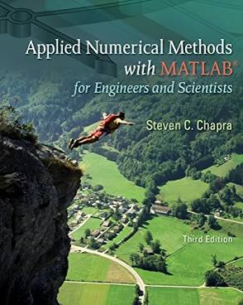
Reference and Topics Covered
Steven C. Chapra, Applied Numerical Methods with Matlab for Engineers and Scientists, 3rd ed., McGraw-Hill, 2012.
*4th ed. could also be used; however, I will use 3rd ed. as main reference.
4

Slide 6
Reference and Topics Covered
1. Introduction to MATLAB (4 lectures) (Ch. 2,3) 2. Sources of Error in Computer Arithmetic and Algorithms (1 lecture) (Ch. 4) 3. Roots and optimization (4 lectures) (Ch. 5 – 7) 4. Linear Systems of Equations (6 lectures) (Ch. 8, 9, 12) 5. Eigenvalues and Eigenvectors (3 lectures) (Ch. 13) 6. Regression, curve fitting, least squares (3 lectures) (Ch. 14, 15) 7. Polynomial Interpolation (3 lectures) (Ch. 17) 8. Numerical Integration (3 lectures) (Ch. 19, 20) 9. Numerical Differentiation (3 lectures) (Ch. 21) 10. Solving Differential Equations, ODE (IVP), ODE (BVP) (4 lectures) (Ch. 22, 24)
5

Slide 7
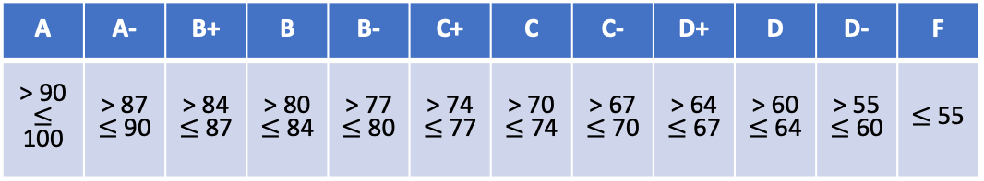
2. Grading
Attendance, active participation, pop-quizzes: 5%
Homework*: 30% (6 assignments)
*we will count best 4 out of 6
Projects: 40% (2 projects, 20% each)
Final Exam: 25%
A | A- | B+ | B | B- | C+ | C | C- | D+ | D | D- | F
> 90 $≤$ 100 | > 87 $≤$ 90 | > 84 $≤$ 87 | > 80 $≤$ 84 | > 77 $≤$ 80 | > 74 $≤$ 77 | > 70 $≤$ 74 | > 67 $≤$ 70 | > 64 $≤$ 67 | > 60 $≤$ 64 | > 55 $≤$ 60 | $≤$ 55
6

Slide 8
Assignments and Projects
1. There will be a total of 6 assignments (best 4 out of 6).
2. Assignment will be due in a week from the day it is assigned.
3. Delay allowed up to 4 days; each passing day you will lose 20% of the marks.
4. Late submission allowed but only if you have secured permission from the instructor.
5. In case of emergency, submit assignment late and inform instructor. If your reasons are not strong enough, it will be considered late submission.
6. Collaboration allowed but assignments must be prepared individually.
7. Codes should also be developed independently; you can, however, collaborate and brainstorm.
7

Slide 9

Assignments and Projects
1. There will be a total of 2 projects (best 4 out of 6).
2. Group of 5 students will be created and each group will finish the project.
3. Reports must be prepared individually.
4. Projects are due in 2 weeks.
Project and Exam Dates
Oct 1: Project 1 assigned
Oct 15: Project 1 due
Oct 29: Project 2 assigned
Nov 12: Project 2 due
Dec 15: Finals (Wed, 2 pm – 5 pm)
No-class Dates
Sep 6, Nov 24, Nov 26
8

Slide 10
Discussion on class type
In-person or mix of in-person and online?
9

Slide 11






Key Topics and Their Applications
Roots and optimization
10

Slide 12


Slide 13
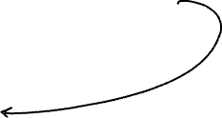
Key Topics and Their Applications
Linear Systems of Equations
11

Slide 14

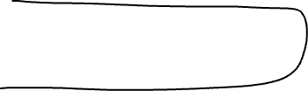

Slide 15
Key Topics and Their Applications
Eigenvalues and Eigenvectors
12

Slide 16
Key Topics and Their Applications
Regression, curve fitting, least squares
13

Slide 17
Key Topics and Their Applications
Solving Differential Equations
14

