Slide 1
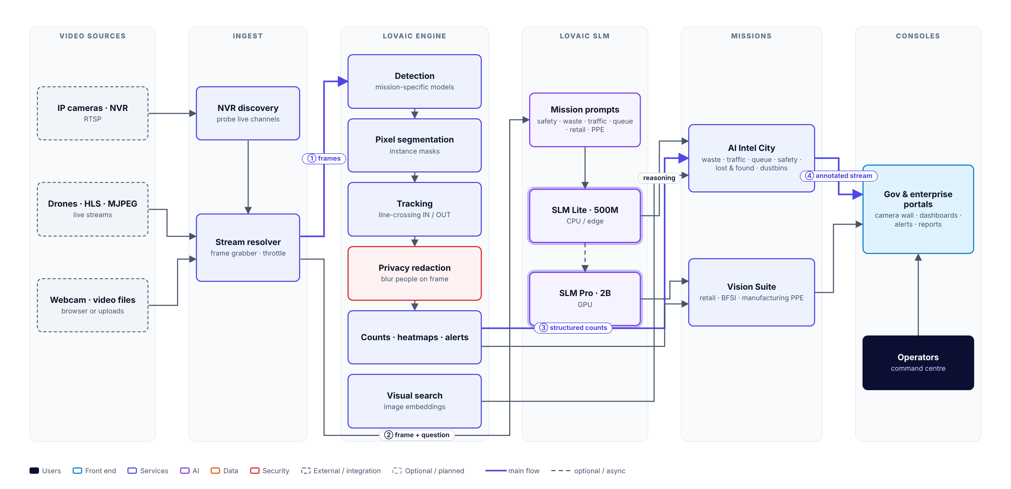
How LOVAIC works — frame to decision
LOVAIC · SOLUTION ARCHITECTURE
Frames from existing cameras pass through the LOVAIC Engine for structured detection, segmentation and tracking; LOVAIC SLM (Lite 500M / Pro 2B) adds plain-language reasoning on demand.
LOVAIC · a RightLeft AI product | Delivered by Uneecops Technologies Ltd
1
Notes:
How LOVAIC works — frame to decision. Frames from existing cameras pass through the LOVAIC Engine for structured detection, segmentation and tracking; LOVAIC SLM (Lite 500M / Pro 2B) adds plain-language reasoning on demand.

Slide 2
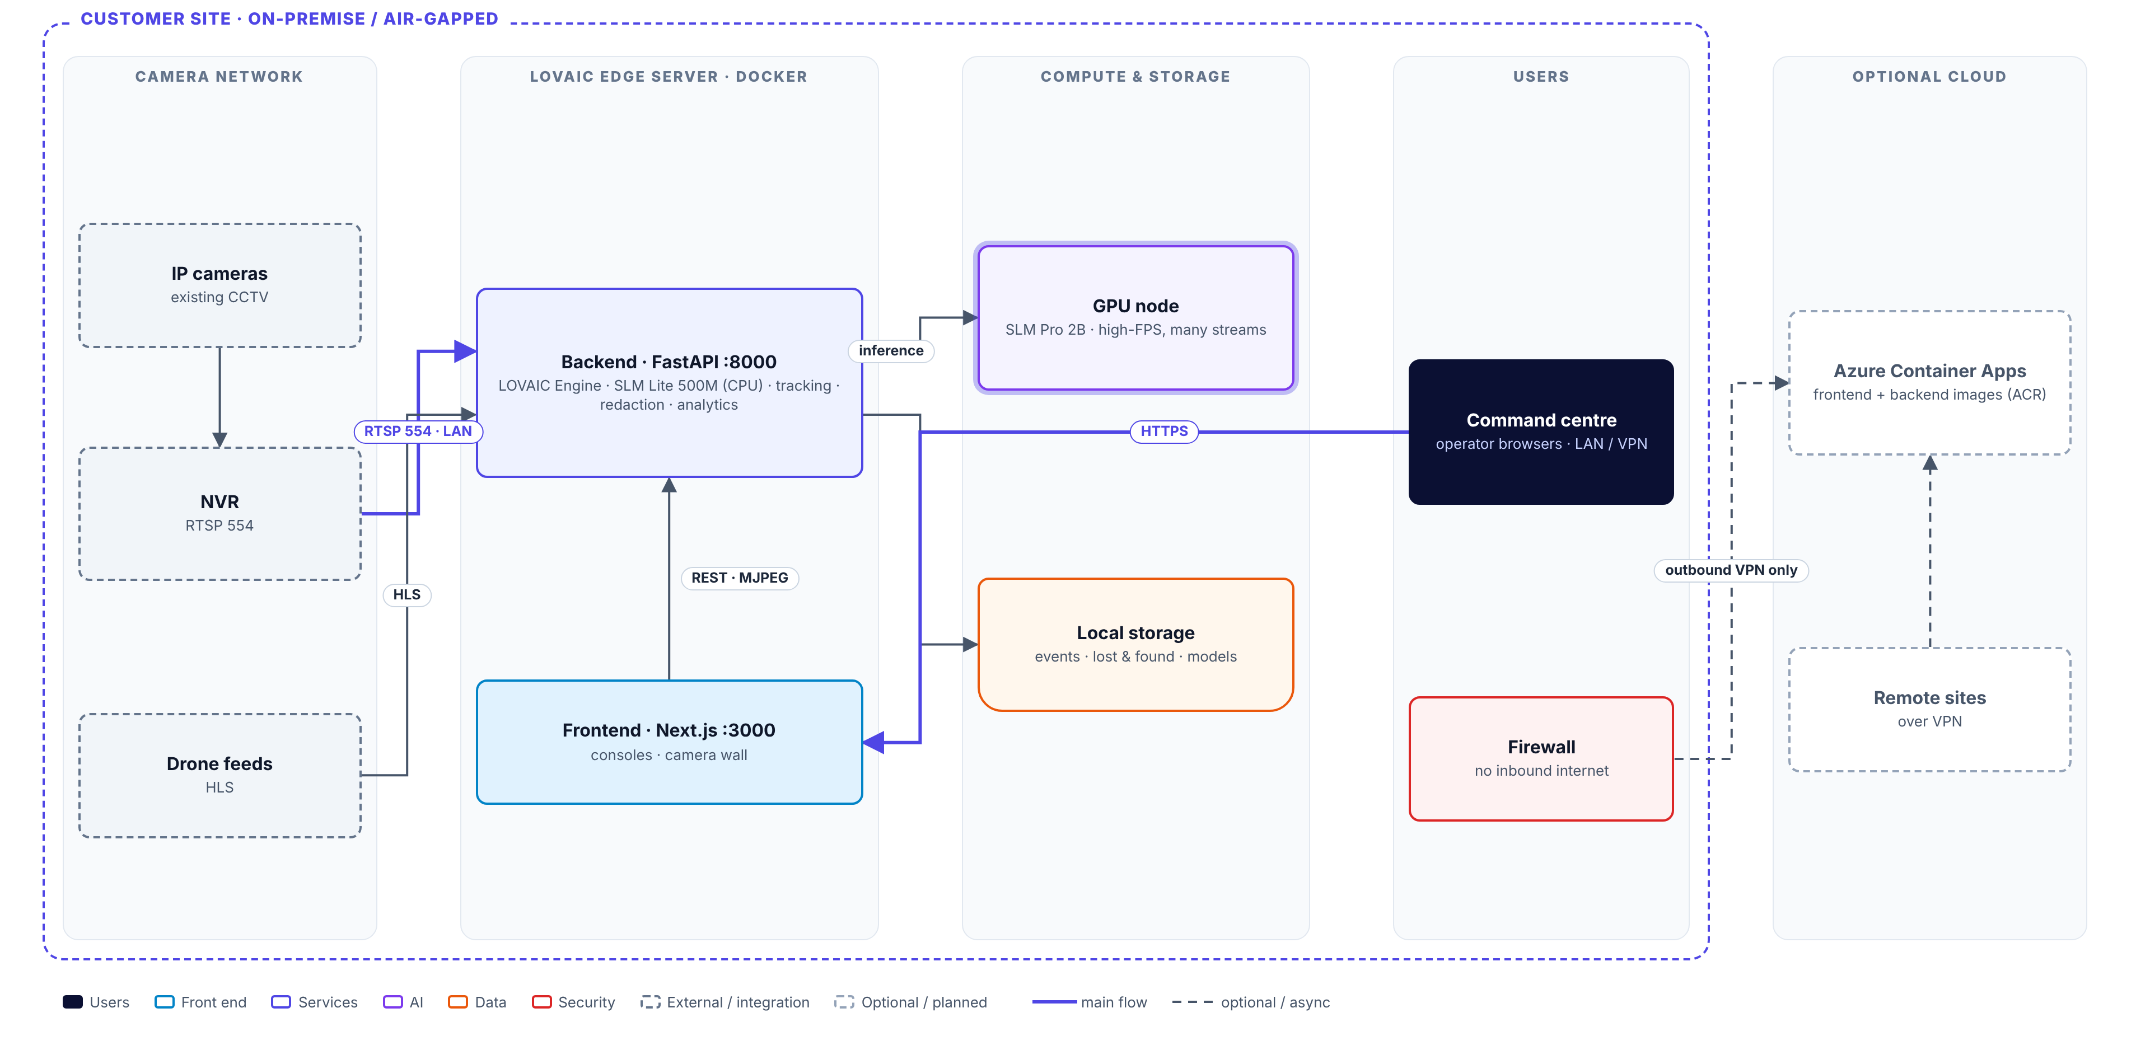
Servers and communication — on-premise first
LOVAIC · DEPLOYMENT TOPOLOGY
Recommended for sovereign sites: an edge server on the camera LAN runs the Engine and SLM Lite on CPU; a GPU node adds SLM Pro and many 24×7 streams. Nothing needs an inbound internet port.
LOVAIC · a RightLeft AI product | Delivered by Uneecops Technologies Ltd
2
Notes:
Servers and communication — on-premise first. Recommended for sovereign sites: an edge server on the camera LAN runs the Engine and SLM Lite on CPU; a GPU node adds SLM Pro and many 24×7 streams. Nothing needs an inbound internet port.

