Slide 1


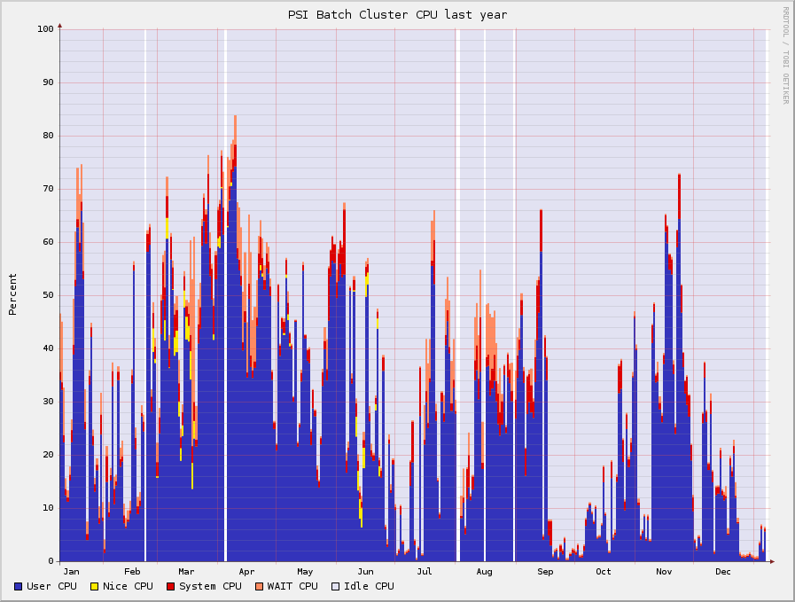



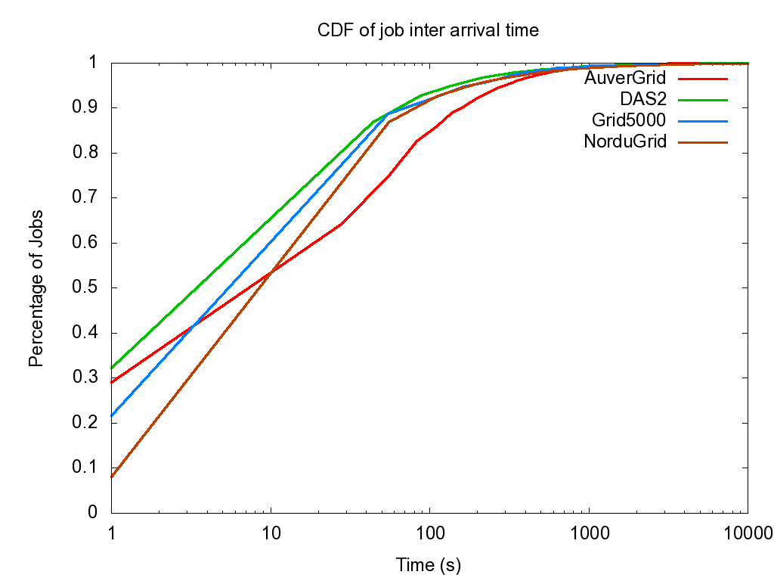
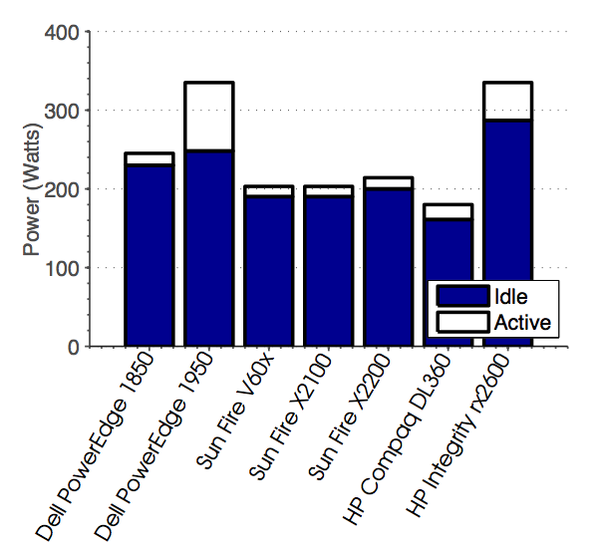
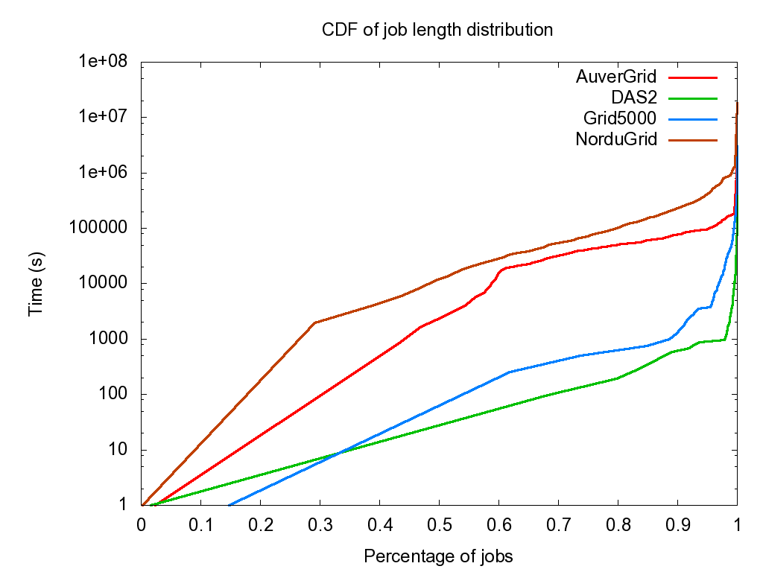
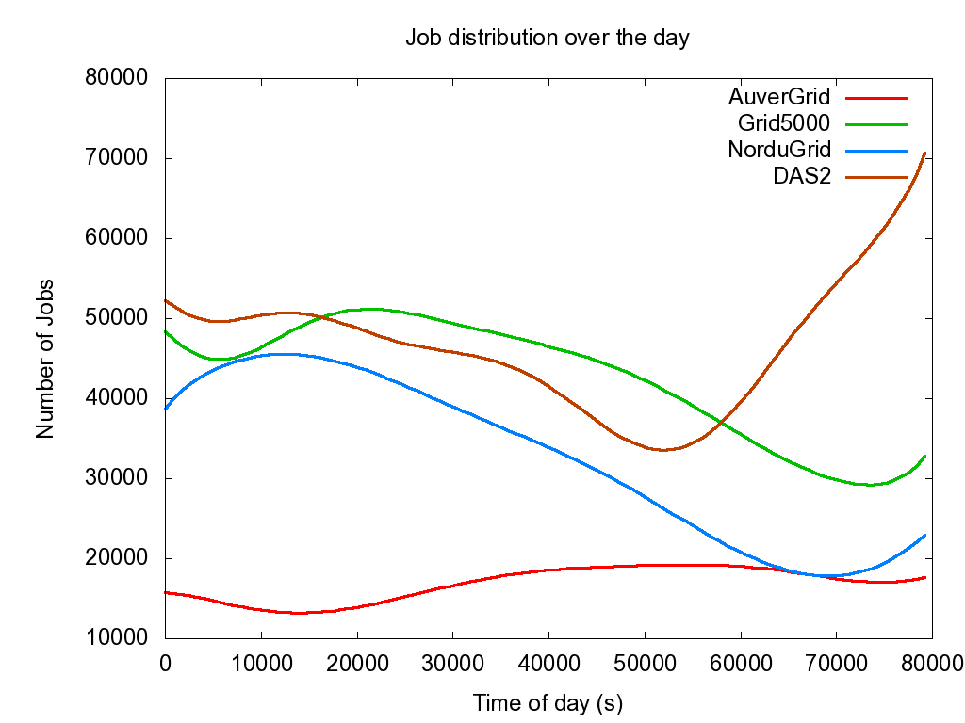
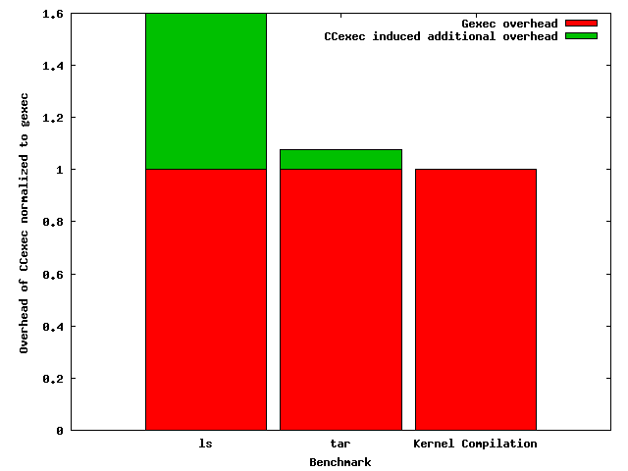
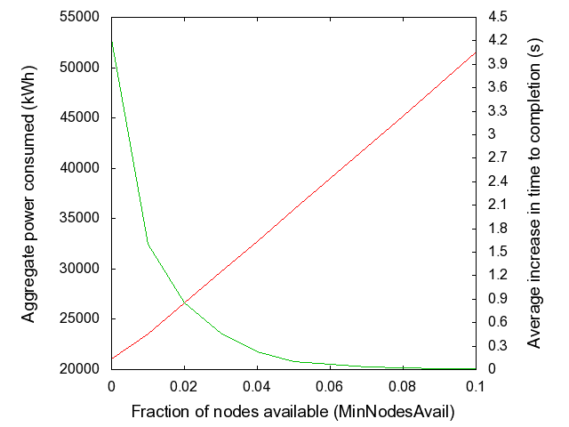
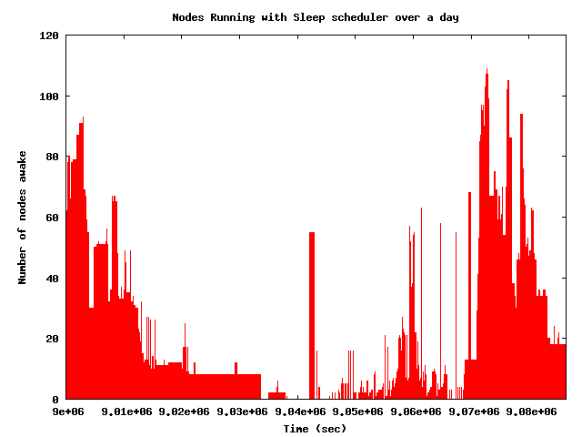
C²: Clean Clusters
Saving the world one cluster at a time
http://prashmohan.github.com/SleepProxyService/
Shaon Barman, Prashanth Mohan, Himanshu Sharma
Motivation
System Architecture
 | Trace 1 | Trace 2
Length of Trace | 192d, 15h | 195d, 4h
Number of Jobs | 200,000 | 99,999
Number of Nodes | 400 | 5000
Total uptime (sleeping when idle) | 5.68% | 1.17%
Average increase in completion of job (using Ccexec) | 3.66s / 39.58% | 3.37s / 5.4 %
If 1% of nodes always active | 1.39s / 9.5% | -
If 5% of nodes always active | 0.19s / 2.28% | -
Dead
PSI cluster CPU usage
Over
loaded
Sleeping
Inter-arrival Times
Active
“Power optimization – A reality check”, S.D.Haggerty, A. Krioukov, D. Culler.
Results
Diurnal Job Distribution
Overhead of CCexec
Job Length Distribution
Massive reduction in power usage possible with “race to sleep”
Minimal impact on completion time
Keeping a set of nodes up all the time improves performance
Many of the jobs running in clusters appears to be of short duration
Energy savings
Building block software
Ganglia – Cluster monitoring software
wakeonlan – used for remote resume
Sleep proxy service – Plugin to gmetad. Maintains list of nodes
CCexec – Power aware scheduler
CCd – Power aware node maintainer

