Slide 1

Towards a power proportional HPC cluster
Shaon Barman, Prashanth Mohan, Himanshu Sharma, David Culler

Slide 2
Motivation
150 TWh of energy is used by networked equipment in the US every year^{[1]}
30.3 million servers around the world
Power usage effectiveness:
Only 40% improvement possible?
PUE typically around 1.4
[1] Bruce Nordman, “Networks, energy, and energy efficiency”
Notes:
150 TWh ~= 8-9 nuclear power plants!
<1 = harvesting of expended heat by IT equipment
Focus in this talk will be more on “Race to sleep”. Same lines as Andrew’s talk.

Slide 3
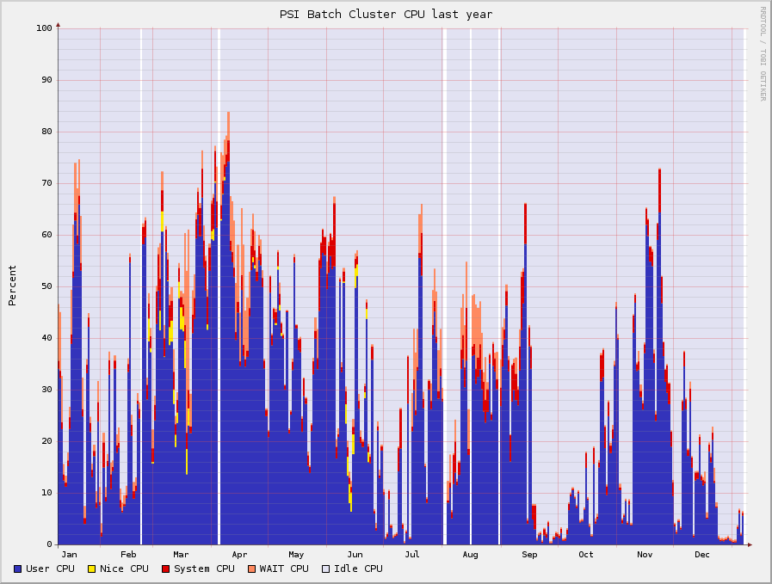
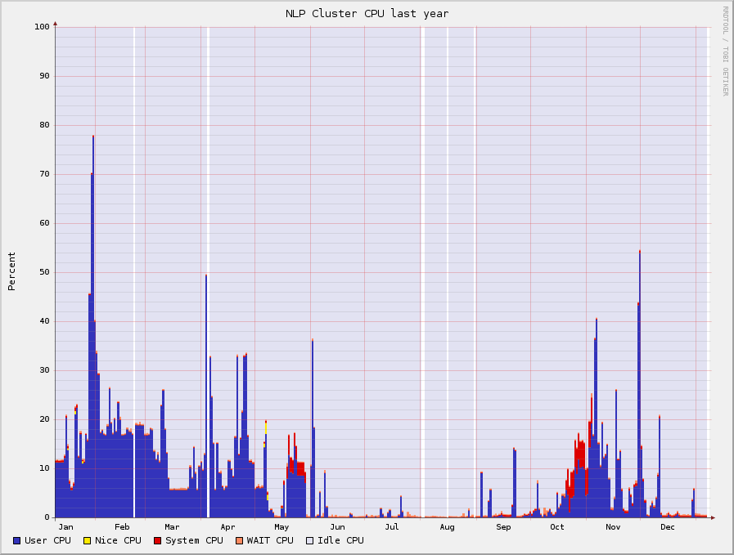
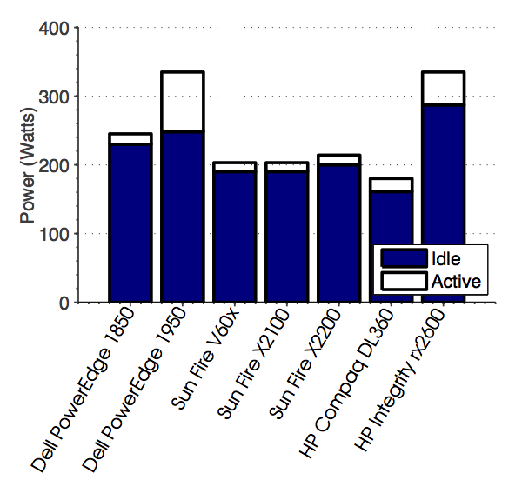
Motivation
“Efficient” data centers have utilization rates of 30-50%
PSI Cluster
S. Dawson-Haggerty, A. Krioukov, and D. E. Culler. Power optimization a reality check.
NLP Cluster
Notes:
Idle and utilized power difference between 10-25%

Slide 4
Power saving primitives
Sleep
Suspend to RAM (S3)
Hibernate (S4)
Shut Down
Wake up
Wake on LAN
IPMI
Processor States (C states)
Voltage/Frequency Scaling
Reliability
Performance
Applicability
Notes:
S0 -> S3 = 1-10 seconds
C state -> nanoseconds or 100s of clock cycles
Voltage and Freq -> SpeedStep, PowerNow, PowerSaver, etc…
Historically
S3, S4 -> Badly supported in Linux
Wake on Lan -> prevalent only now
IPMI -> relatively new standard
This talk -> HPC workload and how to apply these techniques on such a workload

Slide 5
Related Work
Somniloquy
“Skilled in the art of being Idle”
Bonjour Sleep Proxy
Virtualization
“Scheduling Grid Workloads…”
Network proxies

Slide 6
Workloads
Notes:
SSI -> single system image, process tools common to entire cluster
Torque/Maui -> used in about 80% of the top 500 super computers
Earth Simulator alone takes 8 MW

Slide 7
Cluster Managers
Tasks
Tasks
Tasks
Tasks
Tasks
Tasks
Tasks
Tasks
Tasks
Tasks
Programming platform
Tasks
Tasks

Slide 8
Cluster Managers
Tasks
Tasks
Tasks
Tasks
Tasks
Tasks
Tasks
Tasks
Tasks
Tasks
Programming platform
Tasks
Tasks
P
P
P

Slide 9
Queue management
Workstation
Job
Workstation
Workstation

Slide 10
Queue management
Workstation
Workstation
Workstation
Job

Slide 11
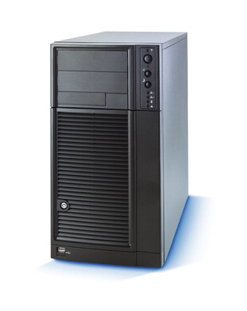

Architecture

Slide 12
Architecture
Resource Information

Slide 13
Architecture

Slide 14

Architecture
Sleep Service
CCd
CCd
CCd

Slide 15
Power saving strategies
Turn all idle machines off

Slide 16
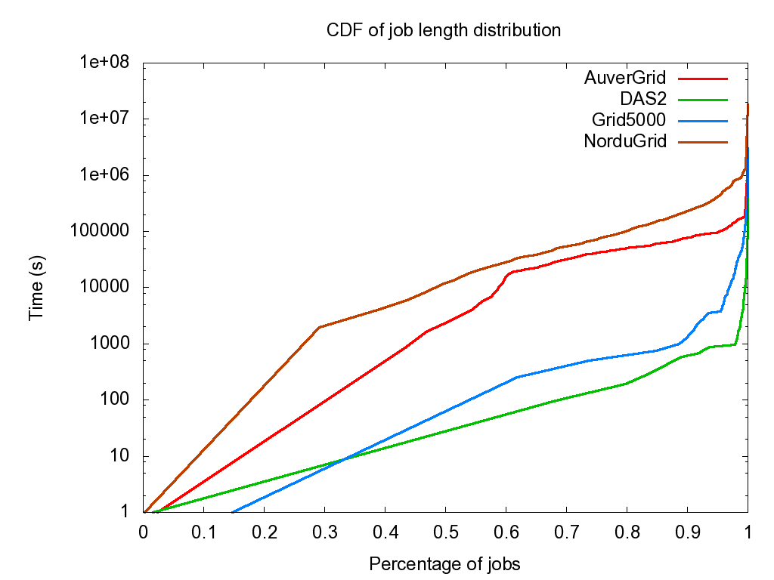
Job Length

Slide 17
Power saving strategies
Turn all idle machines off
Have at least n% of nodes up

Slide 18
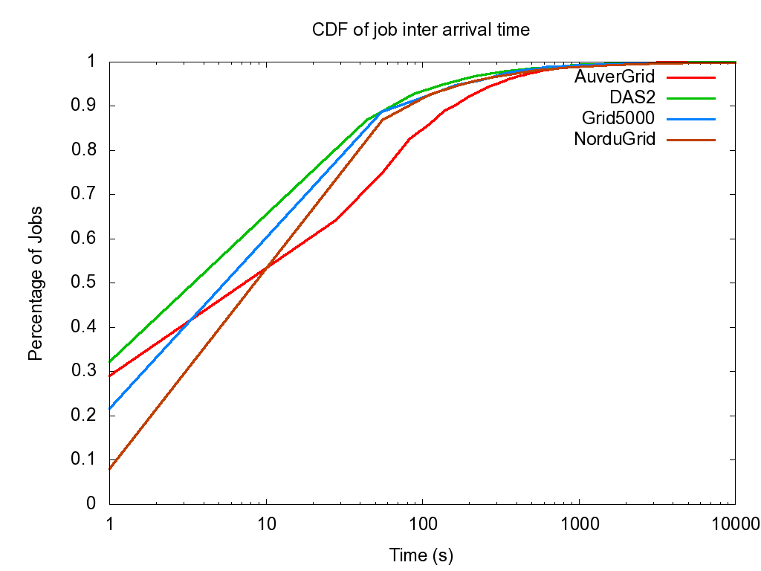
Inter arrival time

Slide 19
Power saving strategies
Turn all idle machines off
Have at least n% of nodes up
Maintain at least n% active nodes

Slide 20
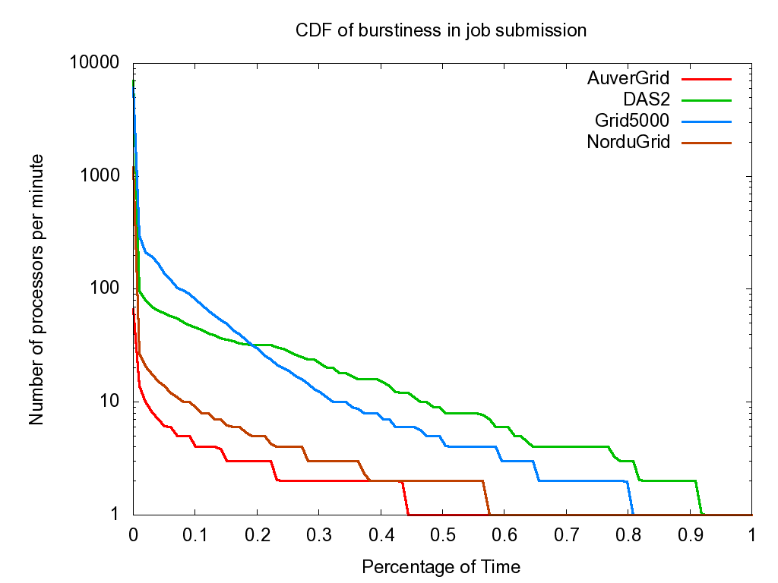
Job Burstiness

Slide 21
Power saving strategies
Turn all idle machines off
Have at least n% of nodes up
Maintain at least n% active nodes
Keep nodes up for n seconds after job completion

Slide 22
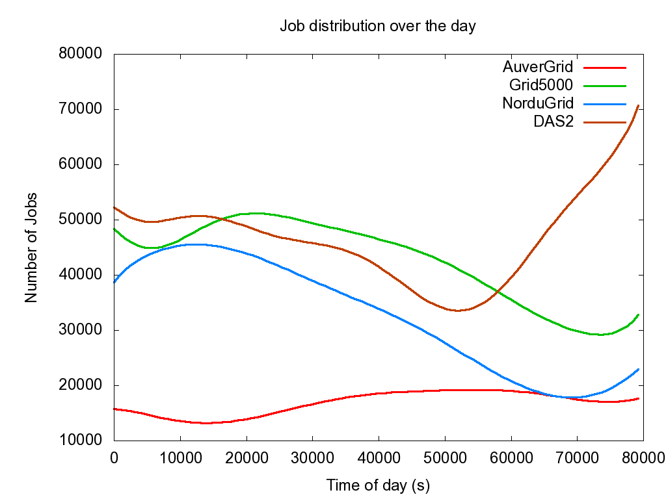
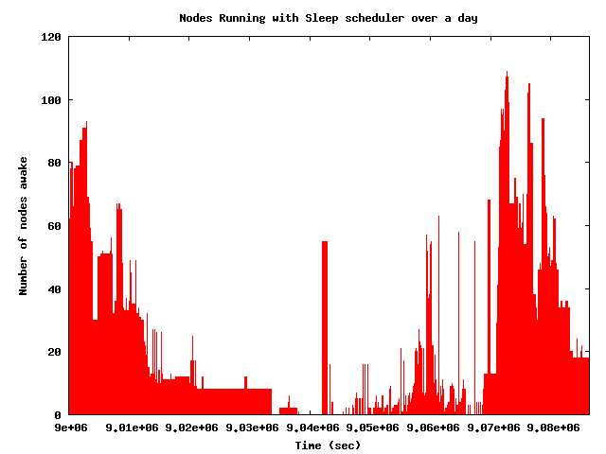
Job arrival time

Slide 23
Power saving strategies
Turn all idle machines off
Have at least n% of nodes up
Maintain at least n% active nodes
Keep nodes up for n seconds after job completion
Different values of ‘n’ for different times of the day

Slide 24
Findings
Power consumption in HPC clusters can be dramatically cut using these trivial power saving strategies
A hybrid solution is best suited for the clusters
Each strategy however has to be tuned for each cluster
~70% of “optimal” energy reduction with very minimal increase in run time (0.35%)
Notes:
Dell Optiplex energy information

Slide 25
Next steps
Energy savings in the presence of distributed file systems
Plugging the power saving primitives into Torque/Maui
Introspect more into dependency graphs of jobs
Sculptability of load

Slide 26
Sculptability of load
Cost
Load

Slide 27
Next steps
Energy savings in the presence of distributed file systems
Plugging the power saving primitives into Torque/Maui
Sculptability of load
Getting it out there…

Slide 28
Thank you
http://github.com/prashmohan/SleepProxyService/

Slide 29
Trace Details
Grid 5000
9 sites in France
15 clusters
OARGrid scheduler
NorduGrid
Denmark, Estonia, Finland, Norway, Sweden
Advanced resource connector (ARC)
68 sites, 42k procs
AuverGrid
5 clusters, 475 CPUs
3Ghz P4 Xeon nodes
DAS-2
5 sites
400 CPUs

Slide 30
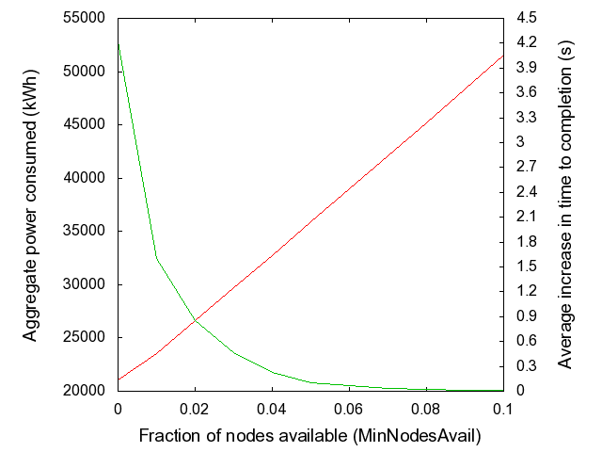
Power-Performance tradeoff
TTC
Power

Slide 31
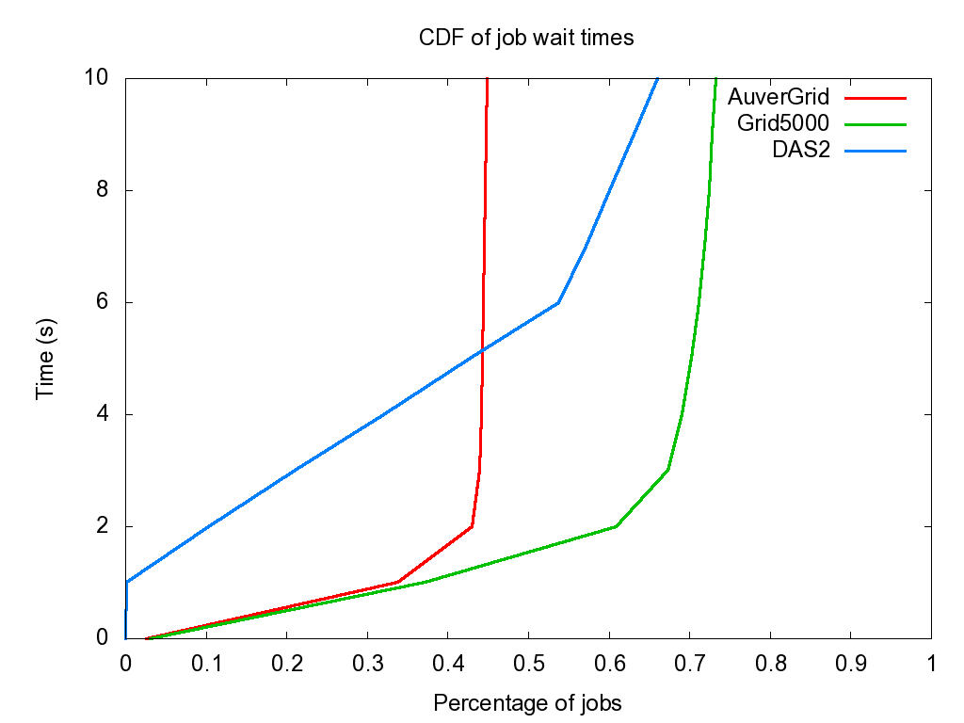
Wait Time

