Slide 1

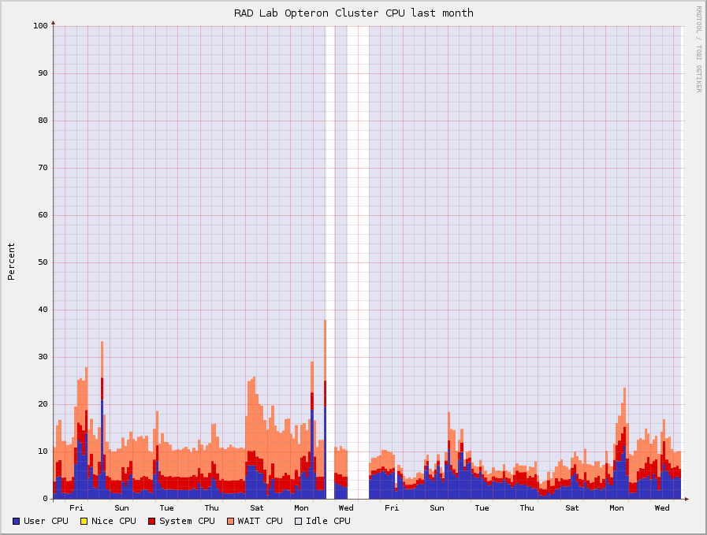



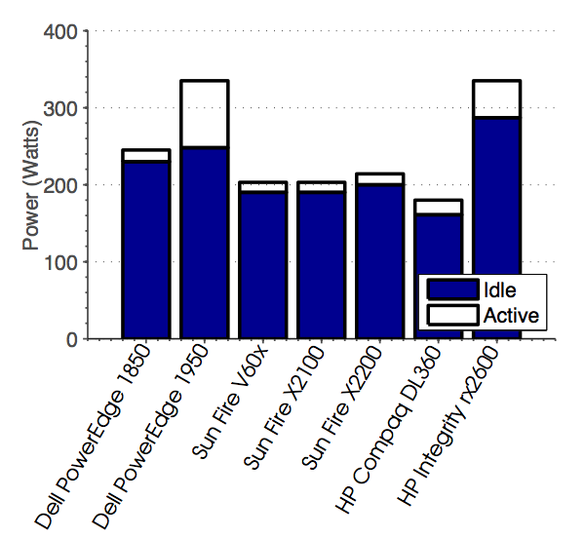
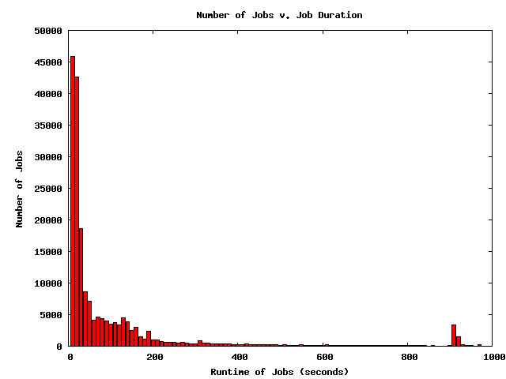
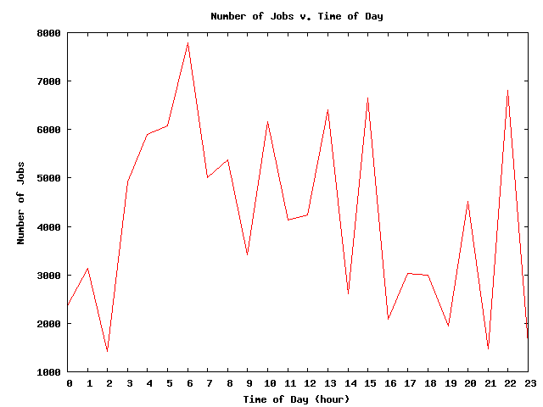
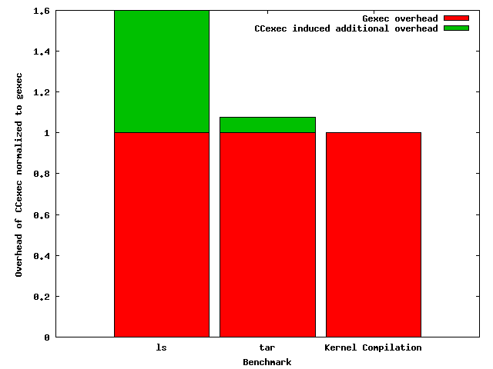
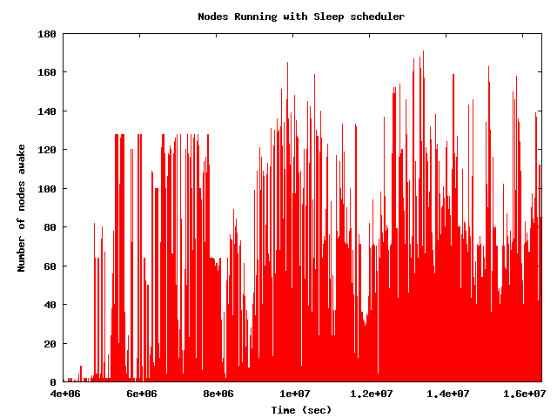
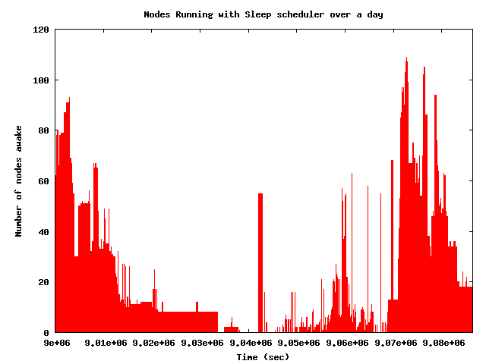
C²: Clean Clusters
Saving the world one cluster at a time
http://prashmohan.github.com/SleepProxyService/
Shaon Barman, Prashanth Mohan, Himanshu Sharma
Motivation
System Architecture
 | Trace 1 | Trace 2
Length of Trace | 192d, 15h | 195d, 4h
Number of Jobs | 200,000 | 99,999
Number of Nodes | 400 | 5000
Total uptime (sleeping when idle) | 5.68% | 1.17%
Average increase in completion of job (using Ccexec) | 3.66s / 39.58% | 3.37s / 5.4 %
If 1% of nodes always active | 1.39s / 9.5% | -
If 5% of nodes always active | 0.19s / 2.28% | -
Dead
Over
loaded
Sleeping
R cluster CPU usage
“Power optimization – A reality check”, S.D.Haggerty, A. Krioukov, D. Culler.
Active
Results
Massive reduction in power usage possible with “race to sleep”
Minimal impact on completion time
Keeping a set of nodes up all the time improves performance
Many of the jobs running in clusters appears to be of short duration
Building block software
Ganglia – Cluster monitoring software
wakeonlan – used for remote resume
Sleep proxy service – Plugin to gmetad. Maintains list of nodes
CCexec – Power aware scheduler
CCd – Power aware node maintainer

Slide 2


Active nodes queue
Sleeping nodes queue
Overloaded nodes queue
1
1

Slide 3
Dead
Over
loaded
Sleeping
Active

