Slide 1


AI CENTER OF EXCELLENCE
Knowledge Fabric
Enterprise Knowledge Intelligence
Answers your organisation can defend, drawn only from documents it has already approved.
Prashobh Paul · AI Architect, QualiZeal · AI Center of Excellence
Notes:
Generic capability overview. No client-specific content, no commercial figures.

Slide 2
What Knowledge Fabric is
A system that answers from your own approved documents — and shows its work
Answers, not documents
Plain-language answers assembled from approved sources, never from general world knowledge.
Every claim carries its source
Each sentence traces to a document, page and paragraph the organisation already approved.
It asks before it guesses
When evidence is thin the system asks one clarifying question instead of refusing or inventing.
It reports its own gaps
Questions the corpus cannot answer become a ranked content backlog for the people who own it.
QualiZeal · AI Center of Excellence
2
Notes:
Lead with the four properties. The fourth is the one competitors do not have.

Slide 3
The problem it addresses
The authoritative answer usually exists — it is just unreachable in the time available
WHERE THE TIME GOES
Search returns documents.
1
Answers are slow
People need answers.
The document exists; finding the right revision of it does not fit inside the decision window.
2
Answers are inconsistent
General assistants return fluent answers. Regulated organisations need provenance. Knowledge Fabric is built for the space between the two — fluent answers that carry their evidence with them.
Two sites, two teams or two languages give different answers to the same question.
3
Answers are undefendable
When an auditor asks where an answer came from, nobody can reconstruct the trail.
4
Knowledge leaves
Institutional memory walks out with the people who hold it, and nothing captures what was lost.
The damage is rarely a wrong answer. It is a slow one — or a confident one taken from a superseded revision.
5
Gaps stay invisible
Nobody knows which questions the organisation cannot currently answer until it matters.
QualiZeal · AI Center of Excellence
3

Slide 4
How an answer is produced
Six stages — permissions applied before searching, evidence scored before writing
1
2
3
4
5
6
Question
Access scope
Retrieve
Grounding check
Generate
Scored answer
Asked in plain language, in the user’s language.
Only sources this person may see are searched.
Meaning-based and exact-term search, merged.
Evidence scored before a word is written.
Written only from retrieved sources, citations inline.
Delivered with citations and a confidence level.
CLARIFY-BACK · ASK, DON’T REFUSE
the recovery path, not a dead end
Below threshold
Refined query
Still insufficient
One targeted question goes back to the user — which entity, which process area, what level of detail. One question, never an interrogation.
The added constraint is folded into a fresh retrieval. In most cases this lifts the evidence above the threshold and the answer proceeds normally.
The system returns the nearest approved sources and guidance on how to rephrase. Never a bare refusal, and never an invented answer.
QualiZeal · AI Center of Excellence
4
Notes:
The clarify-back band is the differentiator. Most systems refuse or invent; this one asks one question and retries.

Slide 5
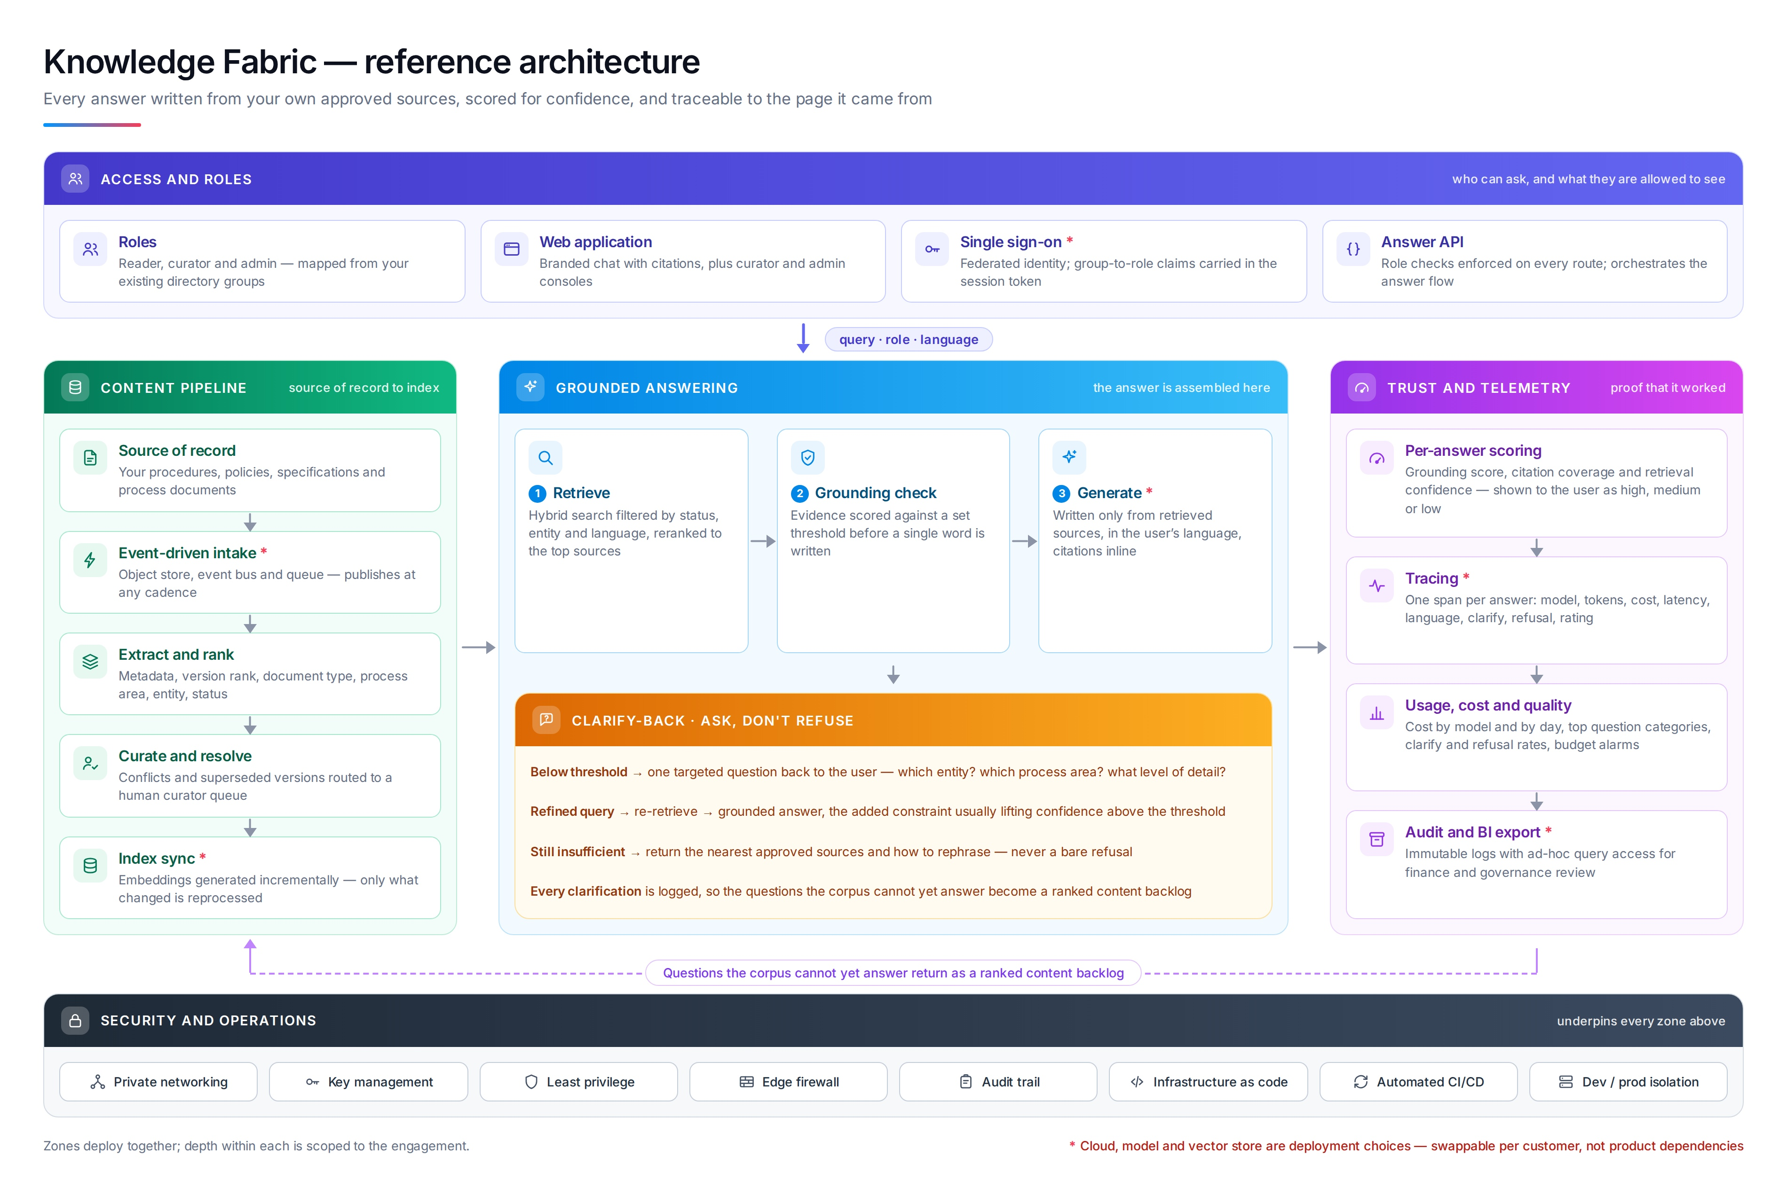
5
Notes:
Trace the flow: content pipeline down the left, into grounded answering, out to telemetry. The dashed violet return is the gap backlog.

Slide 6
What each zone does
One system, five responsibilities
Access and roles
Content pipeline
Grounded answering
Trust and telemetry
Security and operations
who can ask, and what they may see
source of record to index
the answer is assembled here
proof that it worked
underpins every zone above
Roles
Web application
Single sign-on
Answer API
Source of record
Event-driven intake
Extract and rank
Curate and resolve
Index sync
Retrieve
Grounding check
Generate
Clarify-back
Per-answer scoring
Tracing
Usage, cost and quality
Audit and export
Private networking
Key management
Least privilege
Edge protection
Audit trail
The zones close into a loop. Questions the corpus cannot yet answer travel from telemetry back to the content pipeline as a ranked backlog, so the platform improves from real use rather than guesswork.
QualiZeal · AI Center of Excellence
6

Slide 7
Functional coverage
Delivered as one platform — the list describes scope, not a menu
Capability | What it does | Primary audience
Grounded answering | Plain-language answers assembled only from approved sources, never from general world knowledge. | Everyone
Verbatim citation and lineage | Each claim carries its source, down to document, page and paragraph. | Quality, audit, legal
Confidence scoring | A visible high / medium / low level on every answer, derived from evidence strength. | Everyone
Clarify-back | One targeted question when evidence is thin, instead of a refusal or a guess. | Everyone
Entity and relationship graph | Explore how products, processes, regulations and records connect to one another. | Engineering, quality
Knowledge health | Coverage, connectivity, provenance, extraction quality and freshness, with gaps ranked. | Content owners
Version and status awareness | Current revisions outrank superseded ones; draft material is excluded unless requested. | Quality, operations
Multilingual answering | Ask and answer in the user’s language; translated material is labelled as translated. | Global operations
Curator workbench | A human queue for conflicts, duplicates and superseded documents. | Content owners
Role-scoped access | Permissions applied before ranking, so unauthorised content never enters a result. | Security, IT
Usage and quality dashboards | Consumption, question categories, clarification and refusal rates over time. | Sponsors, IT
APIs and embedding | The answer flow exposed to other applications and portals through a governed interface. | IT, product teams
QualiZeal · AI Center of Excellence
7

Slide 8
What the platform covers
Coverage is broad because the questions people ask do not respect system boundaries
Document formats
Source systems
Content types
Word documents, plain text, spreadsheets and readable PDFs — including PDFs with tables and embedded images. Formats beyond these are scoped as their own effort, openly.
Document management and quality systems, engineering and product lifecycle systems, ticketing and service desks, wikis and intranets, shared drives, and regulatory or public registries.
Standard operating procedures, work instructions, policies, specifications, manuals, validation and test records, audit findings, contracts, correspondence and training material.
Business functions
Languages
Question shapes
Quality and compliance, engineering and manufacturing, service and support, operations, procurement, legal, and people functions.
English-first by design; where teams need more, the question and the answer are translated for an agreed, quality-validated language list.
Factual lookup, procedural how-to, comparison across documents, status and version checks, and relationship questions across entities.
QualiZeal · AI Center of Excellence
8

Slide 9
Value delivered
What each group gets — stated without reference to commercial figures
Frontline and operations
Quality, compliance and audit
Engineering and technical teams
Leadership and sponsors
IT and security
The current, approved answer arrives in seconds instead of after a search through revisions.
The same question gets the same answer across sites, shifts and languages.
New joiners become productive without a colleague acting as their search index.
Every answer can be reconstructed to the document, page and paragraph it came from.
Superseded revisions stop circulating as if they were current.
The refusal and clarification record shows exactly where documented knowledge is thin.
Relationships between products, processes, regulations and records become explorable rather than tribal.
Prior work, decisions and test evidence surface at the moment they are relevant.
Time spent reconstructing context is returned to engineering work.
Institutional memory becomes an asset the organisation holds rather than one its people carry.
Consumption and quality are visible, so the platform can be governed on evidence.
Knowledge gaps arrive as a ranked backlog, turning content investment into a prioritised plan.
Identity, permissions and network controls are the ones the organisation already operates.
Content stays inside the customer’s boundary; residency and retention follow existing policy.
No component is a lock-in: model, vector store and cloud are all substitutable.
QualiZeal · AI Center of Excellence
9

Slide 10
Deployment and portability
A platform pattern, not a bet on a single vendor
PLUGGABLE BY DESIGN
DEPLOYMENT MODES
Identity provider
Managed service
Whatever the organisation already runs for single sign-on.
1
Fastest to stand up. Suited to pilots and to content that is not restricted.
Embedding model
Commercial or self-hosted, selected for language coverage and residency.
In-tenant deployment
2
Runs inside the customer’s own cloud account and network boundary. The common production choice.
Vector store
Managed or in-tenant, selected to match the existing data platform.
3
Restricted or disconnected
Language model
Self-hosted models with no external calls, for the most tightly controlled environments.
Commercial API, in-tenant deployment or self-hosted, per the control environment.
If the customer changes cloud, identity provider or model, the pattern survives and the delivered work is not discarded.
QualiZeal · AI Center of Excellence
10

Slide 11
Delivery approach
Each phase ends with something the organisation can evaluate on its own terms
PHASE 1
PHASE 2
PHASE 3
PHASE 4
Discover
Weeks
Prove
Weeks
Harden
Weeks
Extend
Ongoing
Corpus assessment and use-case selection. We inventory the candidate content, test how well it is structured, identify the questions that matter most, and agree what a good answer looks like.
A working pilot on one domain and one audience, with real content and real users. The ontology, filters and thresholds are tuned against the prioritised question set.
Production readiness: identity integration, permission mapping, security review, telemetry and dashboards, operational runbooks and release automation.
Additional domains, languages and audiences, driven by the ranked gap backlog the platform itself produces. Continuous curation replaces one-off content projects.
Content readiness assessment, prioritised question set, target architecture.
Working platform on live content, measured answer quality, curator workflow in use.
Production deployment inside the customer’s control environment, with governance in place.
Expanding coverage, improving health scores, a content plan grounded in real demand.
QualiZeal · AI Center of Excellence
11

Slide 12
What makes this different
1
Generation is gated, not trusted
The grounding check runs before anything is written. Citation is a property of the design, not a promise about behaviour.
2
Clarification instead of refusal
Thin evidence produces a targeted question and a second attempt, recovering answers that a refusal would have discarded.
3
Permissions applied before ranking
Unauthorised content never enters the candidate set, so it cannot shape a result or be inferred from one.
4
The system reports its own gaps
Failed and clarified questions become a ranked content backlog, so the corpus improves from real demand.
5
Portable by construction
Model, vector store, embedding and identity are all deployment choices; none of them is the product.
QualiZeal · AI Center of Excellence
12

