Slide 1


AI CENTER OF EXCELLENCE
Governed Agentic SDLC
AI-driven software engineering that can be trusted inside a production codebase
Five role-specialised agents carry a requirement from intake to a merge-ready change — inside your environment, against your repository, under mandatory human approval.
Prashobh Paul · AI Architect, QualiZeal AI Center of Excellence
Notes:
Generic capability overview. No client identity, no commercial figures.

Slide 2
The premise
Code generation is close to commoditised. The operating envelope is not.
Generating code is no longer the hard part, and will be less so next year. What does not commoditise is whether the system can be trusted where it runs.
The agents are the
visible part.
What makes a system defensible in a live codebase is everything around them — a contract that lets a handoff be refused, guardrails that remove capability rather than discourage its use, and an audit trail that records not only what was approved but why.
THREE QUESTIONS THAT DECIDE ADOPTION
1
Trust
Can it operate inside a codebase somebody else is accountable for?
2
Explanation
Can its actions be explained after the fact, not merely logged?
Governance is the product. The agents are the delivery mechanism.
3
Ownership
Can the organisation own it once the people who built it move on?
QualiZeal · AI Center of Excellence
2
Notes:
Open here. This frames every later slide: the differentiator is the envelope, not the generation.

Slide 3
Five role-specialised agents
Each owns one responsibility, holds no state, and cannot advance its own work
1
2
3
4
5
Feature Builder
Developer
Test Engineer
Code Reviewer
Documentation
Turns a requirement into epics, stories with acceptance criteria, and tasks mapped to stack layers. Enforces scope boundaries and halts on anything outside the agreed surface.
Analyses the existing codebase, presents an implementation plan for approval, then builds across the stack — matching the patterns already there rather than inventing new ones.
Owns test strategy and generation across unit, component, integration and interface layers. Detects coverage gaps and maintains tests as the implementation changes.
Cross-stack automated review before a human opens the change: standards, architectural boundaries, schema breaking changes, infrastructure security. Findings are severity-classified.
Regenerates API, component, interface and infrastructure documentation plus changelogs from the code itself, and flags documentation that no longer matches it.
Writes no code
Plan approved first
Strategy is gated
Never auto-merges
Drift is a gate
QualiZeal · AI Center of Excellence
3

Slide 4
How work moves between them
The agents do not call each other — every handoff is a contract that can be refused
Requirement
Stories
Implementation
Tests
Review
Docs
Merge-ready
intake
scope agreed
plan approved
strategy agreed
findings cleared
drift closed
pre-merge gate
Stateless by design
Schema-validated handoffs
Advancement needs a token
The repository is the audit trail
Agents hold no memory between turns. All state lives in version-controlled artefacts, so a run resumes from a checkout rather than a restart.
The next agent refuses to start if the contract does not validate. A malformed handoff stops the chain instead of propagating quietly.
Work moves only when a human answers a gate with an explicit literal token. Agreement expressed any other way does not advance the chain.
There is no separate governance system to trust or keep running. The evidence is the commit history.
QualiZeal · AI Center of Excellence
4

Slide 5
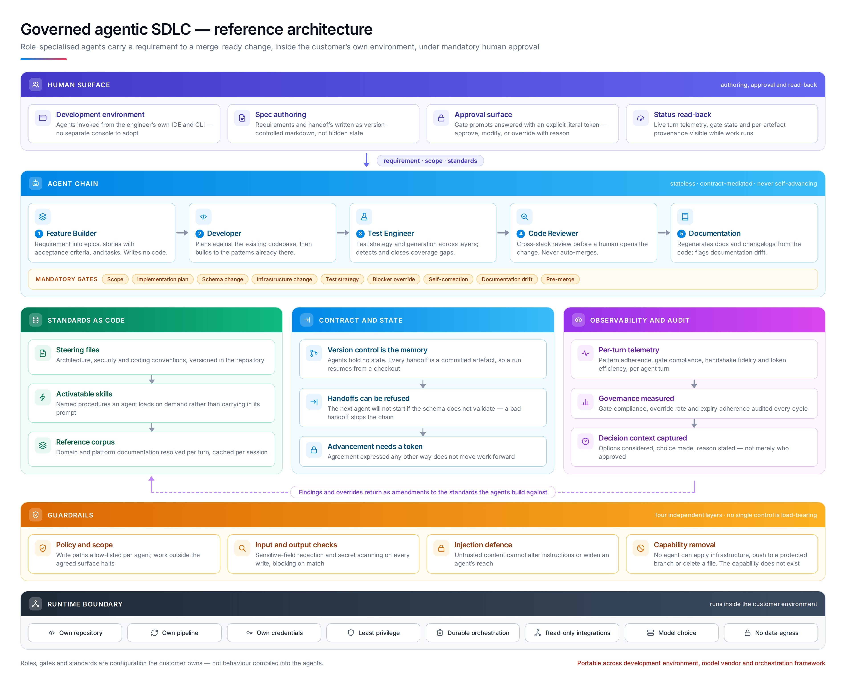
Reference architecture
Human surface, agent chain, standards and contracts, observability — on a guardrailed runtime
5
Notes:
Trace the flow top to bottom. Note the dashed return: findings and overrides become amendments to the standards.

Slide 6
Nine mandatory gates
Each declares in machine-readable form what evidence must be in front of the approver
1
Scope
2
Implementation plan
3
Schema change
4
Infrastructure change
5
Test strategy
6
Blocker override
7
Self-correction
8
Documentation drift
9
Pre-merge
THREE PROPERTIES THAT KEEP GOVERNANCE ALIVE
Approval is a token, not an inference
Blocker overrides expire
Governance is itself measured
Agreement expressed any other way does not advance the chain.
When one lapses the finding re-blocks — stopping governance from decaying into permanent silent exceptions, which is how most gate systems die.
Gate compliance, override rate and expiry adherence are audited every cycle.
QualiZeal · AI Center of Excellence
6

Slide 7
Guardrails in four independent layers
Layered so that no single control is load-bearing
LAYER 1
LAYER 2
LAYER 3
LAYER 4
Policy and scope
Input and output checks
Injection defence
Capability removal
Write paths are allow-listed per agent. Work that drifts outside the agreed surface halts rather than proceeding on assumption.
Sensitive-field redaction and secret scanning run on every write, blocking on match rather than warning.
Untrusted content in a repository or ticket cannot alter an agent’s instructions or widen its reach.
No agent can apply infrastructure, push to a protected branch, delete a file, or reach outside an allow-listed scope.
Preventive
Detective
Preventive
Structural
The strongest guardrails are the ones that remove capability. These are not instructions an agent is asked to follow, and not policies it can be argued out of. The capability does not exist in the environment the agent runs in.
QualiZeal · AI Center of Excellence
7
Notes:
Layer 4 is the one to dwell on. Security reviewers respond to capability removal in a way they never respond to policy.

Slide 8
Standards stop being tribal knowledge
Engineering conventions codified as versioned files the organisation owns and edits
Steering files
Two consequences
Architecture, security and coding conventions, versioned alongside the code they govern.
Compliance moves left
Activatable skills
Conformance happens in the act of building rather than in review. Mechanical findings — naming, boundary violations, missing authorisation checks, over-privileged infrastructure — are resolved before a human opens the change.
Named procedures an agent loads on demand, rather than carrying everything in its prompt.
Reference corpus
Domain and platform documentation resolved per turn and cached per session.
The organisation owns the behaviour
No behaviour is hardcoded. Engineers change what the agents do by editing a versioned file. No retraining, no redeployment, and no dependency on us to evolve it.
Generated code conforms to the organisation’s architecture and security conventions by construction — not because a reviewer catches deviations afterwards.
QualiZeal · AI Center of Excellence
8

Slide 9
The differentiator: observability of the decision
Most systems log what the agent did. Better ones log what a human approved. Very few capture why.
When context is thin an agent halts and asks — recording the options it considered, which one the approver chose, their stated reason, and how long they took to decide.
Asking who approved a change identifies a person without identifying a cause. With decision context captured, four genuinely different failures separate — and each has a different remedy.
What went wrong | What to actually fix
The evidence was wrong | The knowledge source. The approver acted correctly on what they were shown.
The option was missing | The agent’s option generation. No amount of human diligence recovers an option never offered.
The standard was wrong | The steering file — and because standards are versioned, every decision made under the old rule can be found and re-examined as a set.
The judgement was wrong | Coaching, or raise the threshold on that gate. The only one of the four actually about the person.
Three of the four are system defects no individual could have prevented. Without decision context all four look identical in hindsight — and the reflexive response is more process for everybody, which makes delivery slower without making it safer.
QualiZeal · AI Center of Excellence
9
Notes:
This is the slide that separates us. Any competent system produces an audit trail. This produces an explanation.

Slide 10
What the organisation gets
Outcomes the pattern is built to produce — stated without reference to commercial figures
Conformance by construction
Standards become durable
Senior review time is redirected
Compliance moves out of review and into the act of building, enforced against the organisation’s own codified standards.
Written down, versioned and reviewable — readable by a new engineer as easily as by an agent, no longer held by a handful of senior reviewers.
Mechanical findings are resolved before a human opens the change. Expert attention moves to design and risk.
Audit evidence is a by-product
Failure modes are distinguishable
The organisation owns the system
Answering why a change was made and who approved it drops from an evidence exercise to a query.
Corrective effort goes to the actual cause rather than to blanket process — the difference between governance that improves and governance that only accumulates.
Behaviour changes by editing a versioned file. No retraining, no redeployment, no dependency on the people who built it.
QualiZeal · AI Center of Excellence
10
Notes:
If asked about savings: the framing is released capacity, not removed headcount. Any number needs the client’s own actuals behind it.

Slide 11
How we introduce it
A governed agentic system enters a live codebase at deliberately limited scope
PHASE 1
PHASE 2
PHASE 3
PHASE 4
Codify
Weeks
Pilot
Weeks
Harden
Weeks
Transfer
Ongoing
Extract the engineering standards that already exist — in reviewers’ heads, in wiki pages, in review comments — into versioned steering files. Agree scope boundaries and the gate set.
One feature surface, one team, gates enforced from the first run. Guardrails restrict capability before anything is generated, not after a finding.
Telemetry, decision capture, override expiry, governance metrics and the durable orchestration around external actions.
The organisation’s engineers own the steering files and skill definitions. Coverage widens by editing configuration, not by re-engagement.
Standards as reviewable files; agreed blast radius.
Working chain on real code; measured gate compliance.
Production-ready envelope with audit evidence as a by-product.
Self-owned system; widening scope on their schedule.
QualiZeal · AI Center of Excellence
11

Slide 12
Why this transfers
The reusable asset is the pattern, not the tooling
1
Stateless, role-specialised agents
2
Contracts that can be refused
One responsibility each, no memory between turns, no ability to advance their own work.
A handoff that does not validate stops the chain instead of propagating quietly downstream.
3
Advancement gated on explicit approval
4
Guardrails layered, not stacked
A literal token, never an inference from agreement expressed some other way.
Four independent controls so that no single one is load-bearing — the strongest remove capability outright.
5
Standards externalised into owned files
6
Observability that reaches the human decision
Behaviour is configuration the organisation edits, not logic compiled into an agent.
Options, choice and stated reason captured — so failure modes can be told apart afterwards.
None of it is tied to a single development environment, model vendor or orchestration framework. That is deliberate. The operating envelope is what does not commoditise.
QualiZeal · AI Center of Excellence
12

