Slide 1


Nova Biomedical
PRODUCT
KNOWLEDGE FABRIC
Release 1 · Agentic Solution & Delivery Proposal
One governed home for approved product knowledge — grounded, cited answers, honest refusal, and full telemetry, deployed in Nova's own AWS account.
Aug, 2026
https://qualizeal.com
QualiZeal AI Center of Excellence
Notes:
Title slide — Nova Biomedical Product Knowledge Fabric, Release 1 proposal from QualiZeal, August 2026.

Slide 2

Our Understanding & Scope
Nova Biomedical
Nova Biomedical is looking for a governed, source-grounded product knowledge platform — one home for approved IFUs, manuals, bulletins, release notes and knowledge articles, answering in plain English with citations, honest refusal and full telemetry, delivered as a production Release 1 in Nova's own AWS account.
In Scope — Solution Capabilities
In Scope — Delivery & Governance
Governed ingestion from Amazon S3 — IFUs, service manuals, bulletins, release notes, FAQs and knowledge articles, with rich metadata capture
Version governance — current-vs-superseded ranking, duplicate detection, conflicts quarantined to a curator queue, continuous re-indexing
Hybrid retrieval — semantic + keyword with metadata filters and reranking over a Bedrock Knowledge Base
Grounded, cited answering — how-to, lookup, troubleshooting and discovery, every answer carrying sources and a confidence score
Honest refusal — where approved sources are insufficient the platform declines rather than improvises
Nova-branded web application — chat, knowledge dashboard and telemetry dashboard, each surface scoped to the signed-in role
Orchestrator-readiness — documented APIs plus MCP tool definitions for a future Nova Cortex control plane
Managed-service platform: Bedrock Knowledge Bases, Aurora Serverless v2 with pgvector, Step Functions and ECS Fargate — custom logic focused on Nova's governance rules
Enterprise deployment: Nova's AWS account, Terraform IaC, Nova-owned repositories, Dev + Prod with UAT in Dev, Entra ID SSO via Cognito, private networking
Model abstraction: Bedrock model switch by configuration, routing logged, prompt / token / cost telemetry per answer
Roles & access: user, curator and admin roles enforced per route and per dashboard
Structured, checkpoint-driven delivery: 16 weeks · 8 sprints with go / no-go reviews and a working demonstration at every checkpoint
Evaluation & acceptance: a jointly signed evaluation set, thresholds agreed at sign-off, regression at every checkpoint
Phase 2 candidates: multilingual answers, the SME feedback loop and a hosted MCP runtime — designed-in now, delivered with Nova Cortex
Notes:
Playback of the draft scope. Left: what the platform does. Right: how it is built, deployed and governed.

Slide 3






Product Knowledge Fabric — Executive Summary
Nova Biomedical
A governed Product Knowledge Fabric: a question goes in, the platform retrieves from approved Nova documents only, verifies that the answer is grounded, and returns a cited response with a confidence score — or an honest refusal. Version control, curator review and telemetry are built in, not bolted on.
The Problem We Solve
Product knowledge is scattered across IFUs, manuals, bulletins and release notes
Teams cannot tell quickly which version is current, and conflicts go unnoticed
General-purpose AI tools improvise about regulated products — no citations, no version awareness
Critical Features & Business Impact
Feature | Description | Business Value
Governed Ingestion & Version Control | S3 landing → Step Functions extract, metadata and version ranking; duplicates detected, conflicts quarantined for curator review | One approved source of truth — current versions answer by default
Grounded, Cited Answering | Bedrock Knowledge Base hybrid retrieval with filters and reranking; every answer carries source citations and a confidence score | Answers can be checked against the approved document, not taken on trust
Honest Refusal & Guardrails | Grounding verification and citation-coverage checks on each response; below threshold the answer becomes a refusal | The platform never improvises about Nova products
Role-Scoped Access & Telemetry | Entra ID via Cognito — user, curator, admin; prompts, tokens, cost and latency logged for every request | Access control and spend visibility from day one
Release 1 Architecture — Governed Fabric on Managed AWS Services (detailed on the Proposed Solution Architecture slide)
Ingestion
Version Governance
Knowledge Base
Answer Pipeline
Curator Review
Telemetry
S3 landing · EventBridge + SQS · event-driven intake of Nova documents.
Extract · metadata · version rank. Current vs superseded, conflicts quarantined.
Bedrock KB over Aurora pgvector. Hybrid search, filters, reranking.
Retrieve → verify → answer. Cited response, confidence shown, refuse if weak.
Ambiguous versions held for a curator to resolve in the Nova UI.
OpenTelemetry → metrics store → usage, cost and knowledge dashboards.
Key Differentiator: governance-first, not chatbot-first — version control, grounding verification, honest refusal and per-answer cost telemetry are part of the platform, running in Nova's account on Nova-owned code.
Notes:
Executive summary: problem, what the platform is, feature-to-value mapping, the six architectural building blocks, and the differentiator.

Slide 4
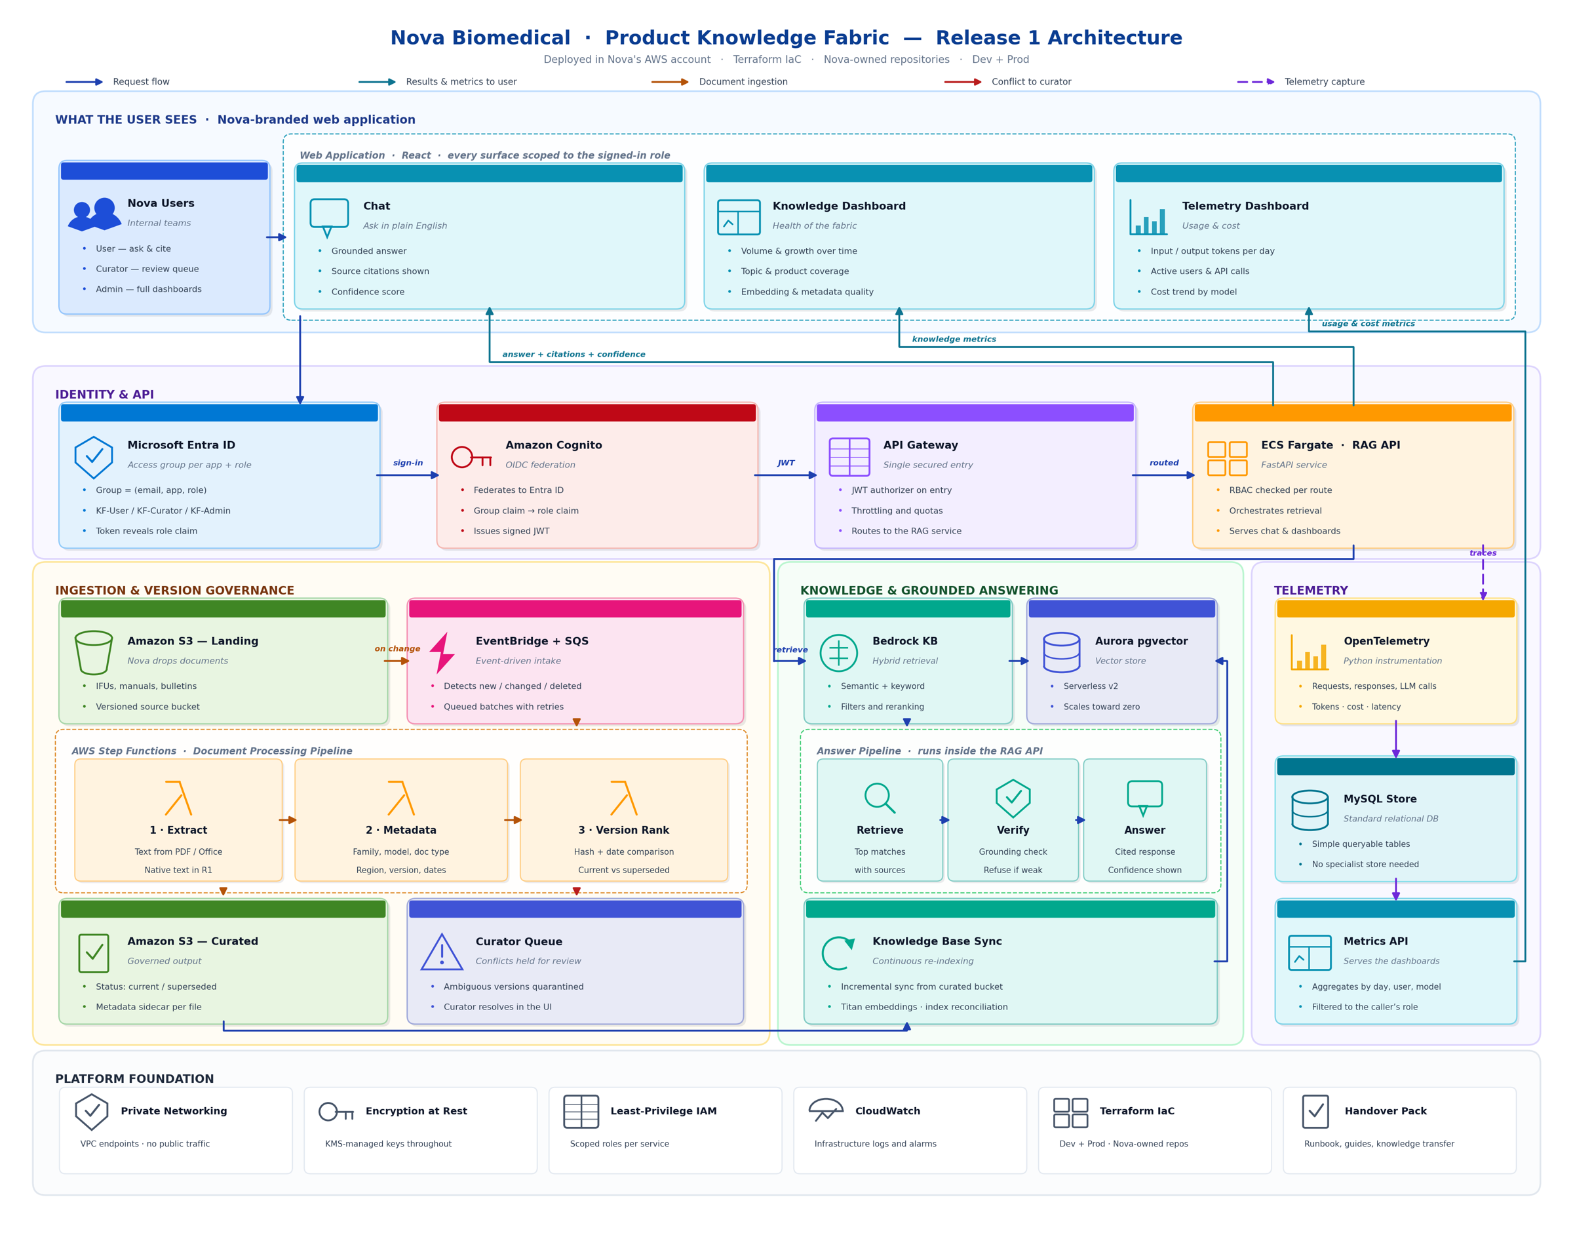



Proposed Solution Architecture
Nova Biomedical
Managed AWS services carry the platform; custom logic focuses on Nova's governance rules — deployed in Nova's AWS account, Terraform IaC, Nova-owned repositories.
WHAT THE USER SEES
Nova-branded React application — chat with cited answers, knowledge dashboard and telemetry dashboard. Every surface scoped to the signed-in role.
IDENTITY & API
Entra ID → Cognito OIDC federation → API Gateway with JWT authorizer → FastAPI RAG API on ECS Fargate, RBAC checked per route.
INGESTION & VERSION GOVERNANCE
S3 landing → EventBridge + SQS → Step Functions: extract, metadata, version rank → curated S3 plus a curator queue for conflicts.
KNOWLEDGE & GROUNDED ANSWERING
Bedrock Knowledge Base with hybrid retrieval over Aurora pgvector; retrieve → verify → answer, with refusal when grounding is weak.
TELEMETRY
OpenTelemetry instrumentation → relational metrics store → metrics API serving the dashboards, filtered to the caller's role.
PLATFORM FOUNDATION
Private networking, KMS encryption at rest, least-privilege IAM, CloudWatch, Terraform for Dev + Prod, and a full handover pack.
Notes:
Full Release 1 architecture. The right rail summarises each band of the diagram.

Slide 5








Deployment Architecture
Everything runs and bills inside Nova's own AWS account — managed services first, Terraform-provisioned, promoted Dev → Prod from Nova-owned repositories.
CI / CD
Git push
CI build
Unit + contract tests
Image → ECR
Terraform apply
Deploy Dev · UAT
Deploy Prod · approval
Nova AWS account · private VPC & VPC endpoints · least-privilege IAM · KMS at rest
MANAGED SERVICES
Web Application
RAG API
Amazon Bedrock
models, guardrails, routing
React · S3 + CloudFront
Nova-branded, role-scoped surfaces
FastAPI on ECS Fargate
2 tasks always on, autoscaled
Aurora Serverless v2
pgvector · scales toward zero
Amazon S3
Document Processing
Knowledge Base Sync
landing + curated, versioned
Step Functions + Lambda
Event-driven, scales on demand
Incremental re-indexing
Titan embeddings · reconciliation
Cognito + Entra ID
OIDC federation · roles
Telemetry store
Environments: Dev and Prod from one Terraform codebase, identical images promoted by tag; UAT runs in Dev. Secrets in Secrets Manager, no credentials in code, service-to-service access by IAM role only.
MySQL · tokens, cost, latency
CloudWatch + KMS
logs, alarms, managed keys
Ownership
Security
Cost & scale
Code and Terraform live in Nova repositories; QualiZeal builds and hands over, Nova operates.
Entra ID SSO, role-based access per route, private networking to the data tier, KMS keys throughout.
Serverless and scale-to-zero components sized for internal usage; Bedrock spend visible per answer.
Notes:
Deployment view: pipeline, what runs inside Nova's account, which managed services back it, and the ownership / security / cost posture.

Slide 6





Technology Stack
AWS-native and Python-first — managed services wherever they exist, so build effort goes into Nova's governance rules.
EXPERIENCE & IDENTITY
React
Microsoft Entra ID
Amazon Cognito
API Gateway
Nova-branded web app
Single sign-on, groups
OIDC federation, JWT
Single secured entry
KNOWLEDGE & ANSWERING
Amazon Bedrock
Titan Embeddings V2
Bedrock KB
Aurora v2 · pgvector
Bedrock Guardrails
Claude Sonnet 4.5 default
Vector representation
Hybrid retrieval + rerank
Serverless vector store
Grounding & refusal checks
PLATFORM, DATA & OPERATIONS
Python · FastAPI
AWS Step Functions
EventBridge + SQS
Amazon S3
OpenTelemetry
Terraform
RAG API on ECS Fargate
Document processing pipeline
Event-driven intake
Landing & curated buckets
Tokens, cost, latency → MySQL
IaC · CloudWatch alarms
Model-agnostic by design: every model call routes through a Bedrock abstraction layer, so provider and model choice stay swappable by configuration, versioned, logged and cost-capped — with routing decisions recorded on every request.
Notes:
Stack is deliberately boring where it can be: managed AWS services, Python, Terraform. Model choice is configuration, not architecture.

Slide 7
16-Week Delivery Plan
A phased delivery overview with go / no-go checkpoints — phases overlap, and each closes with an accepted demonstration on Nova content.
1
2
3
4
5
6
7
8
9
10
11
12
13
14
15
16
Initiate & Frame · Discovery,
Alignment & Solution Architecture
Wks 1–2
Foundations & Access
Wks 2–5
Ingestion & Version Governance
Wks 4–9
Answering, Experience & Evaluation
Wks 8–14
Acceptance, Hardening & Handover
Wks 13–16
Discovery & Architecture
Foundations & Access
Ingestion & Governance
Answering & Experience
Acceptance & Handover
Confirm scope, working assumptions and the alignment points. Corpus, taxonomy and version rules reviewed. Target architecture, guardrails and NFRs signed off.
AWS environment and Terraform baseline. Entra ID app, groups and Cognito federation live. Repositories, CI and Bedrock enablement in place.
Ingestion pipeline on Nova documents. Metadata, version ranking, duplicate detection and the curator review queue working end to end.
Hybrid retrieval with citations and confidence. Refusal controls and model routing. Nova-branded UI, dashboards and telemetry. Evaluation set built with SMEs.
Measured against the signed evaluation set. UAT, hardening and security review. Runbook, guides, orchestrator-readiness package and knowledge transfer.
Architecture Sign-off
Sign-in Live
Corpus Governed
First Cited Answers
Acceptance & Go-Live
Indicative plan — the detailed timeline is set jointly once discovery inputs are confirmed; dependencies first, dates second. Evaluation runs alongside every phase.
Notes:
Five overlapping phases across 16 weeks / 8 sprints, each ending in a go / no-go checkpoint with a demonstration.

Slide 8
Engagement Deliverables
Nova Biomedical
Named deliverables with clear descriptions — depth, formats and acceptance criteria are agreed jointly at engagement checkpoints.
Deliverable | Description
Discovery, Architecture & Alignment Pack | Confirmed scope and measurable success criteria; the four alignment points and working assumptions recorded and signed; architecture views, component responsibilities, security and guardrail approach, and non-functional considerations for Release 1.
Governed Ingestion & Version Control Pipeline | Event-driven ingestion from Amazon S3 with metadata capture, current-vs-superseded ranking, duplicate detection, conflict quarantine and the curator review queue — operating on Nova's approved documents.
Product Knowledge Fabric (working software) | The primary outcome of this engagement: a Nova-branded application deployed in Nova's AWS account — chat with grounded, cited answers and honest refusal, knowledge and telemetry dashboards, and role-scoped access through Entra ID. A working platform Nova teams can use, extend and operate.
Orchestrator-Readiness Package | Documented APIs and MCP-compatible tool definitions so the fabric can be called as a specialist agent by a future Nova Cortex control plane, with the model-routing and configuration approach documented.
Evaluation, Evidence & Handover Pack | The jointly built and signed evaluation set with results against agreed thresholds, including refusal behaviour; source code and Terraform in Nova repositories; runbook, admin, user and deployment guides; the evaluation harness for ongoing measurement; and structured knowledge transfer to Nova's Data & AI and IT teams.
Indicative list — final deliverable scope is confirmed during discovery and refined at each go / no-go review.
Notes:
Five named deliverables; the working platform is the primary outcome.

Slide 9
Commercials
Nova Biomedical
QualiZeal proposes to execute this engagement by deploying the following technical personnel at our Offshore Delivery Centre in Hyderabad, India.
Total duration of project discovery, design, implementation, evaluation and handover is 16 weeks with 8 sprints.
Role | Number | Allocation | Duration (Weeks)
Program Manager | 1 | 50% | 16
AI Architect | 1 | 50% | 16
AI/ML Engineer | 2 | 100% | 16
Data Engineer | 1 | 100% | 16
Full Stack Developer | 1 | 100% | 16
DevOps Engineer | 1 | 50% | 16
QA & Evaluation Engineer | 1 | 50% | 16
Total Cost
Notes:
Pricing excludes AWS consumption and any tool or license costs. All infrastructure and Amazon Bedrock model usage runs and bills within Nova Biomedical's own AWS account.
Effort assumes an English-first Release 1, native-text source documents, and Nova-side inputs available at kickoff; scanned-document OCR is scoped separately.
Accepted checkpoint demonstrations baseline the delivered scope; changes follow a simple change-order path.
Notes:
Team composition and duration. Commercial value to be inserted before issue.

Slide 10

AI-Infused | Platform Driven | Modern QE Company
Thank You
Nova Biomedical · Product Knowledge Fabric — Release 1
https://qualizeal.com
Notes:
Closing slide.

