Slide 1
51 Samples
Full Tokens Generation
Majority Voting
LLM
Final Answer

Slide 2
Majority Voting
Max Cluster
A B C D
C1
A C E D
C2
LLM
A B C D
C1
Final Answer
A B F D
C3
A B C D
C1
51 – X Samples
Full Tokens Generation
51 Samples
PL Tokens Generation

Slide 3
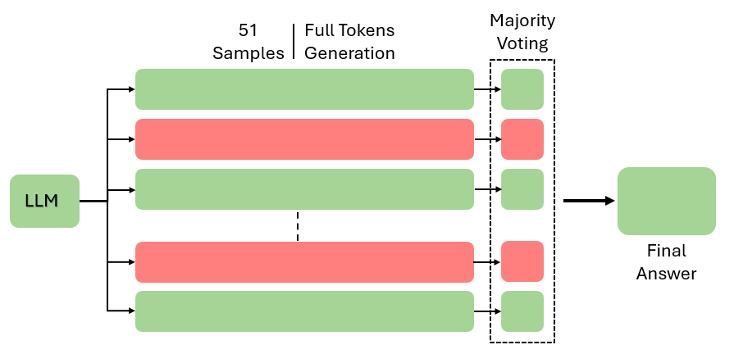
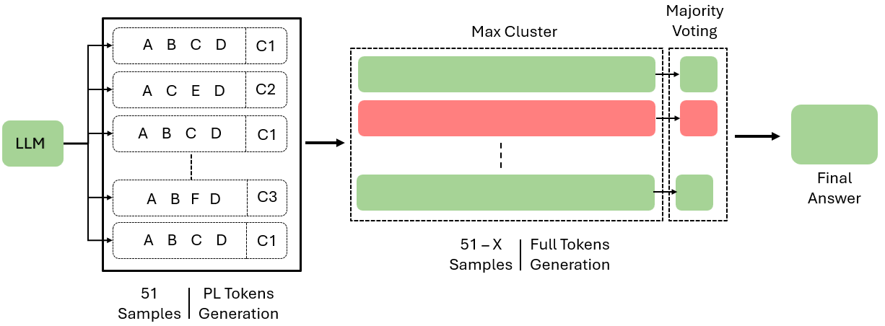
Question : Abcdefsdkncskjcsdkjndskjnsdkfnd

Slide 4
