Slide 1
Self Consistancy Representation
51 Samples
Full Tokens Generation
Majority Voting
LLM
Final Answer

Slide 2
Prefix Self Consistancy Part1
C1
A B C D
T₁
T₁
A C E D
T₂
T₃
A B C D
T₃
T_{n}
LLM
T_{n-1}
A B F D
T_{n-1}
T₂
C2
A B C D
T_{n}
C3
Clustering Time Overhead : 0.1 – 0.8 ms ≈ 0
51 Samples
PL Tokens Generation

Slide 3
Prefix Self Consistancy Part2
Majority Voting
Max Cluster
LLM
Final Answer
51 – X Samples
Full Tokens Generation

Slide 4
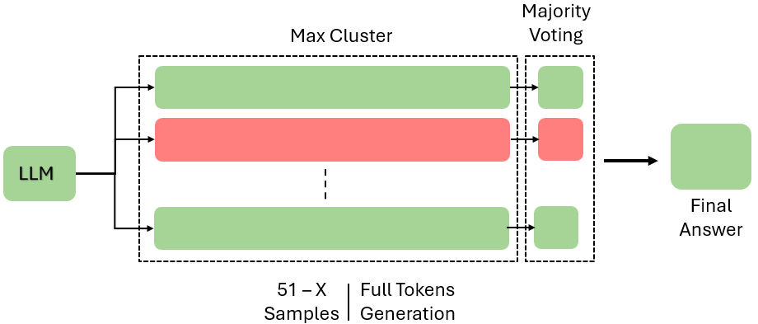
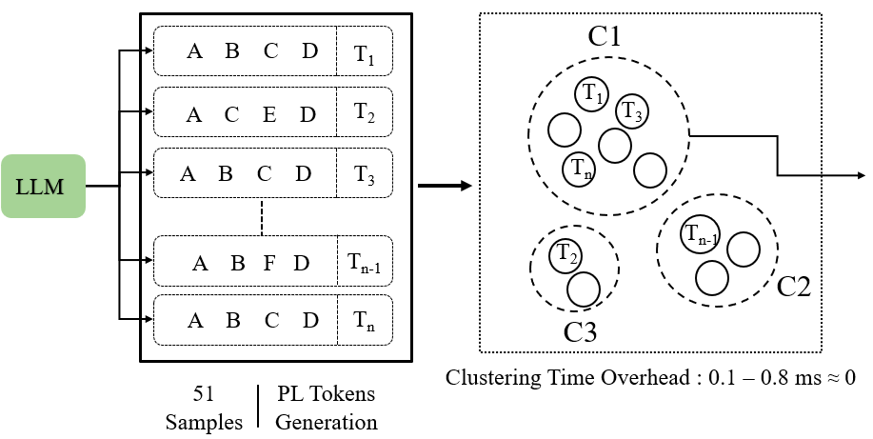
Prefix Self Consistancy

Slide 5
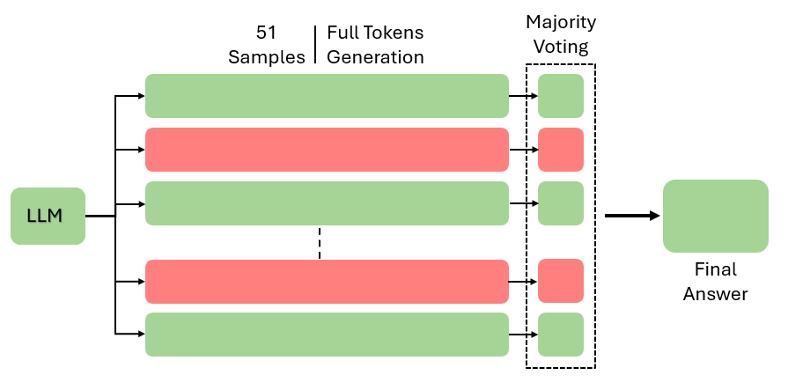
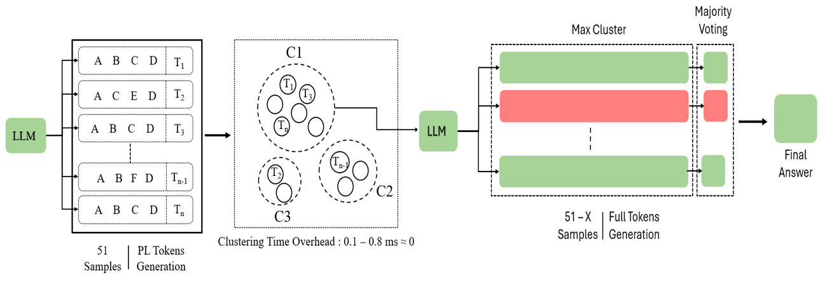
Flow Diagram
Question : Abcdefsdkncskjcsdkjndskjnsdkfnd

Slide 6
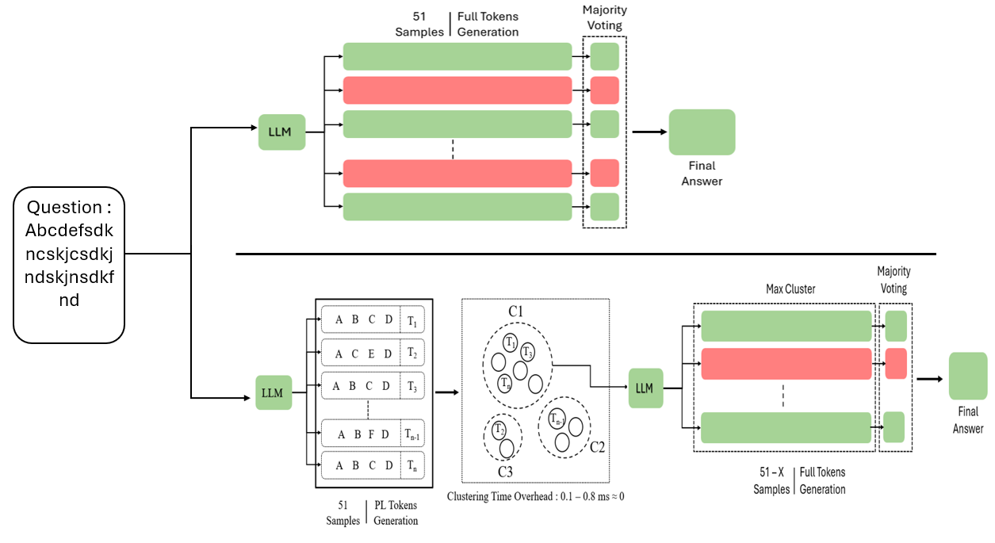

Slide 7
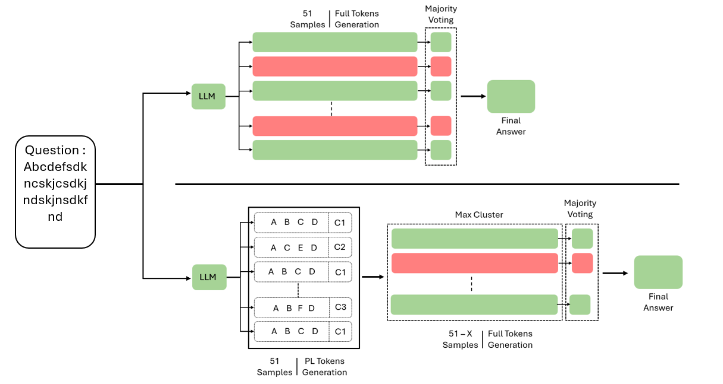

Slide 8
Majority Voting
Max Cluster
A B C D
C1
A C E D
C2
LLM
A B C D
C1
Final Answer
A B F D
C3
A B C D
C1
51 – X Samples
Full Tokens Generation
51 Samples
PL Tokens Generation

