Slide 1
Ai readiness assessment tool
GESIX SOLUTIONS PVT LTD

Slide 2
PROBLEM STATEMENT
Most organizations rely on legacy or custom-built web applications (Java, MEAN, MERN stack). While there is a high demand to integrate AI features into these platforms, many are not structurally ready to support AI, leading to integration failures or security risks. There is currently no standardized tool that allows architects to "scan" an application’s code and design documents to objectively verify if they are ready for AI integration.

Slide 3
Introduction
The AI Readiness Assessment Tool is a web-based application developed to evaluate whether a website is prepared for AI integration. Many organizations aim to adopt AI technologies, but their existing systems may not always have the required components such as structured data, APIs, or scalable architecture.
This tool allows users to upload their project files, which are then analyzed to determine the system’s capability to support AI features. Based on this analysis, the tool generates an AI readiness score, identifies missing components, and provides suggestions for improvement. This helps developers and organizations understand the changes needed to make their systems ready for effective AI integration.

Slide 4
objectives
• Evaluate AI Readiness – Analyze whether a system is capable of integrating AI technologies.
• Identify Missing Components – Detect essential elements required for AI implementation.
• Generate AI Readiness Score – Provide a score indicating the level of AI readiness.
• Provide Improvement Suggestions – Suggest changes to help improve AI compatibility.
• Enable Re-evaluation – Allow users to reassess readiness after making improvements.
• Improve Decision Making – Help organizations plan AI adoption effectively.

Slide 5
Team members and roles
FRONTEND
PRAJNA EP
JAGRUTHI M REDDY
BACKEND
PRASHANTH C
SRUJANA M
SWATHI K
SUMAN K
PREETI V

Slide 6
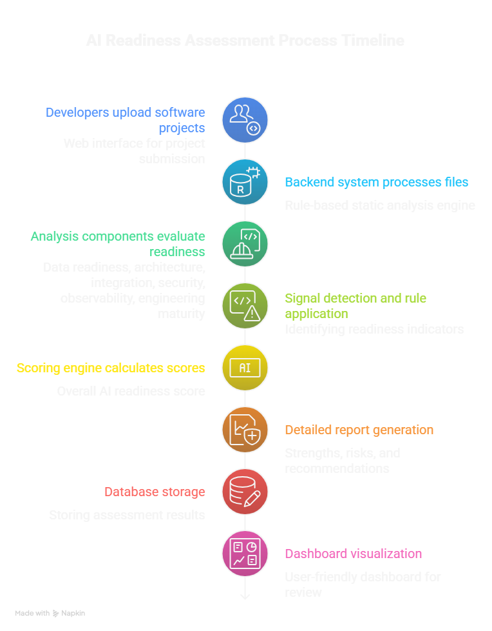
Solution Approach
Our AI Readiness Assessment Tool analyzes an application's codebase and architecture to determine whether it can support AI integration.
The system works through the following approach:
Accept application source code or repository
Analyze files using rule-based static analysis
Detect architectural and security signals
Evaluate readiness across multiple engineering layers
Generate an AI readiness score
Provide improvement recommendations

Slide 7
System overview
The AI Readiness Assessment Tool is a web-based platform that evaluates whether a software application is prepared for AI integration.
System Workflow:
• User uploads project files or GitHub repository • Backend processes and extracts project data • Static analysis engine scans code using predefined rules • Multi-layer evaluation analyzes architecture, security, APIs, and dependencies • Weighted scoring model calculates the AI readiness score • System generates a detailed assessment report with recommendations
Outcome: Provides developers with a clear readiness score and improvement suggestions for AI adoption.

Slide 8
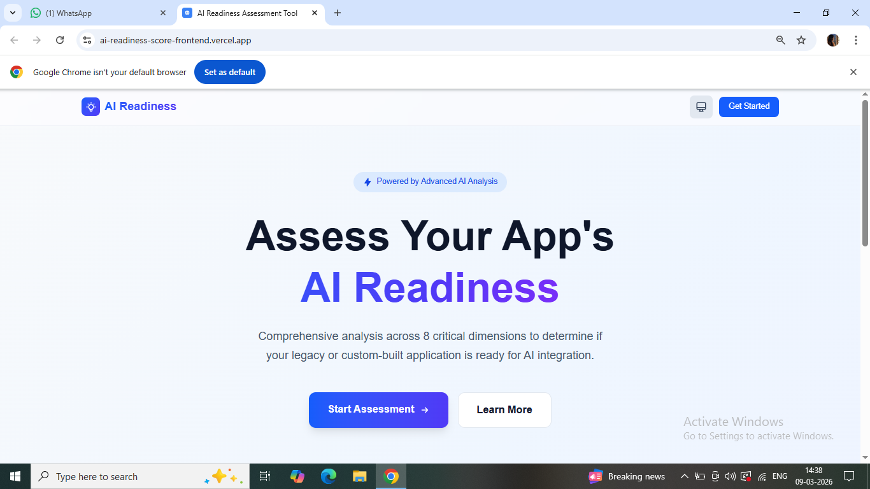
FRONTEND
A website that tests if your software is ready to use AI.
It analyzes 8 key areas of your app to give you a readiness score.
A big blue "Start Assessment" button to begin the evaluation.
It uses "Advanced AI" to perform the analysis.
A web app built on Vercel (https://ai-readiness-score-frontend.vercel.app/)

Slide 9
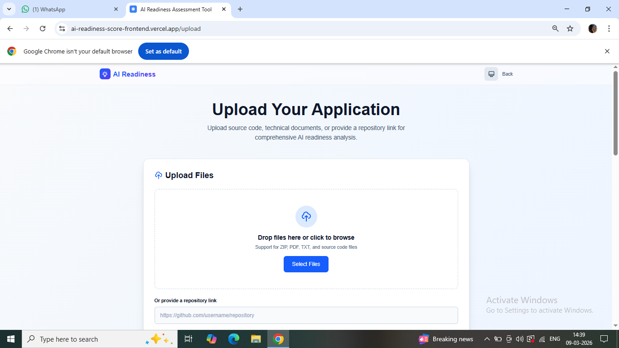
FRONTEND
You are asked to upload your application's data so the tool can analyze it.
You can upload source code, technical documents, or simply provide a GitHub repository link.
The tool accepts ZIP, PDF, TXT, and general source code files.
There is a "drag and drop" area, a "Select Files" button, and a text box for pasting a web link.
A "Back" button in the top right allows you to return to the previous landing page.

Slide 10
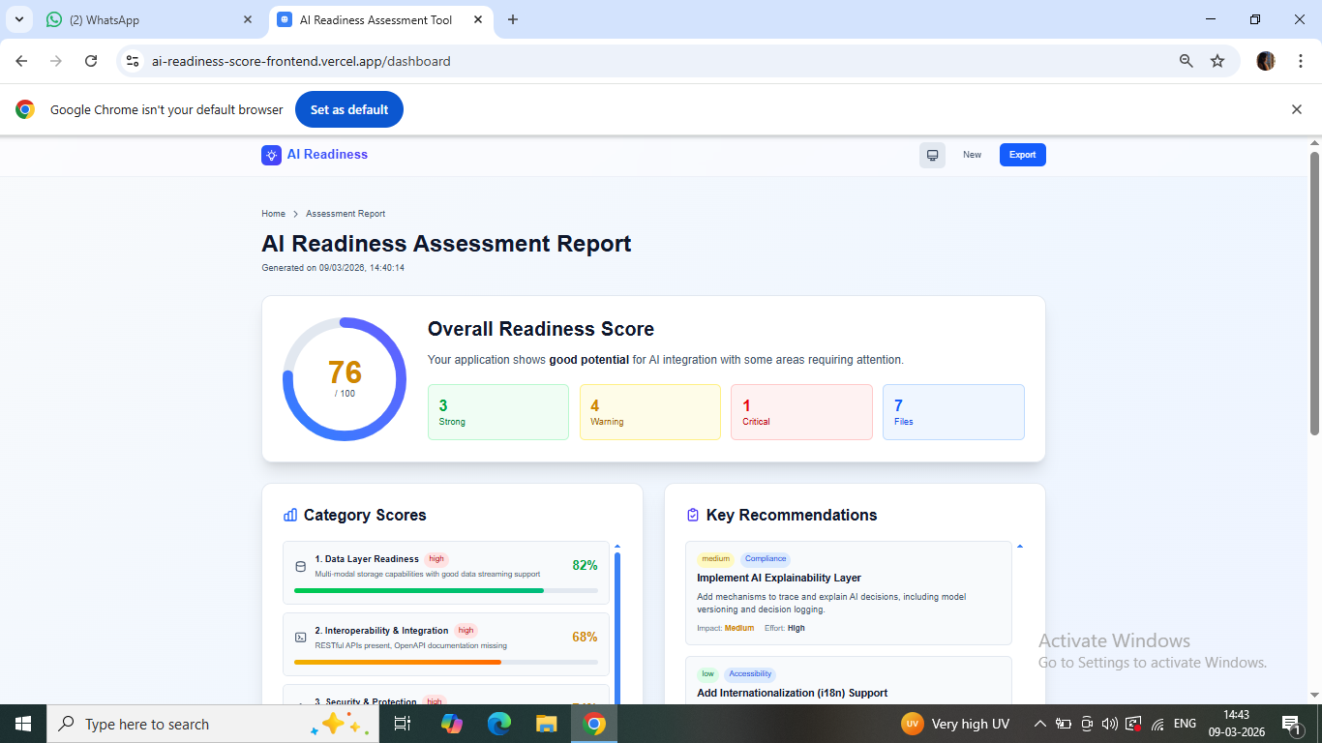
FRONTEND
The tool provides a high-level score to show how much potential your application has for AI integration.
It categorizes findings into different urgency levels, such as "Strong" areas, "Warnings," and "Critical" issues.
The analysis is broken down into specific technical layers, such as data storage, integration capabilities, and security.
It provides a list of "Key Recommendations," which are specific tasks you should complete to improve your app.
You have the option to start a new test or export the final report for your records.

Slide 11
Backend -Static Rule-Based Analysis Engine
The core component of the backend is the Static Analysis Engine.
Key capabilities:
• Executes 56 static analysis rules • Scans all project files and perform each file code line by line • Detects security vulnerabilities, architectural issues, and missing AI capabilities • Identifies infrastructure readiness for AI integration
Rule categories include:
• Security and authentication • Data protection • API design quality • Infrastructure readiness • Code quality • AI/ML readiness • Performance optimization • Compliance and logging
This static-rule based engine ensures consistent and scalable project evaluation.

Slide 12
How rule works?
STEP 1: Rule is DECLARED as a dictionary with patterns
STEP 2: User UPLOADS a ZIP file
STEP 3: Scanner EXTRACTS all text files
STEP 4: For EACH file, for EACH line, for EACH patterns:
------->Does re.search(pattern, line) find a match?
------->YES -> save it as evidence
------->NO -> check next pattern
STEP 5: After all files scanned:
Any evidence found?
YES -> Rule PASSED -> scores are updated
NO -> Rule FAILED -> 0 points + risk + blocker
STEP 6: This rule's points feed into the total score:
Static Score = (total earned / total points declared(included all rules) ) x 100

Slide 13
How rule declared?
RULES = {
R01": {
"name": "JWT / Token Auth",
"category": "Security & Auth",
"severity": "critical",
"score_pts": 8,
"positive_patterns": [ r"jwt\.",r"jsonwebtoken",r"python.jose",r"PyJWT",r"bearer", r"access_token", r"decode_token",r"verify_token",r"oauth2",
r"JWTBearer",r"HTTPBearer", r"create_access_token",],
"negative_patterns": [],
},
}
risk = {
"rule": "R01",
"name": "JWT / Token Auth",
"severity": "CRITICAL",
"message": "No authentication detected in any file",
"advice": "Implement JWT auth with python-jose or PyJWT"
}

Slide 14
Example
from jose import jwt
import os
SECRET = os.environ.get("SECRET_KEY")
def create_access_token(user_id: str):
data = {"sub": user_id}
token = jwt.encode(data, SECRET, algorithm="HS256")
return token
For example lets consider this code is present in user given file,consider rule 1 jwt auth.
Line 1: "from jose import jwt"
Pattern 1 "jwt\." NO (no dot after jwt) , Pattern 2 to 12-> NO
RESULT: 0 matches. Move to next line.
Line 2: "import os" ---> All 12 patterns checked -> NONE match ----> RESULT: 0 matches.
---> it does this for all lines
Line 4: Pattern 6 "access_token" -> YES! "create_access_token" CONTAINS "access_token"
MATCH FOUND!
Record: {file: "auth.py", line: 4, snippet: "def create_access_token(user_id: str):"}
---> like this if any match found it will record it and return the risk declared

Slide 15
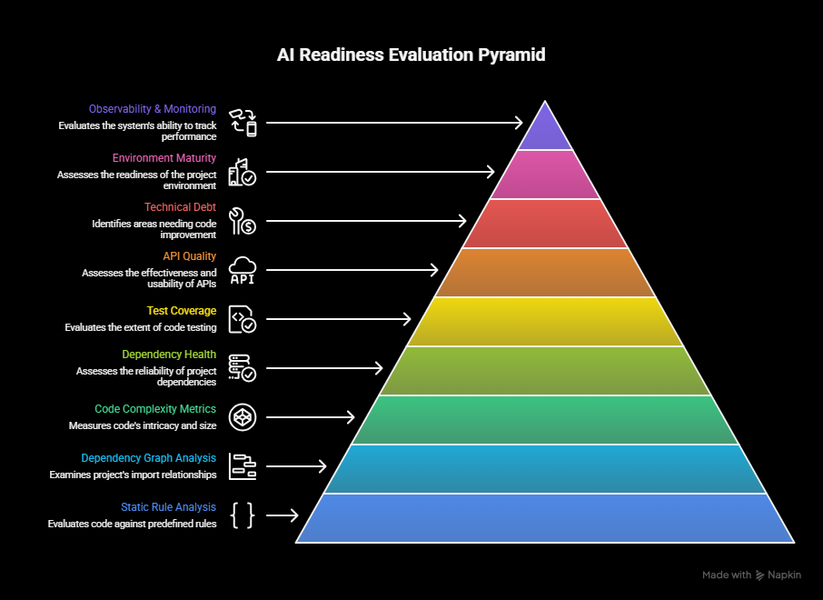
Backend -Multi-Layer Readiness Evaluation
To ensure accurate results, the system evaluates the project across 9 architectural layers.
These layers include:
• Static rule analysis • Import dependency graph analysis • Code complexity metrics • Dependency health analysis • Test coverage analysis • API quality evaluation • Technical debt analysis • Environment configuration maturity • Observability and monitoring readiness
These layers are executed in parallel using multi-thread processing, allowing large projects to be analyzed efficiently.

Slide 16
Backend -Weighted AI Readiness Scoring Model
The system calculates the final AI readiness score using a automated weighted scoring algorithm.
Each analysis layer contributes to the final score with different importance levels.
Example weight distribution:
• Static security rules – 30% • Import graph structure – 15% • Code complexity metrics – 10% • Dependency health – 10% • Test coverage – 10% • API quality – 8% • Technical debt – 7% • Environment configuration – 5% • Observability – 5%
The final score is automatically calculated and normalized between 0 and 100.

Slide 17
Data Storage
The system uses MongoDB as the primary database to store user and assessment data.
User information such as email, profile details, and authentication credentials are stored securely.
Each project assessment is stored with project source, analysis status, and timestamps.
After analysis, the database stores the AI readiness score and layer-wise evaluation results.
The system also stores detected risks, improvement suggestions, and capability indicators for each project.
Users can access previous assessments and review historical reports from the dashboard.
Detailed analysis reports are also saved in log files for debugging and auditing purposes.

Slide 18
AI Readiness Report Generation
After computing the final readiness score, the system generates a detailed report.
The report includes:
• Overall AI readiness score • Security and architectural risk analysis • Layer-wise performance evaluation • Capability detection (authentication, logging, API quality) • Risk register with severity levels • Improvement recommendations to reach AI-ready status
The report is stored in the database and can be exported as JSON, text, or PDF reports.

Slide 19
Future enhancements
• Integrate Large Language Models (LLMs) to perform deeper semantic analysis of code and project documentation. • Support multimodal data analysis, allowing the system to evaluate source code, technical documents, and architecture diagrams together. • Implement AI-powered recommendation systems to automatically suggest improvements for AI readiness. • Enable integration with CI/CD pipelines to perform automated readiness assessments during development. • Expand support for additional programming languages and frameworks. • Develop real-time dashboards for continuous monitoring of AI readiness.

Slide 20
Conclusion
The AI Readiness Assessment Tool provides an automated approach for evaluating whether existing software systems are prepared for AI integration. By analyzing project files using rule-based static analysis and a multi-layer evaluation framework, the system is able to examine important aspects such as security, architecture quality, API design, and infrastructure readiness.
The platform combines these results through a weighted scoring model to generate a clear AI readiness score along with detailed insights about risks and improvement areas. This allows developers and organizations to better understand the current limitations of their applications and the changes required to successfully adopt AI technologies.
Overall, the proposed system helps streamline the evaluation process and supports organizations in making more informed decisions about AI adoption and system modernization.

Slide 21
Thank you

