Slide 1
Fay: Extensible Distributed Tracing from Kernels to Clusters
Prasanna Gautam
UConn CSE-5095-005 (Sept 23, 2014)

Slide 2
Vision
Know what clusters are doing at any time
Down to machine’s system calls
Ask any question to the cluster
Collect answers efficiently
Be able to run continuously
Safely run in production without instrumentation
Apply data mining techniques to clusters

Slide 3
Goals
Platform should allow arbitrary high-level queries about any aspect of system
Stateful Probes
In-machine Data Reduction (filter,aggregate)
Low overhead tracing

Slide 4
Fay: Features
Can be applied to existing, live Windows servers
Single query
Pervasively data-parallel
Inline, safe machine-code at tracepoints
Notes:
Single query
Easy to write & enables automatic optimizations
Pervasively data-parallel
Same model within machines & across clusters
Inline, safe machine-code at tracepoints
Allows us to do computation right at data source

Slide 5
Integrating High Level languages
Extending DryadLINQ to FayLINQ
Distributed Querying
Hide the distributed nature of queries
High level declarative data processing
Can simultaneously express
Trace Collection
Trace Event Analysis
Persisting trace event logs
Powershell interface

Slide 6
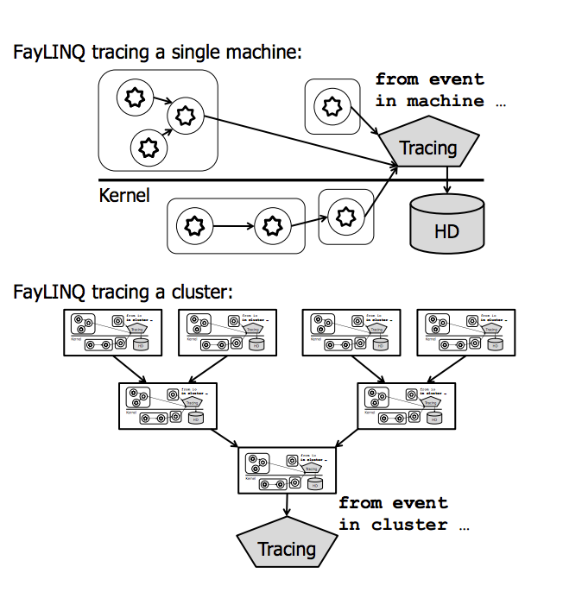
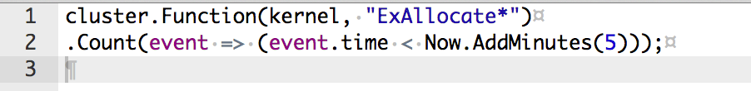
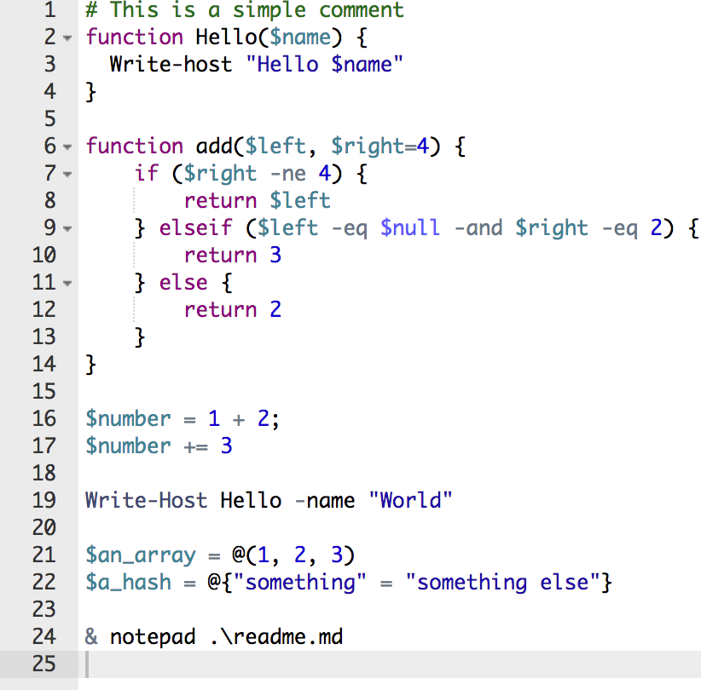
Tracing A Cluster
FayLINQ Example:
PowerShell Example:

Slide 7
Fay vs Specialized Tracing
Fay is general, but can efficiently do
Tracing across abstractions, systems (Magpie)
Predicated and windowed tracing (Streams)
Probabilistic tracing (Chopstix)
Flight recorders, performance counters, …

Slide 8
Tracing with Fay
Dynamic Instrumentation
Minimally intrusive (only first machine code instruction is changed)
Inline invocations
Limits to a single process, kernel
Each address space is traced separately

Slide 9
Low-Level Code Instrumentation
Module with a traced function Foo
Caller:
...
e8ab62ffff call Foo
...
ff1508e70600 call[Dispatcher]
Foo: ebf8 jmp Foo-6
cccccc
Foo2: 57 push rdi
...
c3 ret
Replace 1st opcode of functions
http://www.sigops.org/sosp/sosp11/current/2011-Cascais/22-erlingsson.pptx
Notes:
How do probes become executed?
At the lowest level, we use function hotpatching to instrument a system, by replacing the first opcode of each instrumented function with a jump to a special hotpatch area in front of the function.
This is disaggregated, one thread is doing this
Talk about Informer
Running just machine code at where event is happening is good idea
Have to make safe
Informer did that in ‘69
Can include any code we want
Arbitrary computation
Have to deal with concurrency

Slide 10
Low-Level Code Instrumentation
Module with a traced function Foo
Fay platform module
Caller:
...
e8ab62ffff call Foo
...
ff1508e70600 call[Dispatcher]
Foo: ebf8 jmp Foo-6
cccccc
Foo2: 57 push rdi
...
c3 ret
Dispatcher:
t = lookup(return_addr)
...
call t.entry_probes
...
call t.Foo2_trampoline
...
call t.return_probes
...
return /* to after call Foo */
Replace 1st opcode of functions
Fay dispatcher called via trampoline
http://www.sigops.org/sosp/sosp11/current/2011-Cascais/22-erlingsson.pptx
Notes:
The inserted code calls out to the Fay probe dispatcher, which is pre-loaded into the same address space as the traced module when tracing is deployed. The dispatcher is responsible for looking up and executing the appropriate probe to gather the information necessary to generate a trace event.
This is disaggregated, one thread is doing this
Talk about Informer
Running just machine code at where event is happening is good idea
Have to make safe
Informer did that in ‘69
Can include any code we want
Arbitrary computation
Have to deal with concurrency

Slide 11
Low-Level Code Instrumentation
Module with a traced function Foo
Fay platform module
Fay probes
Caller:
...
e8ab62ffff call Foo
...
ff1508e70600 call[Dispatcher]
Foo: ebf8 jmp Foo-6
cccccc
Foo2: 57 push rdi
...
c3 ret
Dispatcher:
t = lookup(return_addr)
...
call t.entry_probes
...
call t.Foo2_trampoline
...
call t.return_probes
...
return /* to after call Foo */
PF3
XFI
PF4
PF5
XFI
XFI
Replace 1st opcode of functions
Fay dispatcher called via trampoline
Fay calls the function, and entry & exit probes
http://www.sigops.org/sosp/sosp11/current/2011-Cascais/22-erlingsson.pptx
Notes:
To do this, probes can execute arbitrary machine code, as long as this does not change the system we are tracing.
After probe execution, the dispatcher jumps back to the instrumented function by means of a special return trampoline that executes the original, replaced first opcode, before continuing with the function.
This is disaggregated, one thread is doing this
Talk about Informer
Running just machine code at where event is happening is good idea
Have to make safe
Informer did that in ‘69
Can include any code we want
Arbitrary computation
Have to deal with concurrency
--- Trampolining → hook one function, force it to redirect to another and return back to original

Slide 12
Benchmark: Trivial System calls in Tight Loop
Fay adds 220 to 430 cycles per traced function
Fay adds 180% CPU to trace all kernel functions
Approx 10x faster than Dtrace, SystemTap
Slowdown (x)
Null-probe overhead
Cycles
http://www.sigops.org/sosp/sosp11/current/2011-Cascais/22-erlingsson.pptx
Notes:
Take tables
Null-probe overhead (table 2)
Scalability (table 4)
Example application is generation of function call graphs, which require tracing all functions

Slide 13
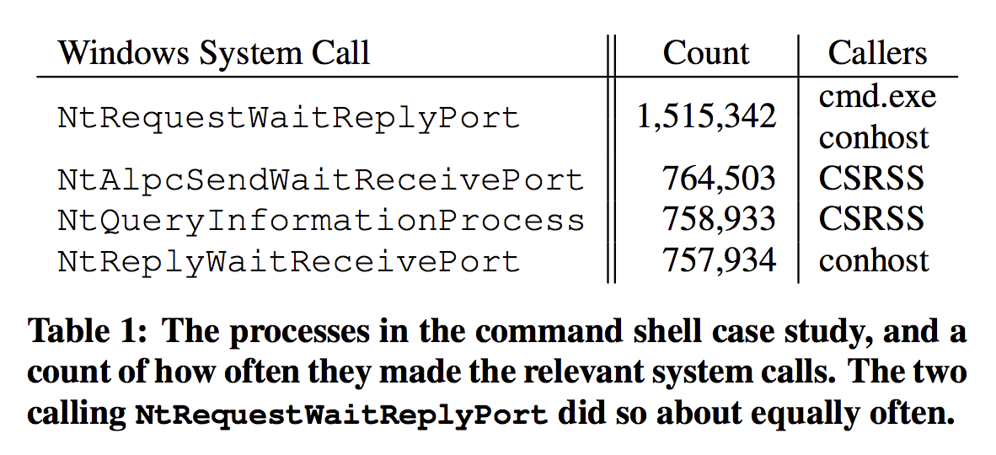
Case Study: Performance Diagnosis
Interactively using Windows Command Shell
High frequency of system calls
Outputting 16MB ASCII file in minimized console window => 3.75 million system calls

Slide 14
Distributed Performance Counters
Fay tracing can trivially count events across machines in cluster
User-Controllable and Efficient aggregation
Per-
Process
Thread
Module
User-mode and Kernel

Slide 15
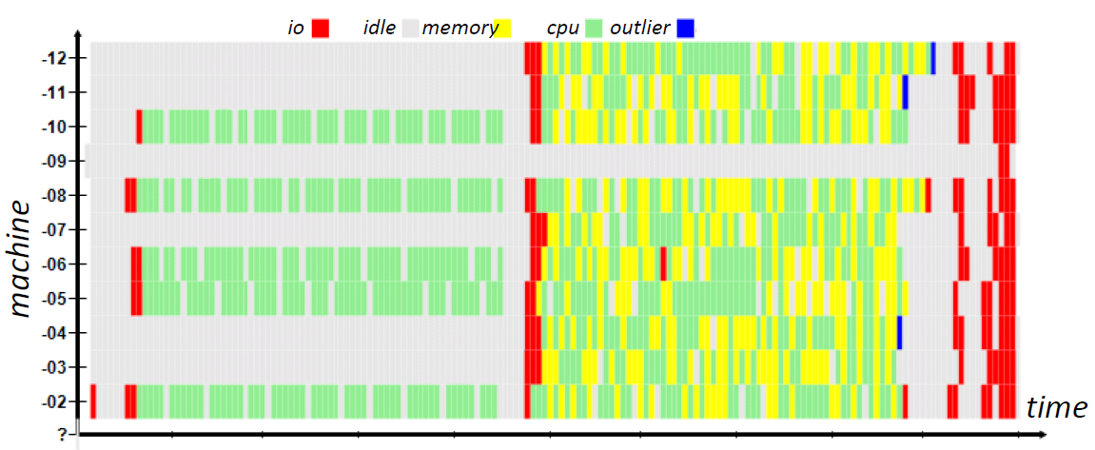
Automatic Analysis of Cluster Behavior
Automatically categorize cluster behavior, based on system call activity
Without measurable overhead on the execution
Without any special Fay data-mining support
Notes:
k-means clustering aims to partition n observations into k clusters in which each observation belongs to the cluster with the nearest mean, serving as a prototype of the cluster.

Slide 16
Scalability, Fault Tolerance
Used Fay to trace all 8,001 hotpatchable functions in Windows kernel and count
Worst case scenario
Fay call dispatcher creates extra stack
Branch-prediction miss on function return
Dtrace is slower but not really comparable
Randomly killing processes, threads, machines
Thread local state is lost
Dryad ensured cluster level fault tolerance

Slide 17
Related Work
Dynamic Instrumentation
New Tracing tools that use dynamic instrumentation like Ftrace
Safe OS extensions
Informer profiler in 1969 did this
Google’s NaCl runs assembly code in browser
Declarative Tracing and Debugging
Integration with LINQ: PQL, PTQL

Slide 18
Issues
Only specific to Windows
Authors mention easy ports to other Oses
LINQ is tied to .NET runtime
Possibly usable in Mono in other operating systems

Slide 19

Questions

