Slide 1
Google’s Dapper – A Large-Scale Distributed Systems Tracing Infrastructure
Prasanna Gautam
9/11/2014 (UConn CSE5095-005)

Slide 2
Goals
Provide developers with
Information about behavior of complex distributed systems, applications
Tools to debug and analyze production service issues
Application level transparency and service dependencies
Assist in minimizing end to end latencies

Slide 3
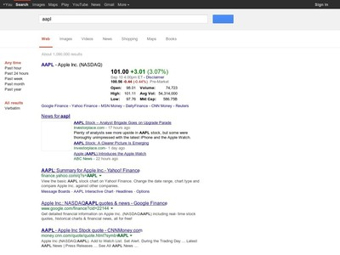
Example: Web Search
Stock quotes
Ad
Images
Result
Search Request
Advertisement
Query Servers
Images
Video
Specialized

Slide 4
Example: Web Search
Many services
A lot of people writing, updating them constantly
Performance sensitive
End to End latency for search needs to be low
On shared hardware with other services competing for resources

Slide 5
Potential solution
Write a library or framework that is
Embedded into majority of services
Continuously collecting and monitoring data
Quick turnaround time

Slide 6
Dapper: Requirements
Low-Overhead
Cannot affect performance significantly
Application Level Transparency
Who did what, when, how(RPC?)
Scalability
At Google Scale, can’t trace everything.. Sample!
Making tracing data available quickly (< 1 min)

Slide 7
Dapper: Requirements
Not an experimental, fringe system
Runs on production hardware and services
Tracing
Annotation-Based | Black-box
More instrumentation | Less instrumentation
Less data is required to correlate | Depends on lot of data and statistical regression techniques
As granular as the user needs | Depends

Slide 8
Dapper: Requirements
Not an experimental, fringe system
Runs on production hardware and services
Tracing
Annotation-Based | Black-box
More instrumentation | Less instrumentation
Less data is required to correlate | Depends on lot of data and statistical regression techniques
As granular as the user needs | Depends

Slide 9
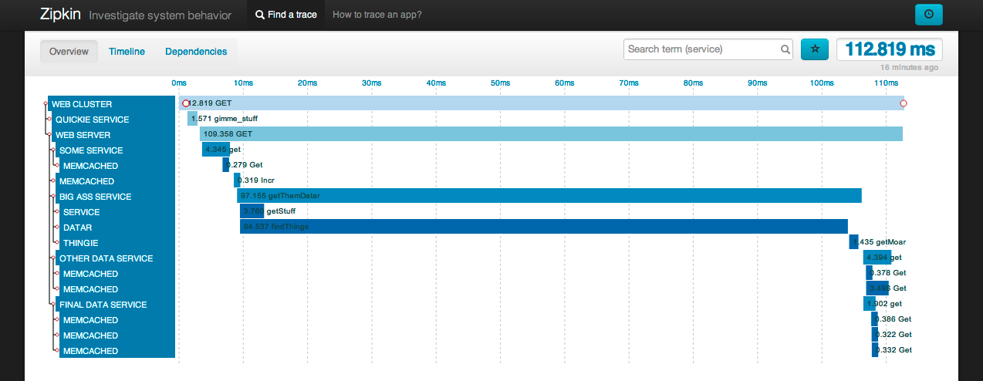
Trace Trees and Spans

Slide 10
Trace Trees and Spans
Spans are tree nodes with
Id
Parent Id
Name
Start and End times
Edges indicate causal relationship
Additional tier of infrastructure adds a level
Can cover multiple hosts

Slide 11
Instrumenting
Tracing the control path
Dapper attaches a thread-local trace-context
Async callbacks store the trace context of creator
Then associated by callee to the relevant worker thread
A
B
trace-id
trace-id
RPC + trace-id
…

Slide 12
Instrumenting
Tracing the control path
Dapper attaches a thread-local trace-context
Async callbacks store the trace context of creator
Then associated by callee to the relevant worker thread
Doesn’t need to know about the actual thread in B.. Or aggregate up..
A
B
trace-id
trace-id
RPC + trace-id
…

Slide 13
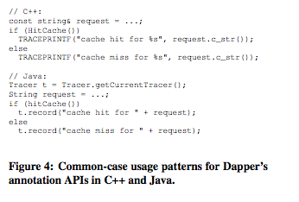
Annotations
Application developers “enrich” code with annotations
Allows map of custom key-value annotations

Slide 14
Sampling
Two levels
How many nodes in the cluster to sample
Runs as a daemon in fraction of production services
Only applications enriched with annotations are traced
Record only fraction of traces
On collector too
1 TB of trace data / day => 0.01% of network traffic
Needs to be available for at least 2 weeks after initial logging

Slide 15
Implementation
Very small and efficient implementation
No significant impact on network, disk or
Traces are collected in log files in the machine
Then pulled and written to BigTable
Median Latency 15 seconds
But can take hours
There’s a way to look at the logs live during “firefighting” operations too

Slide 16
Security & Privacy
Payloads are not automatically logged
But you can opt-in if you need to

Slide 17
Tools
Depot API
Expose clean intuitive interface to the raw data
Access By
Trace-Id
Bulk
Indexed Access
Compressed trace data is only 26% from actual trace data
Web based UI for exposing trace trees

Slide 18
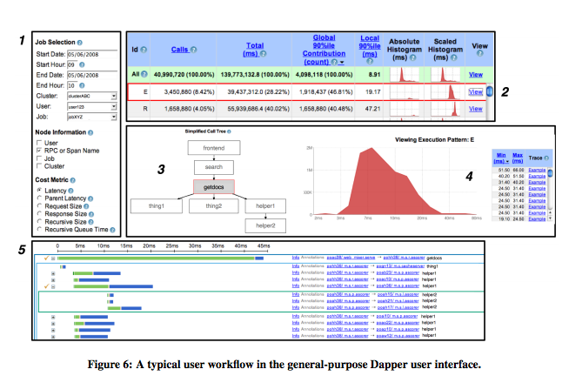
Tools

Slide 19
Adoption
200 active users per week
Teams use it to make informed refactoring decisions
Example AdWords
And add additional tools and extensions
All data is exposed to build better tools and integrations
Integrated with Exception Monitoring

Slide 20
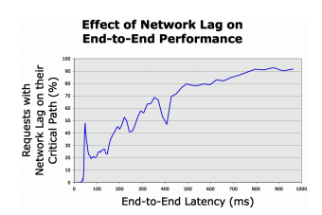
Adoption
Addressing Long-Tail Latency

Slide 21
Related Work
Black-box monitoring systems
Project5
WAP5
Sherlock
Explicit annotation based systems
Pip and Webmon rely on application level annotations
X-Trace, Pinpoint and Magpie focus on middleware and libraries modifications

Slide 22
Contributions
First production distributed tracing framework
Achieves higher degree of application level annotation
Very few workloads that required manual intervention (40 C++ and 33 Java applications)

Slide 23
Problems
Specific to Google’s infrastructure
Batched workloads for efficiency do not have mapped trace-ids
MapReduce for example
Good at system problems, you still need other tools for specifics
Kernel levels are not included

Slide 24
Further
Twitter implemented Zipkin inspired by Dapper
It’s open source
Enabled building distributed request flow comparison services at Google

Slide 25

Questions?

