Slide 1

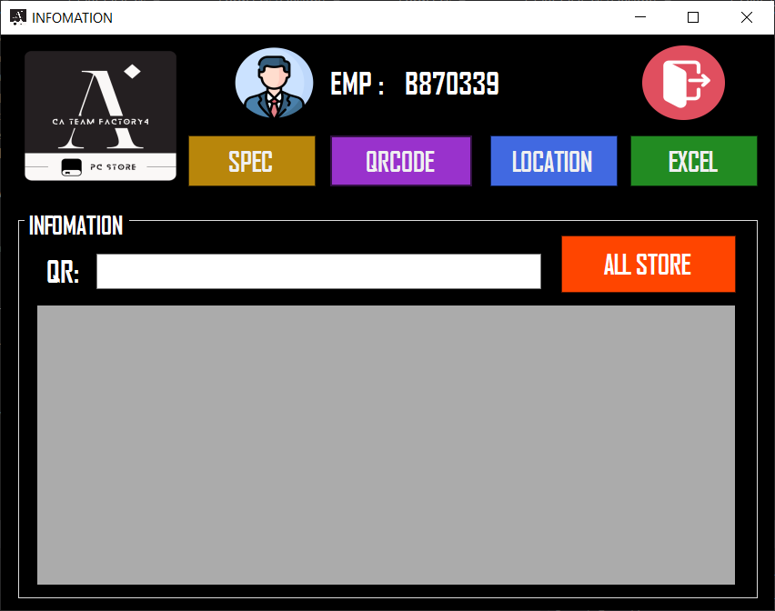
PC STORE

Slide 2
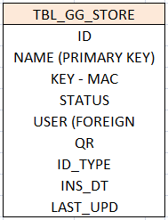
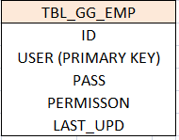
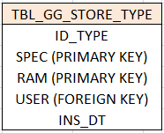
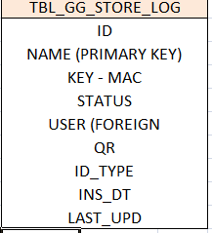
TABLE

Slide 3
Flowchart

Slide 4

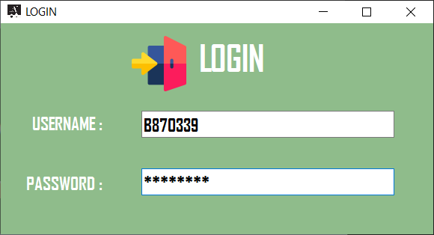
PROGRAM PC STORE
1
LOGIN
1.Login USERNAME and PASSWORD

Slide 5
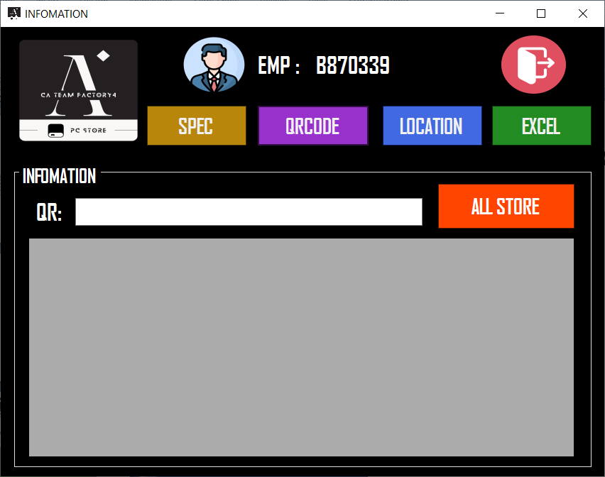
PROGRAM PC STORE
2
INFOMATION
1
1.Logout
2.Funtion ADD SPEC
3.Funtion ADD QR CODE
4.Funtion Update Location
5.Funtion Show PC in Table TBL_GG_STORE
6. Gen Excel file in data table T1
2
3
4
6
5
T1

Slide 6
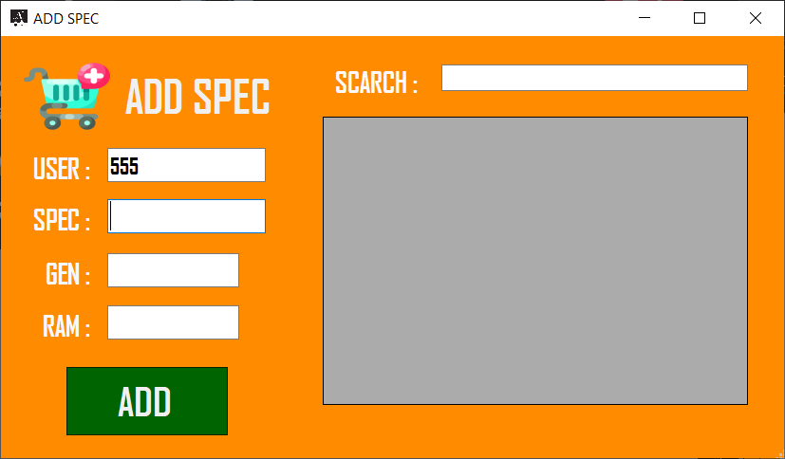
PROGRAM PC STORE
3
ADD SPEC
6
1.User (Auto user login)
2.SPEC PC Ex. I7,I5,I3
3.GEN PC Ex. 2700,3600 [Can check in PC Properties]
4.SPEC RAM
5.Buttom for ADD SPEC in DATABASE and Print
6. Funtion SCARCH for check SPEC PC in DATABASE
1
2
3
T1
4
5

Slide 7
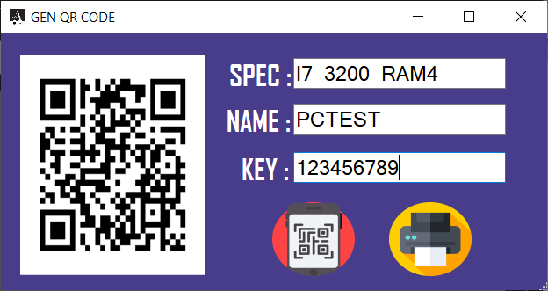
PROGRAM PC STORE
4
GEN QR CODE
5
1.Insert Spec
2.Inser PC NAME (MIS Sticker)
3.Insert Key Window
4.Click for Gen QR CODE
5.Show QR code
6.Print QR CODE
*Default location STORE
1
2
3
4
6

Slide 8
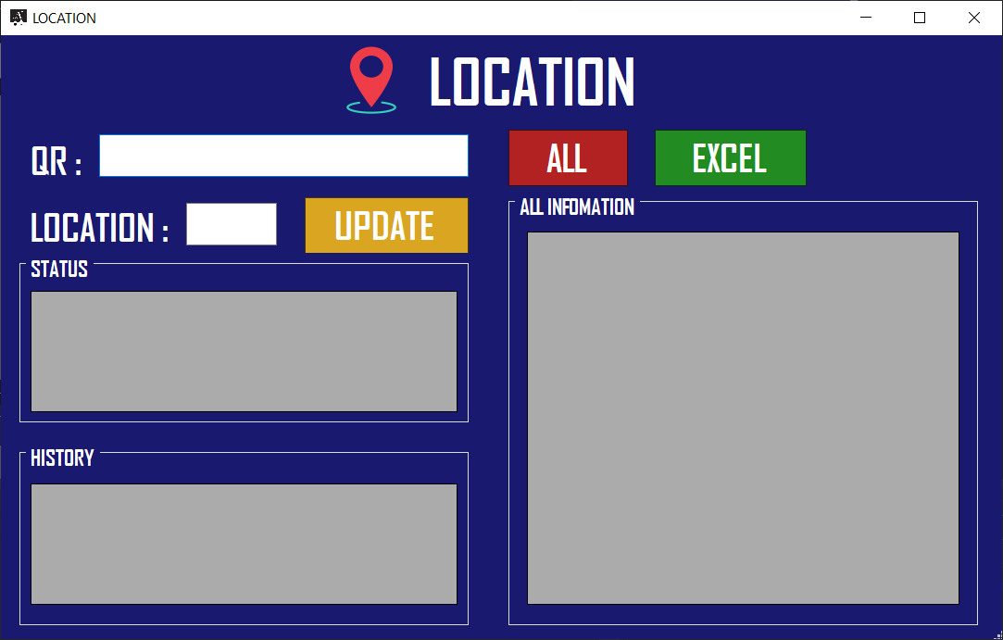
PROGRAM PC STORE
5
UPDATE LOCATION
1.Scan QR code PC store
2.Insert new location
3.Buttom update data location
4.Buttom show all data TBL_GG_STORE
5.Gen EXCEL File follow table T3
T1 : Status PC
T2: History PC
T3 : All data TBL_GG_STORE
1
4
5
2
3
T1
T3
T2

