Slide 1
Solving CTF
Name : Prasna Fikri Oktavian
Lecturer :林建良

Slide 2

Agenda

Slide 3
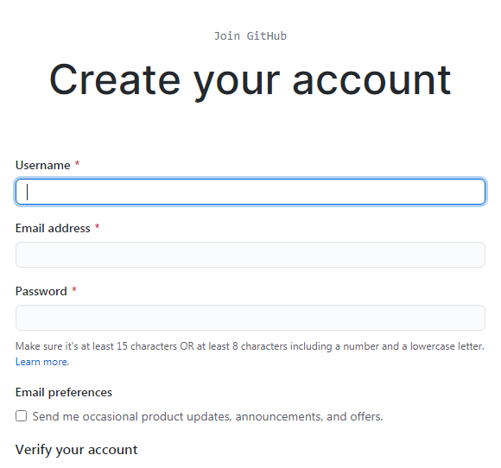
Google Colab

Slide 4
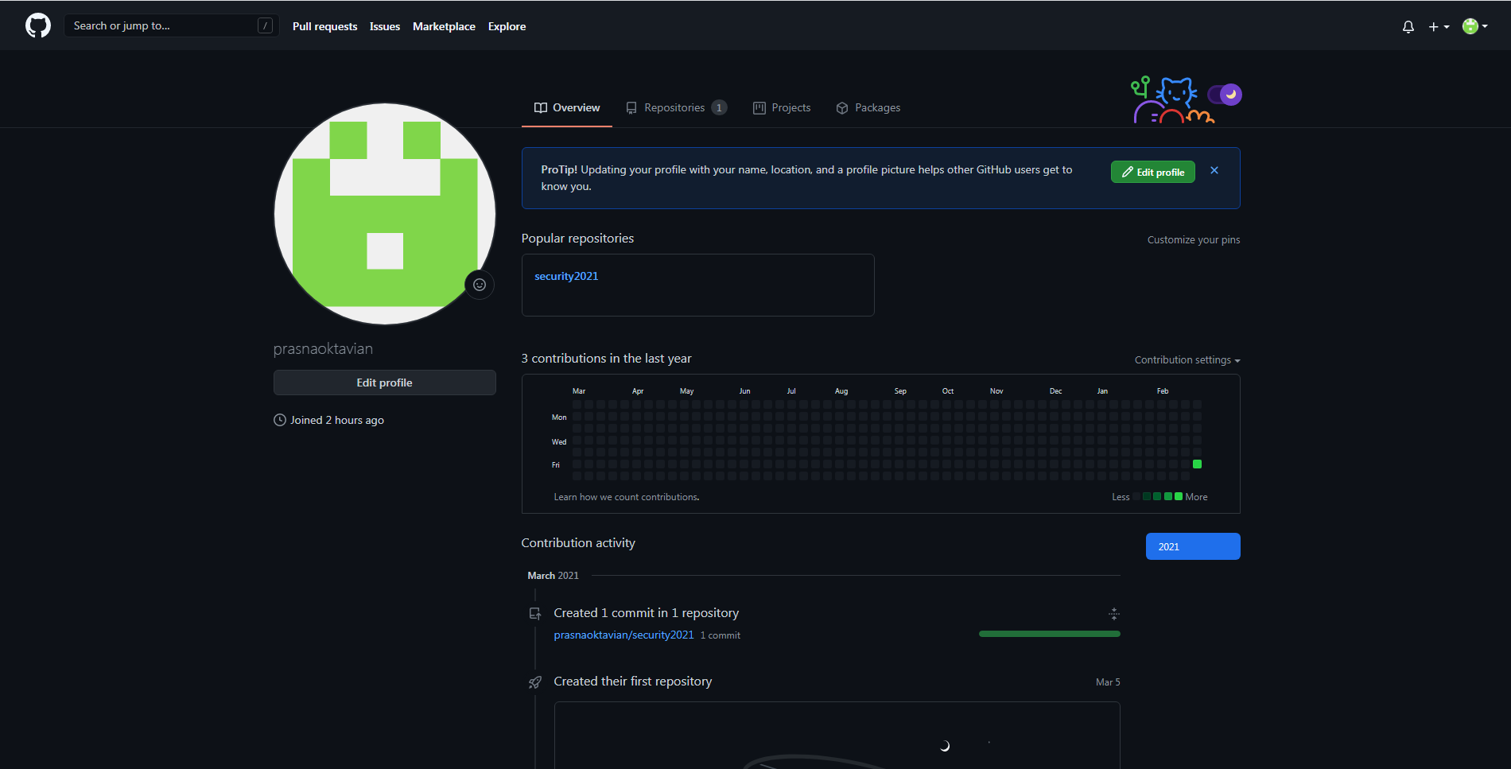
https://github.com/prasnaoktavian

Slide 5
