Slide 1

Treasure hunt Using QR Code
Prashant Agrawal

Slide 2
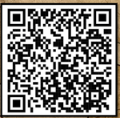
What is QR Code?
QR → Quick Response
A QR code is like a funny-looking puzzle.
A QR like a high-tech treasure map that your phone can read, leading you to exciting online adventures and hidden surprises!
Can human able to read QR code?

Slide 3
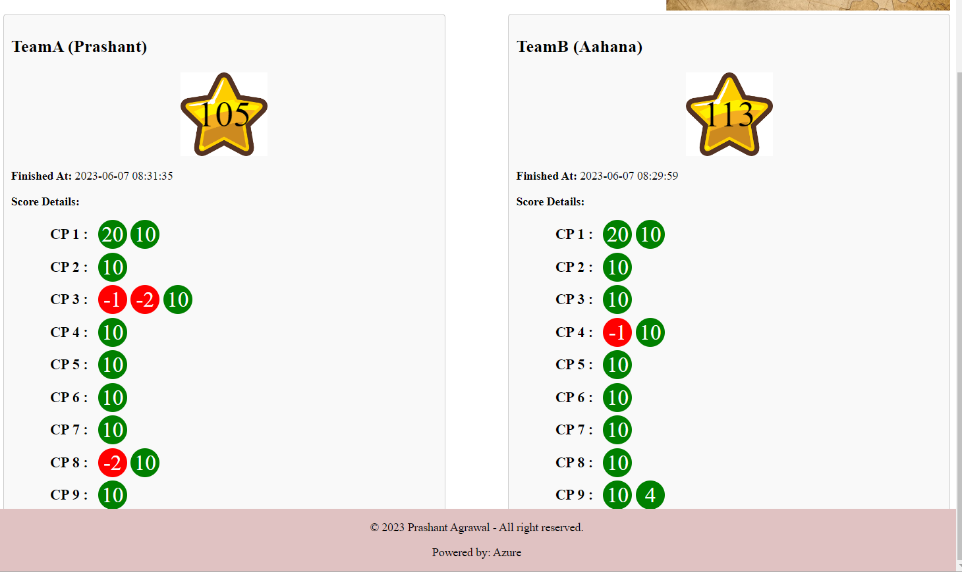
Example Game Dashboard

Slide 4



Rules & Guidelines
No running, snatching, fighting etc.
On stairs, only ONE person can go for scan.
No rush, winner is based on Points
Wrong QR codes → -1 or -2
Everyone in team will get fair chance
Put back the thing after scanning the QR code
Ask Adult Help if required

Slide 5
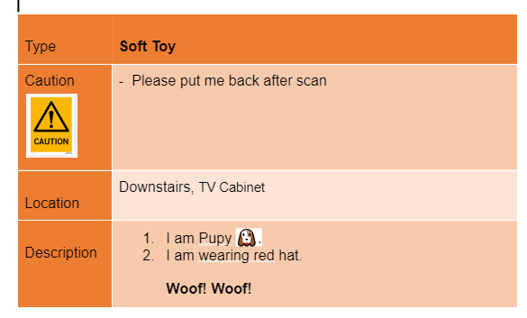
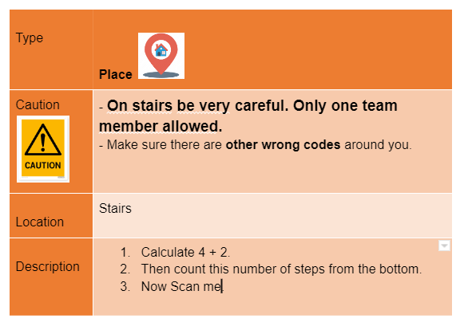
Example Instructions

Slide 6



What to HUNT
Toys
Photo Frames
Person
Etc..

Slide 7
Thank YOU.. Let’s get ready….

Slide 8
Appendix

Slide 9
Codes
Decimal Integer Numbers
Cannot be 0

Slide 10
Model
User
Name
Username/Password
Teams
Key:TeamA, TeamB
Display Name
Kids
Name, Age
Game
StartTime
CheckPointPoints
Name
WebLink
Point
Next_CheckPoint
TeamA/TeamB
Score
Team
CheckPoint

Slide 11
Live Dashboard
Refresh every 10 seconds

Slide 12
Appendix

Slide 13

Wrong QR Code

Slide 14

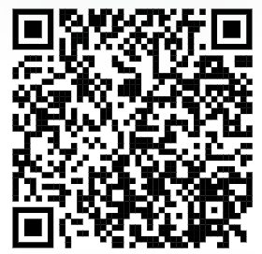
With QR codes

Slide 15
Please wait …
With QR codes

