Slide 1

Treasure hunt Using QR Code
Prashant Agrawal

Slide 2
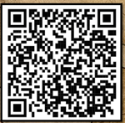

What is QR Code?
QR → Quick Response
Fun facts
Humans can’t read
Rotate and it works
Some Noise no problem

Slide 3



Game Rules & Guidelines
Behavior
On stairs, only ONE person can go for scan.
Points: +10 or - 1 or -2
fair chance to all
Put back the thing
Ask Adult help (only if required)

Slide 4
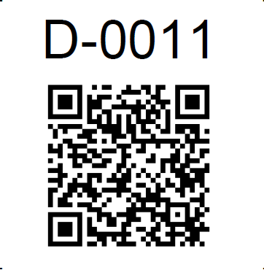
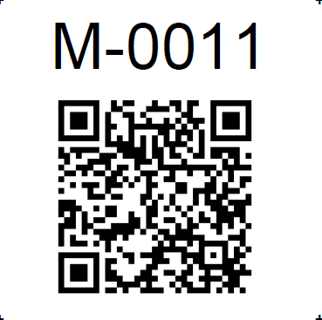

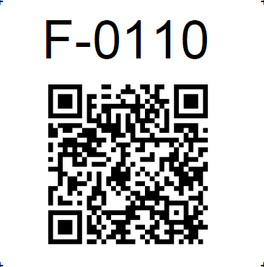
Example QR Codes
Demo
Medium
Hard
Failed/Wrong Codes

Slide 5
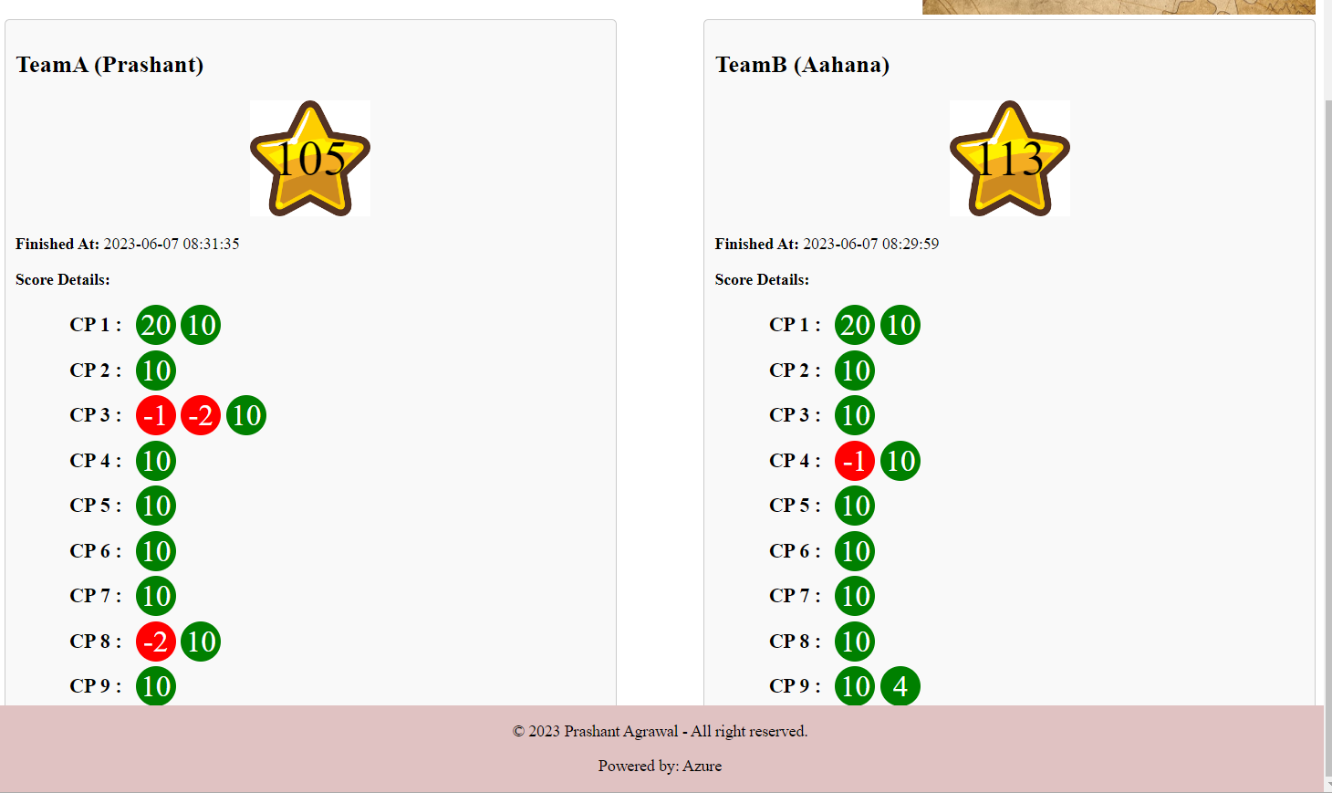
Example Game Dashboard

Slide 6
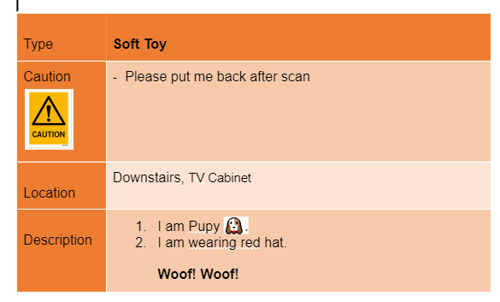
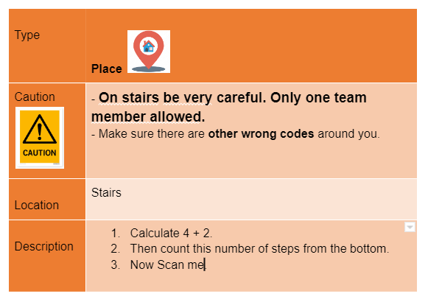
Example Instructions

Slide 7



What to HUNT
Toys
Photo Frames
Person
Etc..

Slide 8


Slide 9
Appendix

Slide 10
Codes
Decimal Integer Numbers
Cannot be 0

Slide 11
Model
User
Name
Username/Password
Teams
Key:TeamA, TeamB
Display Name
Kids
Name, Age
Game
StartTime
CheckPointPoints
Name
WebLink
Point
Next_CheckPoint
TeamA/TeamB
Score
Team
CheckPoint

Slide 12
Live Dashboard
Refresh every 10 seconds

Slide 13
Appendix

Slide 14

Wrong QR Code

Slide 15

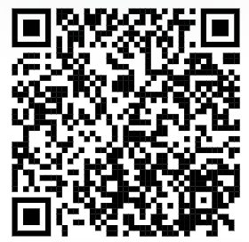
Get real-time Game results
With QR codes

Slide 16
Please wait …
With QR codes

