Slide 1

Treasure hunt Using QR Code
Prashant Agrawal

Slide 2
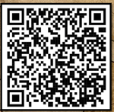
What is QR Code?
QR → Quick Response
A QR code is like a funny-looking puzzle.
A QR like a high-tech treasure map that your phone can read, leading you to exciting online adventures and hidden surprises!
Can human able to read QR code?

Slide 3



Rules & Guidelines
No running, snatching, fighting etc. You will lose -2 points if you do so.
On stairs, only ONE person can go for scan.
Right QR code → +10
Wrong QR codes → -1 or -2
Remember your game code (D, M or H)
Don’t rush, winner is based on Points. However, first team 4 points
Everyone in team should get fair chance
Put back the thing after scanning the QR code
Ask Adult Help if required

Slide 4
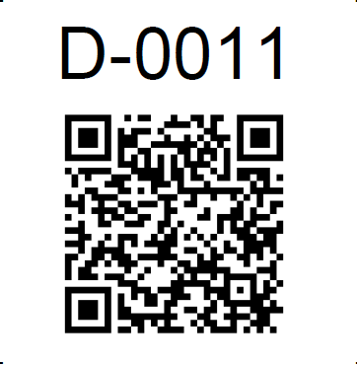
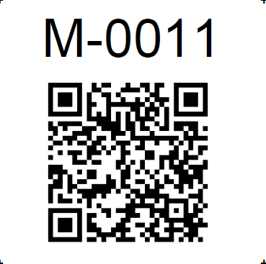
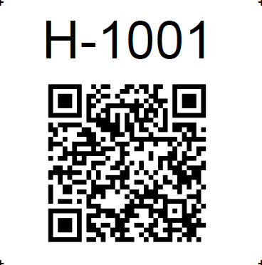
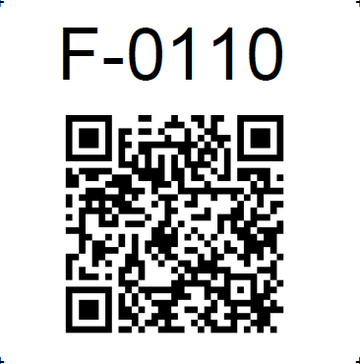
Example QR Codes
Demo
Medium
Hard
Failed/Wrong Codes

Slide 5
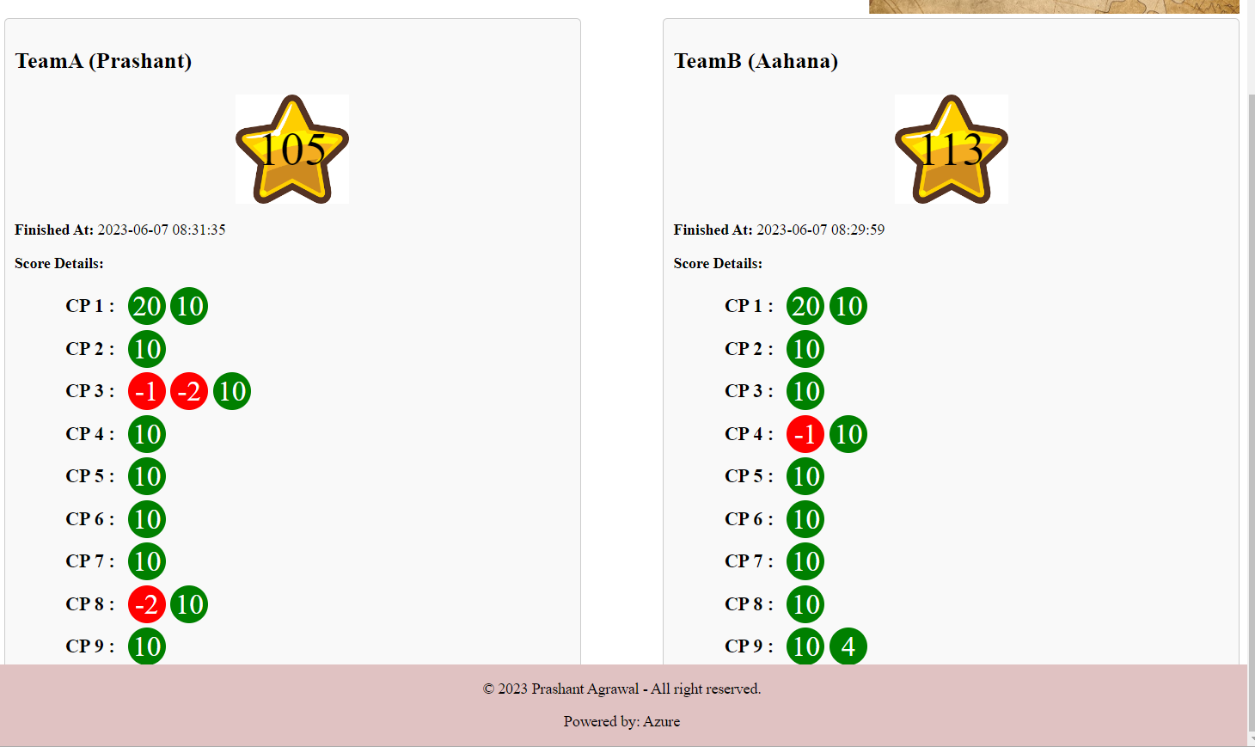
Example Game Dashboard

Slide 6
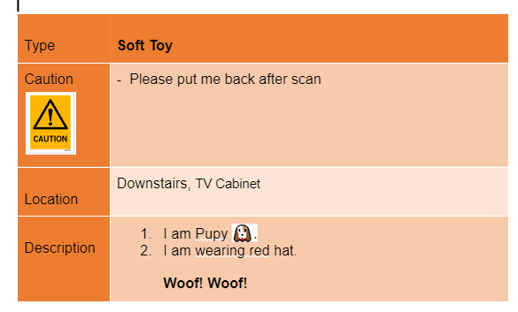
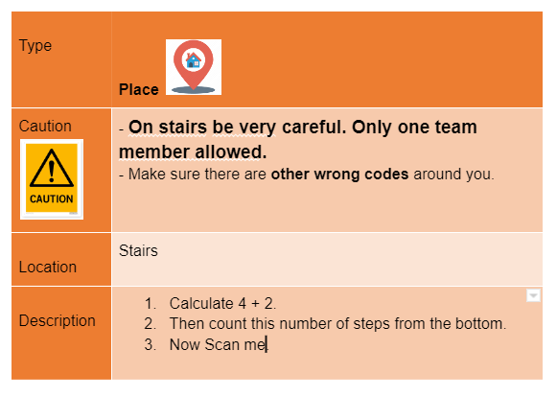
Example Instructions

Slide 7



What to HUNT
Toys
Photo Frames
Person
Etc..

Slide 8


Slide 9
Appendix

Slide 10
Codes
Decimal Integer Numbers
Cannot be 0

Slide 11
Model
User
Name
Username/Password
Teams
Key:TeamA, TeamB
Display Name
Kids
Name, Age
Game
StartTime
CheckPointPoints
Name
WebLink
Point
Next_CheckPoint
TeamA/TeamB
Score
Team
CheckPoint

Slide 12
Live Dashboard
Refresh every 10 seconds

Slide 13
Appendix

Slide 14

Wrong QR Code

Slide 15

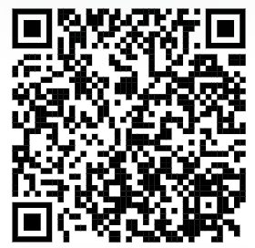
Get real-time Game results
With QR codes

Slide 16
Please wait …
With QR codes

