Slide 1
Points System
Starting Score at 20
10 Points for every Correct Scan
Show next instruction
(-2) Point for every Incorrect Scan for different game code
(-1 ) Point for every Incorrect Scan in same game code
Last Re-Scan with in 2 minutes will not be penalty
Bonus 4 point for team who finish first
Winner who has more points

Slide 2
Codes
Decimal Integer Numbers
Cannot be 0

Slide 3
Model
User
Name
Username/Password
Teams
Key:TeamA, TeamB
Display Name
Kids
Name, Age
Game
StartTime
CheckPointPoints
Name
WebLink
Point
Next_CheckPoint
TeamA/TeamB
Score
Team
CheckPoint

Slide 4
Live Dashboard
Refresh every 10 seconds

Slide 5
Appendix

Slide 6

Wrong QR Code

Slide 7

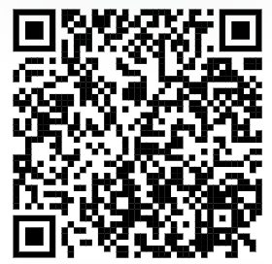
With QR codes

Slide 8
Please wait …
With QR codes

