Slide 1
Capstone Project:
Analytical CRM Development for a Bank
By – Prasoon Bisht

Slide 2

Agenda
Problem Statement
Data Description
Introduction to Analytical CRM
Customer Data Analysis Techniques
Churn Analysis by Region
Churn Analysis by Demographics
Churn Analysis by Credit Card
Customer Segmentation Based on Credit Score
Customer Retention Strategies
Dashboard
Conclusion

Slide 3
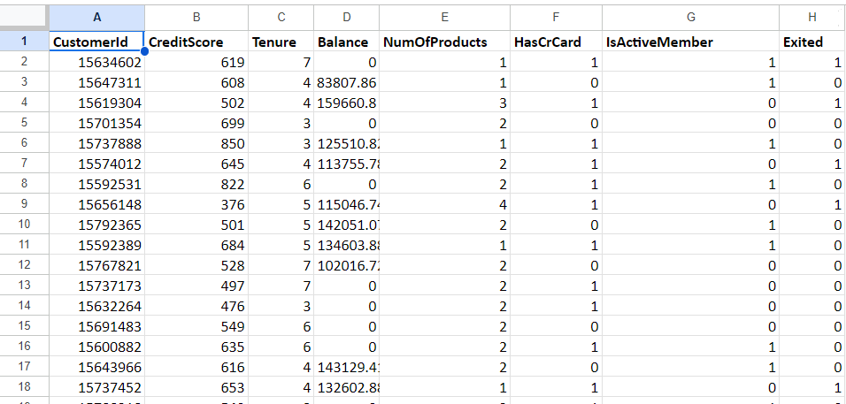
Problem Statement
You are an analytical CRM (Customer Relationship Management) specialist hired by a bank to extract meaningful insights from various customer-related datasets. The bank aims to reduce customer churn, improve service delivery, and enhance customer satisfaction. They have provided you with datasets including customer demographics, transaction details, customer exit information, and active customer profiles.

Slide 4
The image above displays details about Bank Customer data, including:
RowNumber: The row number in the dataset, likely used for reference or indexing.
CustomerId: A unique identifier for each customer.
CreditScore: A numerical representation of the customer's creditworthiness.
Credit score:
Excellent: 800–850
Very Good: 740–799
Good: 670–739
Fair: 580–669
Poor: 300–579
GeographyID: A numerical identifier that likely corresponds to a geographical location, such as a country or region.
GenderID: A numerical identifier for the customer's gender, where for example, '1' could represent male and '2' could represent female.

Slide 5
The image above displays details about bank customer data, including: (Cont..)
Age: The age of the customer.
Tenure: The number of years the customer has been with the bank.
Balance: Current balance in the customer's account.
NumOfProducts: refers to the number of products that a customer has purchased through the bank.
HasCrCard: denotes whether or not a customer has a credit card. This column is also relevant, since people with a credit card are less likely to leave the bank.
1 represents credit card holder
0 represents non credit card holder

Slide 6
The image above displays details about bank customer data, including: (Cont..)
IsActiveMember: active customers are less likely to leave the bank (as per the criteria defined by the bank for identifying the activeness).
1 represents Active Member
0 represents Inactive Member
Estimated Salary: as with balance, people with lower salaries are more likely to leave the bank compared to those with higher salaries.
Exited: whether or not the customer left the bank.
0 represents Retain
1 represents Exit
Bank DOJ: date when the Customer associated/joined with the bank.

Slide 7
Introduction to Analytical CRM in Banking
Overview of Analytical CRM
Definition: Analytical Customer Relationship Management (CRM) focuses on analyzing customer data to enhance interactions and relationships.
Purpose: Aims to improve customer satisfaction and loyalty through data-driven insights.
Importance in the Banking Sector
Customer Insights: Helps banks understand customer demographics, behaviors, and preferences.

Slide 8
Customer Data Analysis Techniques
SQL Queries for Data Retrieval
Utilize SQL to extract customer information, such as average income by gender and geography, and churn rates across demographics.
DAX Formulas for Performance Metrics
Implement DAX formulas in Power BI to calculate key performance indicators, such as churn rates by gender and the average number of products used by credit card holders.
Data Visualization Tools
Leverage Power BI and Excel to create visual representations of customer data, including churn analysis by age and geographic location.

Slide 9
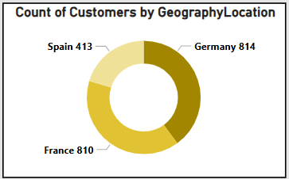
Churn Analysis by Region
Germany and France
Both regions show high churn with 814 exited customers in Germany and 810 in France. This indicates a shared need for targeted retention strategies to reduce customer loss.
Spain
With 414 exited customers, Spain presents a significant opportunity for improvement in retention efforts.

Slide 10
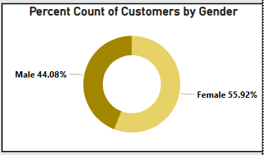
Churn Analysis by Demographics
Female Churn Rate
Female Exit Percent – 55.92%
Female customers exhibit a significantly higher churn rate compared to their male counterparts, indicating a greater risk of exit within this demographic.

Slide 11
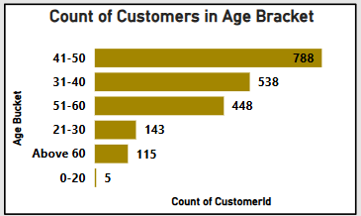
Churn Analysis by Demographics
Customers Over 40 Years
Higher Exit Count
Individuals aged over 40 show increased churn rates, highlighting this age group as a critical segment for retention strategies. This analysis underscores the importance of targeted retention efforts for both female customers and those over 40 to mitigate financial risk for the bank.

Slide 12
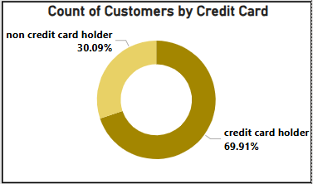
Churn Analysis by Credit Card
Credit Card Holders
Percent of customers who have credit card and have exited – 69.91%
Customers with credit card exhibit more churn than the customers without credit card. This analysis shows the targeted retention for credit card holders.

Slide 13
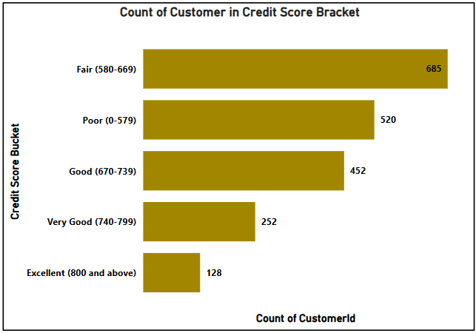
Customer Segmentation Based on Credit Score
Customers with Excellent credit scores (800 and above) exhibit the lowest churn rates, indicating strong loyalty and engagement with the bank.
Customers in the Fair credit score range (580-668) have the highest churn rates, suggesting a lack of satisfaction and potential financial instability.
Targeted marketing strategies can be developed for credit card holders, who represent over 70% of the customer base, to cross-sell additional financial products such as personal loans and insurance
The high churn rate among customers with average credit scores (500-649) poses a significant financial risk, necessitating immediate attention to retention strategies to mitigate potential losses.

Slide 14
Customer Retention Strategies
Personalized Rewards Programs
Personalized Rewards Programs
Personalized Rewards Programs
Tailor rewards based on customer behavior and preferences to enhance engagement.
Focus on high-risk segments identified through churn analysis to increase retention.
Implement loyalty programs that incentivize long-term relationships, particularly for credit card holders.
Offer exclusive benefits to customers with higher tenure to foster loyalty and reduce churn.
Utilize demographic insights to create personalized marketing strategies aimed at specific customer segments.
Leverage data analytics to assess the effectiveness of campaigns and adjust strategies based on customer feedback and behavior patterns.

Slide 15
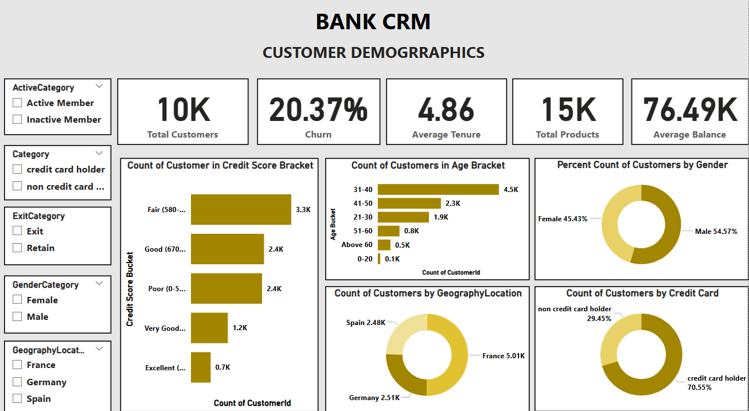
Dashboard

Slide 16
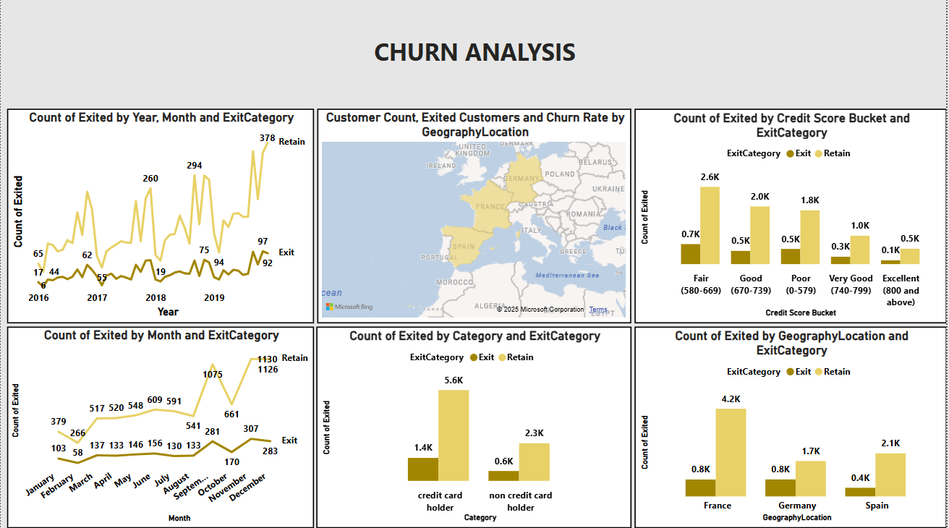
Dashboard

Slide 17
Conclusion
Customer Churn Insights
Demographic Vulnerabilities
Credit Card Ownership Impact
The overall churn rate stands at 20.37%, with significant variations across demographics, highlighting the need for targeted retention strategies.
Customers over 40 years old and female customers (60.37% churn rate) are identified as high-risk segments, necessitating focused engagement efforts.
A notable 69.91% of exited customers were credit card holders, indicating potential opportunities for cross-selling and retention initiatives.
Activity Status Correlation
Customer Churn Insights
Inactive members exhibit a higher exit rate (1302) compared to active members (735), underscoring the importance of maintaining customer engagement.
Leveraging analytical CRM tools can enhance understanding of customer behavior, enabling the bank to implement effective retention strategies and drive business growth.

Slide 18


