Slide 1

Social Media Analysis
Made by –
Prasoon Bisht

Slide 2
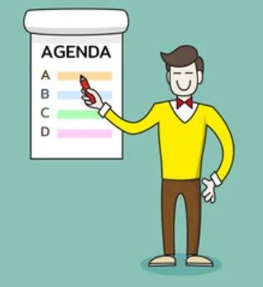
Agenda
Problem Statement
Data Description
Objective Key Metrics and Visualizations
Subjective Question for Insights

Slide 3
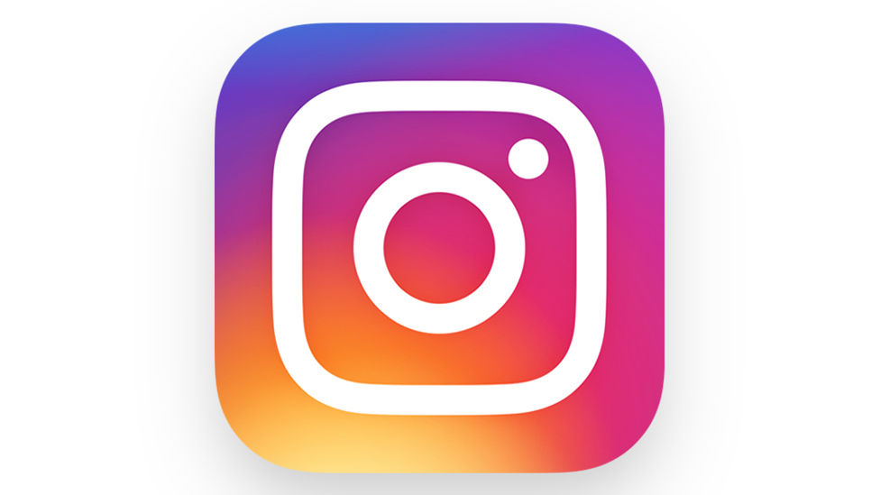
Problem statement
You are hired as a data analyst at Meta and asked to collaborate with Marketing team. Marketing teams wants to leverage Instagram's user data to develop targeted marketing strategies that will increase user engagement, retention, and acquisition. Provide insights and recommendations to address the following objectives.

Slide 4
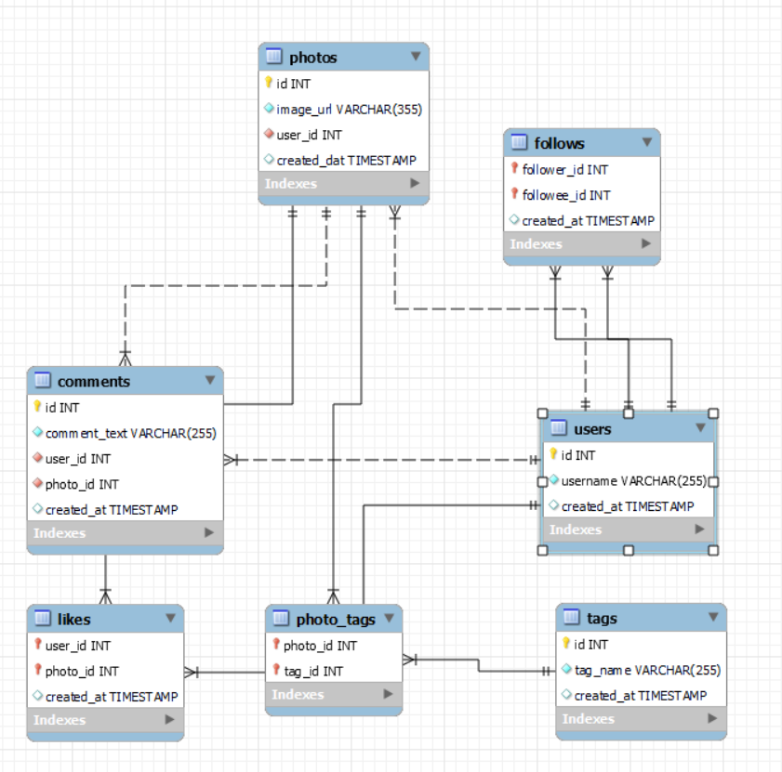
Database schema

Slide 5
Data description
comments_id : unique identifier for each comment
comment_text : text content of a given comment
user_id : unique identifier for each user
photo_id : unique identifier for each photo
created_at : date of interaction in the form like, photos, tags
follower_id : user_id of the follower for a certain user
followee_id : user_id of followee for a certain user
tag_id : unique identifier for each tag
image_url : link to the image posted on the platform
username : username chosen by the user
Data Link: Link

Slide 6
Distribution of User Activity
User activity consists of – posts, likes and comments.
The given charts show the distribution of user posts in terms of percentage of whole.
The distribution is as follows –
Low posts > Zero posts > Medium posts > High posts

Slide 7
Distribution of User Activity
The doughnut chart shows the distribution of likes.
The order of segments is as follows –
Low likes > Medium likes > Zero likes > High likes

Slide 8
Distribution of User Activity
The doughnut chart shows the distribution of comments.
The order of segments is as follows –
Low comments > Zero comments > Hight comments

Slide 9
Hashtags for Personalized and Engaging Ad Campaigns
The chart above shows the sum of count of tags used by users.
Observations –
Party is the mostly used tags by the users.
Other popular tags include food, fashion and beauty.
The least used tags are foodie and landscape.
Food and foodie are similar tags but food is used more than foodie. This can help us use tags that are popular among the users.

Slide 10
Creating more personalized and engaging campaigns by
Interest Groups:
Group users by similar tags to deliver more relevant ads.
Optimized Ads:
Use popular tags in ad messaging to make ads more engaging.
Show ads that align with users’ favorite topics (e.g., food, fashion).
Targeted Ads:

Slide 11
Hashtags for Content Strategy and Ad Campaigns
The chart shows the Top 5 hashtags that highest Engagement Rate.
The highest engagement rates mean the posts with these hashtags are getting a higher number of likes and comments than the other post.

Slide 12
How the above chart can guide content strategy and ad campaigns
Creating Targeted Content:
Tailor content around the most engaging topics. For example, content related to smile or fun (7.51%) will likely attract more interaction, boosting user engagement.
Optimizing Ads:
Incorporate high-engagement hashtags like smile and party into ad campaigns to increase relevance and attention. These tags have demonstrated strong user interest and can enhance ad performance.
Use high-engagement tags like smile (11.81%), beach (8.37%), and party (7.77%) to reach a more active audience. These topics resonate well with users and should be central to content strategy.
Focusing on Popular Hashtags:

Slide 13
Rewarding most Loyal Users
Based on user engagement and activity levels, the users listed in the chart would be considered the most loyal or valuable users as they have the highest engagement among all the users.
Accounts with 0 posts are excluded in this list as possibility of them being fake is high and these accounts can have high user activity.

Slide 14
What kind of rewards can be granted to the users
Recognition:
Publicly acknowledge top users with leaderboards or a “Top Contributors” section. Use badges or titles to highlight their achievements and motivate them to maintain their status.
Rewards:
Offer tangible rewards like gift cards, discounts, or free premium subscriptions. This provides a direct benefit for their continued loyalty and participation.
Give these users early access to new features, products, or special content. This makes them feel like valued insiders with special privileges.
Exclusive Access:
Community Influence:
Let engaged users contribute by becoming moderators or beta testers, allowing them to have a say in shaping the platform and fostering deeper connection.
Incentive Program:
Implement a system where users earn points or credits for their activity (likes, comments, posts) that can be redeemed for perks like merchandise or services, driving further engagement.

Slide 15
Strategies for Inactive Users
The chart here show the users who have no engagement or very less engagement.

Slide 16
What can be done to re-engage and encourage users to start posting or engaging again
Show them post based on their tags and most watch.
We can give them premium customers benefits of limited time if they post or increase their engagement to a certain level. That’ll surely motivate them. As who doesn’t want premium customer benefits for free.
Show them posts which have got higher number of engagement and based on that he can see what kind of tags and photos to post.
Popular Posts:
Personalized Posts:
Benefits of Engagement

Slide 17
Posting, Like and Comment Time for Targeted Marketing Campaign
Peak Engagement Times:
Afternoon (11 AM to 12 PM) and evening (4 PM to 7 PM, 9 PM and 11 PM) are high engagement periods for photos, likes, and comments.
Late-Night Activity:
Strong engagement from 1 AM to 3 AM.

Slide 18
Posting, Like and Comment Time for Targeted Marketing Campaign
Day of the Week Trends:
High activity on Tuesday and Thursday, with sustained engagement on Sunday and Monday. There is a dip on Friday and Wednesday.

Slide 19
Posting, Like and Comment Time for Targeted Marketing Campaign
Marketing Insights:
Schedule campaigns for peak times, particularly in the afternoon and evening on high-engagement days (Tuesday, Thursday, Sunday).
Use late-night activity windows with promotions or interactive content, especially early in the week and late on Wednesday.
Use weekend engagement (Saturday and Sunday) for brand awareness campaigns or targeted ads.

Slide 20
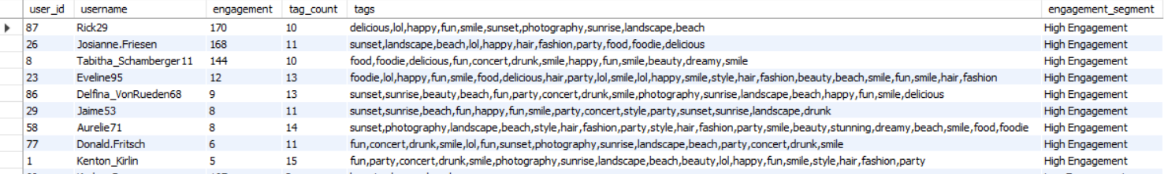
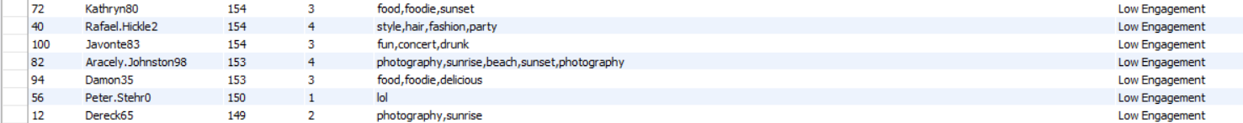
Segmenting user base for targeted marketing campaigns or personalized recommendations
The above table is a snippet of our data that shows users with engagement, tags count and tags used with engagement segment.
This will help us identify tags used in the highest and lowest engagements.
We have also segmented the user base on the engagement (High, Moderate and low). This will be helpful for targeted marketing campaigns or personalised recommendations.

Slide 21
How to segmentation for targeted marketing campaign and personalized recommendations based on user behavior and engagement rates
Less active users with minimal interactions and fewer tags, requiring targeted re-engagement strategies or incentives.
Leverage users' tag preferences (e.g., food, photography) to create personalized campaigns or product recommendations, aligning content with user interests for better engagement.
Active users with high interaction and diverse tag usage, ideal for personalized recommendations, rewards, or influencer campaigns.
High Engagement Users:
Low Engagement Users:
Tag-Based Segmentation:

Slide 22
Ideal Candidate for Influencer Marketing based on Engagement Rate
The chart shows ideal candidate for influencer marketing.
Weighted Score is calculated adding 60 % engagement rate and 40 % followers.
The users shown on the chart have the highest weighted scores.

Slide 23
How to approach and collaborate with these ideal candidates
Offer Mutual Benefits:
Provide clear compensation (monetary, free products, or exclusive access) and emphasize the potential for long-term partnerships.
Encourage Creative Freedom:
Allow influencers to create authentic content that resonates with their audience while setting clear deliverables and expectations.
Tailor messages by researching the influencer's content, highlighting shared values, and emphasizing why they’re a good fit for the campaign.
Personalize Outreach:
Maintain Communication:
Keep open lines for feedback and collaboration throughout the campaign.
Evaluate and Appreciate:
Track campaign success, share results with the influencer, and celebrate their contribution to foster lasting relationships.

Slide 24
Recommendations
Personalized Engagement
Reward high-engagement users with exclusive access, badges, and recognition to maintain loyalty, while offering time-limited incentives to re-engage inactive users.
Optimized Content Strategy
Focus on popular hashtags like smile, party, and beach, scheduling posts during peak times (afternoons and evenings) on high-activity days (Tuesday, Thursday, Sunday).
Influencer Collaboration:
Approach influencers with personalized outreach, offering mutual benefits like exclusive products or compensation, while giving them creative freedom in campaigns.
Targeted Ads & Campaigns:
Use tag-based segmentation to create relevant, targeted ads and content that aligns with users’ interests (e.g., food, fashion), leveraging high-engagement hashtags.
Loyalty & Reward Programs
Implement a points or rewards system to incentivize user activity, offering tangible rewards like gift cards, discounts, or premium features to drive further engagement.

Slide 25
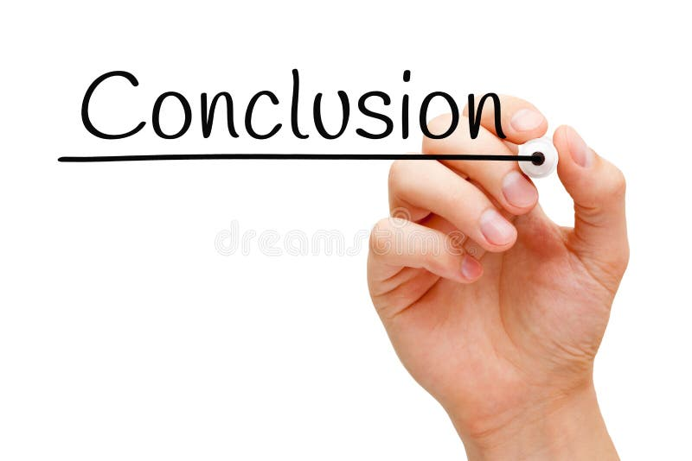
User Engagement: Most users fall into Low Likes (33%), Low Posts (53%), and Low Comments (64%) categories, while High Likes (13%), High Posts (4%), and High Comments (13%) have the least engagement.
Popular Tags: Tags like party (11.81%), food, fashion, and beauty are most used, while foodie and landscape are least used.
Targeted Ads: Ads should focus on high-engagement tags like smile (11.81%), beach (8.37%), and party (7.77%) during peak times—afternoon (11 AM - 12 PM) and evening (4 PM - 7 PM, 9 PM - 11 PM).
Loyal User Incentives: Reward loyal users with exclusive access, leaderboards, or tangible rewards, targeting those with posts > 0 to avoid fake accounts.
Re-engagement: Re-engage 26% zero-post users with personalized content and premium benefits for increased activity.
Influencer Strategy: Focus on influencers with a 60% engagement rate and 40% follower count for optimal collaboration.

Slide 26
