Slide 1
Exploratory Data Analysis - Cars

Slide 2
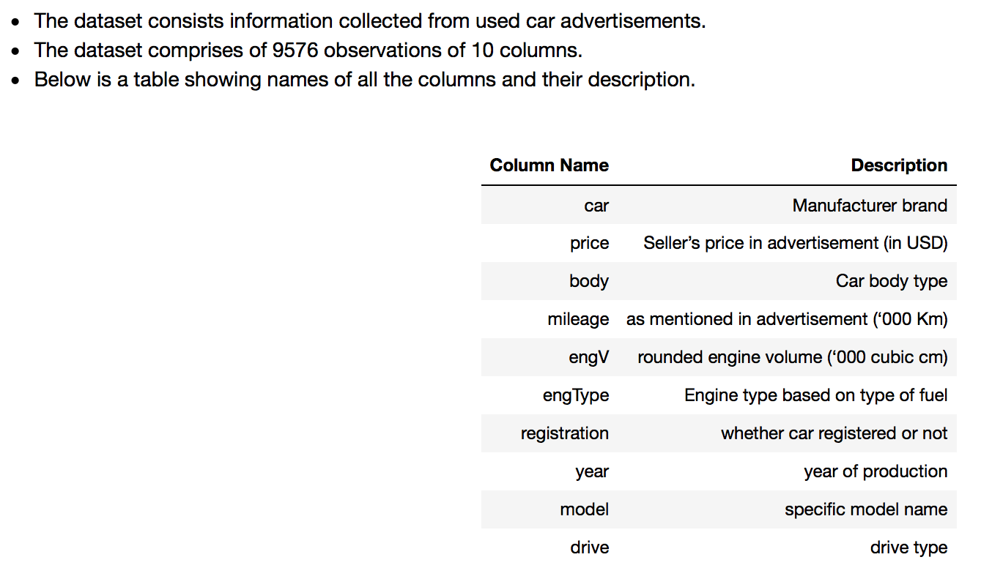
Data Set Description

Slide 3
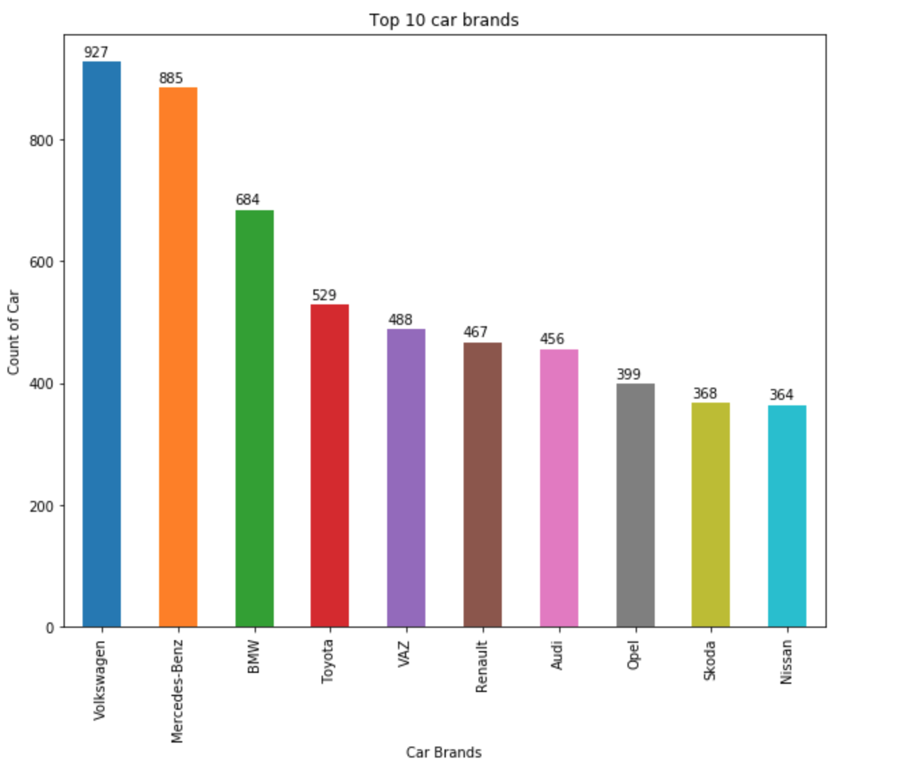
What is the market share of car brands in this market based on volume and revenue?

Slide 4
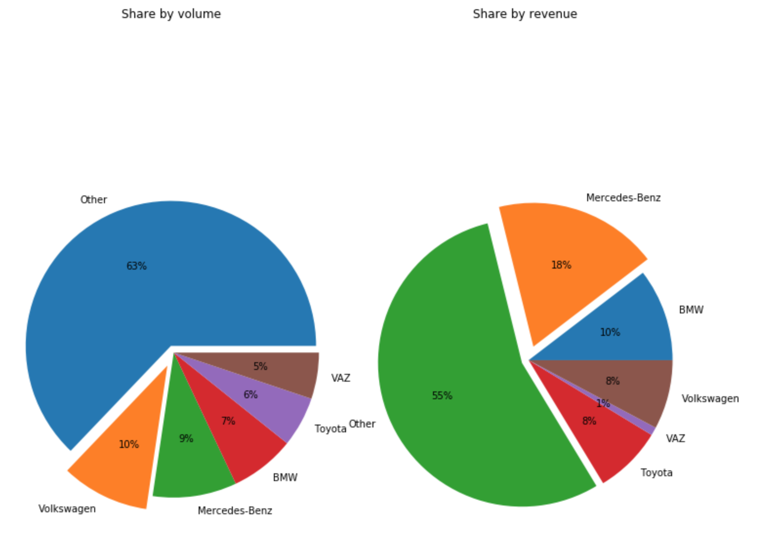
Which are the top 5 most available/sold car models in this market?

Slide 5
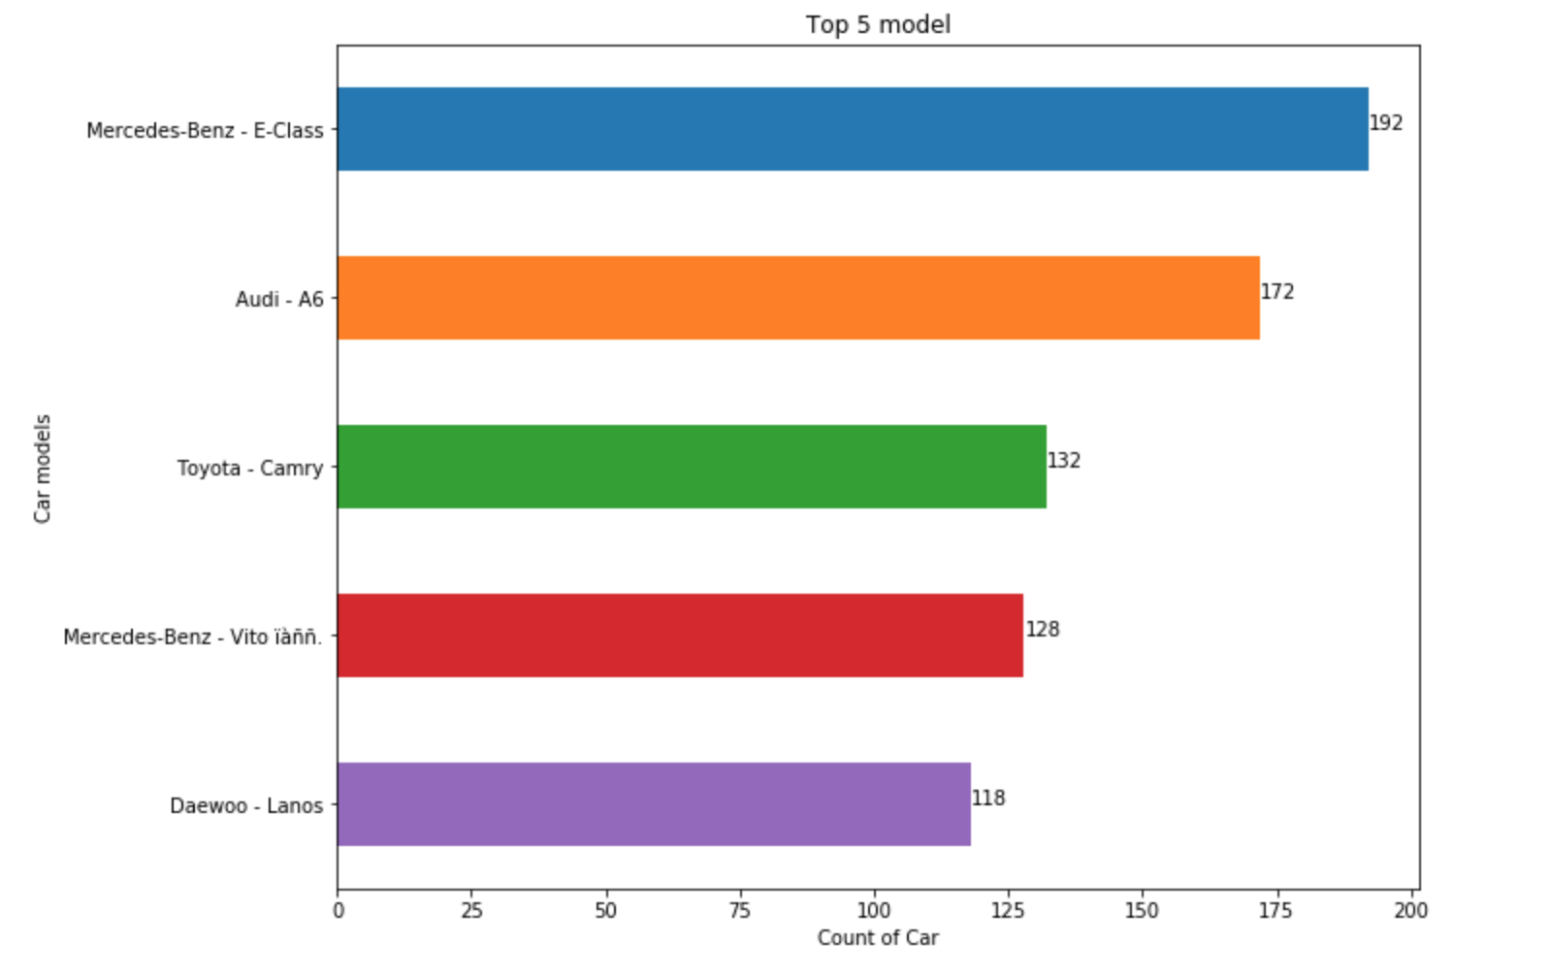
Which are the top 5 most available/sold car models in this market?

Slide 6
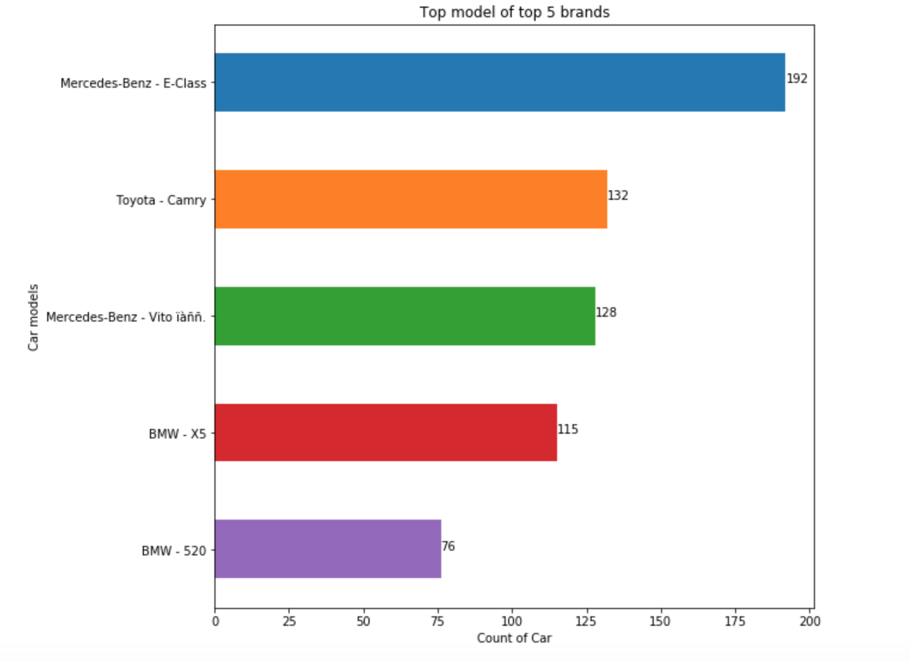
Out of the top 5 brand of cars, Which are the top 5 models most available/sold in this market?

Slide 7
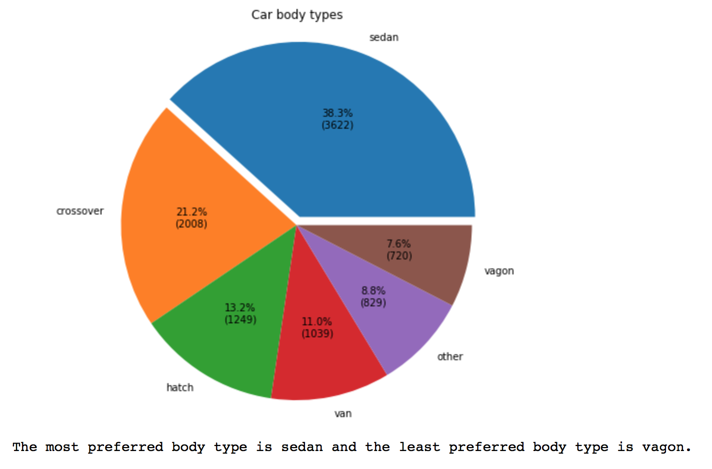
Which are the most and least available/sold/preferred car body type in this market ?

Slide 8
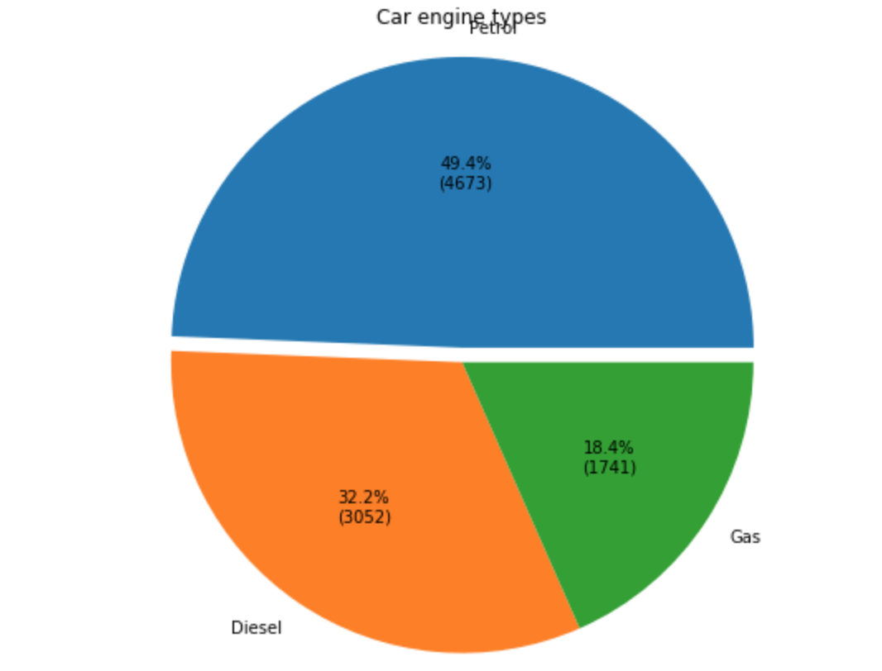
Which are the most and least available/sold/preferred car engine type in this market ?

Slide 9
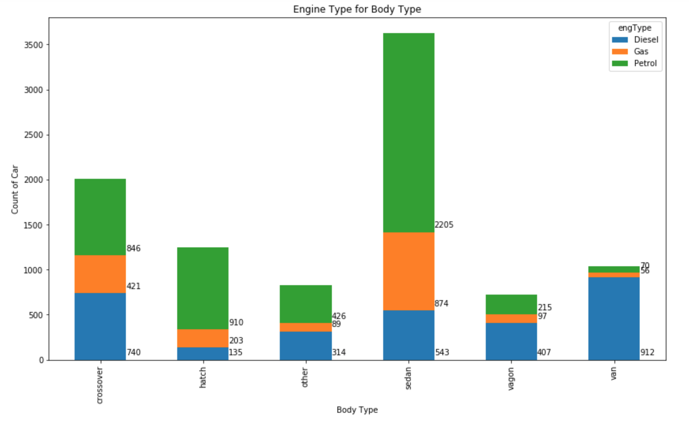
How is the car engine type distributed in each body type ?

Slide 10
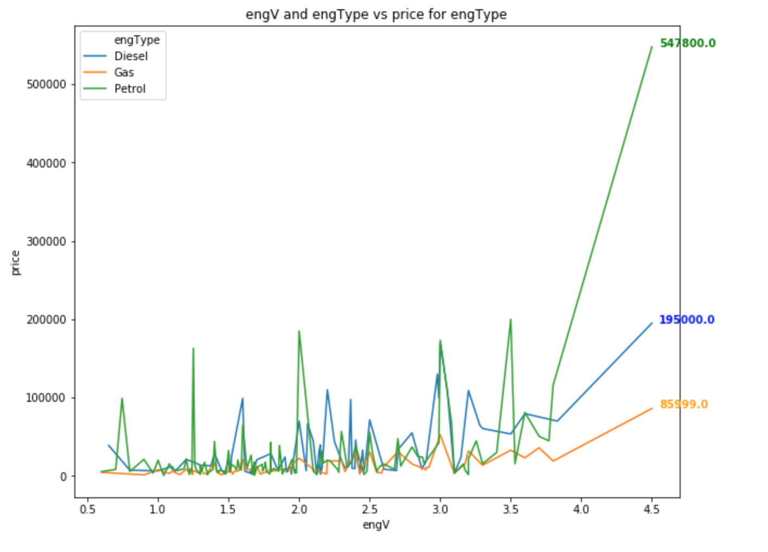
engine type and engV vs price, which kind of engine is more expensive ?

Slide 11
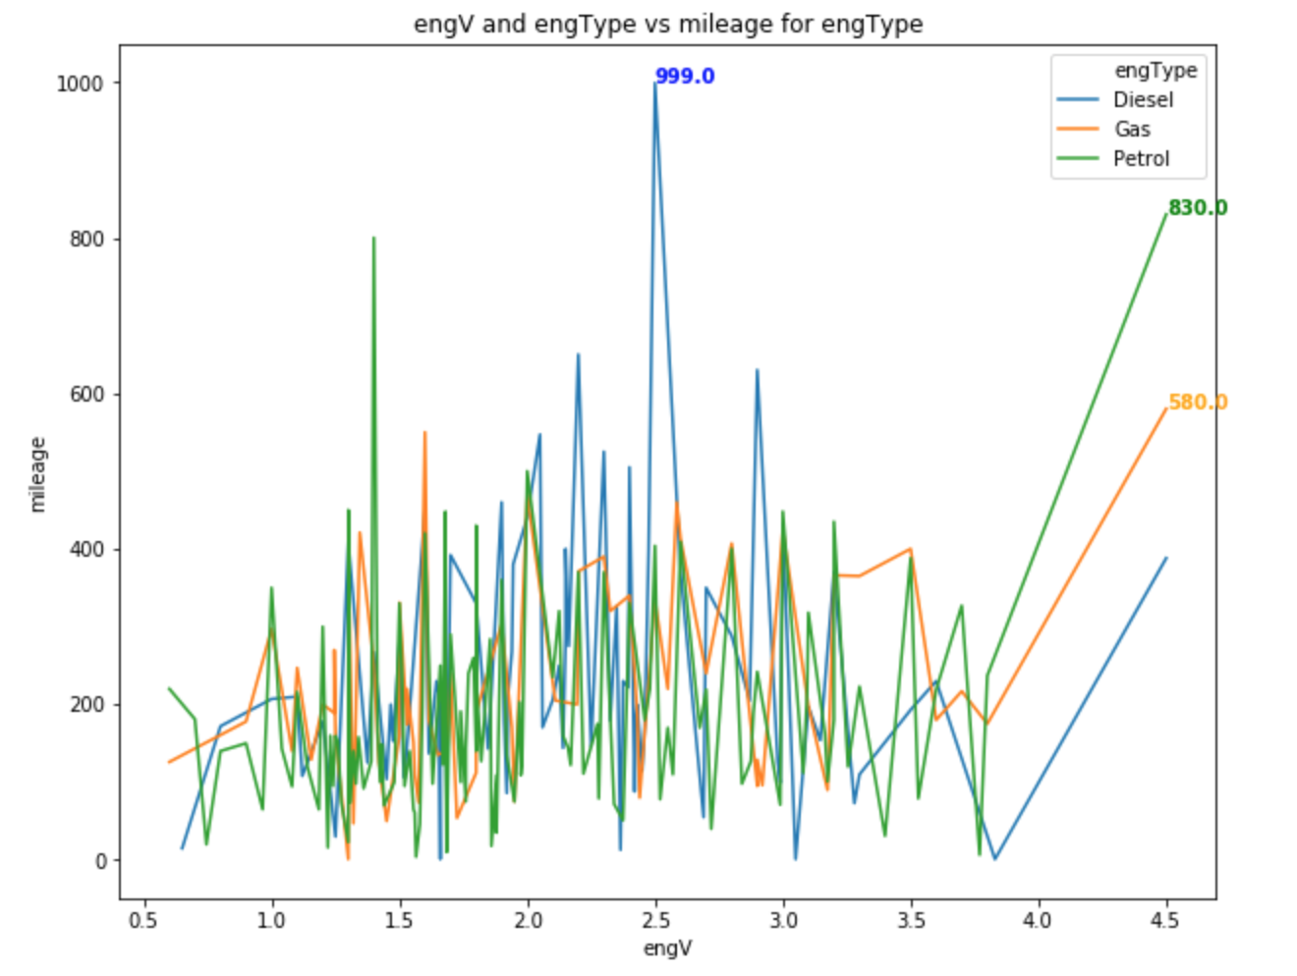
engine type and engV vs mileage, which kind of engine has best mileage ?

Slide 12
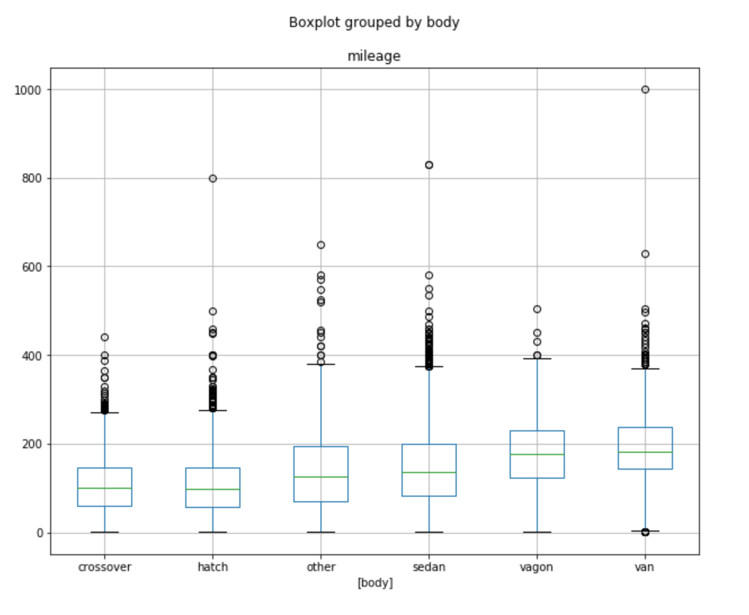
body vs mileage, which kind of body has best mileage ?

Slide 13
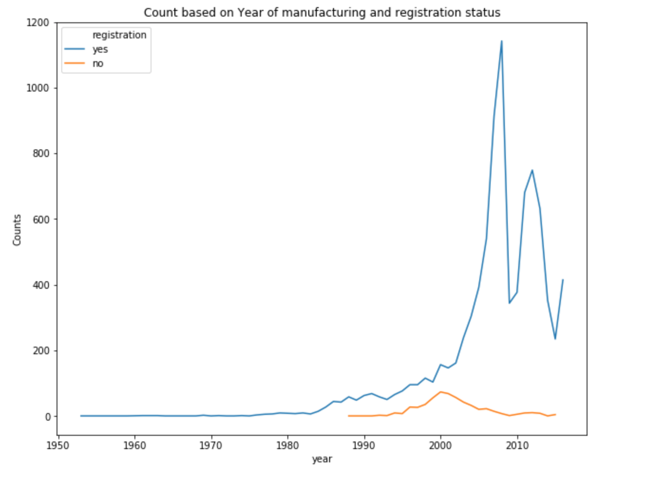
Which year cars are most available/sold and what is their registration status ?

Slide 14
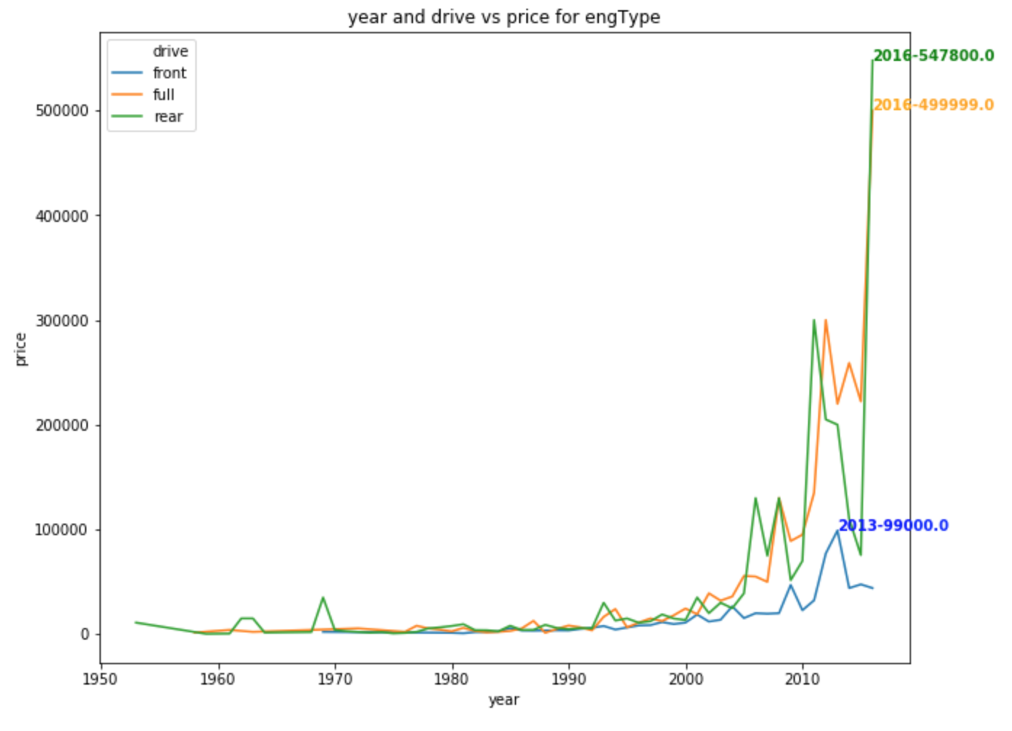
What is the price range of cars based on the year of manufacturing and drive type?

Slide 15
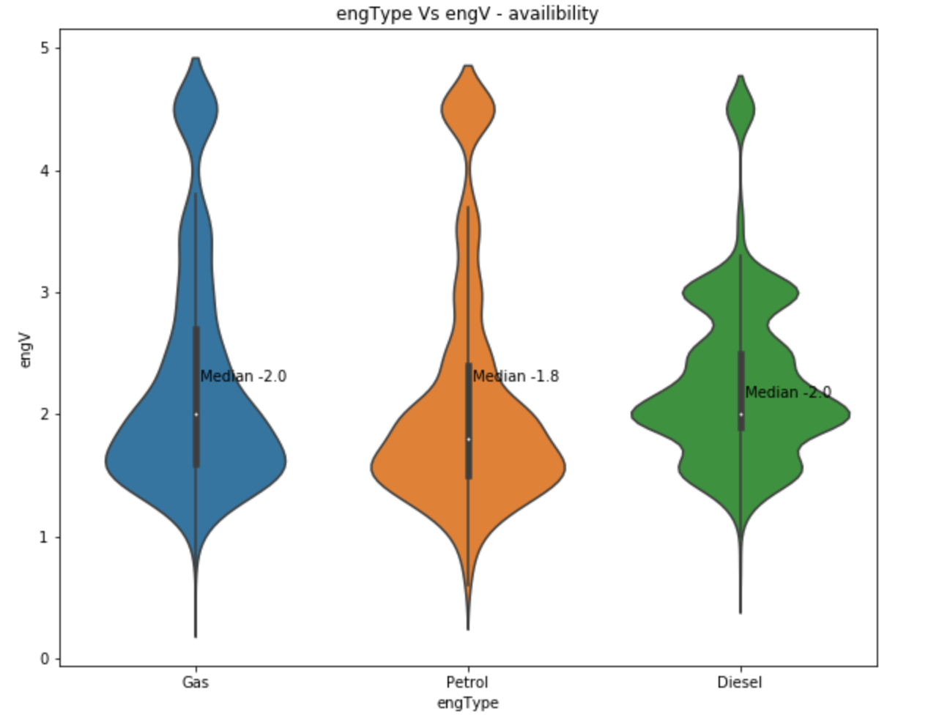
engine types distribution based on engine volume

Slide 16
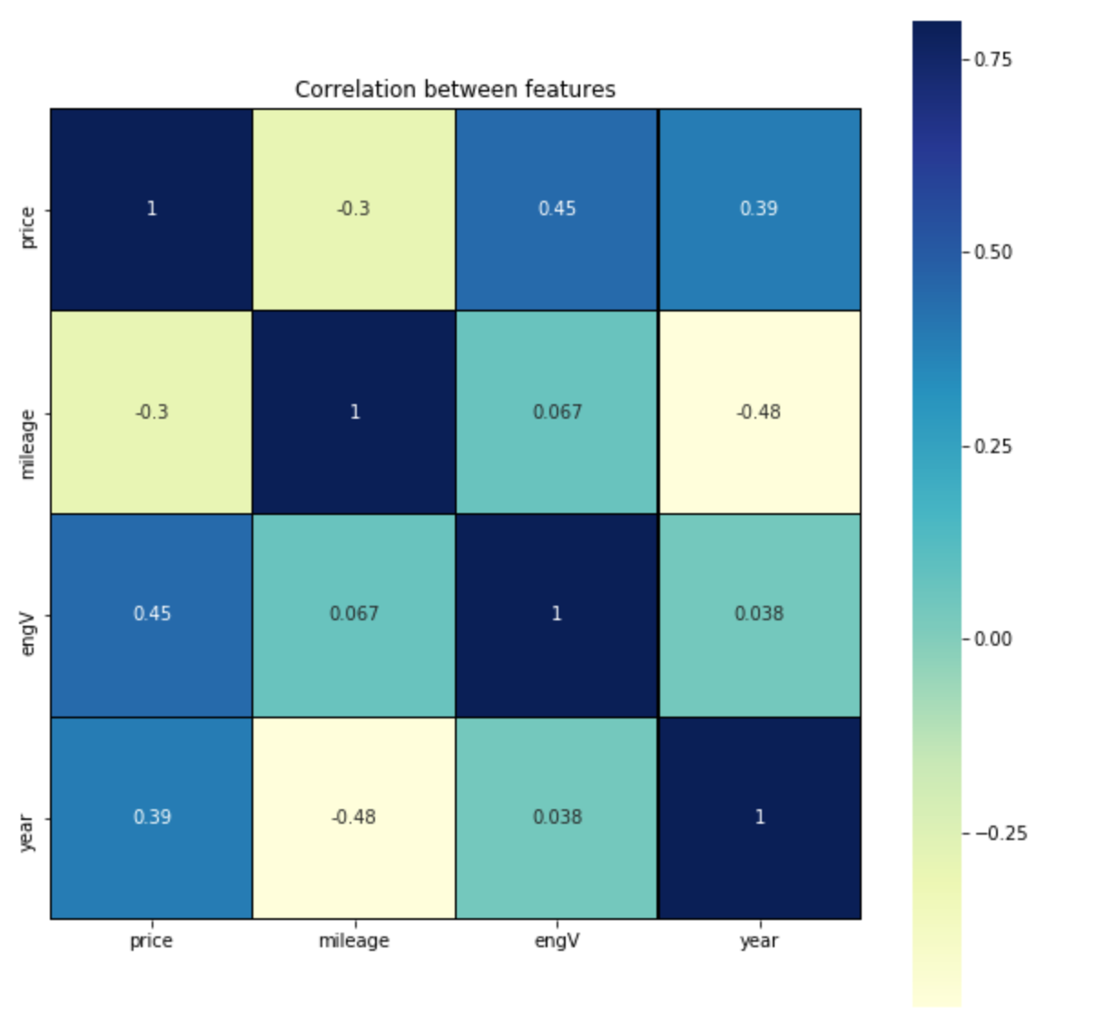
correlation between all the features

Slide 17
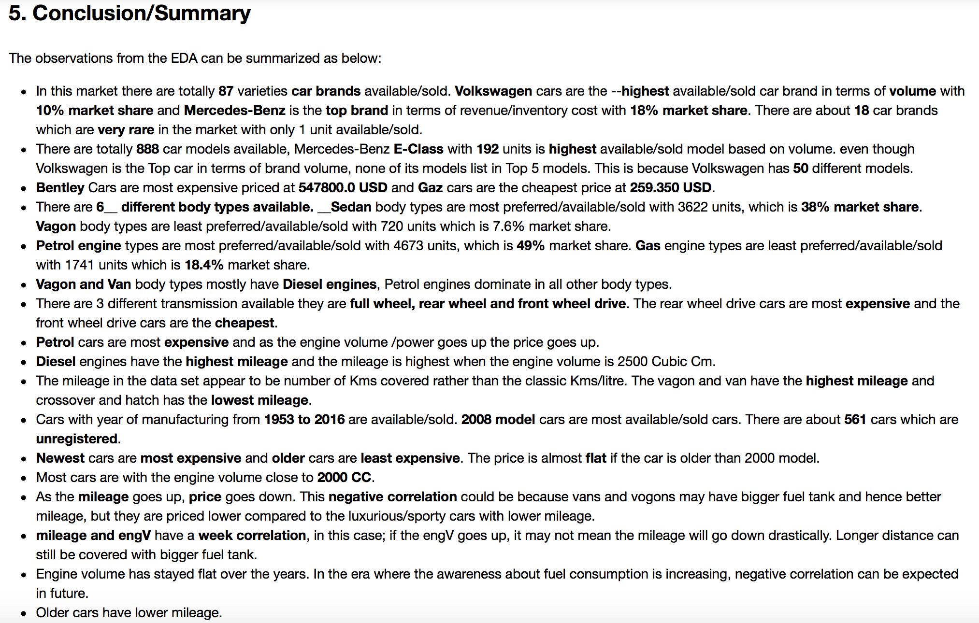

Slide 18
Thank You

