Slide 1
Apple Stock Price Prediction
Forecasting Apple's closing prices for the next 30 days using historical stock data.

Slide 2
Introduction
Predicts Apple's stock closing prices for the next 30 days using historical data from 2012–2019.
Helps investors, traders, and analysts make data-driven decisions.

Slide 3
Objectives
1. Build a time series forecasting model.
2. Analyze short-term and long-term trends.
3. Study impact of external events on stock prices.
4. Evaluate models such as ARIMA, SARIMA, XGBoost.
5. Deploy model via Streamlit for real-time predictions.

Slide 4
Dataset & Attributes
• Date: Trading date
• Open: Opening price
• High: Highest price of the day
• Low: Lowest price of the day
• Close: Closing price
• Volume: Shares traded
Target: Next 30-day Close Price Forecast

Slide 5
Modeling Approach
• Data Preprocessing: Handle missing values, normalization.
• EDA: Trends, seasonality, volatility.
• Feature Engineering: Moving averages, volatility measures.
• Model Selection: ARIMA, SARIMA, XGBoost, Random Forest.
• Hyperparameter tuning via Grid Search & Cross-validation.

Slide 6
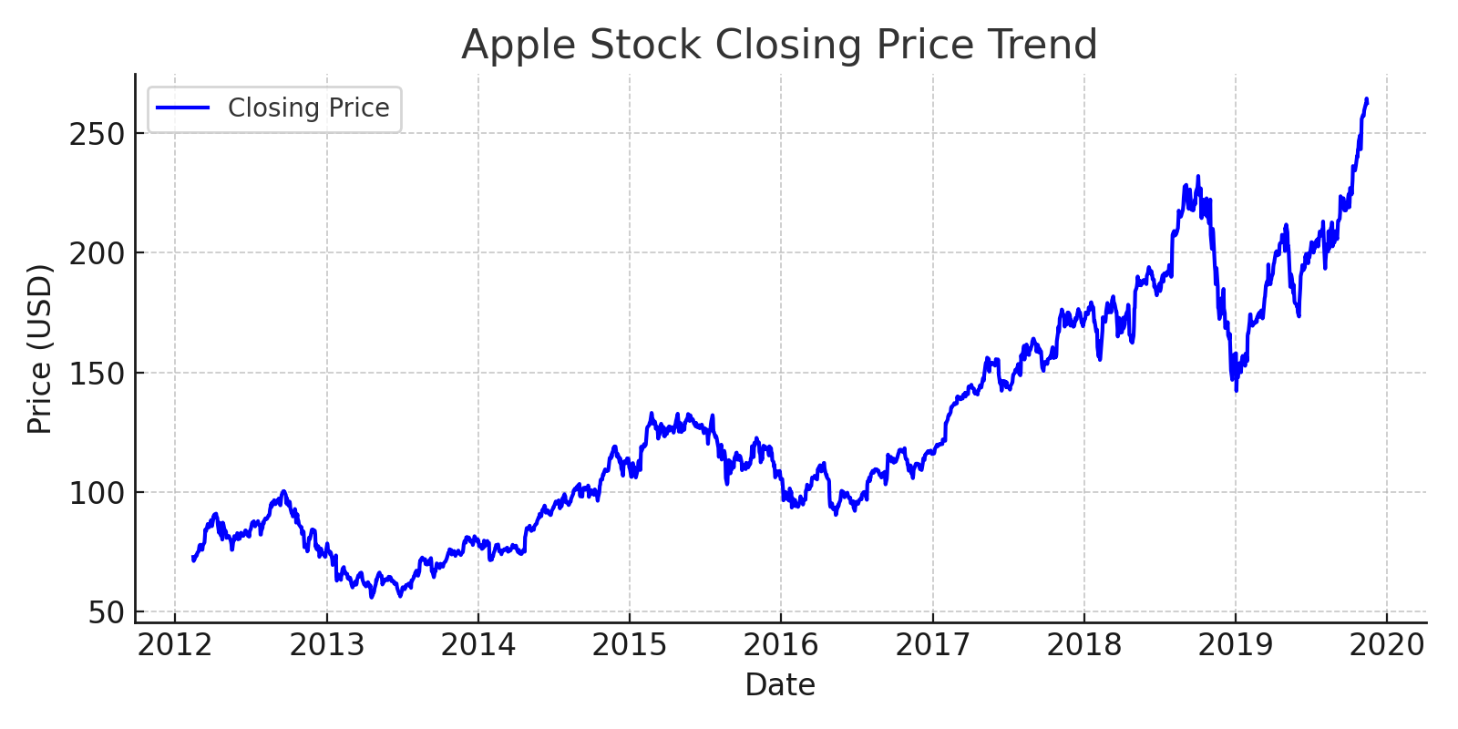

Slide 7
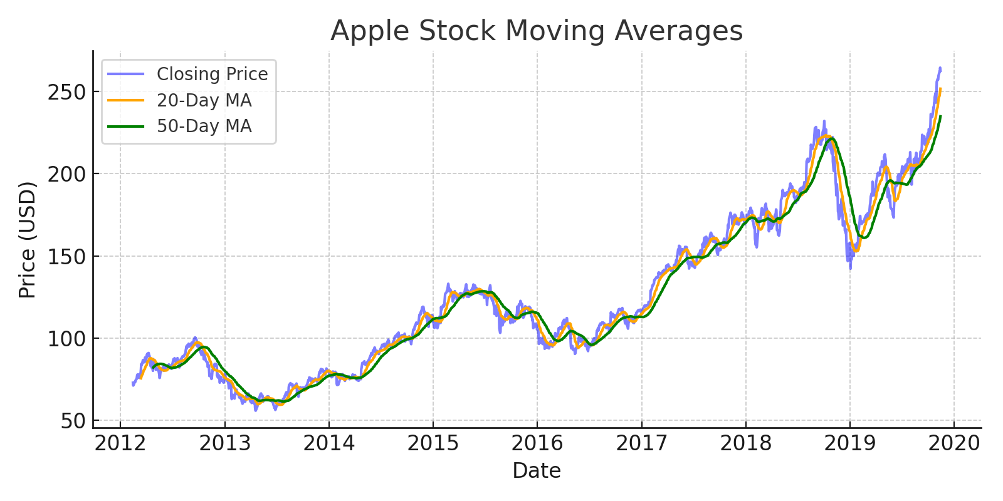

Slide 8
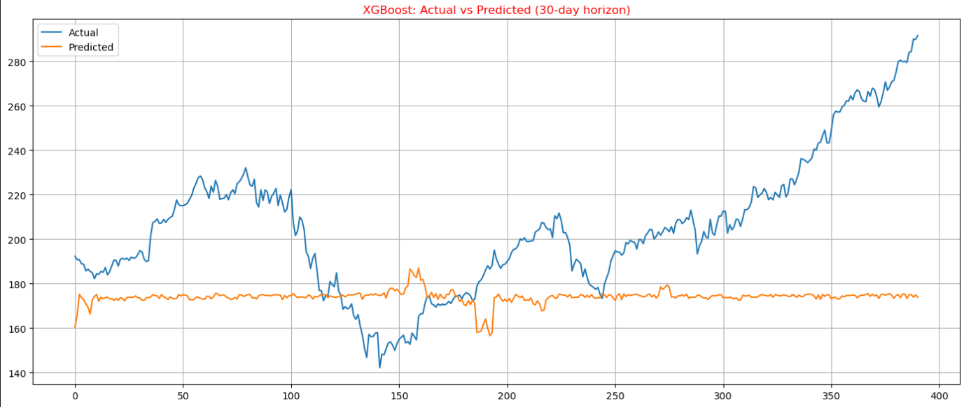

Slide 9
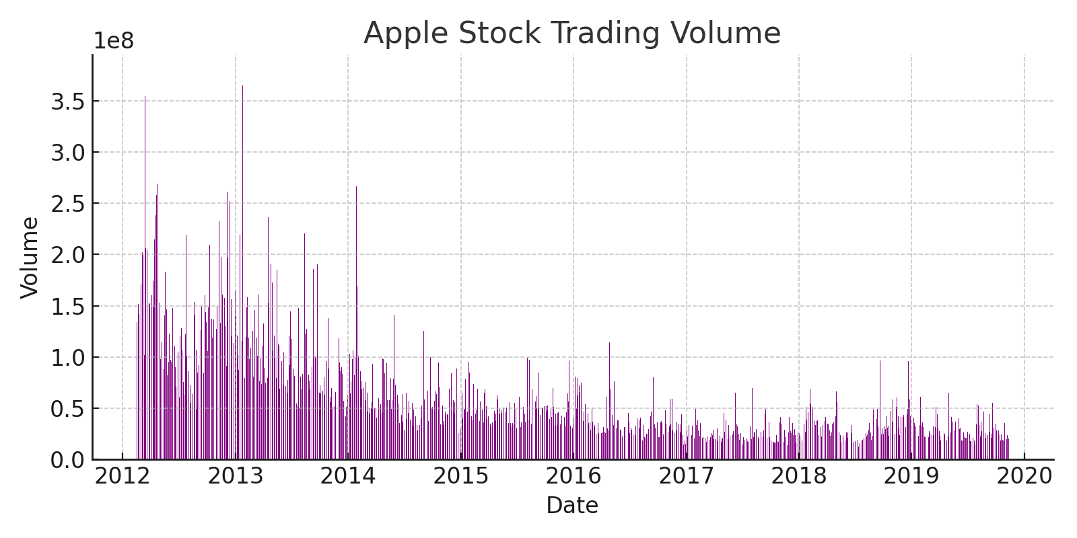

Slide 10
Deployment Plan
• Streamlit web app for predictions.
• Users upload CSV with Date, Open, High, Low, Close, Volume.
• Model predicts next 30-day closing prices.
• Interactive charts show trends and forecasts.

Slide 11
Team Members
Puneet Kumar
Pragati Gupta
Pankhuri Sharma
Muhammed Shanaf P
Swati
Shashi Kumar K
Kommiri Prasanna Kumar

