Slide 1

Applying Iterative Design Principles to a Live Product
Name: Prashant Kumar
Date: 07/25/2020

Slide 2
Step 1
Select KPIs
&
Evaluate Previous Multivariate Experiment Results

Slide 3
Select KPIs for Flyber Analyses
For the data available, which KPI(s) best match Flyber’s business model?
Most affected age group
Increment in customer by region
Frequency of visit of a customer
How would you calculate these KPI(s) using the available event data logs?
Most affected age group- In order to find the increase/decrease in different age group for different experiments, I will find out percentage of each age group of people who are going for experiment_1, experiment_2 or experiment_3.
Increment in customer by region- Here I will try to find out involvement of users of different user in different experiment as compared to control . We will try to find which experiment led increase in customer involvement in which region.
Frequency of visit of a customer-The main motive of this KPI will be find user involvement with different experiments(experiment_1, experiment_2 or experiment_3) as compared to control. We will watch closely, which experiment led increase in user involvement percentage and which had an adverse effect.
List other KPIs that might be important to Flyber but are not calculable based on available data
Some other KPIs which could be useful are:-
The device used (Laptop, Mobile, Tablet etc.)
The number of users who sign up.
Do users tell others(referal)

Slide 4
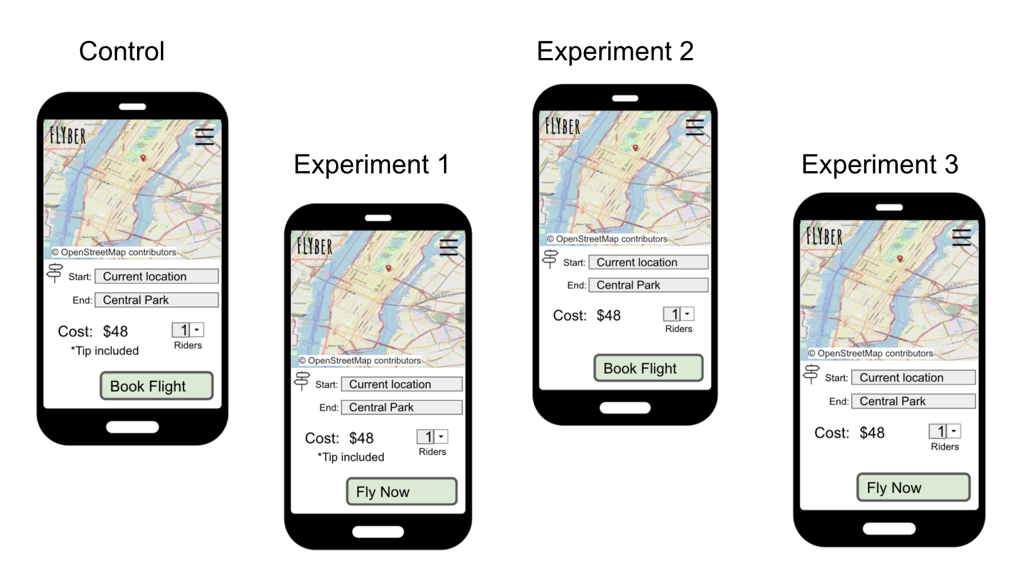
Describe the First Multivariate Experiment
Describe the elements tested during the multivariate experiment. You can use the image below when referencing the tests
We use multivariate experiment when we wish to test more than one change at once.
In the experiment below the element tested are:-
In experiment_1 we are testing whether the button should contain word “Book flight” or “fly Now”.
In experiment_2 we are checking whether to add “Tip included” on the UI or not.
In experiment_3 we are testing whether to add “Tip included” on the UI or not. And also whether the button should have text “Book Flight” or “Fly Now”

Slide 5
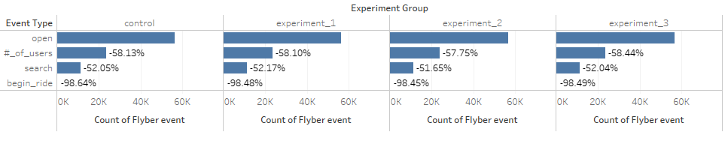
Review Multivariate Test Results: Visualization
Provide a visual representation of the impact of the experiment on the conversion rate of users booking a flight (out of all users opening the app)

Slide 6
Review Multivariate Test Results: Significance Test
Determine if there was a significant difference between the experiments and control states.
Explain how you would perform a t-test to determine if the experimental results had a greater impact on the booking conversion rate than the control state
In order to perform the t-test, we will first make hypothesis
Null hypothesis:- Customer do not convert better with the test state as compared to control state.
Alternative hypothesis:- Customers will convert differently with the test state.
Confidence interval:- 95% confidence
P- value < 0.025, difference is statistically significant, the null is rejected.

Slide 7
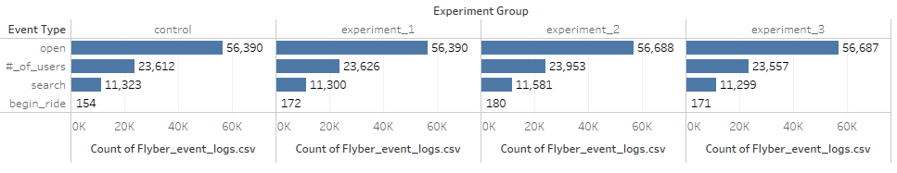
Review Multivariate test results(Continued)

Slide 8
(Continues)
List the test results (p value) for each experiment compared to the control
The p value for different tests are:-
Experiment_1:- 0.1590
Experiment_2:- 0.0843
Experiment_3:- 0.1848
Using the statistical significance calculator of your choice, determine which experiments, if any, had a significant result at the 95% level. Include your calculations as part of your explanation

Slide 9
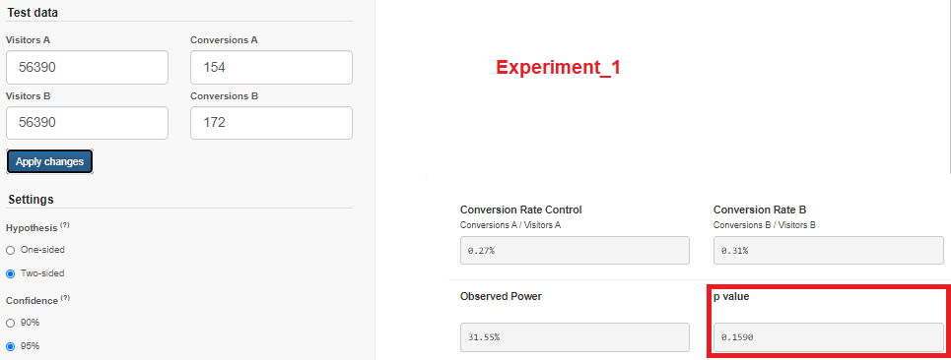

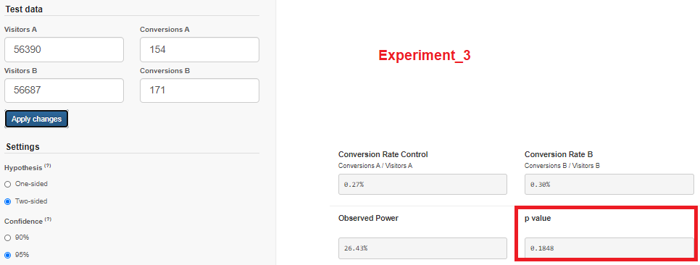

Slide 10
(Continued)
Based on your statistical significance calculations, recommend if any of the experiments should be expanded
Based on the value obtained in different experiments we can conclude that:-
p_ value experiment_1= 0.1590 > 0.025 (null is accepted)
p_ value experiment_2= 0.0843 > 0.025 (null is accepted)
p_ value experiment_1= 0.1848 > 0.025 (null is accepted)

Slide 11
Step 2
Funnel & Cohort Analyses

Slide 12
User Funnel
Identifying the different stages the user funnel
Based on the event types in the data provided, list the 3 or more steps a user can take from opening the app to final booking of a ride
The steps which may be taken by the user are:-
Open
#_of_Users
Search
Begin ride

Slide 13
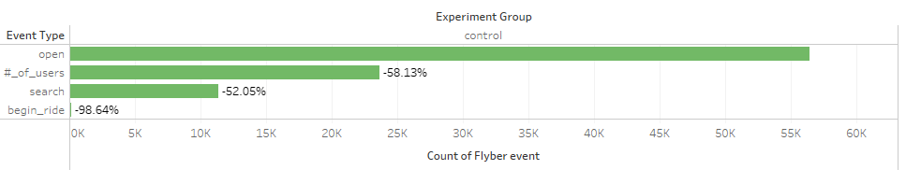
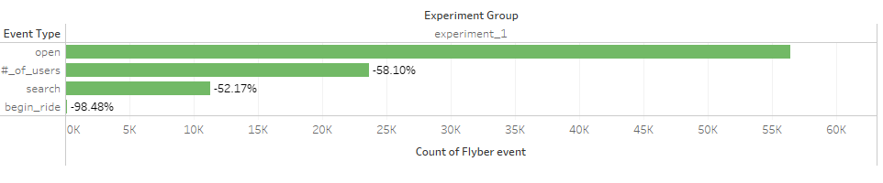

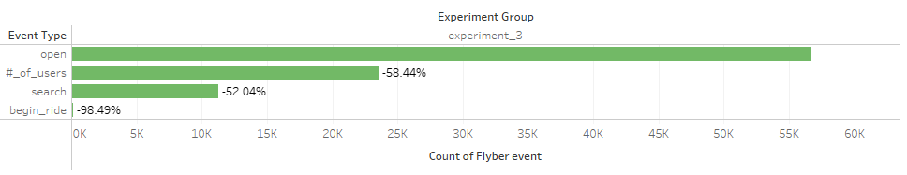
(Continued)
Provide a graph showing the funnel from step to step, including drop off rates.

Slide 14
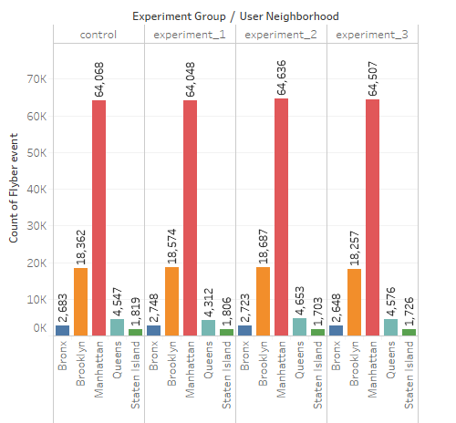
User Segments
Identify 2 demographic attributes present in the data that allow for segment analysis
The 2 demographic attributes present in the data are:-
User Neighbourhood
Age
For each demographic attribute, provide the number of users in each segment group:-
User neighbourhood:-

Slide 15
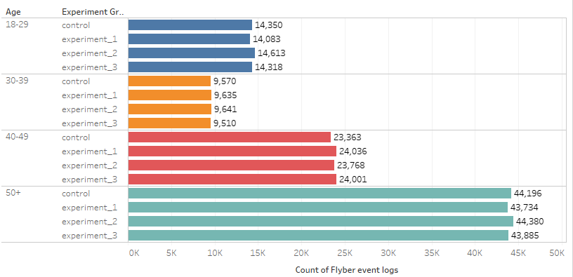
User Segment(Continued)
Age:-

Slide 16
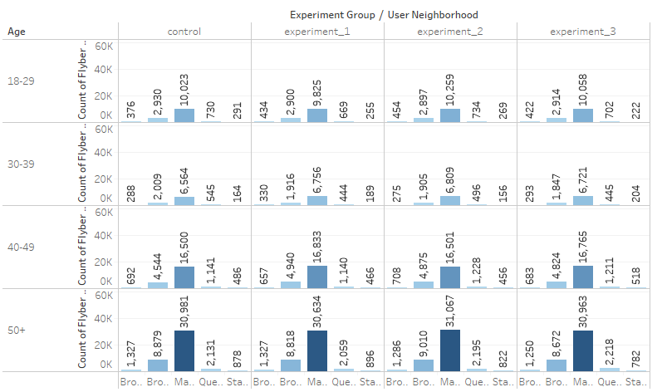
User Segment(continued)
For each demographic attribute, identify the segment group with the largest number of users

Slide 17
(Continued)
For experiment_1
Manhattan:- Has highest user(30, 634) for age group 50+
Brooklyn:- Has highest user(8818) for age group 50+
Bronx:- Has highest user(1327 for age group 50+
Queen:- Has highest user(2059) for age group 50+
For experiment_2
Manhattan:- Has highest user(31, 067) for age group 50+
Brooklyn:- Has highest user(9010) for age group 50+
Bronx:- Has highest user(1286) for age group 50+
Queen:- Has highest user(2195) for age group 50+
For experiment_3
Manhattan:- Has highest user(30963) for age group 50+
Brooklyn:- Has highest user(8672) for age group 50+
Bronx:- Has highest user(1250) for age group 50+
Queen:- Has highest user(2218) for age group 50+

Slide 18
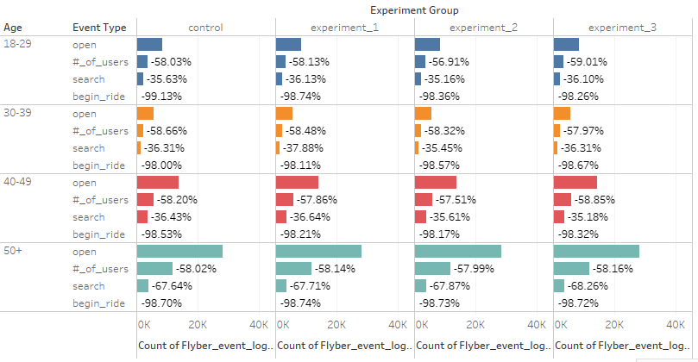
Segment Analysis of Funnel
Identify Opportunities for Improvement
Perform a funnel analysis by segment for all identified demographic attributes and describe the results
Age:- For age group 50+, there is huge drop from #_of_Users to begin_ride stage.

Slide 19
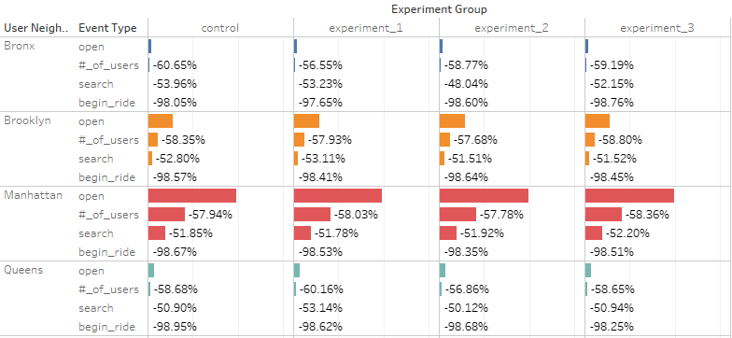

Continued
User Neighbourhod
Staten Island has least number of people entering the Island
For Brooklyn, Experiment_1 has the least funnel drop off.
Experiment_2 shows great reduction in funnel drop of for Staten Island.

Slide 20
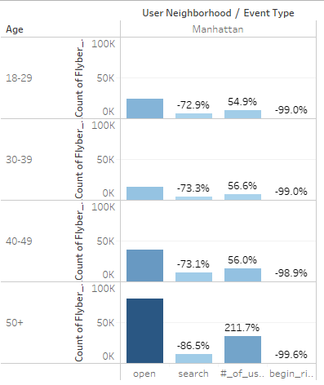
Segment Analysis of Funnel(Continued)
If underperformance for a segment in an attribute is identified, add a visual showing the average funnel conversion by segment group for that demographic
For “manhattan” we can find that there is huge decrease from open event to search event and also from #_of_user to begin ride. Also this is seen for age group 50+

Slide 21
Step 3
Hypothesis & Next Steps

Slide 22
Review Qualitative Data
Read user interviews to understand “why” any funnel under-performance seen in Step 2 might occur
From the interviews it was found:-
There are still people who call a taxi service on the phone..
There are people who take uber thinking to save money.
There are people who are always on the phone, so they just use voice commands to make a booking
Some people found this difficult to follow the instructions.
List your hypothesis for what customer need is being under-served
Customers need better phone(voice command) support
We need to make rides cheaper as much as possible.
Need to make flyber service as comfortable as their private vehicle.
App instructions need to be more User friendly

Slide 23
Review Qualitative Data(continued)
Provide 3 or more quotes as evidence for this hypothesis
I just hail a taxi or tell my phone to call a cab to go to a certain address (I'm always on the phone, so I just use voice commands with my phone most of the time)
If the timing isn't different, I'll take a taxi or uber to save money.
Before Flyber, I'd call a taxi service on the phone.
I have a personal car service on call. My assistant books Flyber whenever I'd be travelling during peak NYC traffic hours. Time is money and Flyber saves me time! But I let my assistant actually book the Flyber because the first few times I tried booking, the instructions were too small.
Drive my car or call a taxi service.

Slide 24
Suggested Features & Experimentation Plan
Share your hypothesis using the following format: We believe [observed quantitative effect] Because [hypothesized user “why”] And that by [general change/opportunity for Flyber to improve] for [targeted cohort] we will see [expected effect ]
We believe providing better voice command support will have better response because there are people who are always on call and they prefer call service and so we will see rise in ride numbers of such Customers who need better phone(voice command) support.
We believe having some cheaper plans for daily people who prefer to to use flyber on daily basis will have better response because there are people who find the fair too high so we will see rise in ride numbers for Customers who are regular.

Slide 25
Suggested Features(Cont.)
Suggest 2 or more features that would match your hypothesis and determine a plan for multivariate testing, including describing the control and experimental conditions
Including *booking a ride instructions
Having some discount code.
To plan a multivariate testing, we will record how many people tap on “discount code” link and if given percentage increase in ride booking numbers.
Determine who should be exposed to the experimental changes
Those people should be exposed to the experimental changes who leave the funnel just after making a search i.e just before making a booking.
List any additional metrics that would be helpful to collect from your suggested features
Increase in conversion rate
Frequency of visit of a customer.

Slide 26
Appendix
Raw Data

Slide 27
Additional Info
You could include supporting or additional information that can support your previous slides but isn’t necessary for every person to see that looks at your slides.

