Slide 1

Bank Account and Transaction Management System
DBMS COURSE PROJECT | PRESENTATION
PIVM Bank
Project 55 | Group 3 | Class: CSE Rhinos
Prasanna Kollu
Pareddy Ishanth Reddy
Mitul Saraswat
Vishnu Mirapa
25WU0101101
25WU0101093
25WU0101073
25WU0101071
Notes:
Introduce the project and the team. About 15 seconds.

Slide 2




Problem Description
OBJECTIVES
PROBLEM STATEMENT
Digitise account opening with admin approval
Manual banking records are error-prone, slow to approve and hard to audit. Customers need one reliable system to open accounts, move money and see exactly what happened.
Record every deposit, withdrawal and transfer
Guarantee consistency with atomic transactions
INTENDED USERS
Secure role-based login and PIN authorisation
Customers
Bank administrators
In scope: accounts, deposits, withdrawals, username transfers, statements, admin approvals.
Out of scope: loans, cards, interest, other banks.
Notes:
About 1 minute. Title, problem statement, objectives, scope and intended users.

Slide 3
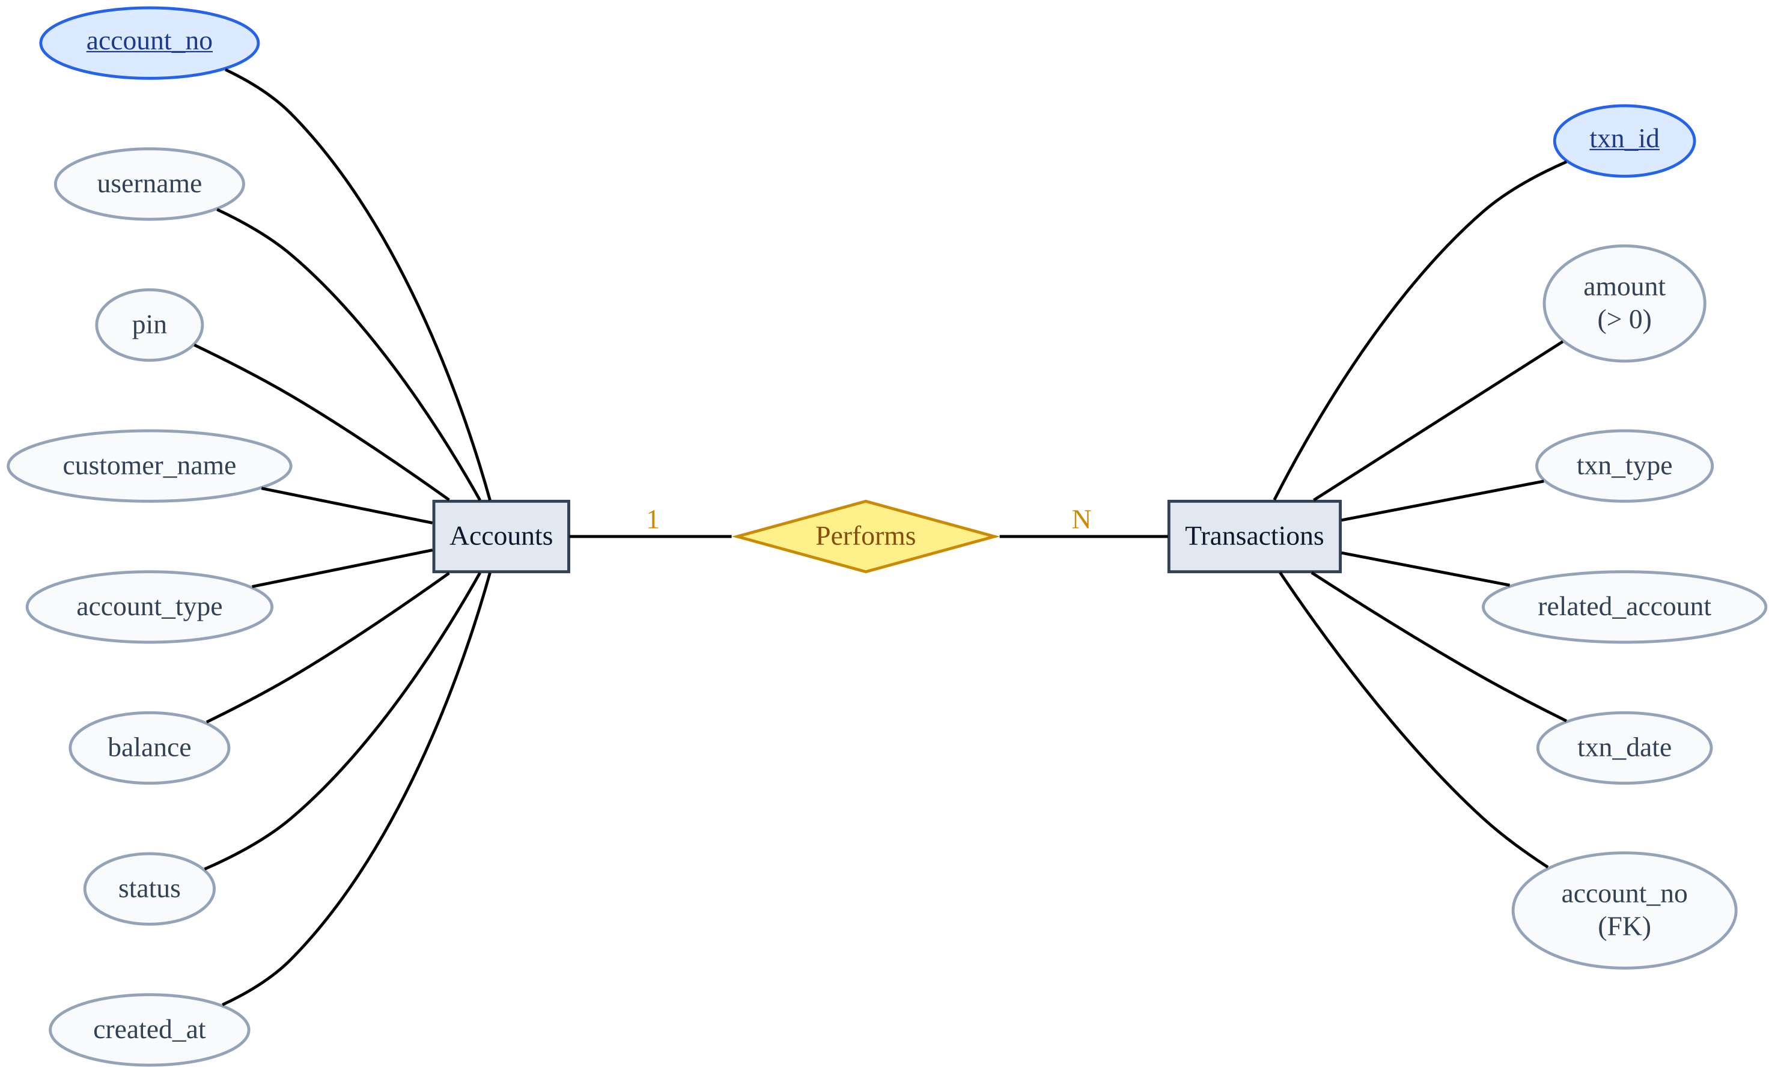
ER Diagram
1 : N
One account performs many transactions
PK
Underlined blue ovals are primary keys
FK
account_no in Transactions links back to Accounts
Notes:
About 1 minute. Two entities with a 1:N relationship (Performs). Underlined attributes are primary keys; account_no in Transactions is the foreign key. related_account holds the counterparty account for transfers.

Slide 4
Relational Schema and 3NF
accounts
transactions
account_no PK
username UNIQUE
pin
customer_name
account_type
balance
status
created_at
txn_id PK
account_no FK -> accounts
txn_type
amount
related_account FK -> accounts
txn_date
1NF
2NF
3NF
Atomic values only, no repeating groups, and every row is uniquely keyed.
Primary keys are single columns, so no partial dependency can exist.
No transitive dependency: every non-key column depends only on the key.
Notes:
About 1 minute. Show the relational schema with PK/FK, then justify 1NF, 2NF and 3NF. Each customer holds one account in this system, so customer details live with the account.

Slide 5
Database and Table Creation
CREATE TABLE accounts (
account_no INT AUTO_INCREMENT
PRIMARY KEY,
username VARCHAR(30) NOT NULL
UNIQUE,
pin CHAR(4) NOT NULL,
customer_name VARCHAR(80) NOT NULL,
account_type ENUM('Savings','Current'),
balance DECIMAL(12,2) DEFAULT 0
CHECK (balance >= 0),
status ENUM('Pending','Active')
DEFAULT 'Pending',
created_at TIMESTAMP
DEFAULT CURRENT_TIMESTAMP
);
CREATE TABLE transactions (
txn_id INT AUTO_INCREMENT PRIMARY KEY,
account_no INT NOT NULL,
txn_type ENUM('Deposit','Withdraw',
'Transfer_Out','Transfer_In'),
amount DECIMAL(12,2) CHECK (amount>0),
related_account INT NULL,
txn_date TIMESTAMP
DEFAULT CURRENT_TIMESTAMP,
FOREIGN KEY (account_no)
REFERENCES accounts(account_no),
FOREIGN KEY (related_account)
REFERENCES accounts(account_no)
);
PRIMARY KEY
FOREIGN KEY
UNIQUE, NOT NULL
CHECK, ENUM
Unique row identity
Transactions tied to accounts
No duplicate usernames
Valid amounts and states
Notes:
About 1 minute. Run CREATE DATABASE / CREATE TABLE live from the .sql file, then INSERT at least 5 rows into each table.

Slide 6
Insert, Join and Aggregate Queries
INSERT INTO accounts (username, pin, customer_name,
account_type, balance, status)
VALUES ('vishnu_m','1234','Vishnu Mirapa','Savings',15000,'Active');
INSERT
Create a record
SELECT t.txn_date, t.txn_type, t.amount, a.username AS counterparty
FROM transactions t LEFT JOIN accounts a ON a.account_no = t.related_account
WHERE t.account_no = 3 ORDER BY t.txn_date DESC;
JOIN
Combine tables
SELECT account_type, COUNT(*) AS accounts, SUM(balance) AS total_held
FROM accounts WHERE status = 'Active'
GROUP BY account_type HAVING SUM(balance) > 10000;
AGGREGATE
Summarise data
Notes:
About 1 minute. Run each query live. Mention the LEFT JOIN keeps deposits and withdrawals that have no counterparty account.

Slide 7




Live UI Demo
INSERT
DELETE
VIEW
UI ACTION
UI ACTION
UI ACTION
Submit the Open Account form
Reject or close an account (admin)
Open the dashboard and statement
SQL
SQL
SQL
INSERT INTO accounts
(..., status) VALUES
(..., 'Pending')
DELETE FROM accounts
WHERE account_no = ?
SELECT ... FROM
transactions LEFT JOIN
accounts ...
Result: New row appears as Pending
Result: Row disappears from the table
Result: Screen matches table data
Also shown: approve an account and send money by username. The debit, the credit and both ledger rows commit together or roll back.
Notes:
About 3 minutes. For each change, show the UI screen, perform the action, then refresh phpMyAdmin to show the database change (before and after).

Slide 8
Questions?
Prasanna Kollu - 25WU0101101
Pareddy Ishanth Reddy - 25WU0101093
Mitul Saraswat - 25WU0101073
Vishnu Mirapa - 25WU0101071
PIVM Bank | Project 55 | Group 3 | CSE Rhinos
Notes:
About 2 minutes for questions.

