Slide 1
Reproducible AI-Assisted Earthquake Early Warning Research for Western Seismic Regions
Method Development on a California FDSN Pilot with Transfer Path to European Networks
AMGCR Earthquake Research — D-F1 / D-F2
Swiss certificate programme (AMGCR)
29 July 2026
1

Slide 2
Why Earthquake Early Warning and open methods matter
EEW: alerts seconds to tens of seconds before strong shaking
P-wave detection, magnitude estimation, ground-motion prediction
European risk: Mediterranean belt, Alps, anthropogenic seismicity
Switzerland/EU expect documented, open methodologies
2

Slide 3
Europe-focused programme; California as methods laboratory
Primary target: European seismic networks
California IRIS/EarthScope pilot: completed validation lab
EarthESND: reference only (88 tests on full checkout)
Pilot science freeze: 2026-07-29
3

Slide 4
Gaps this workflow addresses
Few packaged EEW workflows for European FDSN data
Missing trails: raw MiniSEED → ML-ready features
Benchmark code decoupled from Western pilot science
Small-N pilots cannot support operational EEW claims
4

Slide 5
Objectives and completion status
Primary: reproducible, AI-ready workflow for Europe
O1–O6 completed (through 8×18 features + interpretation)
O4: instrument response 0/8 applied — documented
O7–O9 proposed: Europe, ML, real-time
5

Slide 6
Literature — onsite EEW
STA/LTA and triggers for P-wave onset
Allen & Kanamori (2003); Hoshiba et al. (2008)
Trade-offs: latency, false alarms, magnitude saturation
European focus: metadata, latency budgets, uncertainty
6

Slide 7
Literature — ObsPy, FDSN, ML, reproducibility
ObsPy (Krischer et al., 2015)
USGS events + EarthScope waveforms in pilot
EarthESND: ESN/DENN; reference code only here
Manifests, JSON configs, phase reports
7

Slide 8
Dataset — completed California pilot
8 events; M 4.05–4.87; BHZ; 40 Hz; 300 s from origin
CI.ADO (6) · CI.USC (2)
12 MiniSEED on disk at EDA; 8 manifest-linked analyses
No European waveforms in completed pilot
8

Slide 9
How data were acquired
USGS: California 2024, M 4.0–7.5 → 41 catalog matches
EarthScope: CI, NC, BK; 8 events retained
Distance-ranked station list — not uniform sampling
Public FDSN; no credentials
9

Slide 10
California pilot workflow
Done: download → EDA → signal → preprocessing → features
Done: interpretation, D-S1/D-S2, D-F1 report
EarthESND src/ not used for pilot results
Proposed: EU FDSN, larger N, ML, SeedLink
10

Slide 11
Methods — EDA & signal (Phase A)
EDA: ObsPy inspection; four cohort figures
Signal: peak/RMS, 0–5 s noise proxy, peak SNR
STA/LTA: 0.5 s / 10 s; threshold 2.5
Windows start at origin — no pre-event quiet time
11

Slide 12
Methods — preprocessing & features (Phase B)
Demean, detrend, 5% Hann; band-pass 0.1–15 Hz
Response removal attempted → 0/8 applied
18 features from filtered traces
PGM/Arias: counts-based proxies only
12

Slide 13
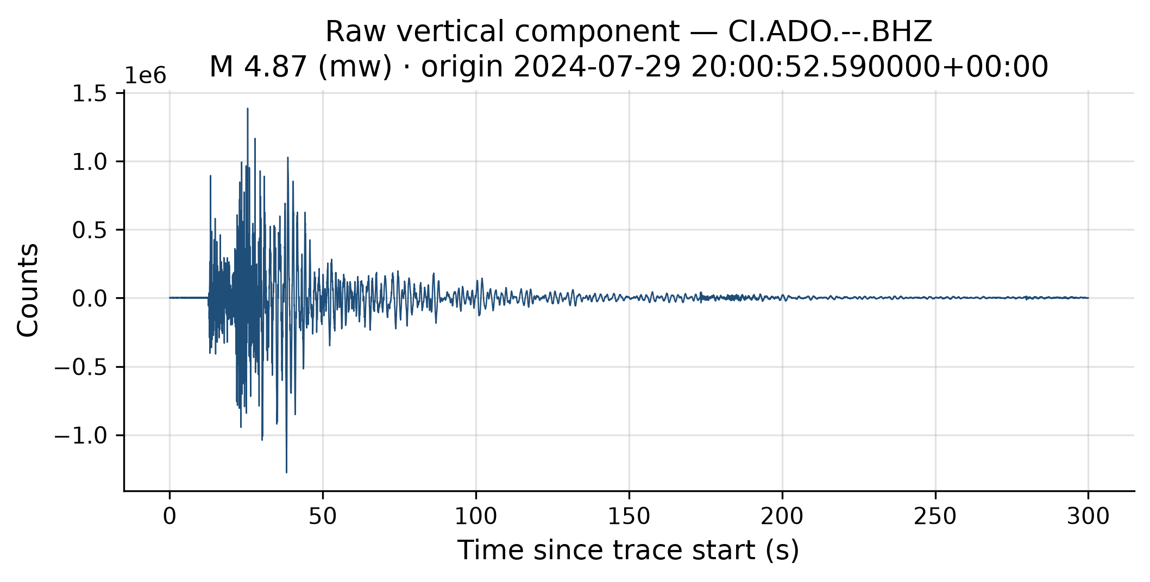
Results — EDA (example waveform)
Figure 1: M 4.87 at CI.ADO — raw counts
Narrow M 4–5 band; query cutoffs
300 s window from trace start
Figure 1. Raw BHZ, M 4.87, CI.ADO (digital counts).
13

Slide 14
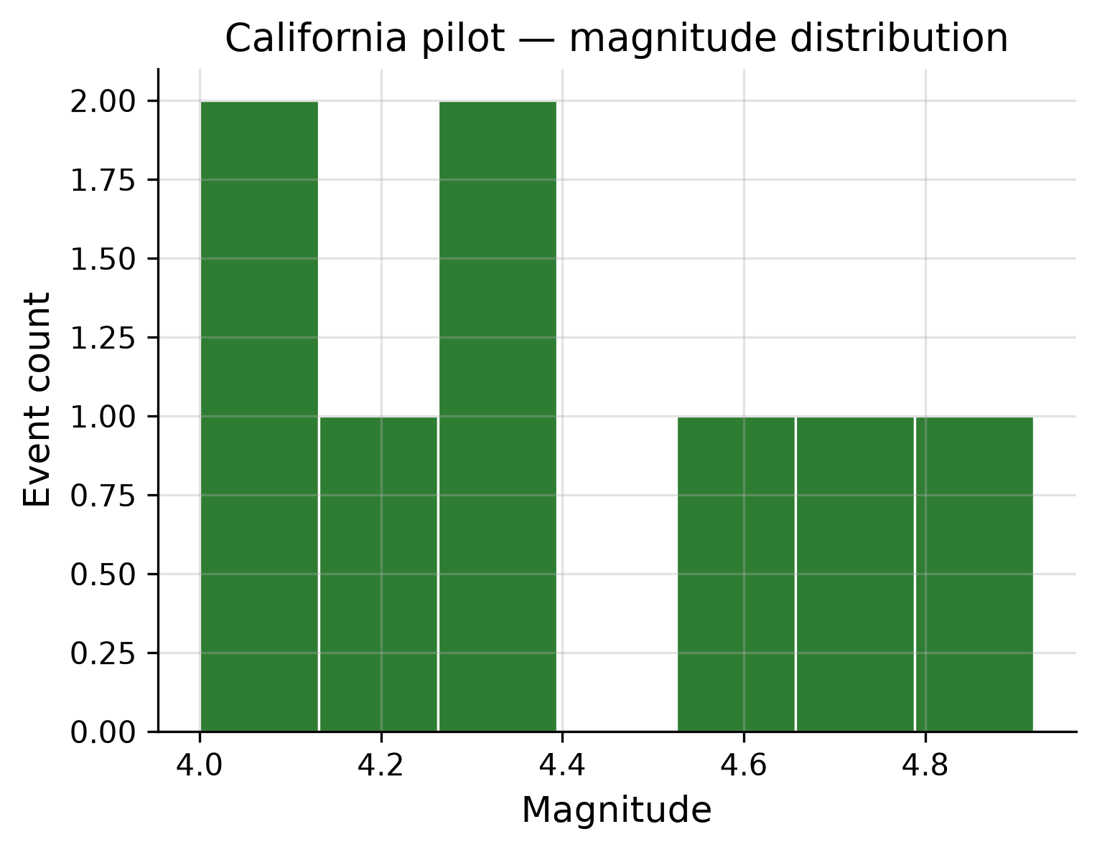
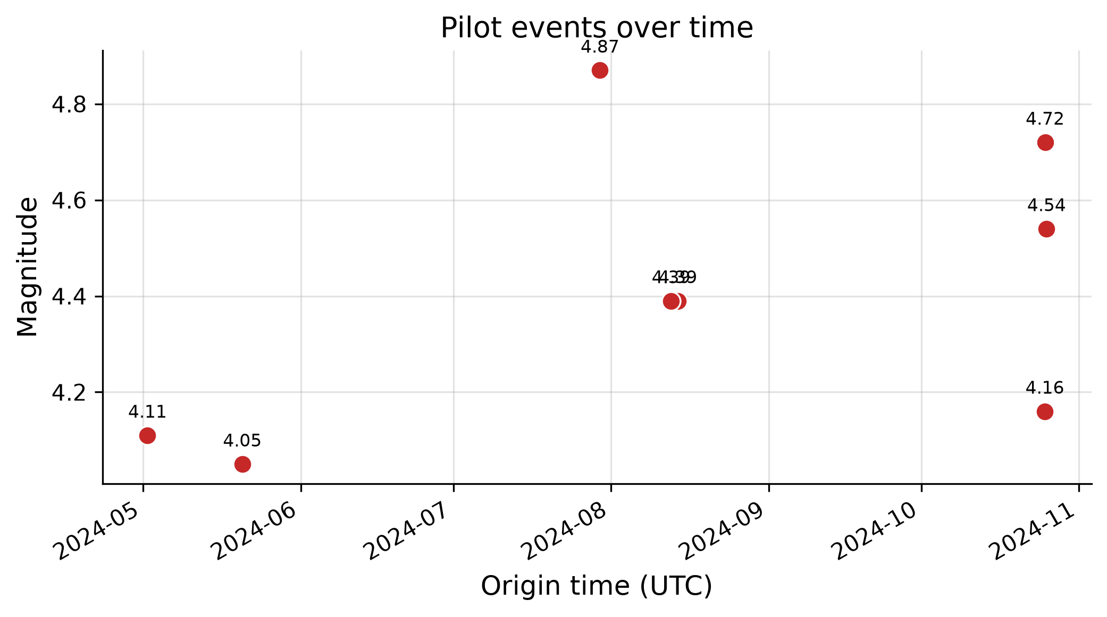
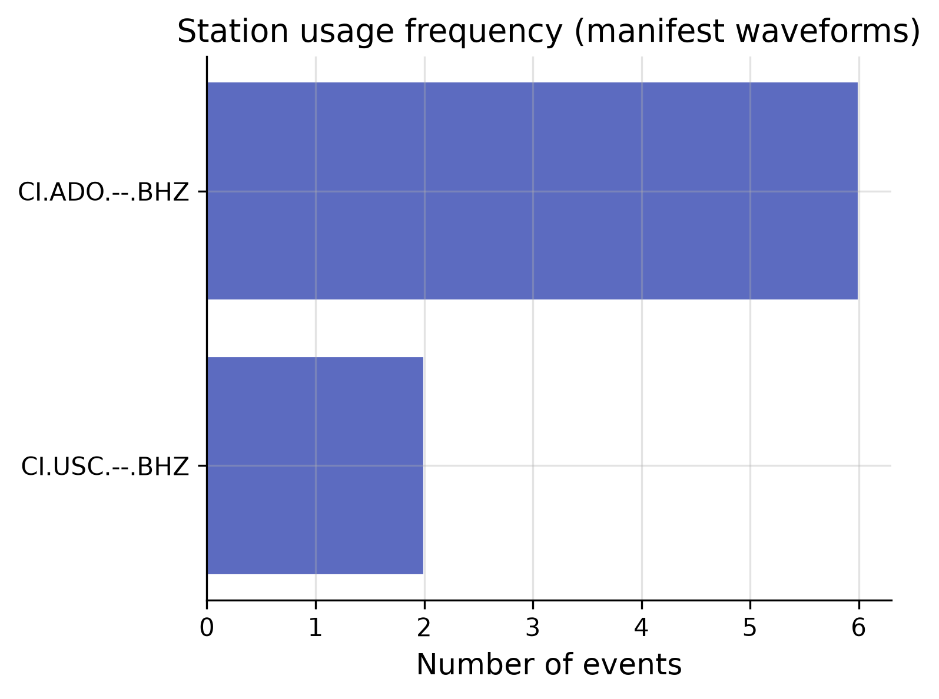
Results — EDA (catalog views)
Figures 2–4: magnitude, time coverage, station usage
ADO supplies 6/8 traces — acquisition bias
Gaps reflect download success
Figure 2. Magnitude distribution (N=8).
Figure 3. Origin time vs magnitude.
Figure 4. Station usage (ADO vs USC).
14

Slide 15
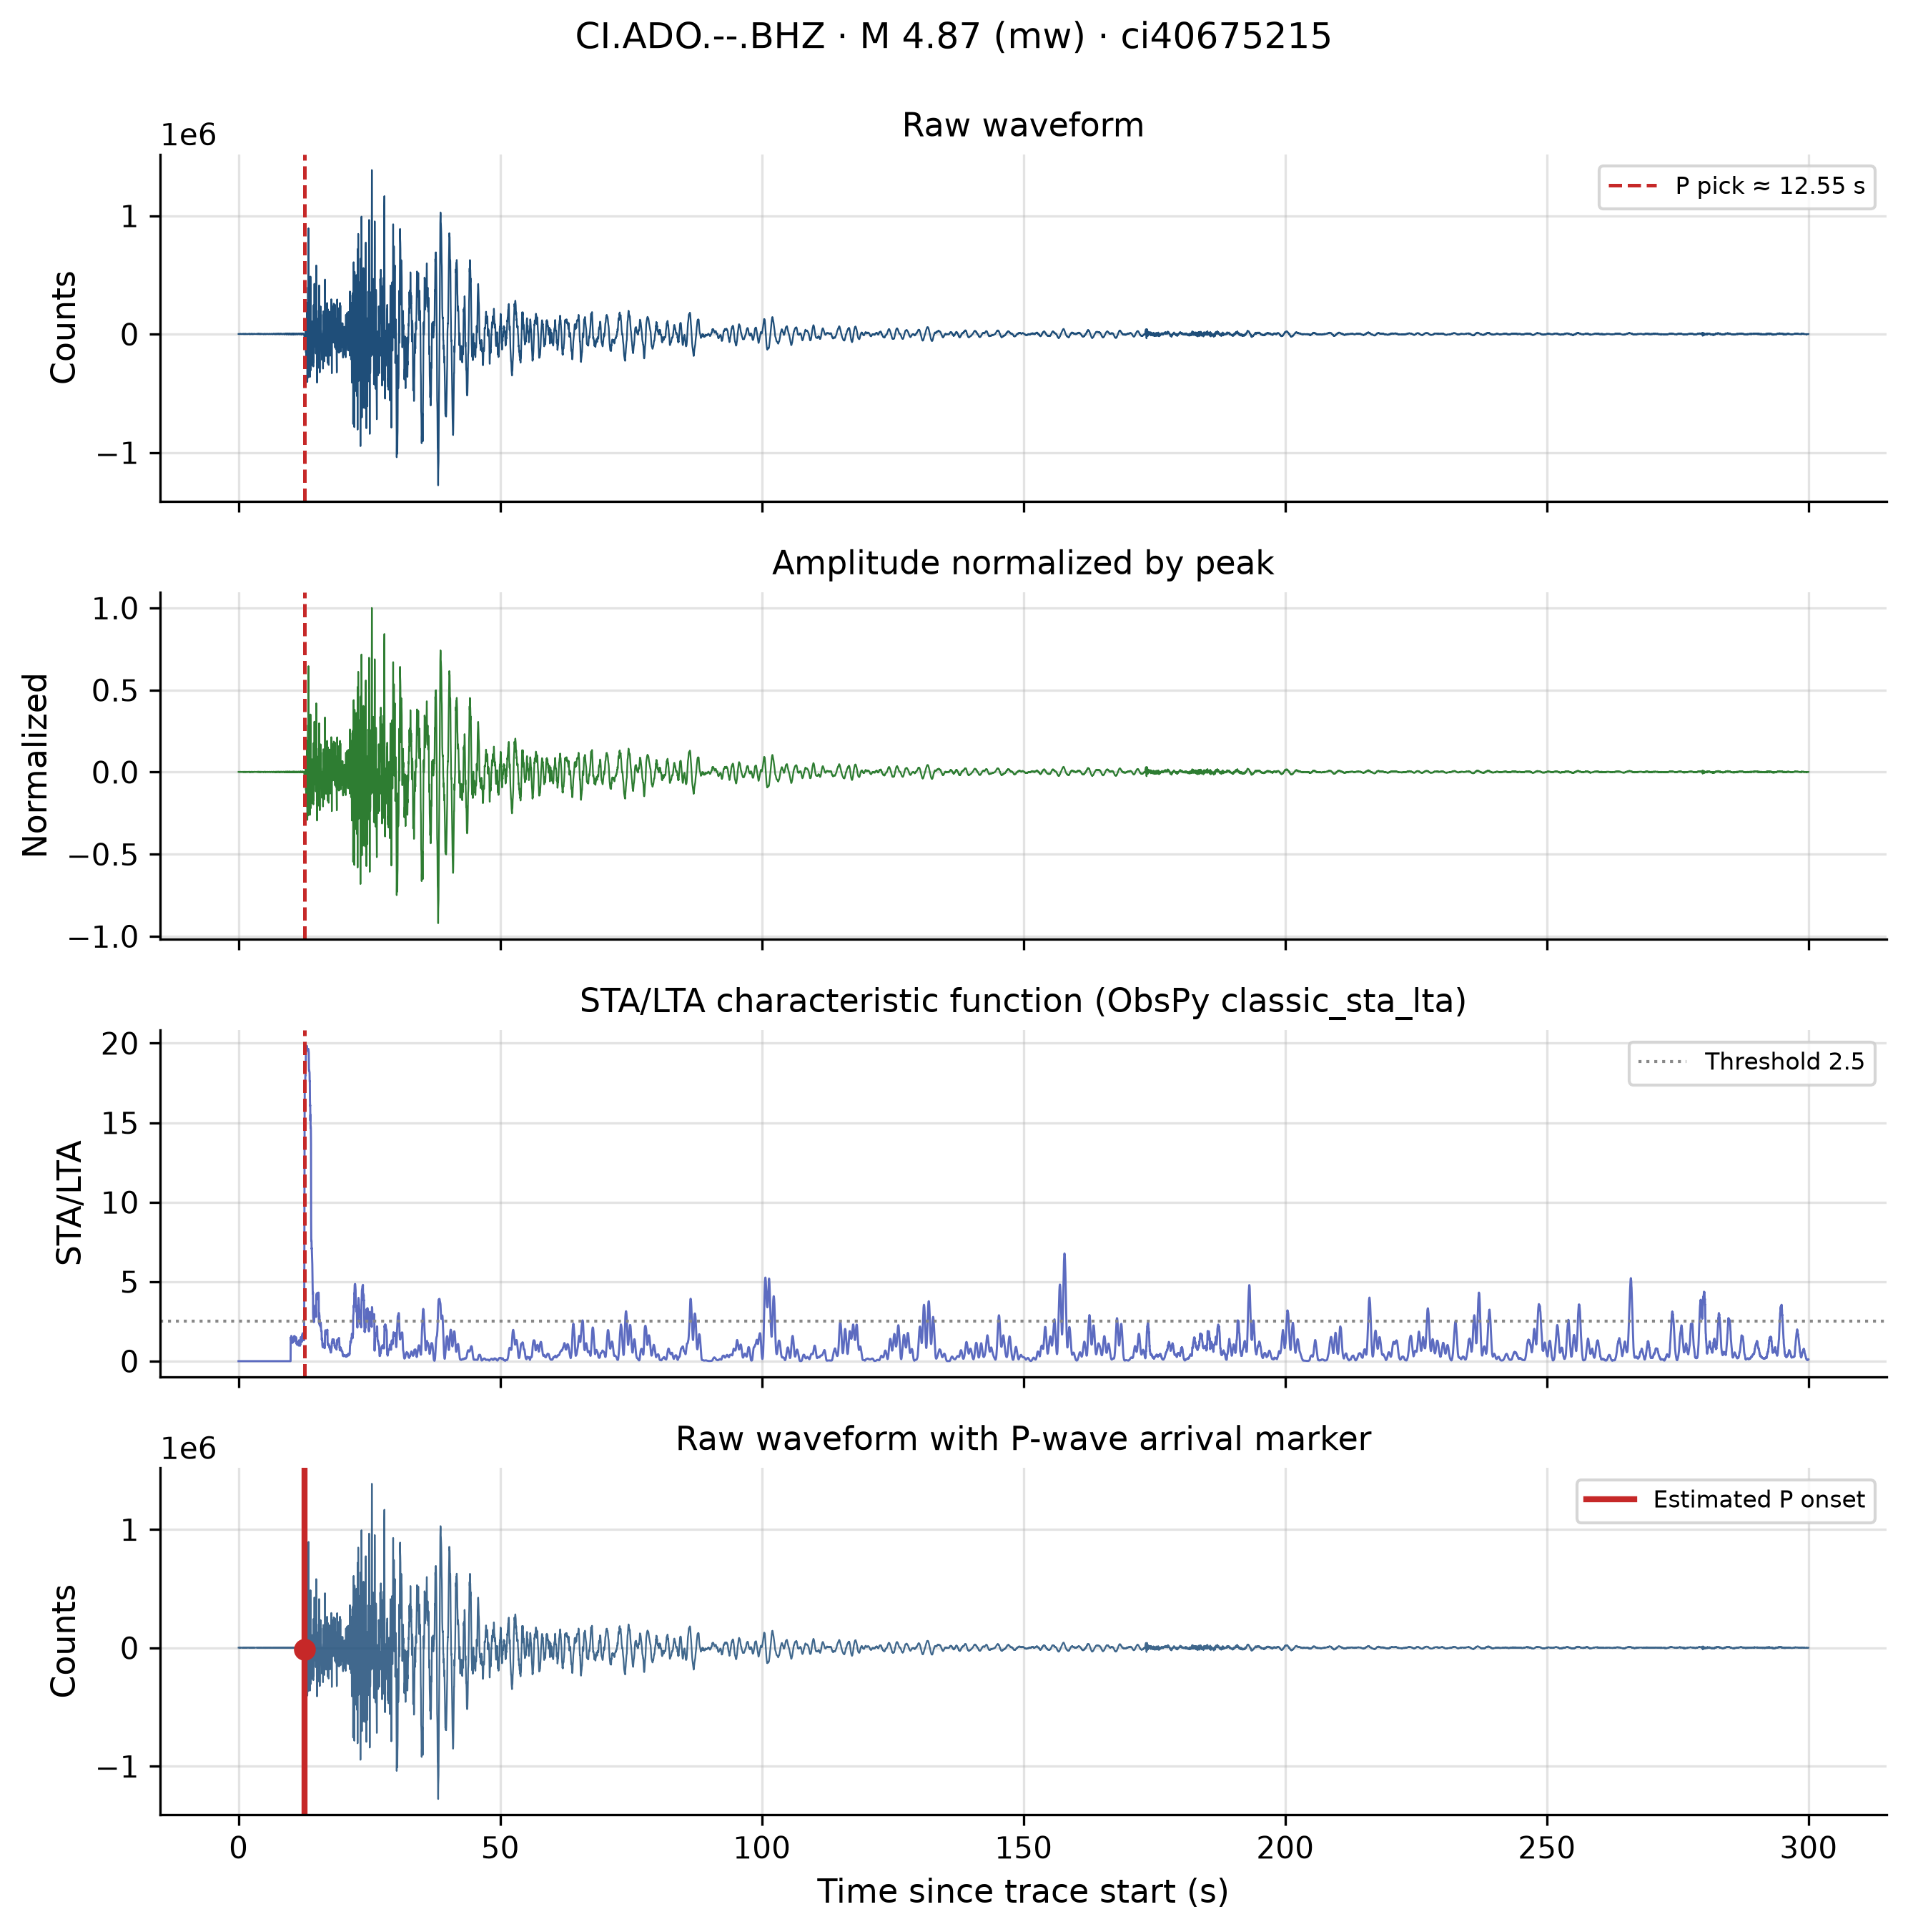
Results — signal analysis (ci40675215)
P pick: 10.15–55.15 s (mean 31.3 s)
Peak SNR: 6.3–778 (median 49.9)
Figure 5: high-SNR case, early pick ~10.2 s
Figure 5. Signal analysis — ci40675215.
15

Slide 16
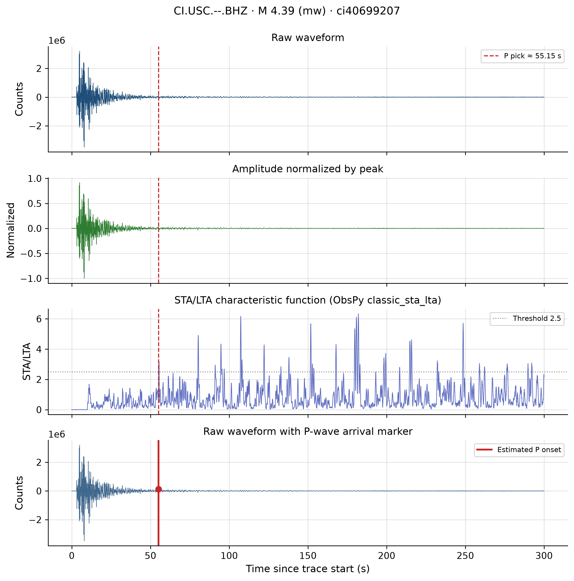
Results — signal analysis (ci40699207 / USC)
ADO: mean SNR 169; USC: mean SNR 42
Figure 6: SNR ~6; duration 0 s
SNR is QC indicator, not detection probability
Figure 6. Signal analysis — ci40699207 (USC).
16

Slide 17
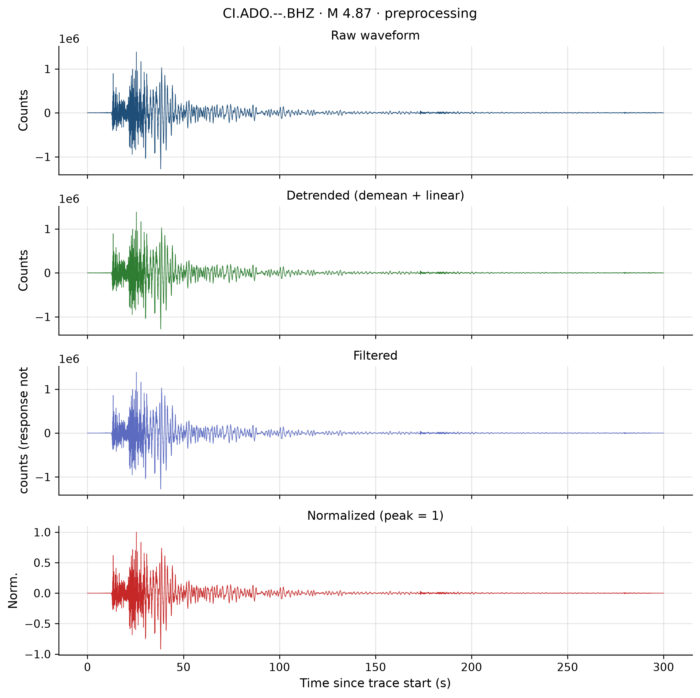
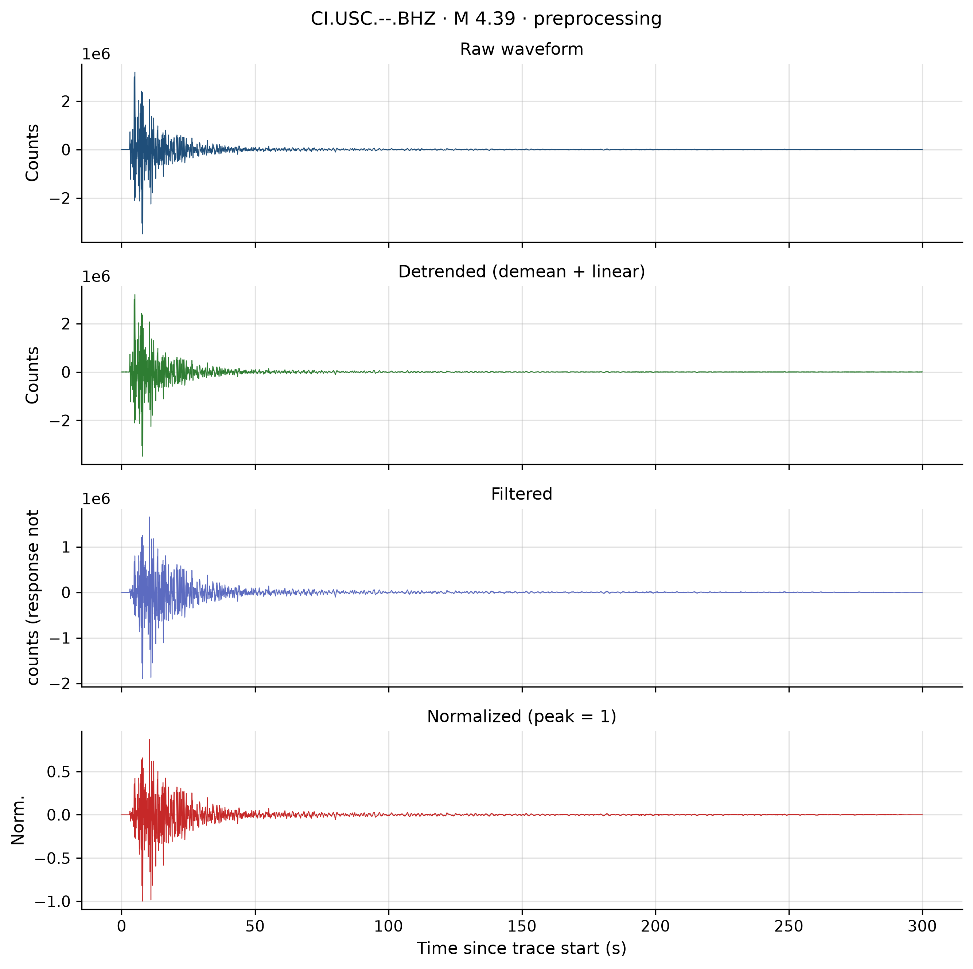
Results — preprocessing
Mean peak-SNR: 137 → 1684 (filtered)
Figures 7–8: raw → detrended → filtered → normalised
Filtered counts ≠ physical motion without response
Figure 7. Preprocessing — ci40675215.
Figure 8. Preprocessing — ci40699207.
17

Slide 18
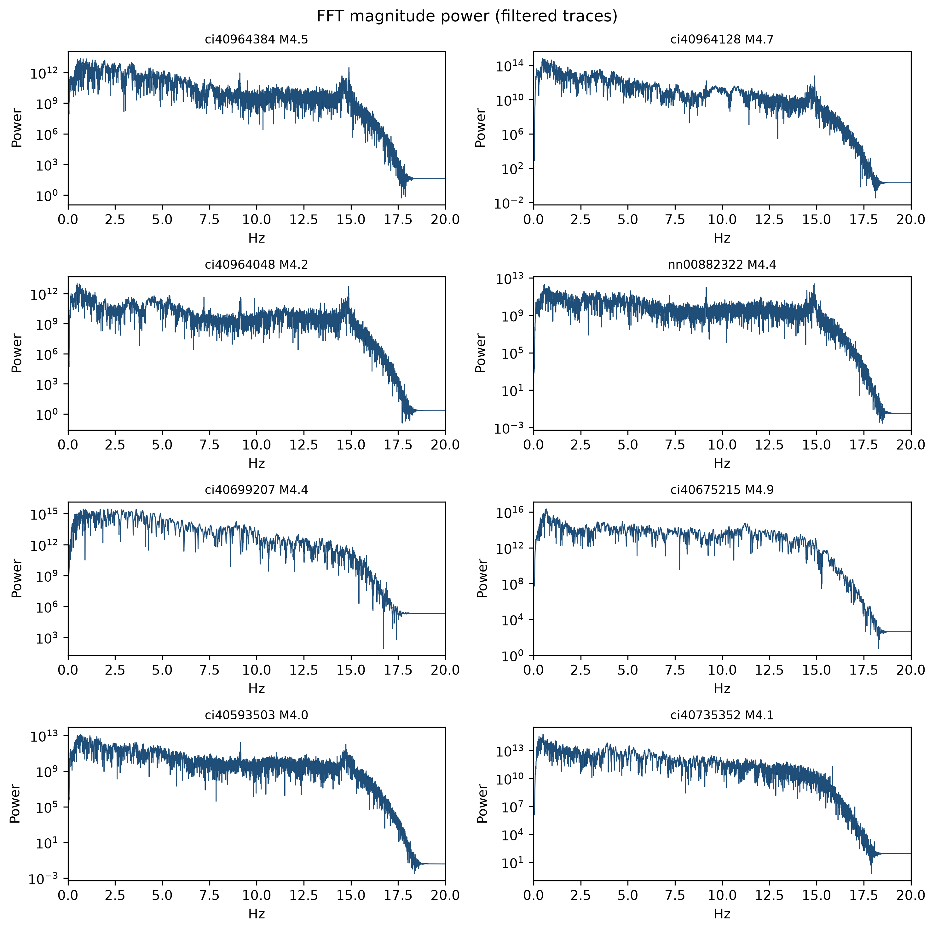
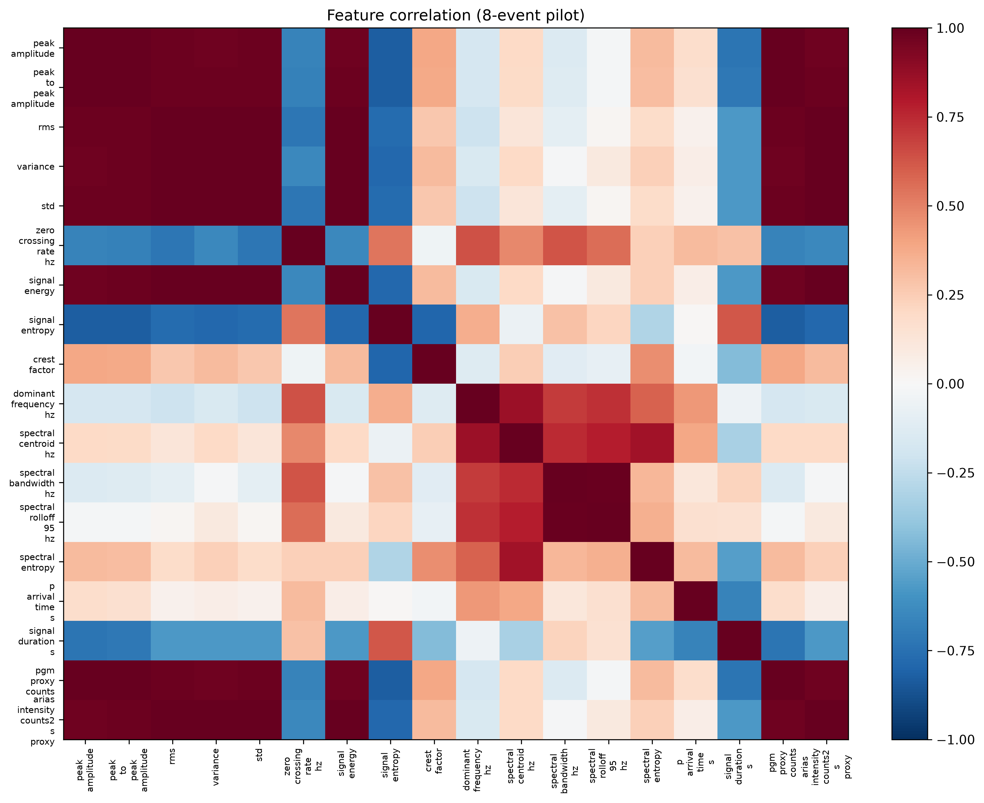
Results — features (spectra & correlations)
8×18 feature matrix
Crest factor mean ≈ 11.4; centroid ~2.3–2.6 Hz
Figures 9–10: FFT grid, correlation heatmap
No ML training in completed pilot
Figure 9. FFT power spectra.
Figure 10. Feature correlation heatmap.
18

Slide 19
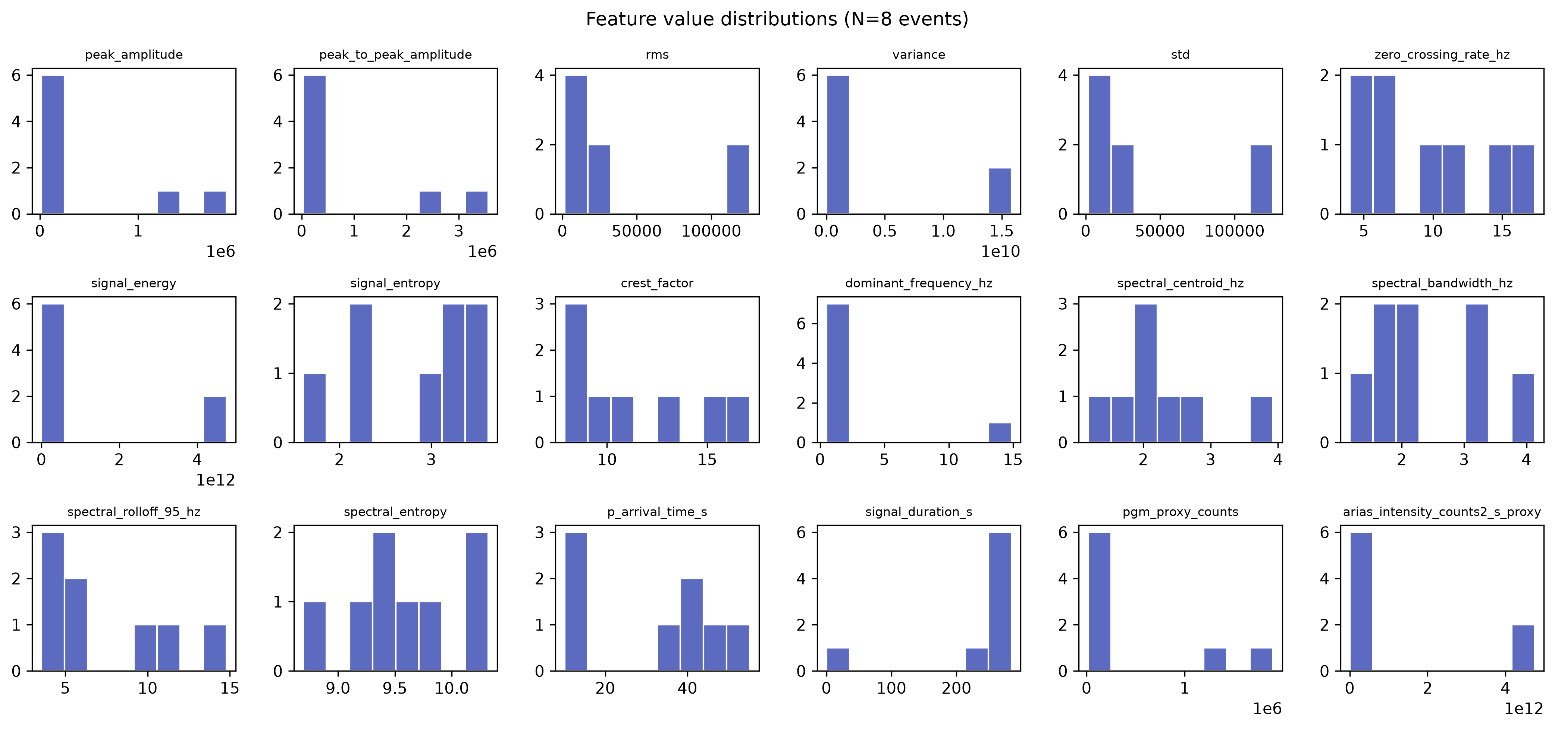
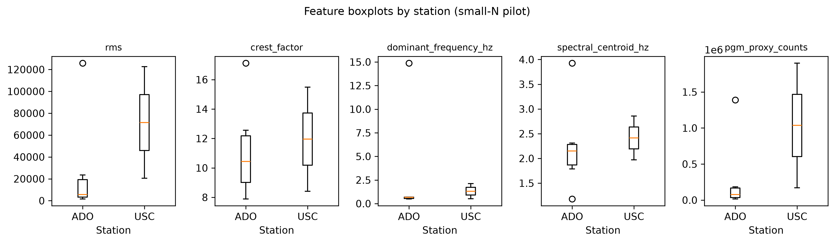
Results — feature distributions & stations
Figures 11–12: histograms, ADO vs USC boxplots
Amplitude features: high collinearity
USC n=2 — indicative only
Figure 11. Feature distributions.
Figure 12. Features by station.
19

Slide 20
Discussion
Script-driven FDSN → features + NPZ stages
Late picks + origin noise limit trigger tuning
Feature matrix: exploratory baselines only
EarthESND: future comparison, not validated here
20

Slide 21
Limitations
N=8; single BHZ; origin-aligned windows
0/8 response removal; ADO-heavy sampling
Mixed mw/ml; unvalidated P picks
Not comparable to EarthESND K-NET metrics
21

Slide 22
Threats to validity
Construct: counts vs physical units
External: California ≠ Europe → EIDA/ORFEUS pilot
Statistical: N=8 → larger catalogues
Mitigations are proposed future work
22

Slide 23
European context & transfer
Europe primary focus; California validates methods
ObsPy/FDSN reproducibility demonstrated
Proposed: ORFEUS/EIDA manifests + same scripts
No EU waveform data yet
23

Slide 24
Future work, conclusions & thank you
Proposed: 50–200+ events, EU pilot, response fix, ML, SeedLink
Conclusion: reproducible chain to 8×18 features established
Acknowledgements: USGS, EarthScope, ObsPy
Questions?
24

