Slide 1
Domain : E-Commerce
Project Name : Olist Store Analysis

Slide 2
Purpose
To track sales, profit, order volume and delivery performance
To identify top customer regions and profitable categories
To analyze customer satisfaction through delivery & review metrics
To support business decisions for growth and operational efficiency

Slide 3

Agenda
1️⃣ KPI Overview
2️⃣ Chart-wise Insights
3️⃣ Observations & Key Findings
4️⃣ Improvement Areas & Action Plan

Slide 4
Purpose of Creating this Dashboard
To monitor key business performance indicators in one place.
To identify top-selling categories and high-value customer segments.
To understand delivery efficiency and review performance.
To support data-driven decisions for sales growth and operations improvement.

Slide 5
KPI 1
KPI 2
KPI 3
KPI 4
KPI 5

Slide 6
KPIs Overview
KPI
Payment Value – 16.47M
Total Price – 12.94M
Total Deliveries – 1.31M
Total Profit – 3.53M
Insight
High sales volume achieved
Strong order revenue
Delivery operations are active & scaled
Business generating good profit margin
📌 Conclusion: The business is financially strong, but improving efficiency could increase profits further.

Slide 7
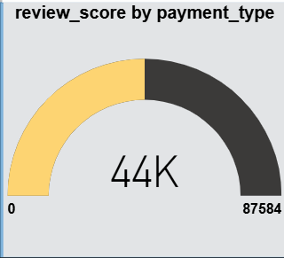
Review Score by Payment Type
Most reviews come from Card & Credit Card payments
Indicates customers prefer trusted and easy payment methods
Cash-based payment users provide fewer reviews → less feedback insight
📌 Suggestion: Add incentives for feedback from all payment types.

Slide 8
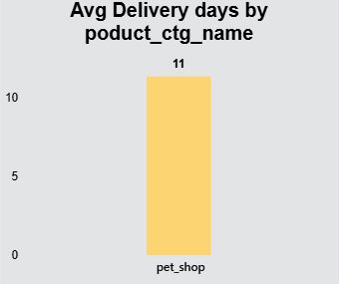
Avg Delivery Days by Category
pet_shop has the longest delivery time at 11 days, much higher than other categories.
This indicates a logistics delay—possibly due to stock issues or slower supplier dispatch.
Longer delivery impacts customer satisfaction and review scores.
📌 Bottleneck identified → Improve logistics in pet category to boost satisfaction.

Slide 9
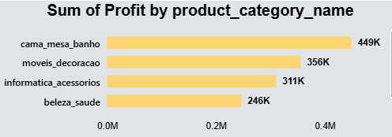
Profit by Product Category
Cama_mesa_banho earns highest profit
Beleza_saude & Informatica_accessorios also contribute well
Some categories show low or negligible profits
📌 Focus more on high-profit categories + revisit pricing for low-profit ones.

Slide 10
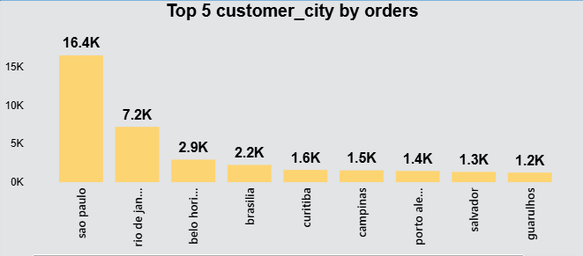
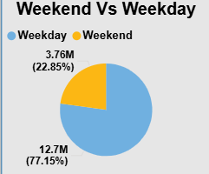
Top 5 Customer Cities
São Paulo is the main market (16.4K orders)
Rio de Janeiro also strong
Other cities have huge growth potential
expand campaigns to emerging cities.
📌 Marketing should focus more on top 2 cities
Weekend vs Weekday Orders
Weekdays = 77% of orders
Weekend orders only 23%
📌 Good opportunity → Weekend promotions & flash sales to increase sales.

Slide 11
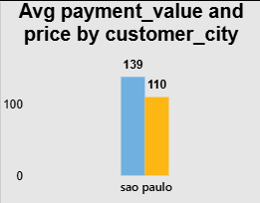
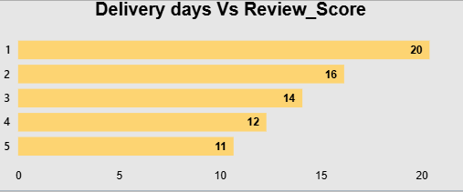
Avg Payment & Price by City
São Paulo customers pay the highest average order value, showing strong spending capability.
Indicates a high-value customer segment that should be prioritized in marketing and retention.
Higher spending may reflect better product availability or stronger brand trust in this region.
Other cities show lower averages, revealing potential markets for targeted promotions.
📌 Retain high-value customers with loyalty programs.
Delivery Days vs Review Score
Fast delivery (1–3 days) receives consistently higher review scores.
Delays above 5 days lead to noticeable drops in customer ratings.
Shows a clear link: delivery speed directly influences customer satisfaction.
📌 Reduce delivery delays → Direct improvement in customer ratings.

Slide 12
Key Findings (Shortcomings from the Data)
These are business gaps highlighted by the dashboard:
Issue Detected from Data
Late delivery in pet_shop
Very low weekend sales
Many cities have small order share
Some categories low profit
Reviews mostly from card/Credit card
What It Means
Customers unhappy → rating & repeat purchase drop
Missing sales opportunities
Market expansion needed
Poor pricing or high cost structure
Weak feedback from other users

Slide 13
Improvement Plan
Area of Concern
Slow shipping in pet category
Low weekend orders
Profit gaps in product categories
Limited customer locations
Limited review feedback
Suggested Action
Improve logistics: faster couriers, better inventory placement, or local warehouses
Launch weekend-only discounts, flash sales, and limited-time offers
Re-evaluate pricing, reduce supplier costs, and optimize product mix
Run geo-targeted ads and expand marketing in smaller/emerging cities

Slide 14
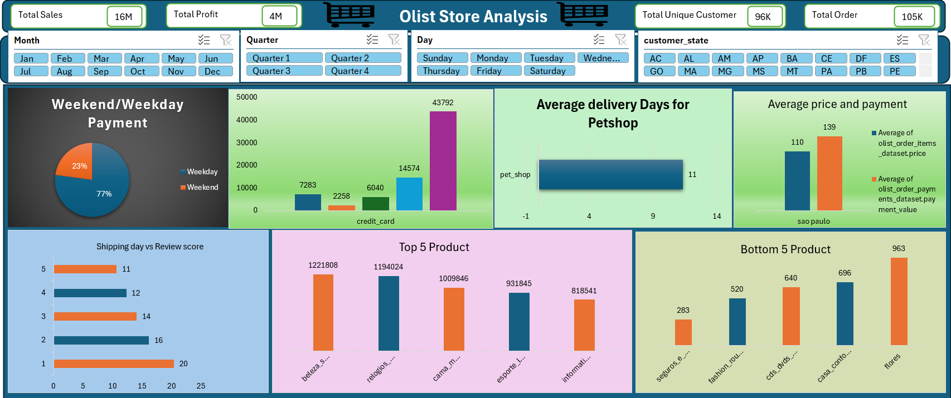
Excel Dashboard

Slide 15
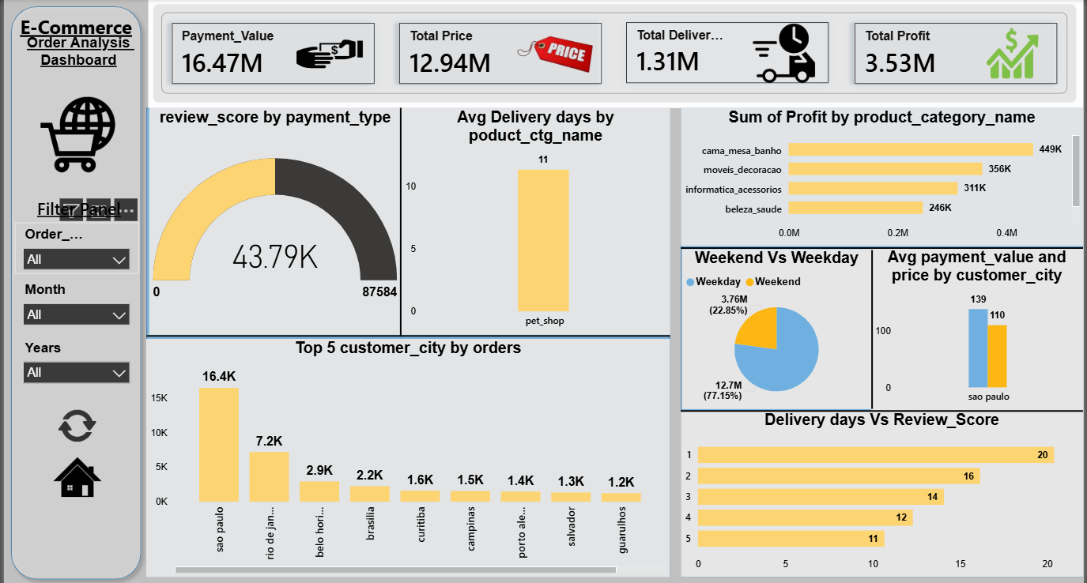
Power BI Dashboard

Slide 16
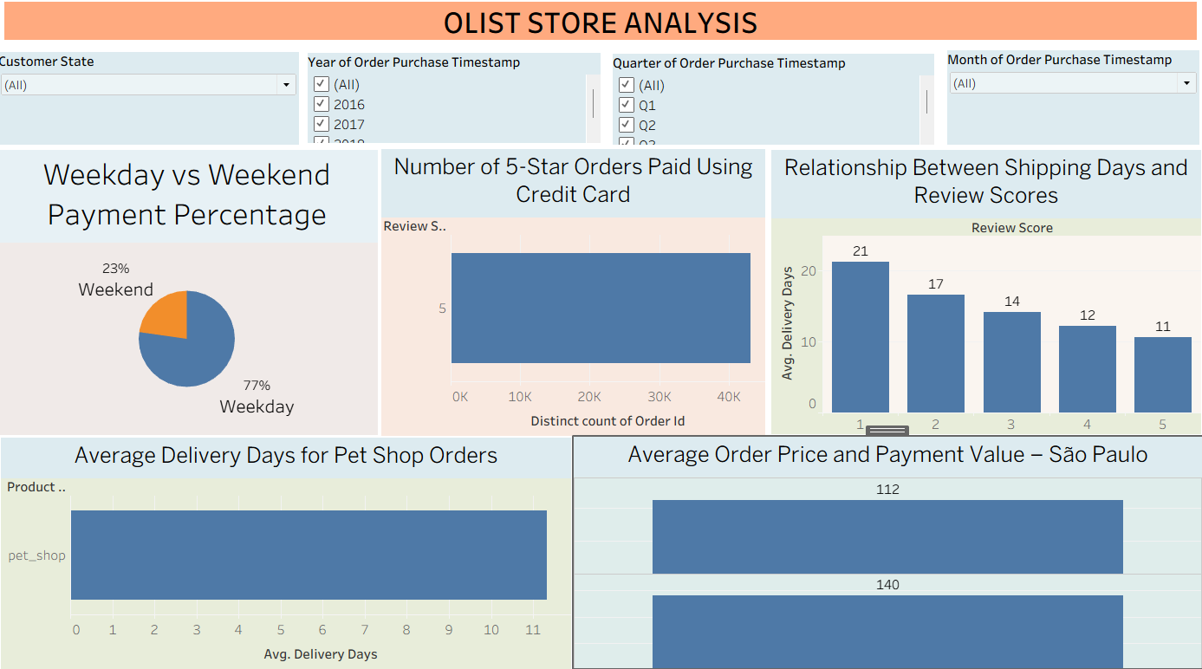
Tableau Dashboard

Slide 17
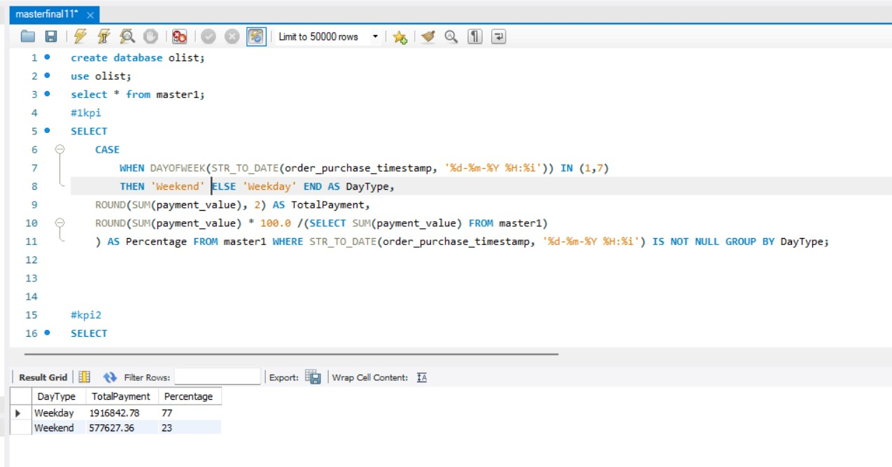
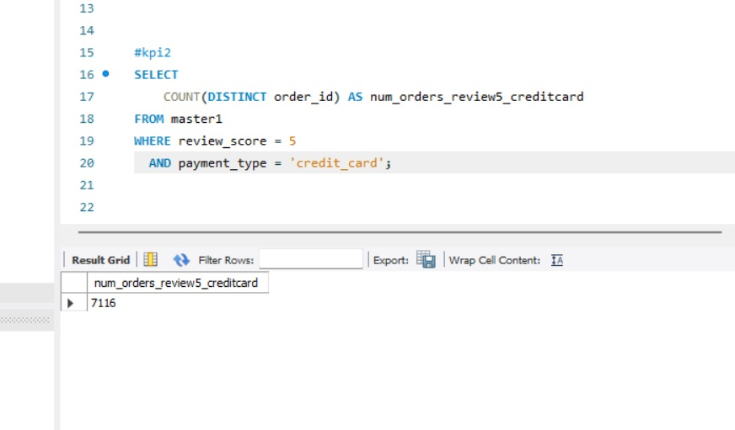
SQL Queries
KPI-1
KPI-2

Slide 18
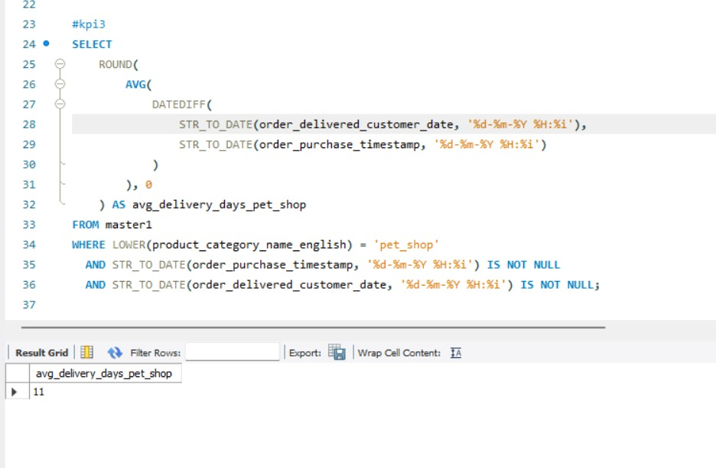
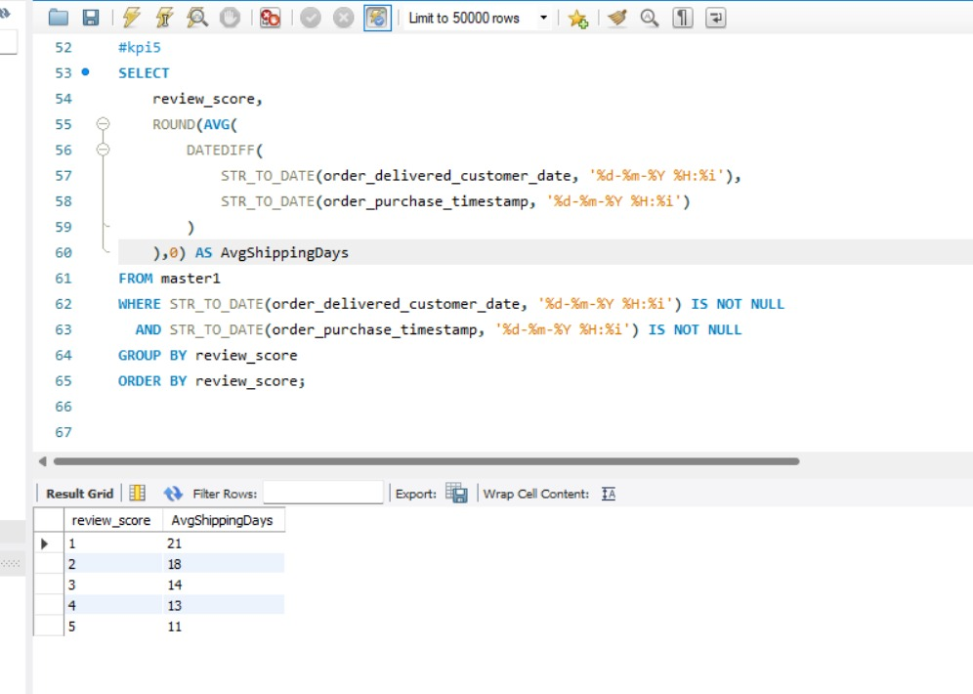
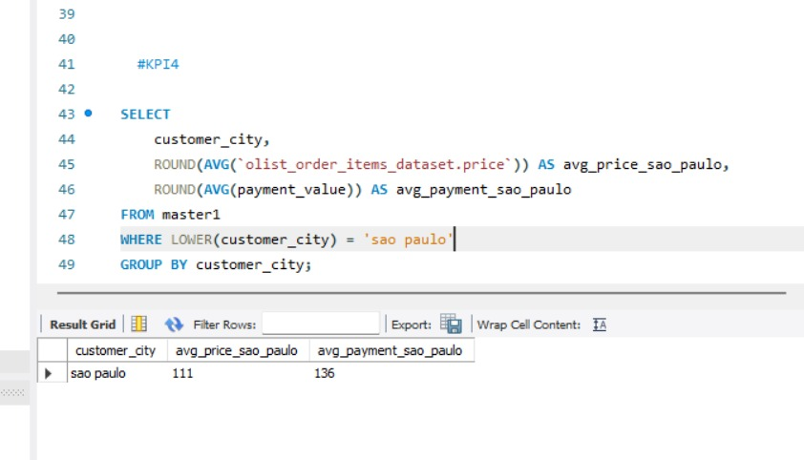
KPI-3
KPI-5
KPI- 4

Slide 19
Conclusion
The business shows strong revenue, solid profit margins, and a large active customer base, especially in top cities like São Paulo.
Delivery speed remains a major factor influencing customer satisfaction, ratings, and repeat purchases.
Expanding market reach beyond dominant cities can unlock new growth opportunities.
By improving logistics efficiency and strengthening targeted marketing, the business can achieve higher sales, better customer retention, and overall sustainable growth.

Slide 20
Thank You

