Slide 1

IST 652 : Scripting for data analysis
Final project proposal
Presented by :
Adarsh
Nandita P
Prasun S
Tarun T

Slide 2
AGENDA
Dataset description
Target analysis
Team member task breakdown
Discussion

Slide 3
Dataset description
This dataset is about the Indian Premier League (IPL), which is a professional Twenty20 cricket league in India. The dataset contains information about all the IPL matches that were played until 2017. It includes data on the teams, players, venues, umpires, and match outcomes.
Here is the link to the dataset : https://data.world/mkhuzaima/ipl-data-till-2017

Slide 4
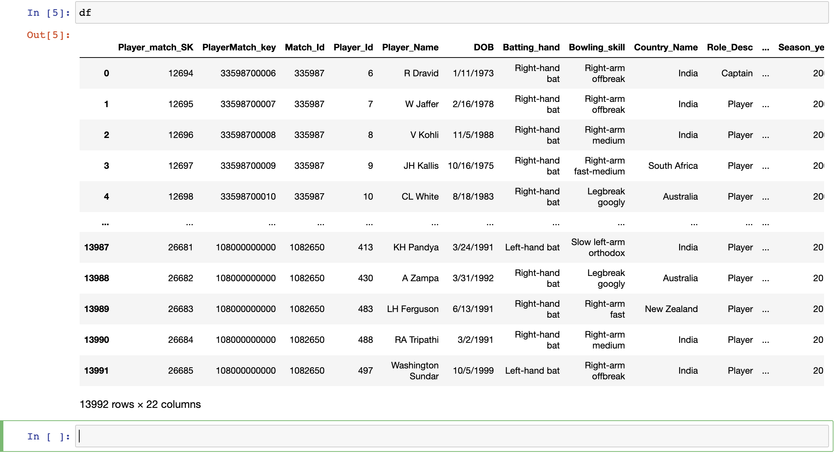

Slide 5
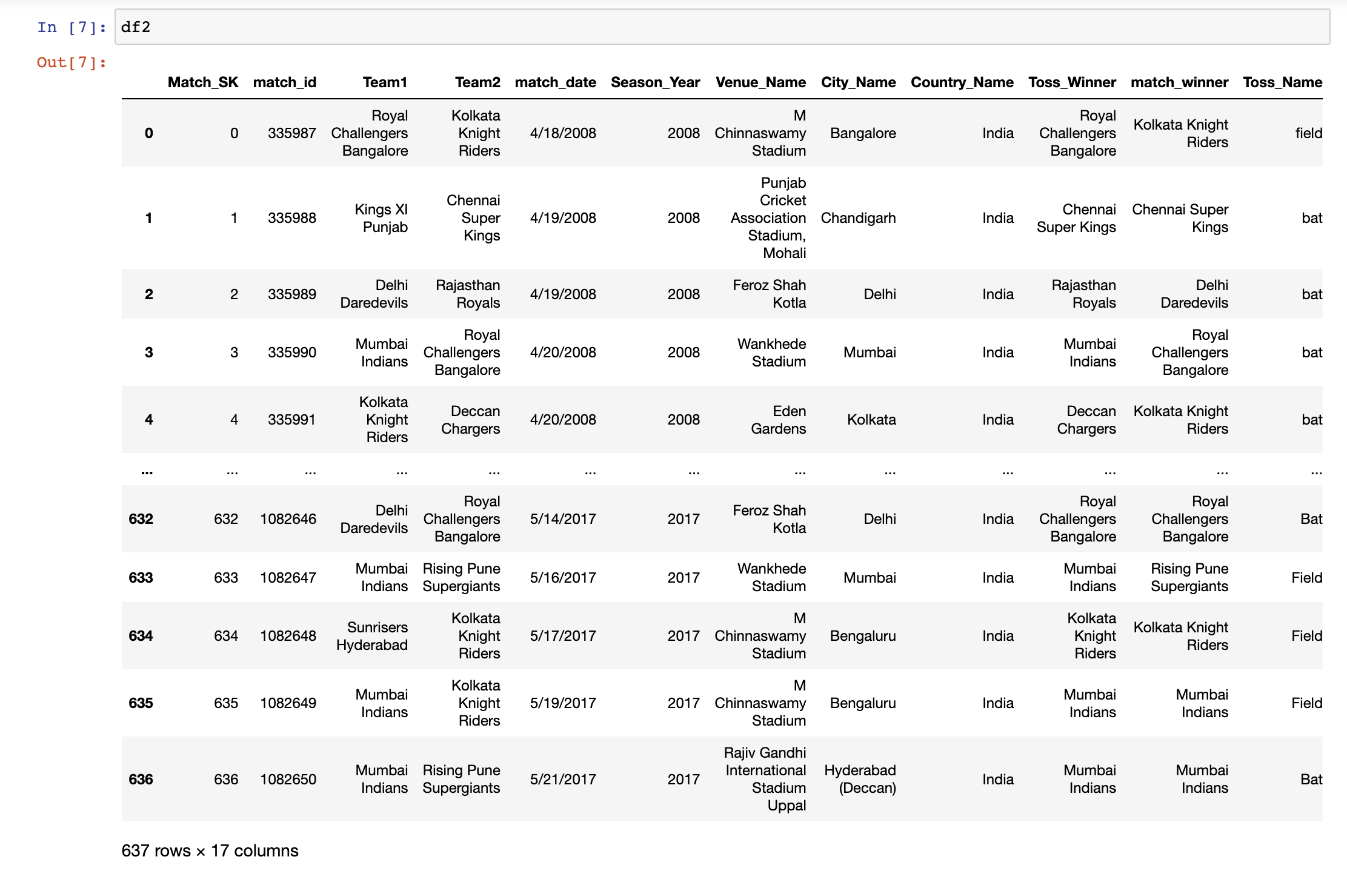

Slide 6
Other datasets
Restaurant food inspection results dataset: The dataset contains information on the last inspection results for food service establishments in New York State. It includes data such as the name of the establishment, location, inspection date, inspection type, violation codes, violation descriptions, and other related details. The dataset contains 20,900 rows and 26 columns.
Link: https://health.data.ny.gov/Health/Food-Service-Establishment-LastInspection/cnih-y5dw
Adult arrests dataset: This dataset contains historical information on adult arrests in New York State, starting from the year 1970. The data is organized by county and is available for all counties in the state. It contains 3255 rows and 13 columns.
Link: https://data.ny.gov/Public-Safety/Adult-Arrests-18-and-Older-by-CountyBeginning-197/rikd-mt35

Slide 7
Target analysis
Team performance: The dataset can be used to analyze the performance of different IPL teams over the years, based on factors such as the number of wins, losses, and draws.
Player performance: The dataset can also be used to analyze the performance of individual players based on factors such as the number of runs scored, wickets taken, and catches.
Match outcomes: The dataset contains information about the outcomes of all the IPL matches played until 2016, which can be analyzed to identify patterns and trends.
Venue analysis: The dataset contains information about the venues where the matches were played, which can be used to analyze the impact of the venue on match outcomes.
Toss analysis: The dataset contains information about the tosses in each match, which can be analyzed to identify any patterns or trends.

Slide 8
Target analysis
Umpire analysis: The dataset contains information about the umpires who officiated in each match, which can be analyzed to identify any patterns or trends.
Innings analysis: The dataset contains information about the innings played by each team, which can be analyzed to identify any patterns or trends.
Run rate analysis: The dataset contains information about the run rate of each team, which can be analyzed to identify any patterns or trends.
Boundary analysis: The dataset contains information about the number of boundaries scored by each team, which can be analyzed to identify any patterns or trends.

Slide 9
Team member task breakdown
Data cleaning and organizing : Nandita P and Prasun s
Data analysis : Tarun T and Adarsh
Data visualization (including interactions) : To be done by all the team members for different analysis factors

Slide 10
Discussion
Any questions or suggestions are welcome!
THANK YOU!!!!!

