Slide 1

JMA DOME
Akshada Avhad
Mugdha Pawar
Prasun Abhishek Singh
Priyamvada Barve
Vaishnavi Deshpande

Slide 2
Content
1. | Introduction
2. | Approach- before course
3. | LP model
4. | Reasons for selecting LP model
5. | Conclusion

Slide 3

Introduction
Concession Stand
Supervisor and General Employee Management
Time Management
Budget

Slide 4

Approach- Before Course
As supervisors are more efficient than general employees, we would have selected only supervisors for finishing the task

Slide 5
What to do?
Let’s use some management science techniques!

Slide 6
LP Model
Cost analysis of different scenarios with the help of excel solver
 | Scenario 1 | Scenario 2 | Scenario 3 | Scenario 4
Cost | $2597 | $3128 | $2464 | $664

Slide 7
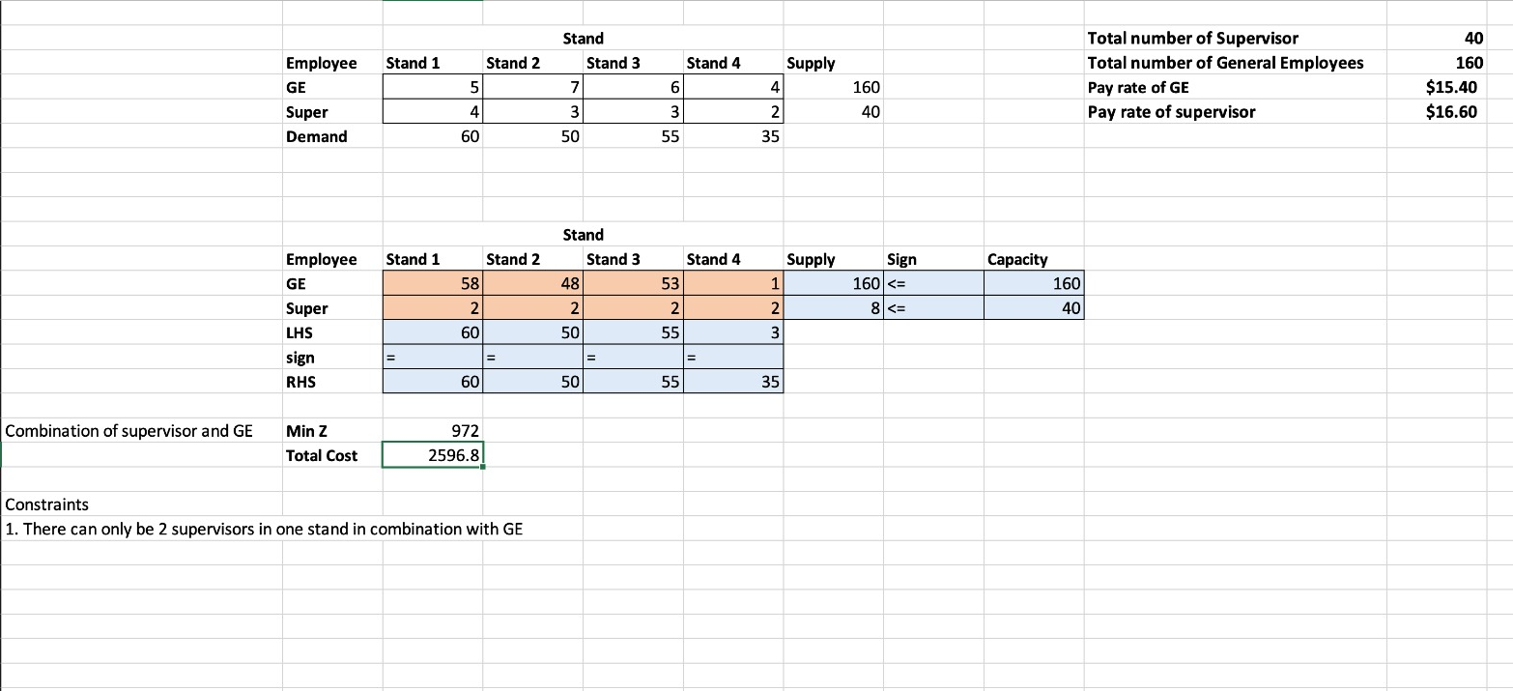
OUR MODEL
We use solver to give us how many employees needed in each stand when the hours and demand is fixed.
These numbers are subjective, and will change and increase depending on the requirement per game.

Slide 8
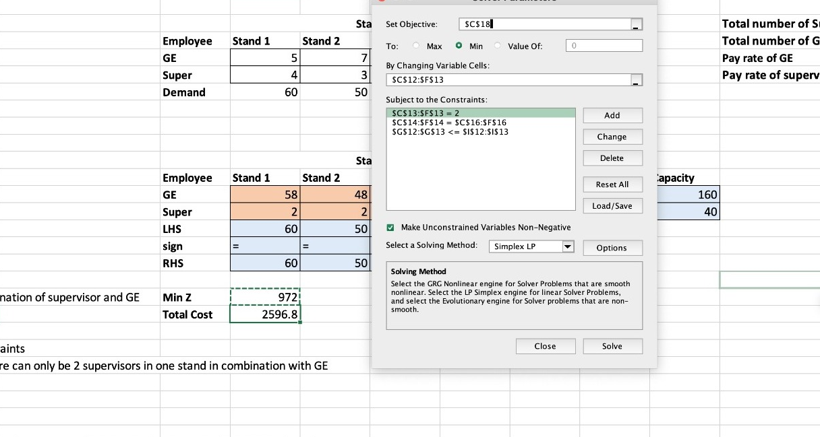
OUR MODEL
Constraints used in the Model

Slide 9
Qualitative Approach
2 Supervisors
10 Supervisors
Only General Employee
Only Supervisor
Most optimal combination considering management, cost, time and quality constraints. | Multiple supervisor making it more costly | Less quality work due to no supervision | We cannot utilize all the supervisor staff as they have other responsibilities and time constraints
Optimal Case
Least optimal
Less Optimal
Less Optimal

Slide 10
Reasons For Selecting LP Model
01
02
03
Combinations
Scenarios
Constraints
LP model uses different combination to get optimal solution
LP model has flexibility of considering multiple scenarios
Facilitates in considering different constraints to get optimal solution

Slide 11
Conclusion
Perspective
Decision Tree
Direction
Decisive Choices
Constraints
Prepared
This subject helped us gain perspective
We created decision tree to cross-check our solution
This course has guide us towards logical solution
Management science techniques has helped us decide right choices
We learned the importance of constraints in any optimal solution
We are prepared to work as management professionals

Slide 12

Open For Questions!

