Slide 1
Dynamic Auctions in Cloud Using Bank Account Mechanisms
P. Suryapratap Prasun Joshi
MT2017075 MT2017083
28 November 2018

Slide 2
Contents
Problem statement and goal of the project
Theory
Algorithm
Results

Slide 3
Goal Statement
Implementation of research paper “Dynamic Auctions with Bank” Accounts by Vahab Mirrokni et al.
Compare the results of the paper to that of our implementation.
Proving this type of Dynamic Auction is better than the static Myerson Auctions.

Slide 4



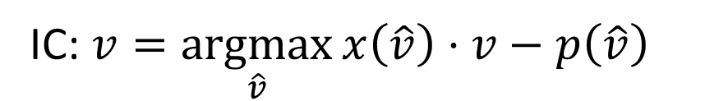
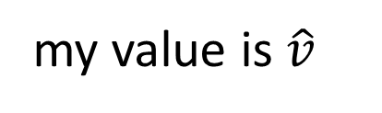
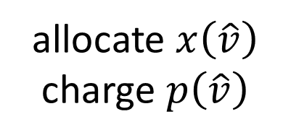


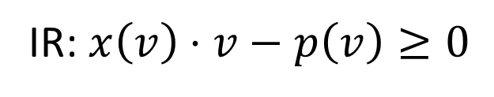
Auction Goal: maximize revenue
private value
$$v=1$$
information
$$v\sim F$$
allocate $x\left(\hat{v}\right)$
charge $p\left(\hat{v}\right)$
actions
my value is $\hat{v}$
IC:$v=\underset{\hat{v}}{argmax}{x\left(\hat{v}\right)⋅v−p\left(\hat{v}\right)}$
Requirements:
IR:$x\left(v\right)⋅v−p\left(v\right)≥0$

Slide 5



Dynamic Setting
Day 1
Day 2
Day 3
Day 4
v~U[0, 2]
v~U[0, 4]
v~U[0, 6]
v~U[0, 4]
Same type, different items

Slide 6



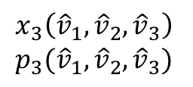




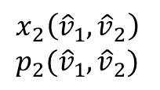



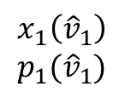


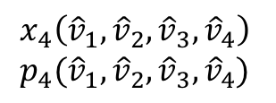
Dynamic Auction (Clairvoyant)
Day 1
Day 2
Day 3
Day 4
$$v\sim U\left[0, 2\right]$$
$$v\sim U\left[0, 4\right]$$
$$v\sim U\left[0, 6\right]$$
$$v\sim U\left[0, 4\right]$$
private
$$v_{1}$$
$$v_{2}$$
$$v_{3}$$
$$v_{4}$$
report
$${\hat{v}}_{1}$$
$${\hat{v}}_{2}$$
$${\hat{v}}_{3}$$
$${\hat{v}}_{4}$$
$$x_{1}\left({\hat{v}}_{1}\right)$$
$$p_{1}({\hat{v}}_{1})$$
$$x_{2}\left({\hat{v}}_{1},{\hat{v}}_{2}\right)$$
$$p_{2}({\hat{v}}_{1},{\hat{v}}_{2})$$
$$x_{3}\left({\hat{v}}_{1},{\hat{v}}_{2},{\hat{v}}_{3}\right)$$
$$p_{3}({\hat{v}}_{1},{\hat{v}}_{2},{\hat{v}}_{3})$$
$$x_{4}\left({\hat{v}}_{1},{\hat{v}}_{2},{\hat{v}}_{3},{\hat{v}}_{4}\right)$$
$$p_{4}({\hat{v}}_{1},{\hat{v}}_{2},{\hat{v}}_{3},{\hat{v}}_{4})$$
outcome

Slide 7
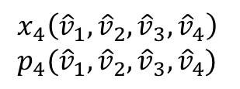
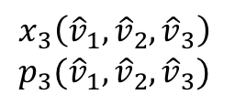

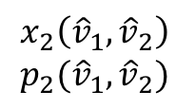
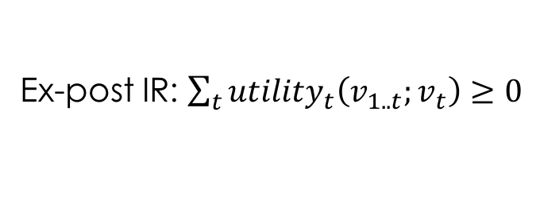
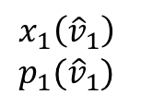
Dynamic Auction (Clairvoyant)
Day 1
Day 2
Day 3
Day 4
$$v\sim U\left[0, 2\right]$$
$$v\sim U\left[0, 4\right]$$
$$v\sim U\left[0, 6\right]$$
$$v\sim U\left[0, 4\right]$$
$$x_{1}\left({\hat{v}}_{1}\right)$$
$$p_{1}({\hat{v}}_{1})$$
$$x_{2}\left({\hat{v}}_{1},{\hat{v}}_{2}\right)$$
$$p_{2}({\hat{v}}_{1},{\hat{v}}_{2})$$
$$x_{3}\left({\hat{v}}_{1},{\hat{v}}_{2},{\hat{v}}_{3}\right)$$
$$p_{3}({\hat{v}}_{1},{\hat{v}}_{2},{\hat{v}}_{3})$$
$$x_{4}\left({\hat{v}}_{1},{\hat{v}}_{2},{\hat{v}}_{3},{\hat{v}}_{4}\right)$$
$$p_{4}({\hat{v}}_{1},{\hat{v}}_{2},{\hat{v}}_{3},{\hat{v}}_{4})$$
outcome
$$utility_{t}\left({\hat{v}}_{1..t};v_{t}\right)≜x_{t}\left({\hat{v}}_{1..t}\right)⋅v_{t}−p_{t}\left({\hat{v}}_{1..t}\right)$$
Requirements:
Dynamic IC: $v_{t}=\underset{{\hat{v}}_{t}}{argmax}\left[{uility}_{t}\left({\hat{v}}_{1..t};v_{t}\right)+E\left[future_utility\left({\hat{v}}_{1..t}\right)\right]\right]$
Ex-post IR: $\sum_{t}{utility_{t}\left(v_{1..t};v_{t}\right)}≥0$
Objective: maximize expected revenue = $E\left[\sum_{t}{p_{t}\left(v_{1..t}\right)}\right]$, subject to DIC & ep-IR

Slide 8
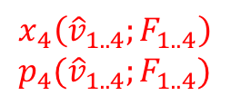
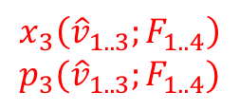
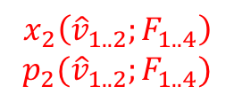
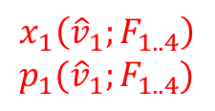
Dynamic Auction (Clairvoyant)
Day 1
Day 2
Day 3
Day 4
$$v\sim U\left[0, 2\right]$$
$$v\sim U\left[0, 4\right]$$
$$v\sim U\left[0, 6\right]$$
$$v\sim U\left[0, 4\right]$$
$$x_{1}\left({\hat{v}}_{1}\right)$$
$$p_{1}({\hat{v}}_{1})$$
$$x_{2}\left({\hat{v}}_{1},{\hat{v}}_{2}\right)$$
$$p_{2}({\hat{v}}_{1},{\hat{v}}_{2})$$
$$x_{3}\left({\hat{v}}_{1},{\hat{v}}_{2},{\hat{v}}_{3}\right)$$
$$p_{3}({\hat{v}}_{1},{\hat{v}}_{2},{\hat{v}}_{3})$$
$$x_{4}\left({\hat{v}}_{1},{\hat{v}}_{2},{\hat{v}}_{3},{\hat{v}}_{4}\right)$$
$$p_{4}({\hat{v}}_{1},{\hat{v}}_{2},{\hat{v}}_{3},{\hat{v}}_{4})$$
outcome
$$x_{1}\left({\hat{v}}_{1};F_{1..4}\right)$$
$$p_{1}({\hat{v}}_{1};F_{1..4})$$
$$x_{2}\left({\hat{v}}_{1..2};F_{1..4}\right)$$
$$p_{2}({\hat{v}}_{1..2};F_{1..4})$$
$$x_{3}\left({\hat{v}}_{1..3};F_{1..4}\right)$$
$$p_{3}({\hat{v}}_{1..3};F_{1..4})$$
$$x_{4}\left({\hat{v}}_{1..4};F_{1..4}\right)$$
$$p_{4}({\hat{v}}_{1..4};F_{1..4})$$

Slide 9

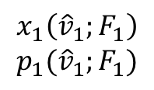
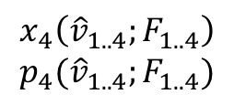
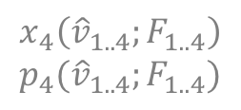
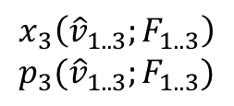
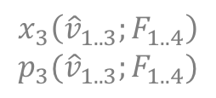
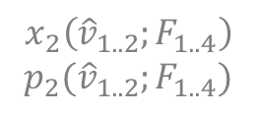
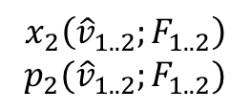
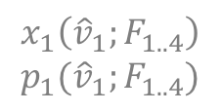
Dynamic Auction (Non-clairvoyant)
Day 1
Day 2
Day 3
Day 4
?
?
?
$$v\sim U\left[0, 2\right]$$
$$v\sim U\left[0, 4\right]$$
$$v\sim U\left[0, 6\right]$$
$$v\sim U\left[0, 4\right]$$
private
$$v_{1}$$
$$v_{2}$$
$$v_{3}$$
$$v_{4}$$
report
$${\hat{v}}_{1}$$
$${\hat{v}}_{2}$$
$${\hat{v}}_{3}$$
$${\hat{v}}_{4}$$
$$x_{1}\left({\hat{v}}_{1};F_{1}\right)$$
$$p_{1}({\hat{v}}_{1};F_{1})$$
$$x_{2}\left({\hat{v}}_{1..2};F_{1..2}\right)$$
$$p_{2}({\hat{v}}_{1..2};F_{1..2})$$
$$x_{3}\left({\hat{v}}_{1..3};F_{1..3}\right)$$
$$p_{3}({\hat{v}}_{1..3};F_{1..3})$$
$$x_{4}\left({\hat{v}}_{1..4};F_{1..4}\right)$$
$$p_{4}({\hat{v}}_{1..4};F_{1..4})$$
outcome
clairvoyant outcome
$$x_{1}\left({\hat{v}}_{1};F_{1..4}\right)$$
$$p_{1}({\hat{v}}_{1};F_{1..4})$$
$$x_{2}\left({\hat{v}}_{1..2};F_{1..4}\right)$$
$$p_{2}({\hat{v}}_{1..2};F_{1..4})$$
$$x_{3}\left({\hat{v}}_{1..3};F_{1..4}\right)$$
$$p_{3}({\hat{v}}_{1..3};F_{1..4})$$
$$x_{4}\left({\hat{v}}_{1..4};F_{1..4}\right)$$
$$p_{4}({\hat{v}}_{1..4};F_{1..4})$$

Slide 10
Results overview
 | Simple Format | High Revenue | Buyer Flexibility | Optimality | Efficient Computation | Forecast-free
Static Auctions | YES | NO | YES | Arbitrarily large gap | YES T-free | YES
Dynamic Auctions | NO | YES | Maybe YES | YES | Unknown (exponential?) | NO
Bank Account Mechanisms | YES | YES | YES | YES | somehow YES FPTAS poly(T) | NO

Slide 11
Dynamic Environment: Model
Seller has a sequence of items to sell to buyers.
Items arrive over time.
Each period, one item for sale.
The item will be destroyed, if not sold.
Unknown actual value until the t-th period.
Stage-wise independent, commonly known priors.
Additive valuation.
Seller's allocation rule and payment rule could depend on past periods.

Slide 12

Dynamic Environment: Application
Seller has a sequence of items to sell to buyers.
Items arrive over time.
Each period, one item for sale.
The item will be destroyed, if not sold.
Unknown actual value until the t-th period.
Stage-wise independent, commonly known priors.
Additive valuation.
Seller's allocation rule and payment rule could depend on past periods.
Google sells ad impressions to advertisers.
Impressions may come from users' searches on search engines.
- Arrive over time, destroyed immediately if not sold.
The value of each impression varies with (at least) the user's information (location, time, age, gender, cookies, etc.).
Currently, the auctions are rarely conducted dynamically.

Slide 13
Non-clairvoyance: importance
In practice, the seller (Google) cannot predict the type of the next item (impression).
More importantly, even if the seller could predict the types, the buyers might not trust the seller’s prediction. (Common knowledge assumption violated)

Slide 14
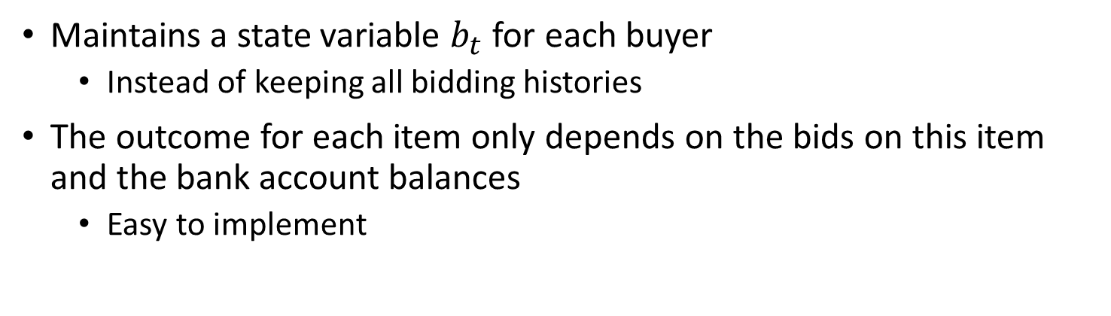
Bank Account Mechanism
Maintains a state variable $b_{t}$ for each buyer
Instead of keeping all bidding histories
The outcome for each item only depends on the bids on this item and the bank account balances
Easy to implement
Every dynamic auction is “isomorphic” to a bank account mechanism.
No loss of generality by restricting to bank account mechanisms

Slide 15
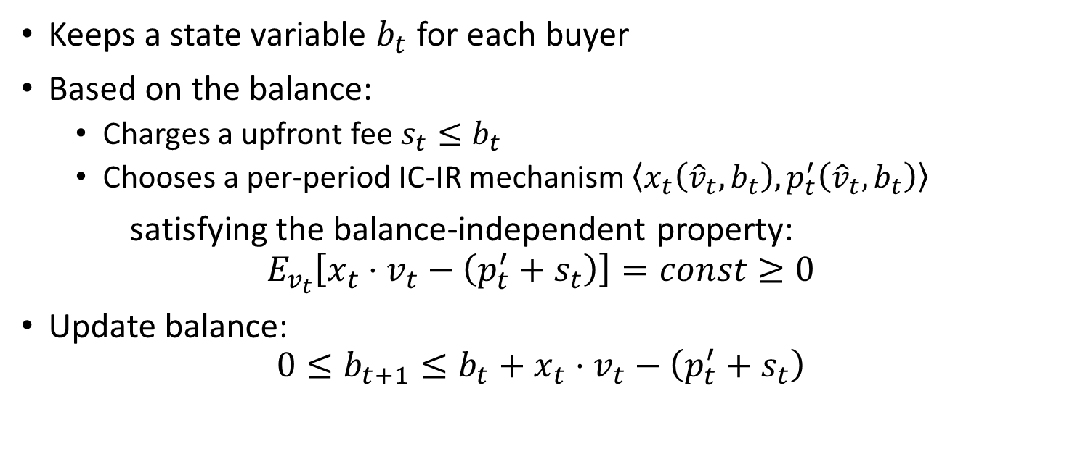
Bank Account Mechanism
Keeps a state variable $b_{t}$ for each buyer
Based on the balance:
Charges a upfront fee $s_{t}≤b_{t}$
Chooses a per-period IC-IR mechanism $\left\langle x_{t}\left({\hat{v}}_{t},b_{t}\right),p_{t}^{′}\left({\hat{v}}_{t},b_{t}\right)\right\rangle$
satisfying the balance-independent property:
$$E_{v_{t}}\left[x_{t}⋅v_{t}−\left(p_{t}^{′}+s_{t}\right)\right]=const≥0$$
Update balance:
$$0≤b_{t+1}≤b_{t}+x_{t}⋅v_{t}−\left(p_{t}^{′}+s_{t}\right)$$

Slide 16
How & Why it works?
How:
Bank account as a summary of the history
Buyers put their surplus into their bank accounts
Unspent balances will be returned
Spent = E[utility with discounts] – E[utility without discounts]
Why:
Increasing the efficiency of the allocation, higher social welfare
Buyer utilities not increase
Therefore, revenue = social welfare – buyer utilities, increases

Slide 17
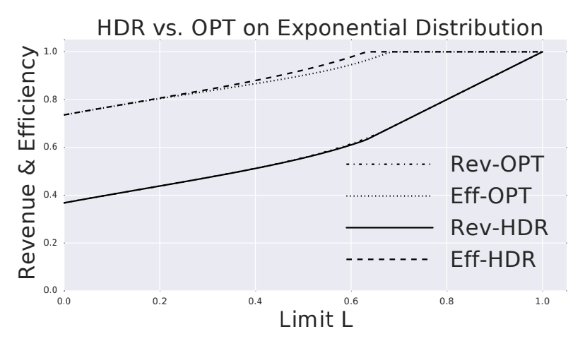
Results

Slide 18
Conclusion
Dynamic auctions gives better revenue as compared to static auctions
Bank Account Mechanism is simplest way to implement Dynamic Auctions and generate optimal revenue.

Slide 19
Thanks!!

