Slide 1

EDA Of IPL

Slide 2
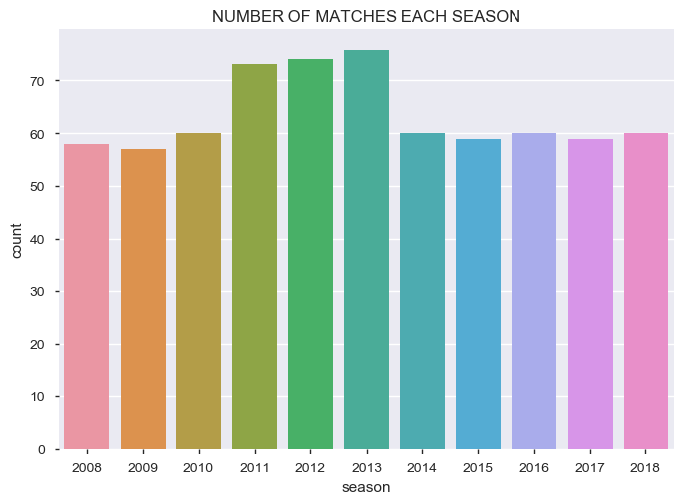
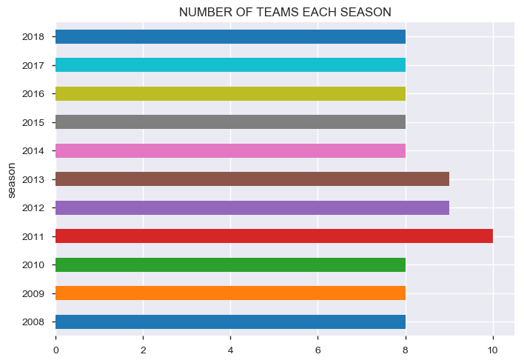
How many matches are being played every season?
Number of teams were more in 2011,2012 and 2013

Slide 3
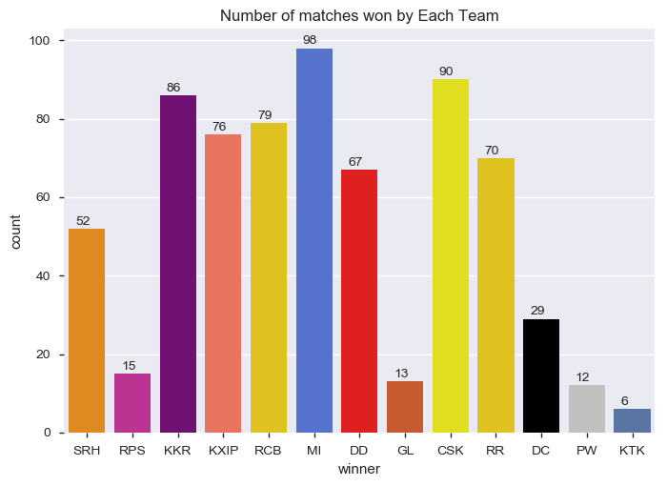
Who has won most number of matches?
Mumbai Indians have most number of wins, but in true fact Chennai has most number of wins as it was banned from IPL for 2 years
P.S- Fan of Chennai:)

Slide 4
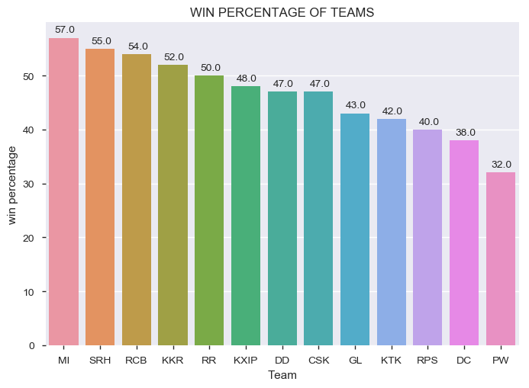
Which team has most winning percentage?

Slide 5

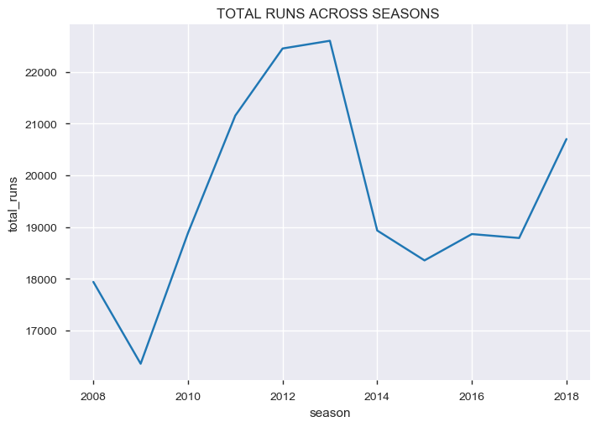
How many runs were scored across the seasons?
In the year 2012, 2013 there was heavy rainfall of runs in IPL

Slide 6

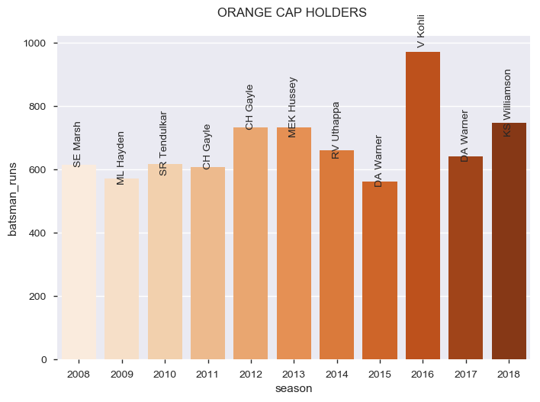



Who were the ORANGE Cap holders in each season?

Slide 7
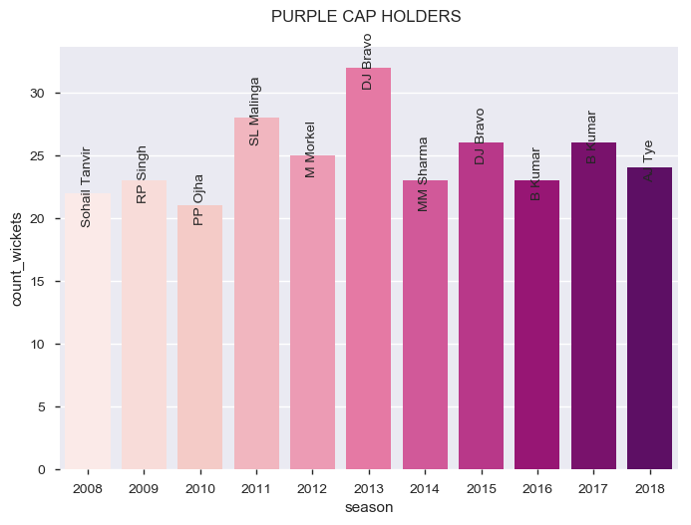
Who were the PURPLE Cap holders in each season?

Slide 8
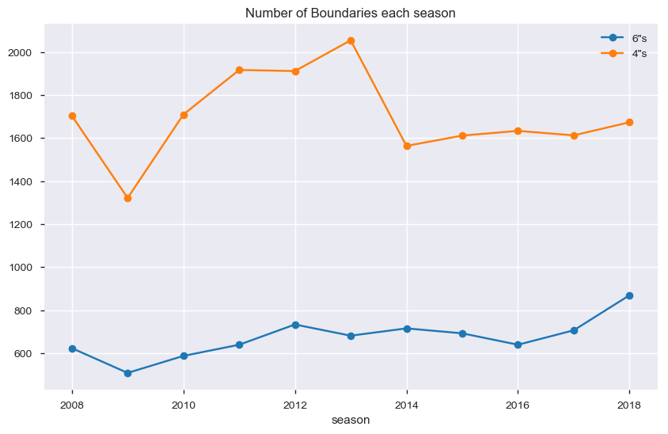
How many fours and sixes were hit each season?

Slide 9
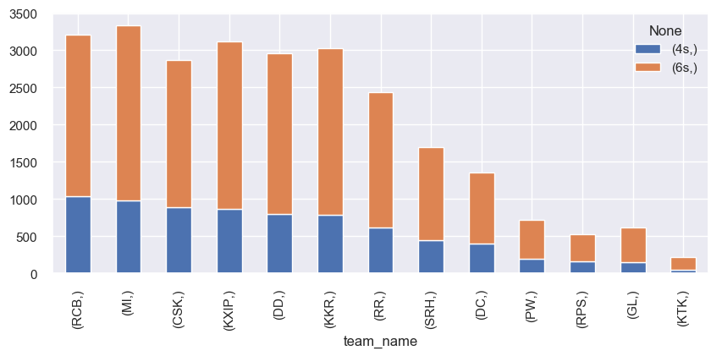
Which team has hit maximum number of boundaries in the entire IPL?

Slide 10
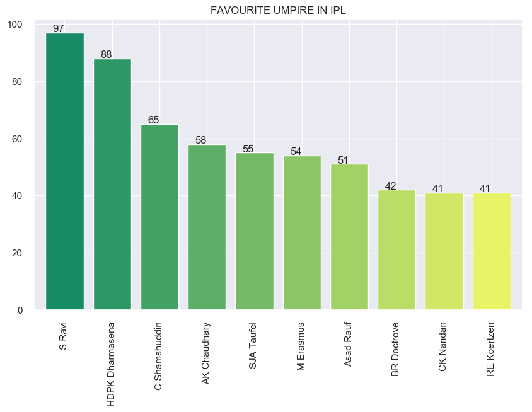
Who is the favorite umpire of IPL ?

Slide 11
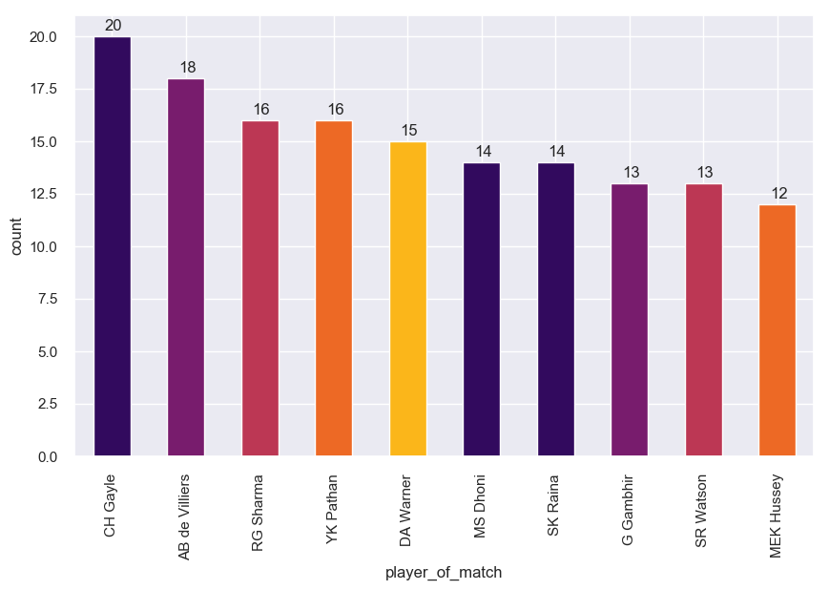
Who has won the most Man Of The Match award?

Slide 12
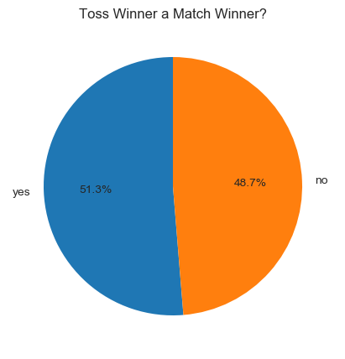
Is Toss winner a Match Winner in IPL T20?
As the pie chart shows the probability of winning the match after winning the toss is almost 50-50 , we can't conclude that toss wins a match in IPL.

Slide 13
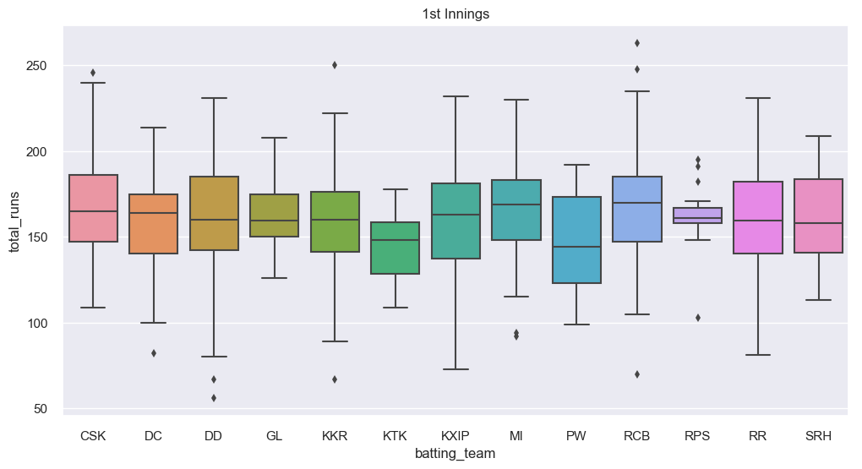
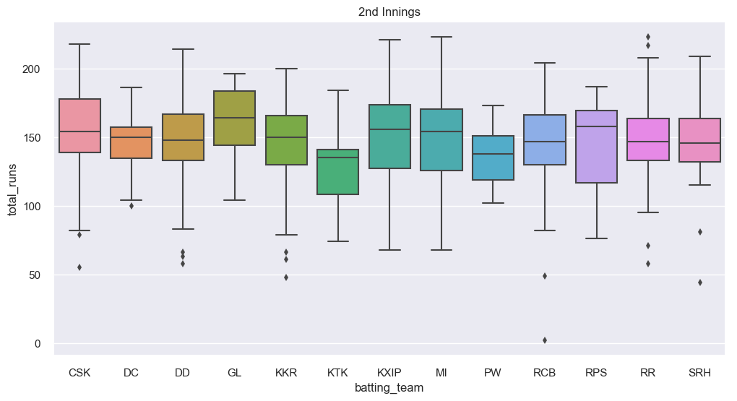
How is the score distributions for teams in each innings?
According to Graph 1 the batting by CSK in innings 1 looks to be the best. Graph 2 also conveys the same story.
In Graph 2 we see a point near 0 which may seem to be outlier. But it is so because the match was disrupted.

Slide 14
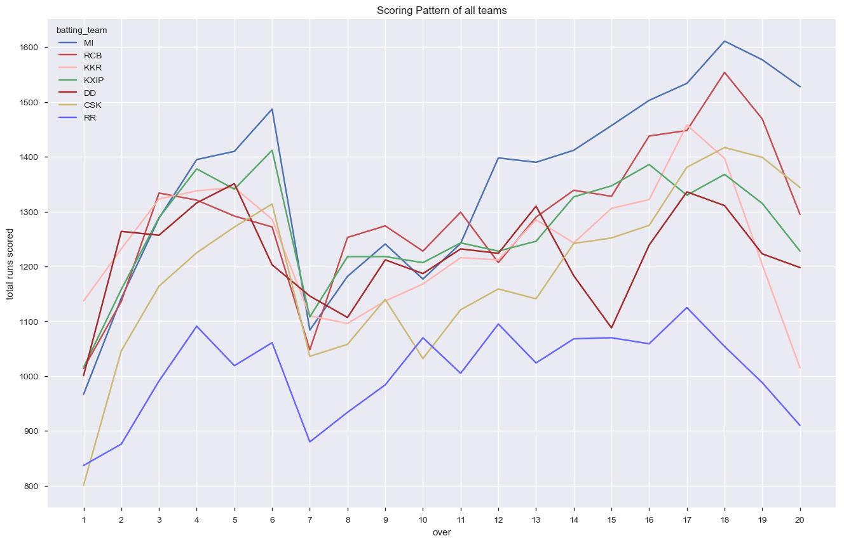
How is the run scoring patters for teams in each overs?
Maximum runs are being scored in the last 5 overs of the match. MI and RCB have shown increasing trend in the runs scored throughout the match.

Slide 15
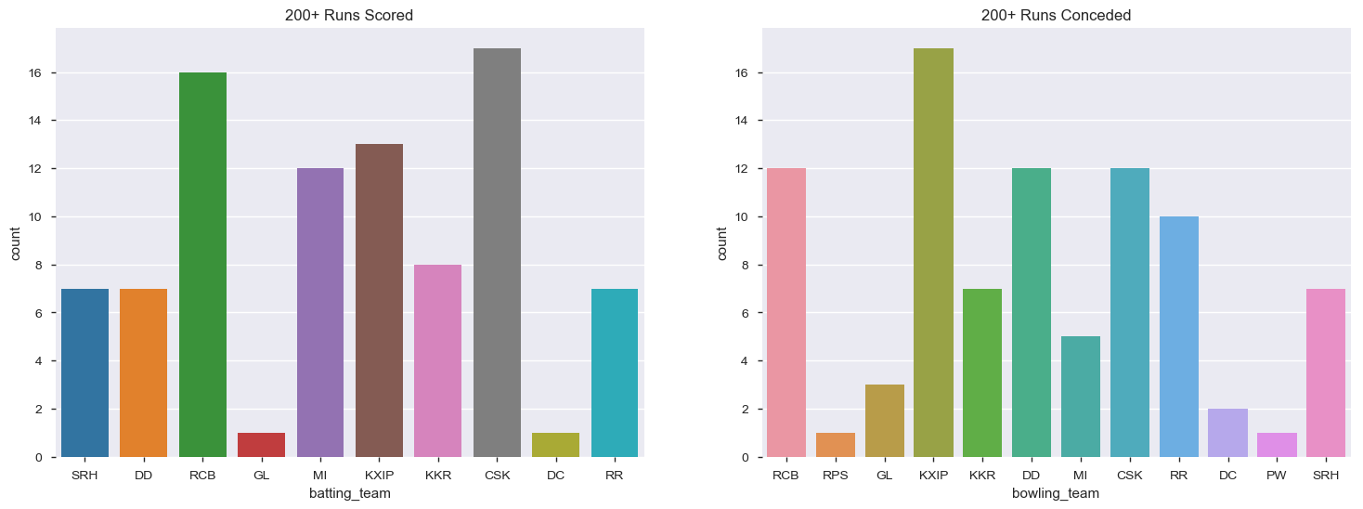
How many times a team has scored and conceded 200+ runs?

Slide 16
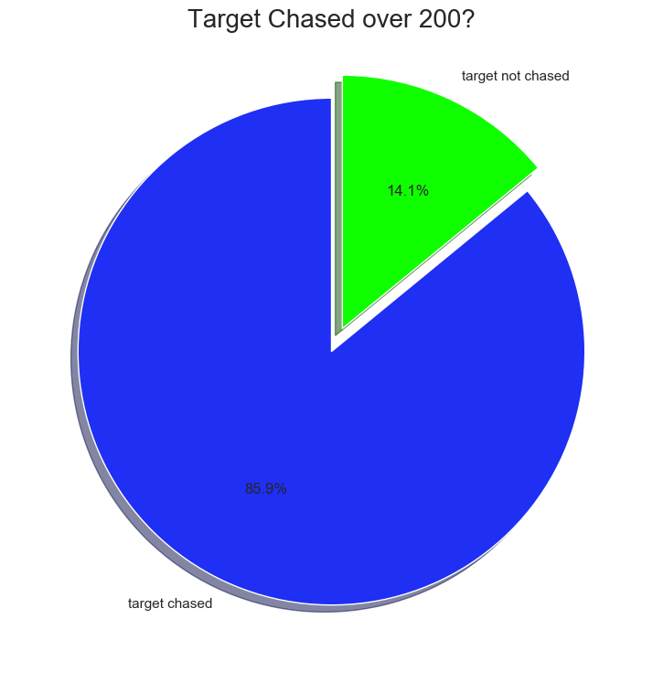
How many times a 200+ score has been chases successfully?
It seems that probability of winning a match after scoring 200 runs is very high.

Slide 17
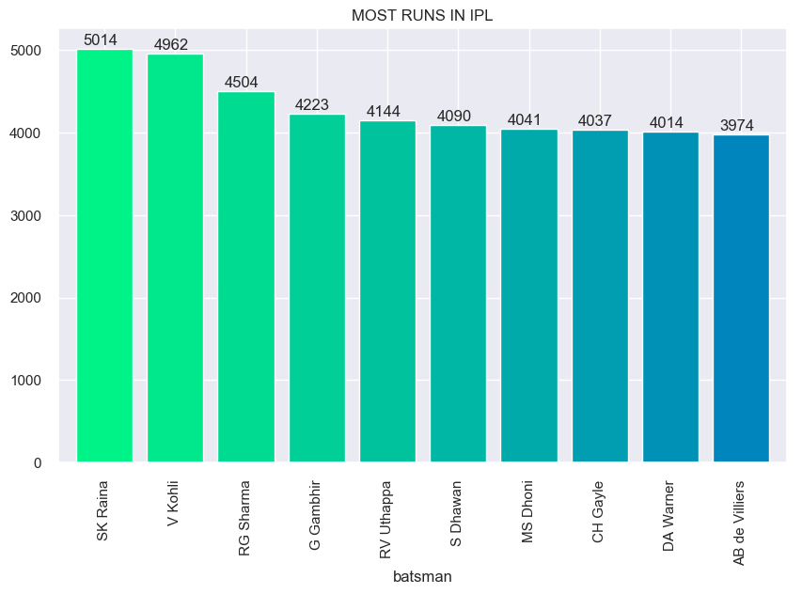
Which batsman has scored most runs in IPL?

Slide 18
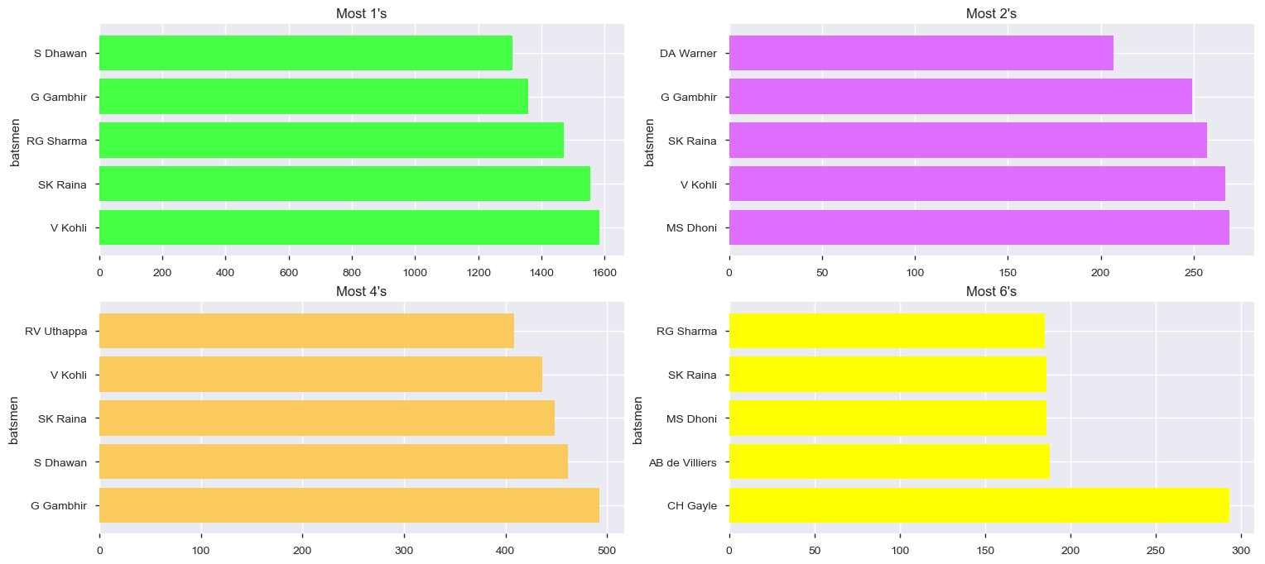
Who are the batsmen with most number of 1s, 2s, 4s and 6s?
Kohli has scored the maximum 1's
Dhoni has the maximum 2's . Those Strong Legs :p
Gambhir has the maximum 4's.
C Gayle has the maximum 6's and he leads by a big margin.

Slide 19
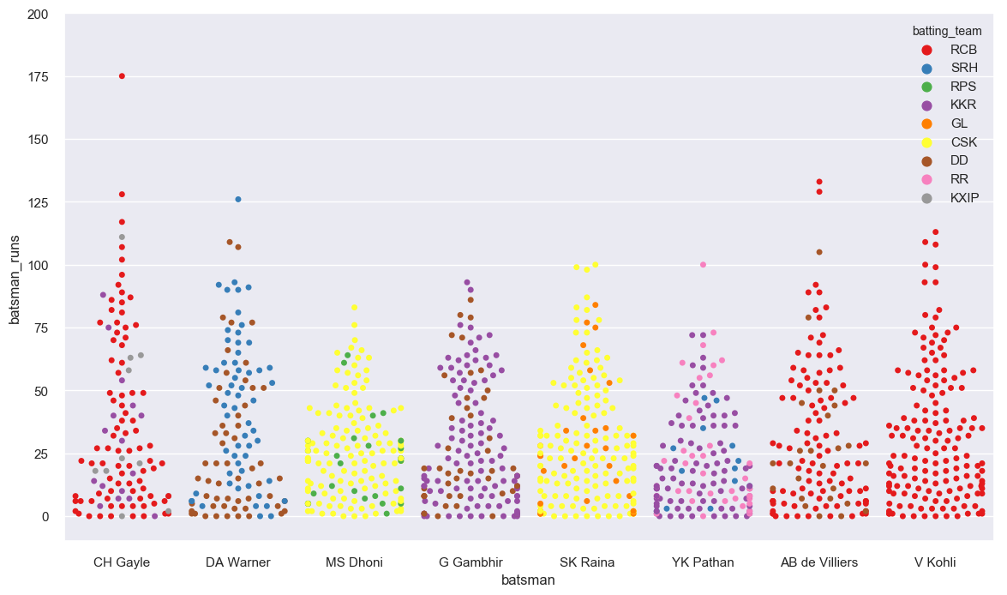
How is the Individual Scores pattern By Top Batsman each Innings?
Chris Gayle has the highest Individual Score of 175 and Highest Number of Centuries i.e 5
MS Dhoni and Gautam Gambhir have never scored a Century.
V Kohli has played only for 1 IPL Team in all seasons i.e RCB

Slide 20
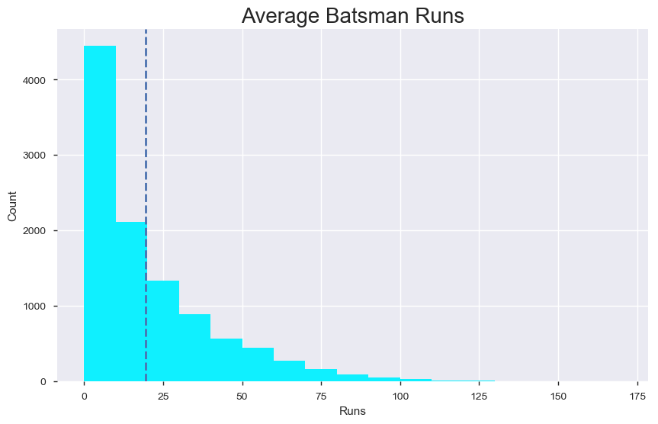
What is the average batsman score across seasons?
The average score for a batsman is around 19-20. Also the number of single digit score is quite high and the number of centuries is low.

Slide 21
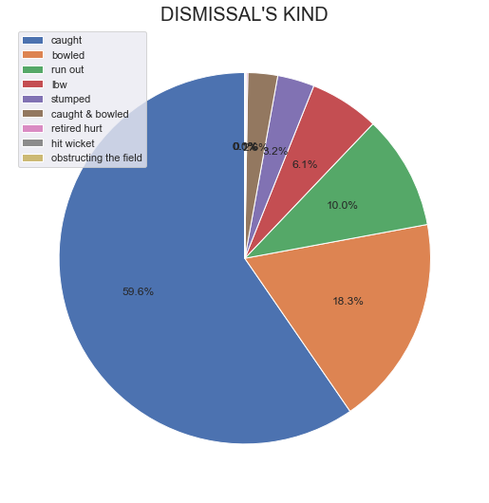
How were the batsmen got out mostly?

Slide 22
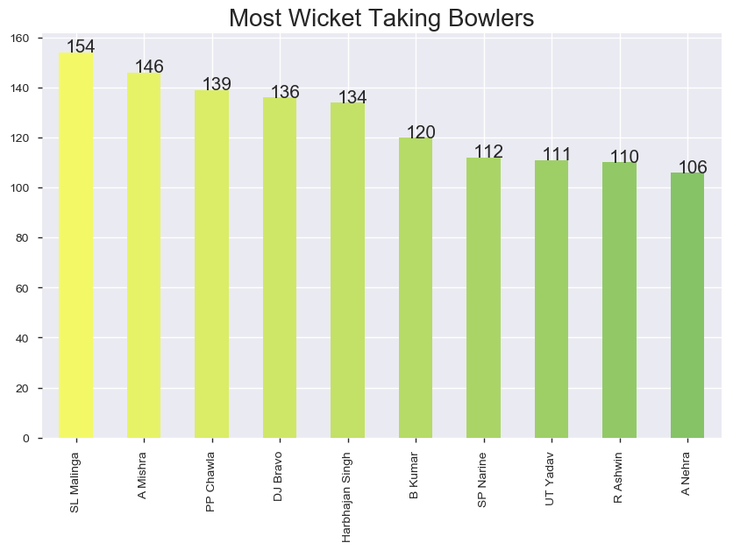
Who are top 10 most wicket taking bowlers in IPL?

Slide 23
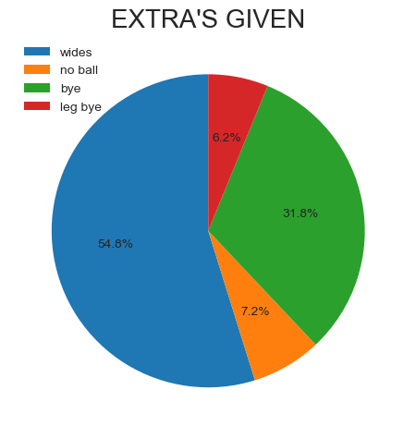
How were the different types of extra runs given?

Slide 24
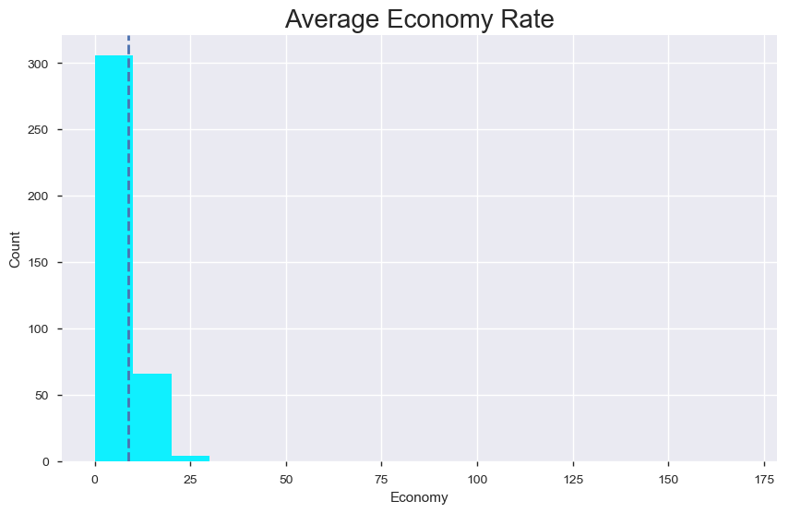
What is the average economy rate of a bowler?
The average economy rate for a bowler is around 8 to 9.

Slide 25
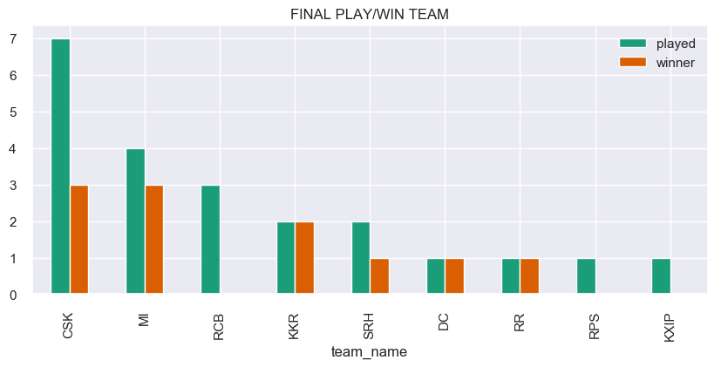
Which team has won most number of IPL finals?

Slide 26
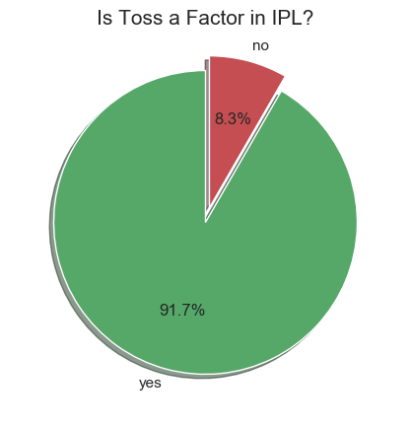
Is toss a factor in Final?
We can see that winner of the toss in final match of IPL is very likely to win the final match too.

Slide 27
THANK YOU

