Slide 1
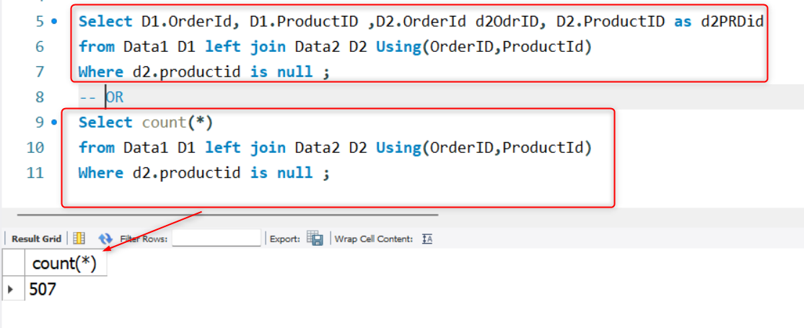

There are 2 datasets present in the file. Data 1 and Data 2
The primary key for both data1 and data2 is Order Id + Product ID combination (i.e. the individual datasets do not have any duplicate on this combination)
Provide solution and approach for the following:
1) How to identify the Records (Order ID + Product ID combination) present in data1 but missing in data2 (Specify the number of records missing in your answer)
NOTE: Here we are doing LEFT join considering D2 table is in the left
NOTE: If we would have add any numeric column then we had to apply sum function on it.
Prasun Karar

Slide 2
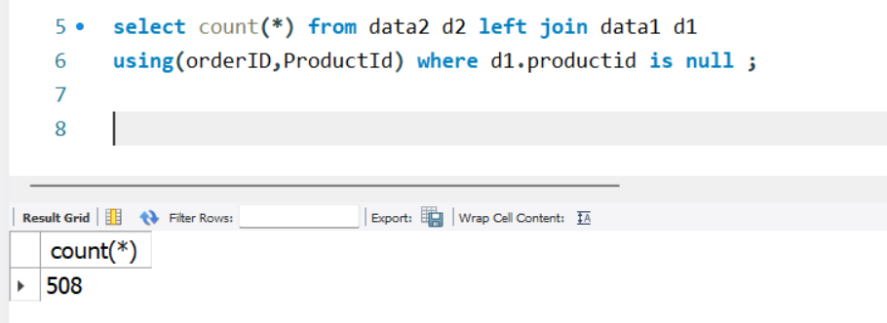
2) How to identify the Records (Order ID + Product ID combination) missing in data1 but present in data2
(Specify the number of records missing in your answer)
Prasun Karar

Slide 3
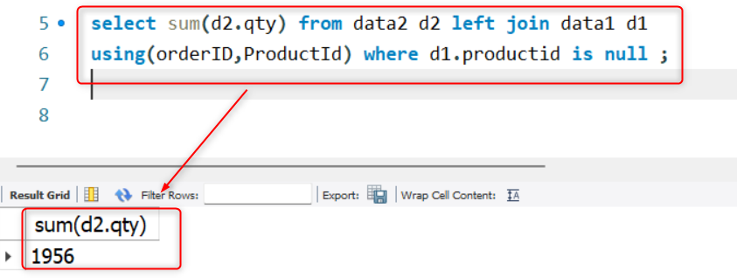
3) Find the Sum of the total Qty of Records missing in data1 but present in data2
Prasun Karar

Slide 4
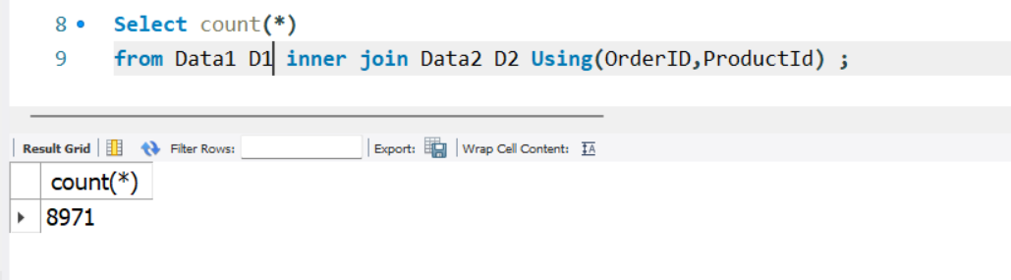
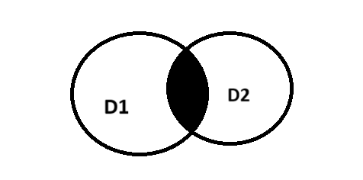
4) Find the total number of unique records (Order ID + Product ID combination) present in the combined dataset of data1 and data2
Prasun Karar

