Slide 1
BUSINESS
112
Survey responses
INSIDER
70
From Publisher to Platform:
Aged 18-34
Three Moves to Convert 18-34 Year-Olds Into Subscribers
4
Research pillars
3
Strategic moves
MAY 6, 2026 | CONFIDENTIAL | BUSINESS INSIDER | NYU
Consulting Team: Hannuo | Amaan | Izzie | Icy | Praswanth

Slide 2
OUR RECOMMENDATIONS | OVERVIEW
Three Workstreams Address the Problem in Sequence, and Each One Sets Up the Next
01 Reporter-as-Creator and Social Funnel
02 Free Daily Briefing and Newsletter Verticals
03 AI as Production Force-Multiplier
Reporter-as-Creator
and Social Funnel
Free Daily Briefing
and Newsletter Verticals
AI as Production
Force-Multiplier
Fix the handoff from social discovery to BI's owned ecosystem. Named reporter-led short-form video formats paired with a referral mechanic that removes paywall friction entirely on first touch.
Build a daily reading ritual before asking for money. A free personalized briefing builds the habit. Two career-utility newsletter verticals, Money Memo and Career Dispatch, are the subscription offer that follows.
Scale output without diluting editorial trust. A phased 90-day AI pilot expands BI's production capacity. Human reporters retain editorial voice and judgment at every stage.
CONFIDENTIAL | Business Insider Engagement Strategy | May 2026 | n=112

Slide 3
METHODOLOGY
We Surveyed 112 People and Researched Four Pillars, Wide in Reach, Deep in Learning
SECONDARY RESEARCH | Four Pillars
PRIMARY SURVEY | What We Found
01
Vertical Video Mechanics
112
70
Reporter-led format testing, 3-second hook analysis and mobile-first retention metrics
02
Market Gap Analysis
Total survey respondents
Aged 18-34 (target segment)
Competitive audits of NYT, WSJ, Bloomberg and Substack to find underserved verticals
03
Growth and Monetization
Referral mechanics, paywall friction mapping and employer-bundle pricing strategy
30
63%
04
AI Strategy and Trust
Questions across all 4 pillars
Majority in core demographic
How AI affects reader trust, paywall bypass behavior and content production capacity
Bottom line: We went wide across 112 respondents to find patterns, and deep into four research pillars to understand the competitive context. Every recommendation that follows draws from both.

Slide 4
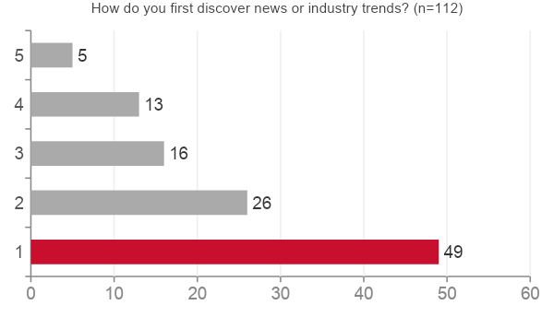
RESEARCH | AUDIENCE HABITS
Social Media Is BI's Primary Discovery Channel, But Readers Arrive Through Platforms BI Cannot Monetize
PRIMARY SURVEY n=112
BI's reach is borrowed, not owned
49 of 112 respondents discover news first on social. BI's content is found on TikTok, Instagram and YouTube, platforms that capture engagement value without returning it to BI.
Email is an underused loyalty asset
Only 13 respondents cite newsletters as their primary discovery channel, despite newsletters delivering the highest subscription conversion rates in digital media.
The morning window is the key activation moment
Early morning before 9am is the number one consumption time slot. BI's notification and newsletter cadence should target 6-8am to compete for this daily habit window.
CONFIDENTIAL | Business Insider Engagement Strategy | May 2026 | n=112

Slide 5
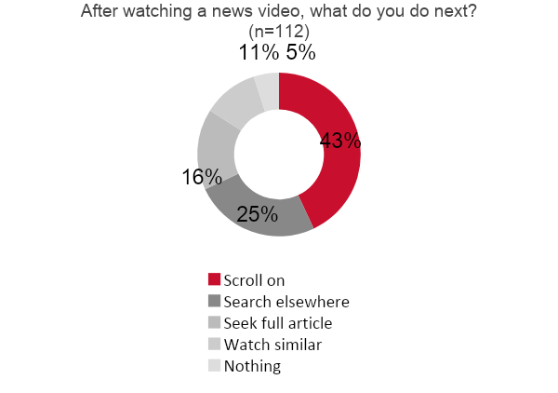
RESEARCH | VIDEO BEHAVIOR
43% Scroll Past After a News Video; BI Captures Only 16% Who Seek the Full Article
PRIMARY SURVEY n=112
43%
16%
scroll past without
engaging further
seek the full
article on BI
How to close the gap
SECONDARY RESEARCH
A reporter visible in the first 3 seconds drives significantly higher retention than a title card or voiceover alone
Embedding an article link as an on-screen call to action captures the 16% already looking for more
A referral mechanic replaces paywall friction with peer trust at the moment of conversion
CONFIDENTIAL | Business Insider Engagement Strategy | May 2026 | n=112

Slide 6
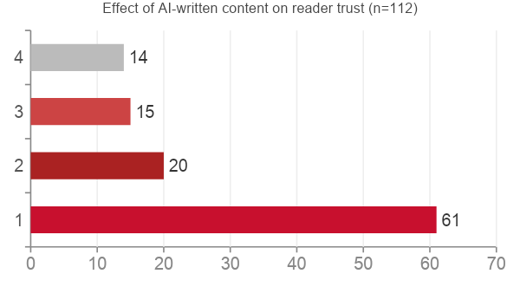
RESEARCH | AI AND TRUST
84% Say AI-Written Content Erodes Trust, Yet 63% Already Use AI to Bypass BI's Paywall
PRIMARY SURVEY n=112
63%
55%
use AI to bypass
paywalls occasionally
still read with visible
human sign-off
What this means for BI
AI is most dangerous as a substitute for human journalism. BI's competitive advantage is its named reporters, editorial point of view and institutional credibility. None of these can be replicated by a language model.
However, 55% would still read AI-assisted content when human sign-off is clearly visible. AI as a production tool is viable. AI as an author is not.
RISK: Readers who habitually use AI to summarize BI articles have a significantly lower subscription conversion probability. Reducing paywall friction is a parallel priority, not a sequential one.

Slide 7
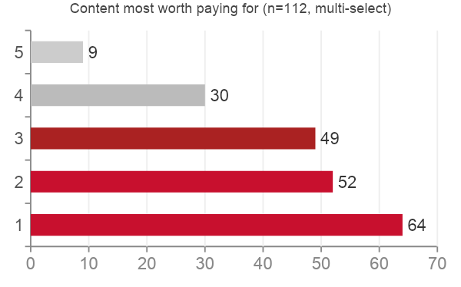
RESEARCH | MONETIZATION AND MARKET GAPS
Career Utility Unlocks Willingness to Pay; BI Underserves the Three Verticals This Audience Values Most
PRIMARY SURVEY n=112
SECONDARY RESEARCH
Personal Finance
HIGH
Morning Brew leads here; BI wins on data journalism depth and source access
Career Development
HIGH
LinkedIn dominates on reach; BI beats them on reporting depth and insider access
Entrepreneurship
GROWING
Substack and podcast creators own this; BI has no dedicated newsletter presence
38% of respondents would pay $10+ per month if content supports career or investment decisions | 39% have employer subscription budgets, B2B path is validated

Slide 8
INSIGHT 01 | AUDIENCE BEHAVIOR
The Discovery Is Happening. The Conversion Is Not. Friction at the Social-to-Owned Handoff Is the Root Problem.
49 of 112
PRIMARY SURVEY
respondents discover BI first on social media. The audience exists. The designed path from social into BI's owned ecosystem does not.
51%
SECONDARY RESEARCH
of 18-34 year-olds pay more attention to individual news creators than to news brand accounts. The reporter personality is the hook, not the BI masthead.
85%+
SECONDARY RESEARCH
referral conversion rate achieved by Morning Brew using a peer-invite mechanic. Peer trust removes the paywall moment entirely for new subscribers.
IMPLICATION:
Build a 4-step funnel: Hook via reporter-led video, Bridge to BI article with no paywall on first touch. Engage through daily briefing and newsletter opt-in, Convert through referral mechanic and employer bundle.
CONFIDENTIAL | Business Insider Engagement Strategy | May 2026 | n=112

Slide 9
INSIGHT 02 | ENGAGEMENT MODEL
Readers Do Not Cancel Because of Price. They Cancel Because BI Never Became Part of Their Daily Routine.
Not a content problem.
A ritual problem.
35%
PRIMARY SURVEY
The 5-Visit Rule
of respondents who cancelled said they did not use it enough, not that it was too expensive or too low quality. Habit is the retention mechanism.
Surface the subscription offer only after a reader has returned 5 or more times. Measure return visits over 30 to 60 days. Convert the habitual reader, not just the curious one.
73/112
PRIMARY SURVEY
respondents said daily one-minute summaries would bring them back every day, the top habit driver, nearly double personalized feeds and newsletters.
90 days
SECONDARY RESEARCH
is the make-or-break retention window. Habit and community features extend subscriber lifetime by 13-24%. The subscription ask must come after the habit forms.
IMPLICATION:
BI does not have a content problem. It has a ritual problem. A free personalized daily briefing with no paywall is the habit engine. Career and finance newsletter verticals are the subscription product that follows.
CONFIDENTIAL | Business Insider Engagement Strategy | May 2026 | n=112

Slide 10
INSIGHT 03 | AI STRATEGY
AI Destroys Value as an Author and Creates Value as Invisible Production Infrastructure.
AI AS AUTHOR | destroys trust
AI AS PRODUCTION TOOL | scales output, preserves trust
AI-written bylines: 84% of survey respondents say this reduces trust or willingness to pay
Video transcription and script generation from existing reporter interviews
Article-to-newsletter brief conversion, cutting production time without replacing editorial voice
AI making news judgment calls or setting the editorial agenda
SEO optimisation, headline A/B testing and topic trend detection
AI-generated video presenters with no human face or voice
Personalized content feed curation to increase return visit frequency and reduce churn
PRIMARY SURVEY n=112
55% of respondents would still read AI-assisted content when human sign-off is clearly visible. The guardrail is transparency and human oversight, not the absence of AI entirely.

Slide 11
RECOMMENDATION 01 | REPORTER-AS-CREATOR AND SOCIAL FUNNEL
Three Reporter-Led Video Formats and a Referral Funnel Convert Social Viewers Into Subscribers Without a Hard Paywall
DISCOVER
BRIDGE
ENGAGE
CONVERT
TikTok / Instagram / YouTube
BI Article or Newsletter
Daily Briefing and Newsletter
Referral Mechanic and Employer Bundle
>
>
>
Reporter-led 60-second hook
Frictionless link, no paywall on first touch
Career Intel and Money Moves opt-in
Peer trust removes paywall friction
The Brief
Daily | 60 seconds
Money Moves
3x per week | 90 seconds
Career Intel
2x per week | 2 minutes
Named BI reporter covers the top 3 business headlines. Opens with reporter on screen. Closes with a direct link to the full article on BI.
Personal finance reporter covers one actionable topic per episode. Connects to the Money Memo newsletter with a direct opt-in call to action.
Job market reporter with an occasional guest expert. Connects to Career Dispatch newsletter. Subscriber opt-in embedded in the final frame.
CONFIDENTIAL | Business Insider Engagement Strategy | May 2026 | n=112

Slide 12
RECOMMENDATION 02 | HABIT FORMATION AND NEWSLETTER VERTICALS
A Free Daily Briefing Builds the Reading Ritual; Two Career-Utility Newsletters Are the Subscription Offer
FREE DAILY BRIEFING | No paywall | No subscription required
60-second personalized briefing by interest area. No paywall. Surface the subscription offer only after 5 or more return visits.
MONEY MEMO
CAREER DISPATCH
PERSONAL FINANCE | EVERY MONDAY
CAREER DEVELOPMENT | EVERY WEDNESDAY
Salary negotiation playbooks
Job market weekly pulse
Investing basics: ETFs and index funds
Skills in demand: AI, data and finance
Side income and freelance tax strategy
Interview preparation with industry insiders
Financial planning for career transitions
Workplace culture and remote work trends
Gap: Morning Brew leads here; BI wins on data journalism depth and source access
Gap: LinkedIn dominates on reach; BI beats them on reporting depth and insider access
Pricing: $5 to $10 per month (48% of respondents) | Employer-billed bundles for the 39% with company subscription budgets

Slide 13
RECOMMENDATION 03 | AI AS PRODUCTION FORCE-MULTIPLIER
Deploy AI as a Production Force-Multiplier Now and Build a Proprietary Content Data Advantage Over Time
PHASE 1 | 90-Day Production Pilot
PHASE 2 | Content Data Advantage
10% Pilot | Days 1-30
01
Insider Knowledge Base
AI-assisted video transcription, article-to-script conversion and thumbnail A/B testing. Human editors review all output before every publish.
Structure 10+ years of verified BI reporting into a searchable intelligence product. Validated by 70% of respondents expressing interest in a single company-intelligence platform.
25% Scale | Days 31-60
02
Proprietary Data Layer
Newsletter brief generation, SEO headline optimisation and topic trend detection. Measure quality and engagement versus manual baseline.
BI's exclusive source relationships, verified documents and investigative datasets cannot be replicated by a public language model. This is the defensible content moat.
50% Integration | Days 61-90
Full workflow integration with human-in-the-loop sign-off at every stage. AI handles production scale; reporters retain editorial voice and judgment.
03
Content Licensing Recovery
Identify unauthorized use of BI content and convert those contacts into licensing relationships, recovering revenue from a high-margin stream.
CONFIDENTIAL | Business Insider Engagement Strategy | May 2026 | n=112

Slide 14
RISKS AND GUARDRAILS | AI DEPLOYMENT
Our Recommendations Carry Real AI Risks, These Five Guardrails Make Them Work
1
No AI bylines
4
Trust metrics monitored weekly
Reporters own every piece of content. AI is invisible production infrastructure, never a named contributor or author.
Shares, time on page and subscription rates tracked continuously. Any decline triggers immediate review of AI output.
2
Human editorial sign-off before every publish
5
Proprietary data isolated from external crawlers
Every AI-assisted piece requires reporter or editor approval before going live. No exceptions at any stage of the pilot.
BI's investigative data, source notes and exclusive datasets are separated from public AI training pipelines and external API access.
3
AI never sets the editorial agenda
AI surfaces trend signals and suggests topics based on engagement data. Reporters make every news judgment call.
DATA VALIDATION | 55% of respondents would still read AI-assisted content when human sign-off is clearly visible. Transparency is the guardrail, not the absence of AI.

Slide 15
ROADMAP | 90-DAY ACTIVATION PLAN
Three Work Streams Over 90 Days Build the Habit First and Unlock Subscription Conversion by Month 6.
WORKSTREAM 1
WORKSTREAM 2
WORKSTREAM 3
Reporter-as-Creator
and Social Funnel
Daily Briefing and
Newsletter Verticals
AI Production
Pilot
Week 1
Define 3 video formats and production template
Week 1
Audit newsletter list and define vertical segments
Week 1
Identify AI tools and define governance rules
Week 4
Pilot The Brief: 5 episodes, measure retention
Week 4
Launch Money Memo pilot to 5,000 subscribers
Week 4
10% pilot: transcription and script generation
Week 8
Launch Money Moves and Career Intel formats
Week 8
Launch Career Dispatch and A/B test subject lines
Week 8
25% expansion: newsletter briefs and SEO
Week 12
Publish video playbook and make scale decision
Week 12
Analyze open rates, clicks and paid conversion
Week 12
Review metrics and make 50% integration decision
Success metrics: 35%+ video retention | 500+ newsletter opt-ins per week | Paywall conversion lift of 15% by Month 6

