Slide 1
ITKO Stubbing
UT/DST Support

Slide 2
Benefits
Easier/Faster data creation
Easy data creation for Production Defects
Data related to previous releases can be created
Better Unit Testing
Increases Productivity

Slide 3
Pre-requisites
Lisa configuration in local
Config file changes (for non-SL APIs)
Agent Name creation
DSSLogin war installation (for DSS Only)
DSS Configuration changes

Slide 4
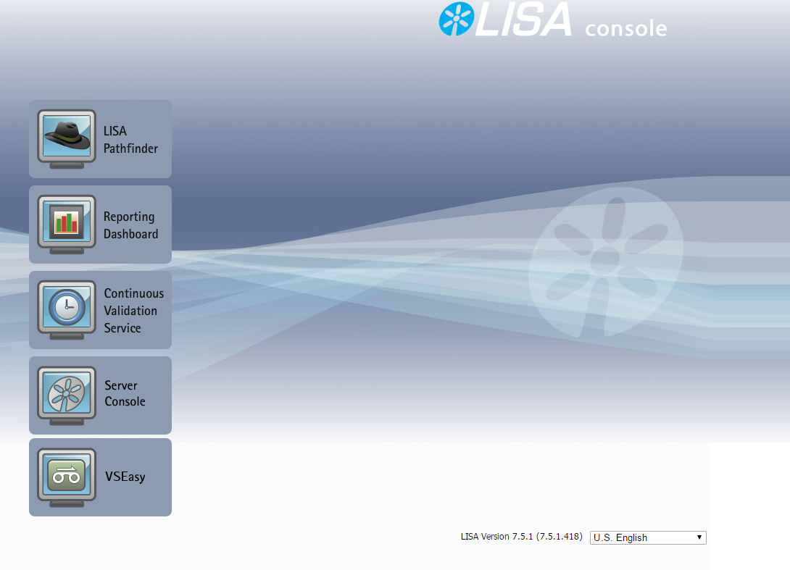
LISA Console

Slide 5
Olam Configuration
Update Stubbing env. cef in service-config, cefconnection and environment.properties file.
Place Lisa Agent Jar files in accessible location in System.
Add “set JAVA_OPTIONS=%JAVA_OPTIONS% -javaagent:[PATH_TO_LisaAgent2.jar_FILE]=url=tcp://10.243.224.188:2009,name=[ATTUID]Agent” in “StartWebLogic.cmd” file.
Start Server and update Stubbing team to add your agent name in their system (For first time only)

Slide 6
BEST Configuration
Deploy “DSSLogin” in Web-Logic Server.
Update stubbing cef in “service-config” file.
Start server.

Slide 7
E2E Flow (DSS)
Stubbing Env.
CPC
DSS Platform
DSSLogin
TGuard
Enabler
IFSUD
CSI
BEST
Framework
Service
Layer
IFSAPD
…

Slide 8
DSS Configuration
Update below path variables in “configuration.js” file.
TGUARD.TARGET.URL=http://[DSSLOGIN_WAR_ACCESS_URL]/dssLogin/setCookies?appID=M81162&returnURL=[ENCODED_LOCAL_RETURN_URL]
TGUARD.POST.URL.MULTILOGIN=http://[DSS_LOGIN_WAR_ACCESS_URL]/dssLogin/multiLogin
Start server

Slide 9
Stubbing Team
Sachin Agarwal (sa050b)
Vishal Kothekar (vk7927)
Kapil Kulkarni (kk2406)
Deepali Mundada (dm609u)

