Slide 1

Predicting Drug Consumption using AI
This presentation outlines our project focused on predicting cannabis usage using machine learning techniques. Our goal is to leverage personality traits and demographic features to identify at-risk individuals or groups, thereby enabling targeted public health interventions.
The insights gained from this project can inform policy decisions and resource allocation in the realm of public health. We will cover our data sources, feature selection process, methodology, model performance, and the challenges we encountered along the way.
By- Pratyush Goutam (RA2211042010023), Ayush Jaiswal (RA2211042010020)
CSBS, AG-2, GenAI

Slide 2
Data Sources and Feature Selection
To build our predictive models, we primarily used two datasets: the UCI Drug Consumption Dataset for training and testing, and the NSDUH 2017 Survey for validation. These datasets offer a range of features that allow us to explore various factors influencing cannabis use.
Demographic Features
Personality Traits
Age
Neuroticism
Gender
Extraversion
Education
Openness
Agreeableness
Conscientiousness
Impulsiveness
Sensation Seeking
Our target variable is binary: Cannabis User (Yes/No), allowing us to frame the problem as a classification task.

Slide 3






Methodology and Tech Stack
Our methodology involved a structured workflow to ensure rigor and reproducibility. We began with data collection and cleaning, followed by feature selection to identify the most relevant variables. Data visualization played a crucial role in understanding patterns and relationships within the data.
Data Collection & Cleaning
Gather and preprocess raw data.
Feature Selection
Identify key predictive variables.
Data Visualization
Understand data patterns.
Model Training & Evaluation
Train models and assess performance.
Result Interpretation
Draw meaningful conclusions.
Our tech stack included Python (Pandas, Scikit-learn, TensorFlow, Seaborn), Tableau Public, and Jupyter Notebook, each serving a specific purpose in the project.

Slide 4
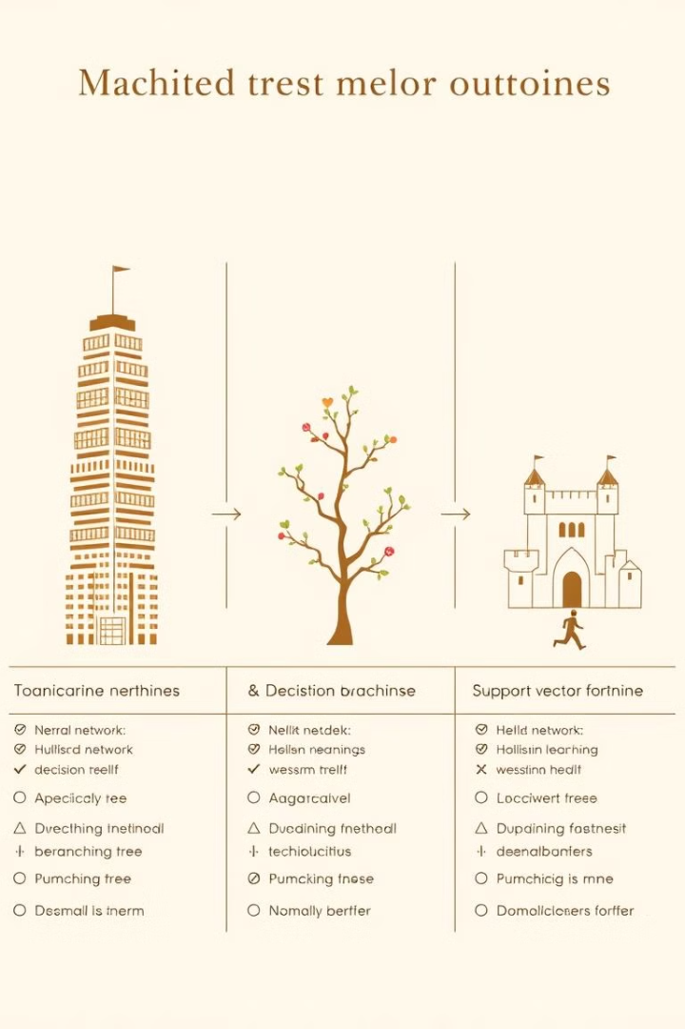
Model Performance and Results
We tested multiple models, including Logistic Regression, Support Vector Classifier, Gradient Boosting, Ridge & ElasticNet Regression, and Deep Neural Network. Logistic Regression gave the best accuracy on both training and test datasets.
Logistic Regression
Support Vector Classifier
High accuracy on training and moderate accuracy on test data.
Performed well but slightly lower accuracy than Logistic Regression.
Deep Neural Network
Showed overfitting issues, with high train accuracy but lower test accuracy.
The Deep Neural Network (DNN) resulted in a train accuracy of 92.7% but a test accuracy of 84.2%, indicating overfitting.

Slide 5

Challenges, Takeaways, and Future Directions
We faced several challenges, including matching validation dataset features, addressing missing personality traits, dealing with deep learning model overfitting, and iterative data preprocessing. These hurdles required creative problem-solving and a flexible approach.
Logistic Regression
Population-Level Insights
Works best for classification tasks.
Useful for understanding trends, not individual predictions.
Next Steps
Enhance generalization & try ensemble models.
Our next steps involve enhancing the generalization of our models and exploring ensemble methods to improve predictive performance.

