Slide 1



EcoScan: Your Guide to Sustainable Living
EcoScan is an innovative platform that leverages AI technology to empower individuals with the knowledge and tools necessary to make informed choices about recycling and reuse.
by Team Nova

Slide 2

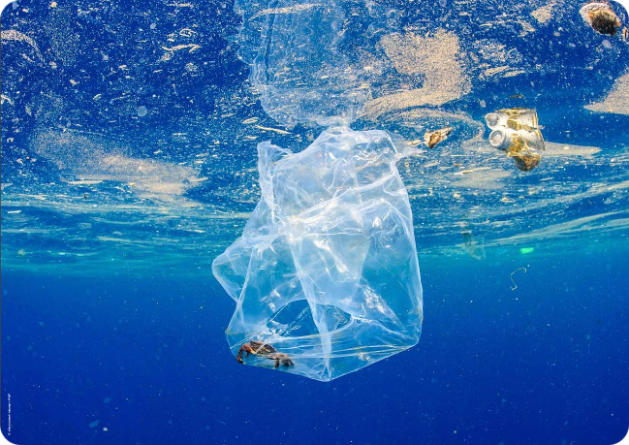
The Recycling Crisis
Globally, we face a mounting challenge with waste management. Improper disposal of recyclable materials often ends up in landfills, polluting our environment and contributing to climate change.
Limited Access to Recycling
Lack of Awareness
Many individuals lack comprehensive knowledge about recyclable materials and proper sorting procedures.
Not all communities have readily accessible recycling facilities, leading to improper waste disposal.
Contamination Issues
Improperly sorted recyclables, like food-contaminated containers, compromise the recycling process, making it less effective.

Slide 3





Solution: AI Image Classification
EcoScan's AI image classification system allows users to simply point their phone camera at an item and receive instant guidance on its recyclability.
Image Capture
Users take a photo of the object using their smartphone camera.
AI Analysis
EcoScan's AI analyzes the image and identifies the material composition of the object.
Recycling Guidance
The platform provides clear instructions on how to recycle the item correctly.

Slide 4
Solution: AI Chatbot Assistance
EcoScan's AI chatbot, powered by ChatGPT, offers voice-based recycling guidance, making it convenient for users with visual impairments or those who prefer a hands-free approach.
Voice Recognition
Interactive Dialogue
Personalized Recommendations
Users can verbally describe the object to the chatbot, leveraging its speech recognition capabilities.
The chatbot engages in a conversational exchange with the user, asking clarifying questions and providing tailored recycling instructions.
The chatbot can also offer specific recommendations based on the user's location and local recycling guidelines.

Slide 5

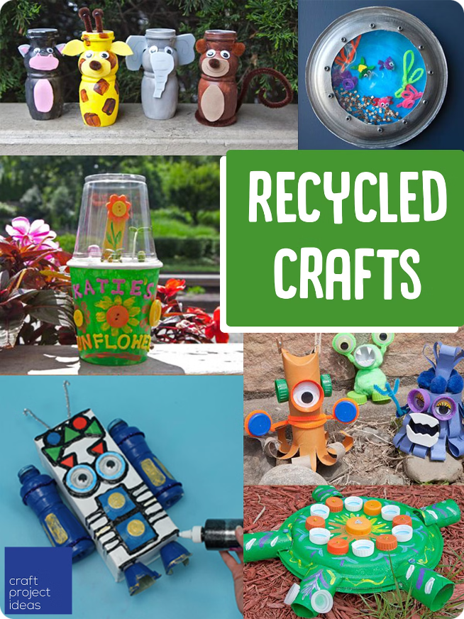
Solution: Reuse Recommendations
EcoScan encourages sustainable living by promoting the reuse of everyday items, reducing waste and minimizing our environmental footprint.
1
Creative Upcycling Ideas
2
Community Sharing
Users can share their own reuse projects with the EcoScan community, inspiring others and fostering a culture of creativity.
EcoScan provides innovative ways to repurpose materials, transforming discarded objects into useful and decorative items.
3
Resource Directory
EcoScan offers a comprehensive directory of local organizations that accept donations of reusable items.

