Slide 1
WebNote
Secure File Management System
By Pratap Indalkar

Slide 2
Introduction / Problem Statement
Users need a secure, private platform to upload, manage, and access files/notes online.

Slide 3
Objectives
Secure user authentication
Easy file upload/download
Support for multiple file types (images, PDFs, etc.)
Delete & manage files easily

Slide 4
Technology Stack
Frontend: React.js, CSS, Axios
Backend: Node.js, Express.js, Multer, JWT, bcryptjs
Database: MongoDB
Tools: Postman/ThunderClient for API testing

Slide 5
System Architecture
User → Frontend → Backend API → Database → File Storage

Slide 6
Backend Packages
Package | Purpose
express | Web framework for building the API server
dotenv | Loads environment variables from .env file
cors | Enables cross-origin requests (frontend can call backend)
mongoose | Connects and interacts with MongoDB database
multer | Handles file uploads (images, PDFs, etc.)
jsonwebtoken | Creates & verifies JWT tokens for authentication
bcryptjs | Hashes and verifies passwords securely
path | Node.js built-in module for handling file paths
fs | Node.js built-in module for file system operations (deleting files)

Slide 7
Frontend Packages
Package | Purpose
react | Core React library for UI
react-dom | React rendering to the DOM
react-router-dom | For routing between pages (Home, Login, Register, Dashboard)
axios | For making HTTP requests to backend
vite | Fast development build tool for React frontend

Slide 8
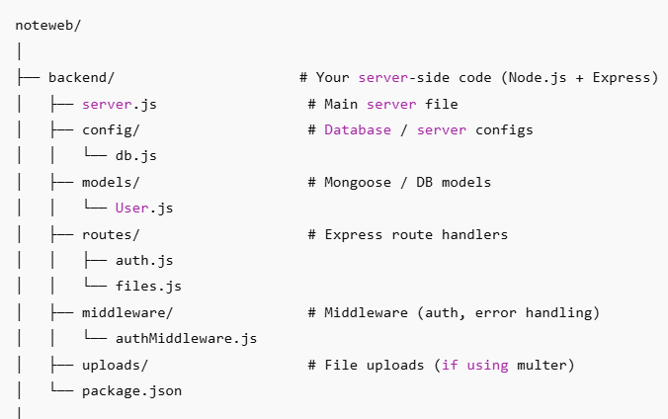
Folder Structure

Slide 9
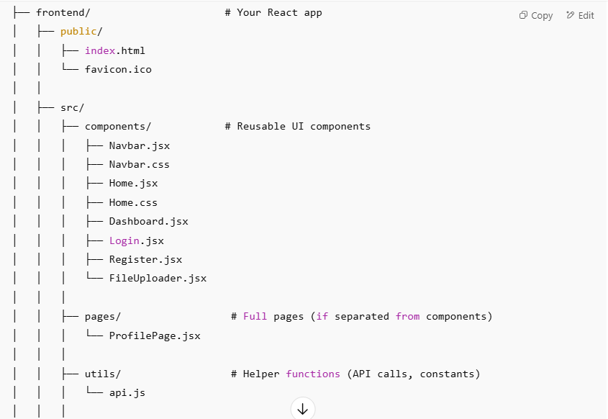
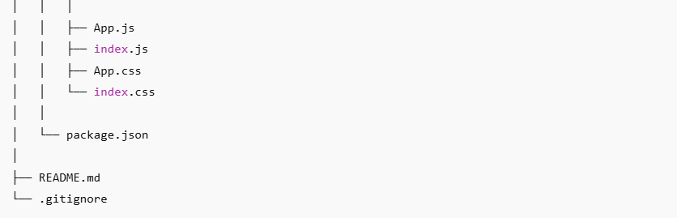

Slide 10
Features
Register/Login
Upload & View files
Delete files
Logout functionality
Google Form integration for Feedback/Rate Us

Slide 11
backend command
# Initialize Node.js project
npm init –y
# Install server dependencies
npm install express mongoose cors jsonwebtoken bcryptjs multer dotenv
# Install nodemon for auto-restart during development
npm install --save-dev nodemon
# Run backend
npm run dev

Slide 12
Frontend command
# Create frontend folder
npm create vite@latest frontend
# Install dependencies
npm install
npm install axios react-router-dom
# Run frontend
npm run dev

Slide 13
Challenges & Solutions
File type validation
JWT authentication handling
Serving static files

Slide 14
Conclusion & Future Scope
Possible improvements:
Cloud storage integration
Multi-user collaboration

Slide 15
Thank You
Questions?

