Slide 1

Intern as a Full stack developer
(https://www.Hackveda.in/)
Director mentor :
Devanshu Shukla
Director and Co-founder
by
Virendra Pratap Kharwar
(2019361@iiitdmj.ac.in)
Full-Stack Developer Mentor
Yash Chandra Upadhyay

Slide 2
Tasks
Doctor’s Appointment
TM web Application
Software Requirement Specification (SRS)
Calculator
Portfolio website (By using React jS and CSS)

Slide 3
Task Name: Doctor Appointment Page

Slide 4
Website for Doctor’s Appointment The project's main focus is to search for doctors nearby the user's area and choose the appropriate doctor for an appointment as per their needs.
https://doctors-appointment-5427.000webhostapp.com/

Slide 5
As an individual working on the TM Master Web Application project, I have utilised various skills to develop the web application. These include HTML, CSS, JavaScript, as well as web development tools such as
I have used Figma to create custom designs for the website.
000webhost.app - A free web hosting service.

Slide 6
Locofy.ai - Which is used to convert Figma designs into HTML, CSS code.
I have used PHP as backend language and MySQl as Database for developing this website
The web service has been tested using Postman to ensure its functionality.
However, during the testing process, I faced a few Postman errors that required me to troubleshoot and find solutions.

Slide 7
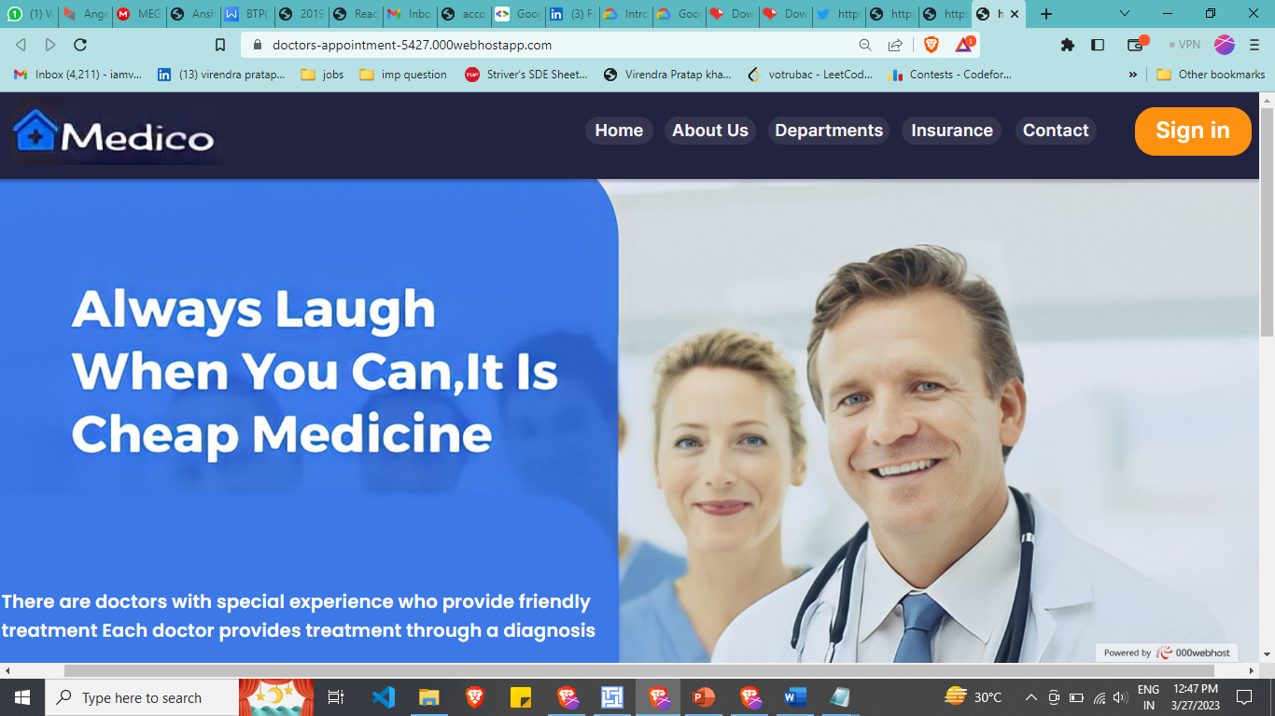
Here Some screenshot

Slide 8
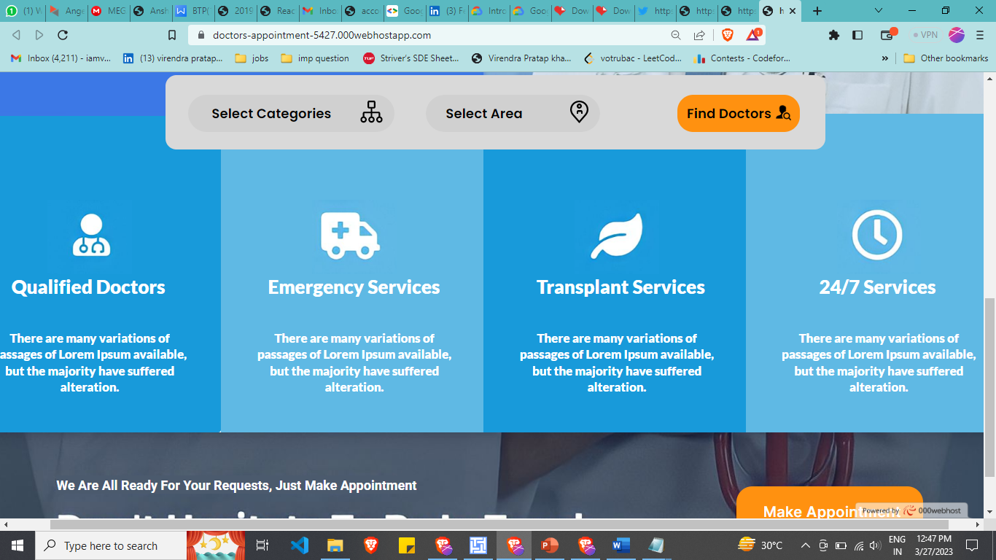
Here Some screenshot

Slide 9
CONCLUSION
Overall, the development of the Doctor Appointment Page reason is to learn basic development Tool Like VS Code, Figma, Anima, Locofi.ai and etc.
Here is the deployment Link https://doctors-appointment-5427.000webhostapp.com/

Slide 10
Task Name: TM web Application
Here is the deployment Link http://100.25.159.90:8000/

Slide 11
TM web Application
Trusting Minds is a medical clinic that is committed to providing the best possible care to its patients.
The TM Master Web Application project is an essential step towards achieving its goal.

Slide 12
Continue......
As a Full Stack Web Developer intern, my primary task was to understand the client's software requirement specification and develop a master application that meets the clinic's needs.
The web application will allow the clinic to streamline its patient record management, appointment scheduling, and other critical functions, ensuring that the clinic runs smoothly and effectively.

Slide 13
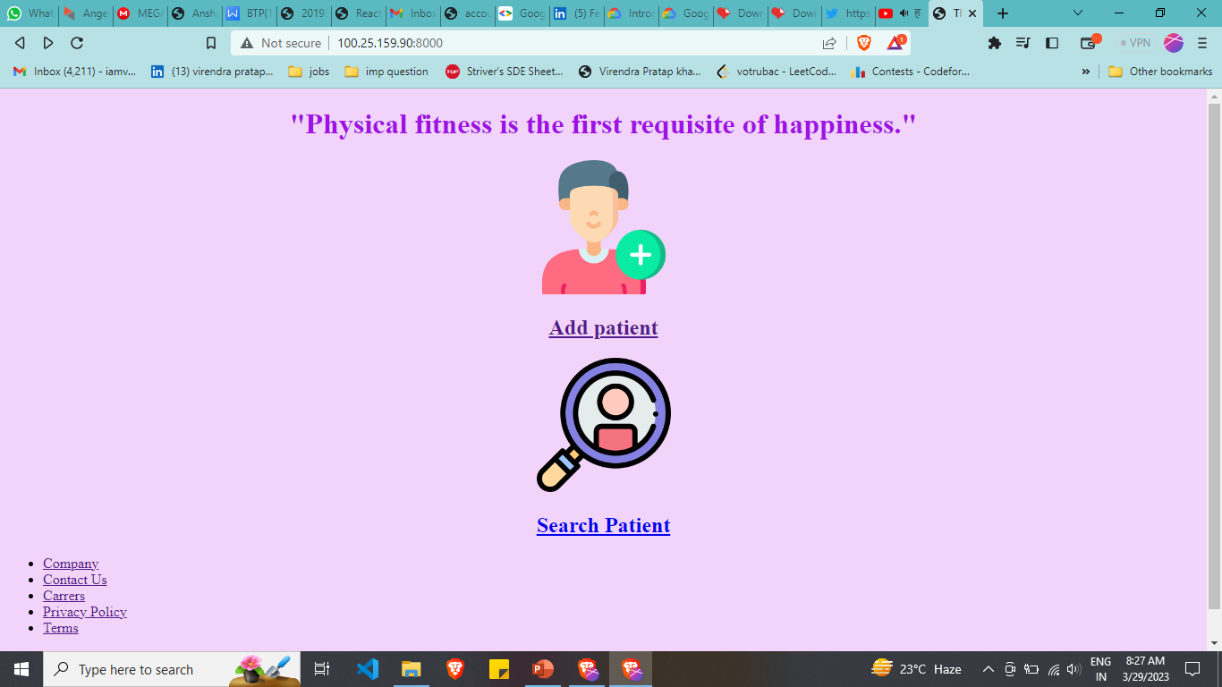
Here is the Screenshot of the TM Web Application
Code Github Link: https://github.com/pratap21/Tm-web-application

Slide 14
CONCLUSION
Overall, the development of the TM Master Web Application has been a valuable learning experience. The utilization of various web development tools and technologies has enhanced my skills and understanding of web application development.
Here is the deployment Link http://100.25.159.90:8000/

Slide 15
Software Requirement Specification(SRS)
The SRS document will provide a detailed description of the features, functionalities, and requirements of the software.
It will serve as a blueprint for the development team to follow during the software development process.
Link to the SRS document:- https://drive.google.com/drive/folders/15V89oKWREiVsmmdUtaxihqEqVyGBu5sg?usp=sharing

Slide 16
Software Requirement Specification (SRS)
Continue…
The SRS document will ensure that the web application meets the clinic's needs and will be a valuable resource for future maintenance and updates.
The review of the discussion video playlist helped to define the scope of the Project TM Master Web Application.

Slide 17
Steps involved in creating a SRS document :-
Step 1: Review the discussion video playlist
Step 2: Define the project scope
Step 3: Identify the stakeholders
Step 4: List the functional and NonFunctional requirements
Step 5: Prioritize the requirements
Step 6: Create a system architecture

Slide 18
Steps involved in creating an SRS document:-
Continue….
Step 7: Create use cases
Step 8: Define the data requirements
Step 9: Define the testing requirements
Step 10: Define the project timeline
Step 11: Review and refine
Step 12: Finalize the SRS document

Slide 19
SRS Continued….
The prioritization of the requirements based on importance and urgency helped to determine the development order for the software.
The data requirements were identified and documented to ensure proper data storage and management.
The project timeline and milestones were established to keep the project on track.
.
Link to the SRS document:- https://drive.google.com/drive/folders/15V89oKWREiVsmmdUtaxihqEqVyGBu5sg?usp=sharing

Slide 20
SRS continue…
The prioritization of the requirements based on importance and urgency helped to determine the development order for the software.
The data requirements were identified and documented to ensure proper data storage and management.
The project timeline and milestones were established to keep the project on track.
Link to the SRS document:- https://drive.google.com/drive/folders/15V89oKWREiVsmmdUtaxihqEqVyGBu5sg?usp=sharing

Slide 21
CONCLUSION
In conclusion, the creation of the SRS document for the Project TM Master Web Application was a crucial step towards ensuring the success of the project.
Through the thorough review of the discussion video playlist, we were able to identify and document all the necessary functional and non-functional requirements that the software should meet.

Slide 22
Task Name:
Introduction to Web Standards and JavaScript Concepts and Fundamentals Data Types, Variables, and Operators in JavaScript
Link to the Project: https://virendra-calculator.netlify.app/

Slide 23
Calculator
As part of my internship, I developed a simple Calculator App to showcase my skills.
The app is built using HTML, CSS, and JavaScript, utilizes local storage, and is Deployed.
The app is a basic demonstration of my web development abilities and calculating mathematical expressions.

Slide 24
Calculator
HTML code
HTML code includes the necessary elements to create the layout of the application, such as a header section, an input field for adding new expressions, and an operators.
CSS code
CSS code is used to style the application's elements, such as the font, background color, and alignment.
JavaScript code
JavaScript code includes functions that allow the application to store and retrieve the tasks from local storage and render them on the webpage.

Slide 25
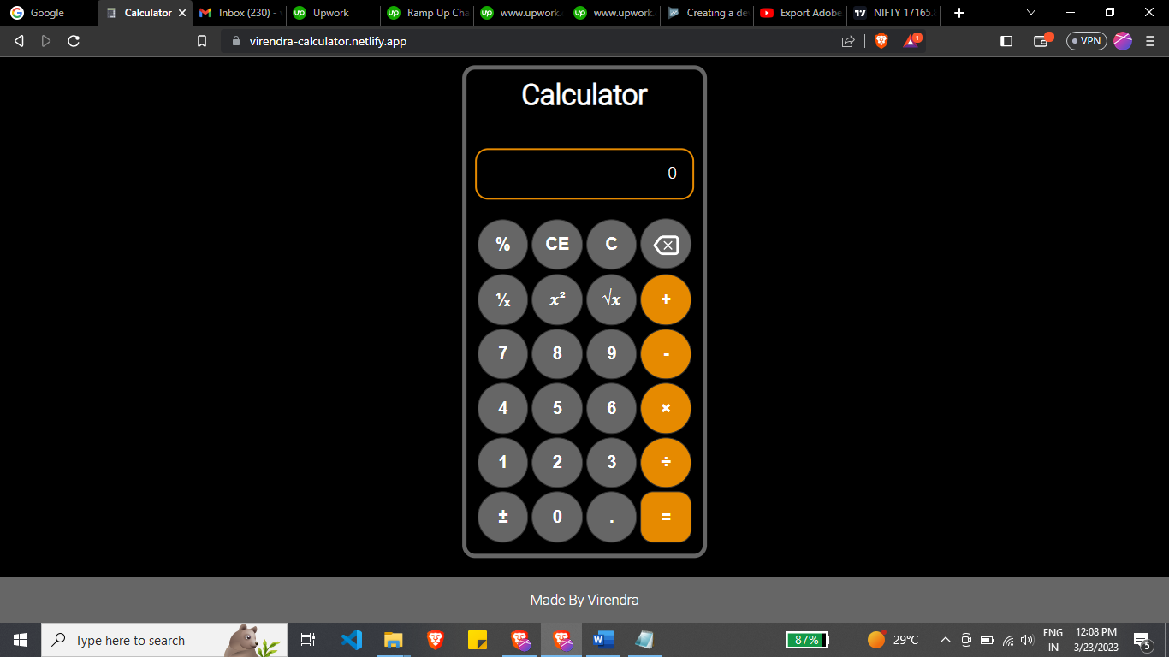
Link to the Project
https://virendra-calculator.netlify.app/
Link of Calculator code in Drive:https://drive.google.com/drive/u/0/folders/1qIo88F3TjGYbQRObgd7eboFhNGpxSPLw

Slide 26
CONCLUSION
In conclusion, this is a basic yet functional Calculator Application that can be expanded and customized to meet different requirements.
With further development and customization, this code can be used as a starting point to create more complex and advanced CalculatorApplications.
Overall, I found the Calculator App to be a valuable tool for managing my tasks and staying organized. With a few additional features, it has the potential to become even more useful for a wider range of users.

Slide 27
Task Name: Portfolio Website (By using React and CSS)

Slide 28
Portfolio Website
It is a React App.
It is a personal and professional project for learning react Js and CSS for a wider range with more dependencies, and plugins like Framer Motion, Yarn, Npm,email.js, etc.
The project’s main focus is to elaborate on your personal and professional skills.

Slide 29
Portfolio Website
This project runs on a local server as well as online Deployed on the Netify platform.
Email.Js help us contact anybody from my website. Toggle mode: Toggle turn Light or Dark mode.
Framer Motion: This plugin provides Dynamics on the website.
Link to the portfolio website: https://virendra-pratap.netlify.app/

Slide 30
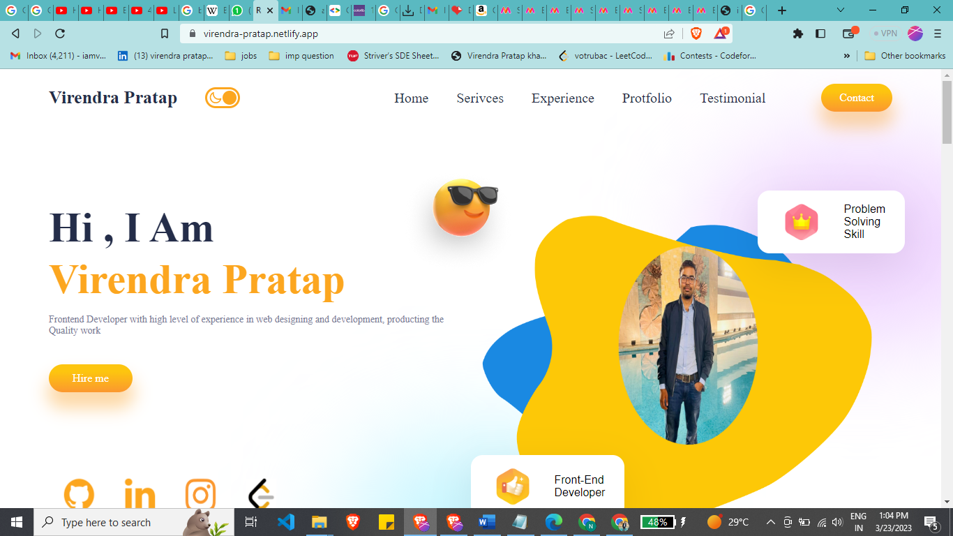
Here are the some screenshots

Slide 31
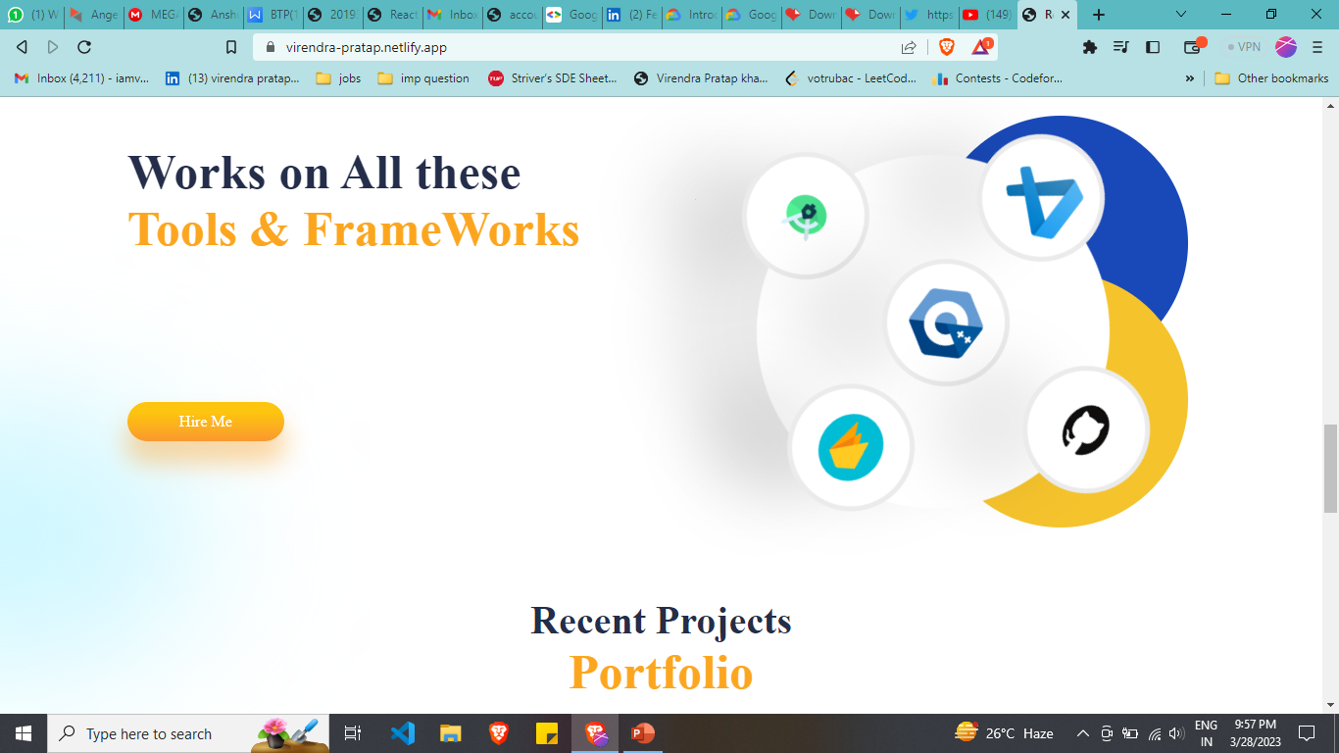
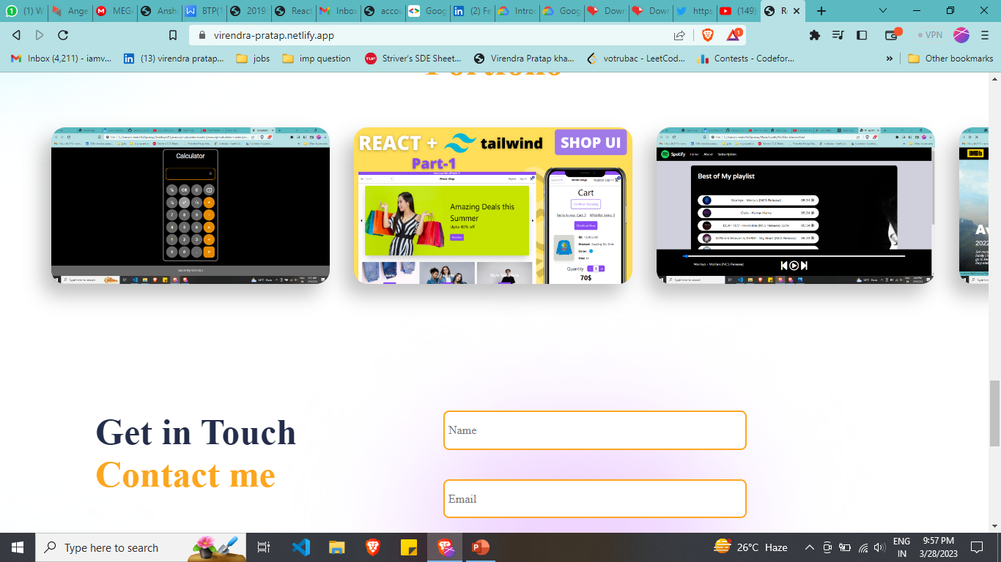
Here are the some screenshots

Slide 32
Thank You!

Slide 33
Any Question?

Slide 34
Contact Email 2019361@iiitdmj.ac.in
GitHub Link https://github.com/pratap21

