Slide 1




Federated Learning and edge computing in credit card fraud detection
Enhancing Security and Privacy in Financial Transactions

Slide 2
Title | Credit Card Fraud Detection using Federated Learning
Subtitle | Mastering Financial Security with Advanced Technologies
Presented By | Avinesh Pratap Singh, Brijesh Kumar, Rahul Agrawal
Supervision | Prof. Prasanta K. Jana
Institution | Indian Institute of Technology(ISM), Dhanbad
Date | 07-05-2024

Slide 3
Content:
Introduction
Background
Methodology
Model Implementation
Results
Conclusion
Acknowledgments
Notes:
When conducting research, it is easy to go to one source: Wikipedia. However, you need to include a variety of sources in your research. Consider the following sources:
Who can I interview to get more information on the topic?
Is the topic current and will it be relevant to my audience?
What articles, blogs, and magazines may have something related to my topic?
Is there a YouTube video on the topic? If so, what is it about?
What images can I find related to the topic?

Slide 4

Introduction
This project addresses the escalating issue of credit card fraud by developing a robust fraud detection system using federated learning and edge computing. Our findings demonstrate that Federated Averaging significantly enhances detection capabilities while maintaining stringent data privacy.
Notes:
Once you find your sources, you will want to evaluate your sources using the following questions:
Author:
Who is the author?
Why should I believe what he or she has to say on the topic?
Is the author seen as an expert on the topic? How do you know?
Current:
How current is the information in the source?
When was the source published?
Is the information out-of-date?
Accuracy:
Is the content accurate?
Is the information presented objectively? Do they share the pros and cons?

Slide 5
Background
Fraud Definition and Impact
Fraud involves illegal gain through deception. It not only causes direct economic losses but also undermines the legal and societal frameworks of financial systems.
Machine Learning for Fraud Detection
Machine learning offers powerful tools to detect patterns and anomalies in large datasets, making it crucial for identifying fraudulent activities in financial transactions.
Challenges with Current Systems
Current fraud detection systems face challenges like skewed data distributions and the inability to adapt to new fraud tactics quickly, known as concept drift.
Notes:
After consulting a variety of sources, you will need to narrow your topic. For example, the topic of internet safety is huge, but you could narrow that topic to include internet safety in regards to social media apps that teenagers are using heavily. A topic like that is more specific and will be relevant to your peers. Some questions to think about to help you narrow your topic:
What topics of the research interest me the most?
What topics of the research will interest my audience the most?
What topics will the audience find more engaging? Shocking? Inspiring?

Slide 6
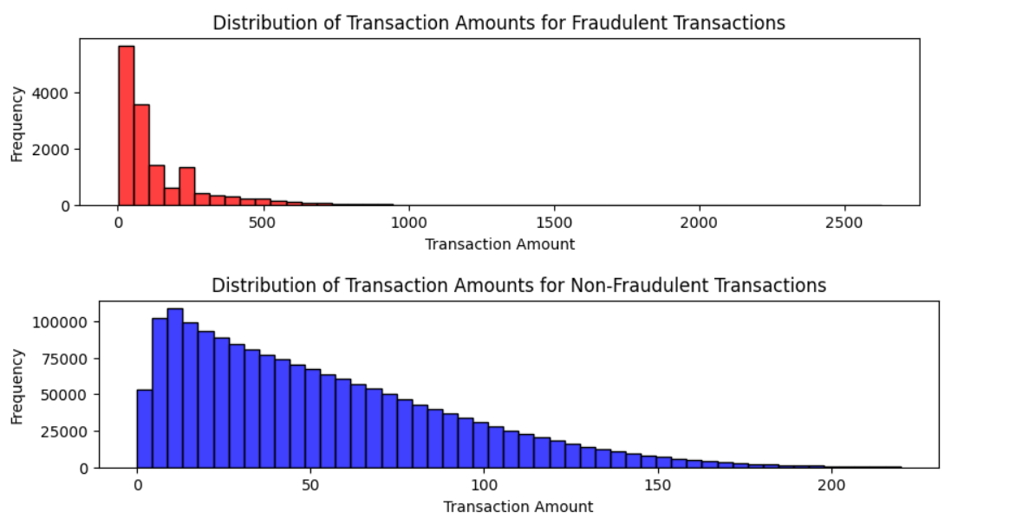
Methodology
Dataset
It can be seen that the fraudulent transactions are usually small span while the non-fraudulent transactions occur within a larger span of amount of money.
Notes:
Now, that you have narrowed your topic, you will want to organize your research in a structure that works. There are some common organizational patterns based on the kind of research you are doing.
Organizational Structures:
Cause and Effect- this kind of structure is great for explaining the causes and effects of a topic
Compare and Contrast- in this pattern you highlight the similarities and differences of the topic
Explain process- this structure is great for outlining a series of steps to follow;
Definition- if you want to make sure your audience understands what something is using illustrations, meanings, clarifying misconceptions, you may want to use this structure
Classification- a common organizational structure is grouping like topics or facts from the research together. For instance, in the internet safety about social media apps, you may organize the research where you look at each social media app one at a time

Slide 7
Methodology
Banks Grouping
Mathematical Formulation
The problem at hand is to optimally assign N bank nodes to M server nodes, minimizing the total cost defined by:
Cost =𝛼 × Distance + 𝛽 × Load
where Distance is the Euclidean distance between assigned bank and server nodes, and Load is the number of bank nodes assigned to a particular server, influencing server capacity strain. Here,
𝛼 and 𝛽 are weighting factors that balance the importance of distance minimization and load balancing.
Notes:
Now, that you have narrowed your topic, you will want to organize your research in a structure that works. There are some common organizational patterns based on the kind of research you are doing.
Organizational Structures:
Cause and Effect- this kind of structure is great for explaining the causes and effects of a topic
Compare and Contrast- in this pattern you highlight the similarities and differences of the topic
Explain process- this structure is great for outlining a series of steps to follow;
Definition- if you want to make sure your audience understands what something is using illustrations, meanings, clarifying misconceptions, you may want to use this structure
Classification- a common organizational structure is grouping like topics or facts from the research together. For instance, in the internet safety about social media apps, you may organize the research where you look at each social media app one at a time

Slide 8
Methodology
SMOTE for Balancing Dataset in Fraud Detection
Mathematical Formulation
SMOTE algorithm generates synthetic samples by operating in the feature space rather than the data space. For each minority class sample, it selects its
k nearest neighbours from the minority class. Synthetic samples are then created by choosing one of the
K nearest neighbours and connecting the line segment between the minority class sample and its chosen neighbour. Samples are generated randomly along this line, according to the formula:
New Sample = Existing Sample + λ × (Neighbour Sample − Existing Sample)
where λ is a random number between 0 and 1
Notes:
Now, that you have narrowed your topic, you will want to organize your research in a structure that works. There are some common organizational patterns based on the kind of research you are doing.
Organizational Structures:
Cause and Effect- this kind of structure is great for explaining the causes and effects of a topic
Compare and Contrast- in this pattern you highlight the similarities and differences of the topic
Explain process- this structure is great for outlining a series of steps to follow;
Definition- if you want to make sure your audience understands what something is using illustrations, meanings, clarifying misconceptions, you may want to use this structure
Classification- a common organizational structure is grouping like topics or facts from the research together. For instance, in the internet safety about social media apps, you may organize the research where you look at each social media app one at a time

Slide 9
Methodology
MLP and Federated Averaging
We opted for a Multi-Layer Perceptron (MLP) integrated with Federated Averaging (FedAvg) due to its robust ability to model complex, non-linear relationships inherent in financial transaction data. The MLP is ideal for this task, given its flexibility in architecture which allows it to learn from a multitude of features that characterize fraudulent activities
Notes:
Now, that you have narrowed your topic, you will want to organize your research in a structure that works. There are some common organizational patterns based on the kind of research you are doing.
Organizational Structures:
Cause and Effect- this kind of structure is great for explaining the causes and effects of a topic
Compare and Contrast- in this pattern you highlight the similarities and differences of the topic
Explain process- this structure is great for outlining a series of steps to follow;
Definition- if you want to make sure your audience understands what something is using illustrations, meanings, clarifying misconceptions, you may want to use this structure
Classification- a common organizational structure is grouping like topics or facts from the research together. For instance, in the internet safety about social media apps, you may organize the research where you look at each social media app one at a time

Slide 10
Methodology
Incorporating Federated Averaging enhances the model's capability by leveraging decentralized datasets across various nodes (e.g., different banks) without compromising data privacy. This approach is vital in environments where data cannot be shared due to privacy regulations or security policies. Federated Averaging allows for the collective intelligence of diverse datasets to be harnessed, improving the generalization of the model while adhering to privacy concerns. By training locally and averaging model updates centrally, FedAvg effectively broadens the model's exposure to varied data patterns, enhancing detection efficacy and making it superior to traditional centralized learning methods that lack robustness against diverse or skewed data distributions.
Notes:
Now, that you have narrowed your topic, you will want to organize your research in a structure that works. There are some common organizational patterns based on the kind of research you are doing.
Organizational Structures:
Cause and Effect- this kind of structure is great for explaining the causes and effects of a topic
Compare and Contrast- in this pattern you highlight the similarities and differences of the topic
Explain process- this structure is great for outlining a series of steps to follow;
Definition- if you want to make sure your audience understands what something is using illustrations, meanings, clarifying misconceptions, you may want to use this structure
Classification- a common organizational structure is grouping like topics or facts from the research together. For instance, in the internet safety about social media apps, you may organize the research where you look at each social media app one at a time

Slide 11
Model Implementation
Banks Grouping :
The PSO algorithm was implemented to manage the assignment of 600 bank nodes to a subset of 90 server nodes, each with a specific communication range. The process began with the random initialization of particle positions within the feasible space, ensuring no server assignment exceeded the communication range of 1000 units. Each particle's position represents a specific assignment of bank nodes to servers, and its velocity represents the potential changes to this assignment.
Notes:
After you’ve done your research, it’s time to put your presentation together. The first step in the process is to introduce the topic. This is a great time to connect your topic to something that your audience can relate. In other words, why should they listen to all the information you will be sharing in your research presentation? What is in it for them? You may also want to include a graphic or image to grab their attention.
Feel free to duplicate this slide by right-clicking on this slide in the slides pane to the left and select Duplicate Slide.
The next step in your presentation is to state your claim or topic clearly. Your teacher may even call this your thesis. As you state your thesis, you may find that this layout is not the best layout for your claim or topic. You can change the layout by clicking the drop-down menu next to the Layout in the Slides menu section. You can choose Two Content, Comparison, or Picture with Caption. Note: A different layout might change the look of the icons on this page.
You will also want to state your facts. You have done the research now share some of the interesting facts with your audience. Facts do not have to be boring; you can communicate facts in a variety of ways by going to the Insert Tab. In the Insert tab you can:
Insert pictures from your computer or online.
Add a chart
Create some SmartArt
Insert a variety of icons to help your facts come to life. Note: You can change the color of the icons by selecting the icon and then click on the Format tab and then Graphics Fill. From there, you will choose a color from the list or choose More Fill Colors to give you more options.
Since this research presentation is a result of your hard work and searching, you want to make sure you support the claims or points in your presentation with facts from your research findings. Make sure you give the author proper credit for helping you share your ideas. If one of your sources has a video that is relevant to your topic, you can add the video as added support. Keep in mind the length of the video and the amount of time you have for your presentation. For a 5 minute speech, the video should be no longer than 30 seconds.
Questions to consider:
How will you state the author of the source?
Will you need to cite the source on the slide?
What are some ways you can engage your audience so they feel like they are a part of the presentation? Some ideas to consider is by taking a quick poll like: by a show of hands, how many of you think school uniforms are a way to cut down on bullying? Another suggestion is to have them hold up a certain number of fingers to see if they agree or disagree. Finally, you can share a story that the audience can relate to that makes them laugh.
After all the applause, your audience may have some questions. Be prepared to answer some of their questions by making a list of questions you think they might ask. You may also want to share the presentation with them by providing the link to your presentation, if they want more information.

Slide 12
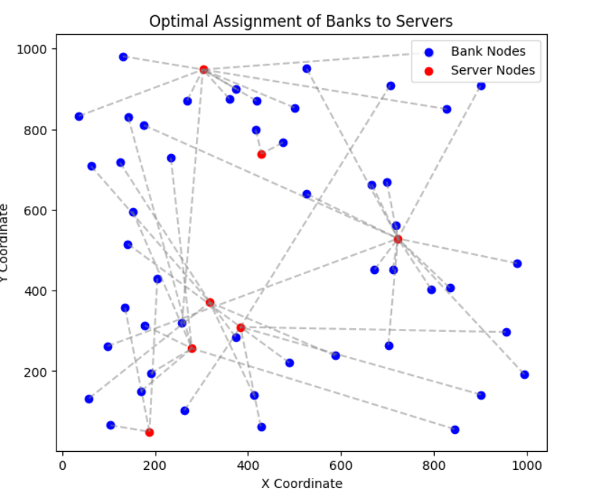
Model Implementation
Notes:
After you’ve done your research, it’s time to put your presentation together. The first step in the process is to introduce the topic. This is a great time to connect your topic to something that your audience can relate. In other words, why should they listen to all the information you will be sharing in your research presentation? What is in it for them? You may also want to include a graphic or image to grab their attention.
Feel free to duplicate this slide by right-clicking on this slide in the slides pane to the left and select Duplicate Slide.
The next step in your presentation is to state your claim or topic clearly. Your teacher may even call this your thesis. As you state your thesis, you may find that this layout is not the best layout for your claim or topic. You can change the layout by clicking the drop-down menu next to the Layout in the Slides menu section. You can choose Two Content, Comparison, or Picture with Caption. Note: A different layout might change the look of the icons on this page.
You will also want to state your facts. You have done the research now share some of the interesting facts with your audience. Facts do not have to be boring; you can communicate facts in a variety of ways by going to the Insert Tab. In the Insert tab you can:
Insert pictures from your computer or online.
Add a chart
Create some SmartArt
Insert a variety of icons to help your facts come to life. Note: You can change the color of the icons by selecting the icon and then click on the Format tab and then Graphics Fill. From there, you will choose a color from the list or choose More Fill Colors to give you more options.
Since this research presentation is a result of your hard work and searching, you want to make sure you support the claims or points in your presentation with facts from your research findings. Make sure you give the author proper credit for helping you share your ideas. If one of your sources has a video that is relevant to your topic, you can add the video as added support. Keep in mind the length of the video and the amount of time you have for your presentation. For a 5 minute speech, the video should be no longer than 30 seconds.
Questions to consider:
How will you state the author of the source?
Will you need to cite the source on the slide?
What are some ways you can engage your audience so they feel like they are a part of the presentation? Some ideas to consider is by taking a quick poll like: by a show of hands, how many of you think school uniforms are a way to cut down on bullying? Another suggestion is to have them hold up a certain number of fingers to see if they agree or disagree. Finally, you can share a story that the audience can relate to that makes them laugh.
After all the applause, your audience may have some questions. Be prepared to answer some of their questions by making a list of questions you think they might ask. You may also want to share the presentation with them by providing the link to your presentation, if they want more information.

Slide 13
Model Implementation
SMOTE in Credit Card Fraud Detection
Applying SMOTE to the minority class in the dataset to create a balanced class distribution.
Notes:
After you’ve done your research, it’s time to put your presentation together. The first step in the process is to introduce the topic. This is a great time to connect your topic to something that your audience can relate. In other words, why should they listen to all the information you will be sharing in your research presentation? What is in it for them? You may also want to include a graphic or image to grab their attention.
Feel free to duplicate this slide by right-clicking on this slide in the slides pane to the left and select Duplicate Slide.
The next step in your presentation is to state your claim or topic clearly. Your teacher may even call this your thesis. As you state your thesis, you may find that this layout is not the best layout for your claim or topic. You can change the layout by clicking the drop-down menu next to the Layout in the Slides menu section. You can choose Two Content, Comparison, or Picture with Caption. Note: A different layout might change the look of the icons on this page.
You will also want to state your facts. You have done the research now share some of the interesting facts with your audience. Facts do not have to be boring; you can communicate facts in a variety of ways by going to the Insert Tab. In the Insert tab you can:
Insert pictures from your computer or online.
Add a chart
Create some SmartArt
Insert a variety of icons to help your facts come to life. Note: You can change the color of the icons by selecting the icon and then click on the Format tab and then Graphics Fill. From there, you will choose a color from the list or choose More Fill Colors to give you more options.
Since this research presentation is a result of your hard work and searching, you want to make sure you support the claims or points in your presentation with facts from your research findings. Make sure you give the author proper credit for helping you share your ideas. If one of your sources has a video that is relevant to your topic, you can add the video as added support. Keep in mind the length of the video and the amount of time you have for your presentation. For a 5 minute speech, the video should be no longer than 30 seconds.
Questions to consider:
How will you state the author of the source?
Will you need to cite the source on the slide?
What are some ways you can engage your audience so they feel like they are a part of the presentation? Some ideas to consider is by taking a quick poll like: by a show of hands, how many of you think school uniforms are a way to cut down on bullying? Another suggestion is to have them hold up a certain number of fingers to see if they agree or disagree. Finally, you can share a story that the audience can relate to that makes them laugh.
After all the applause, your audience may have some questions. Be prepared to answer some of their questions by making a list of questions you think they might ask. You may also want to share the presentation with them by providing the link to your presentation, if they want more information.

Slide 14
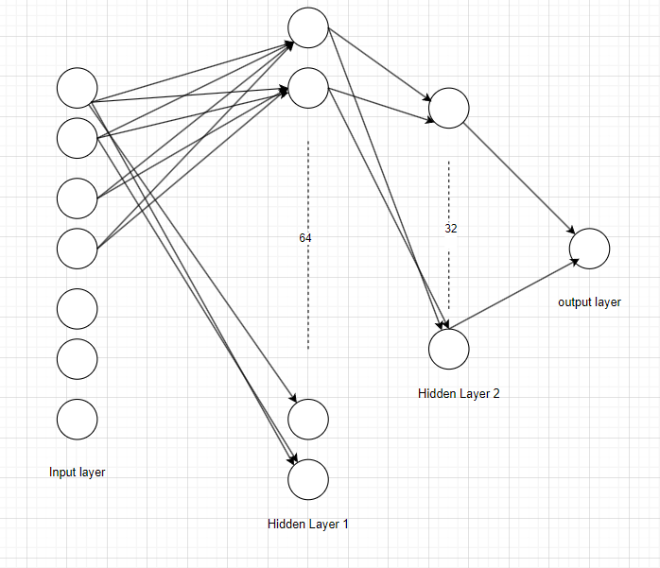
Model Implementation
Multilayer perceptron
The Implemented MLP Architecture is Described as below
Notes:
After you’ve done your research, it’s time to put your presentation together. The first step in the process is to introduce the topic. This is a great time to connect your topic to something that your audience can relate. In other words, why should they listen to all the information you will be sharing in your research presentation? What is in it for them? You may also want to include a graphic or image to grab their attention.
Feel free to duplicate this slide by right-clicking on this slide in the slides pane to the left and select Duplicate Slide.
The next step in your presentation is to state your claim or topic clearly. Your teacher may even call this your thesis. As you state your thesis, you may find that this layout is not the best layout for your claim or topic. You can change the layout by clicking the drop-down menu next to the Layout in the Slides menu section. You can choose Two Content, Comparison, or Picture with Caption. Note: A different layout might change the look of the icons on this page.
You will also want to state your facts. You have done the research now share some of the interesting facts with your audience. Facts do not have to be boring; you can communicate facts in a variety of ways by going to the Insert Tab. In the Insert tab you can:
Insert pictures from your computer or online.
Add a chart
Create some SmartArt
Insert a variety of icons to help your facts come to life. Note: You can change the color of the icons by selecting the icon and then click on the Format tab and then Graphics Fill. From there, you will choose a color from the list or choose More Fill Colors to give you more options.
Since this research presentation is a result of your hard work and searching, you want to make sure you support the claims or points in your presentation with facts from your research findings. Make sure you give the author proper credit for helping you share your ideas. If one of your sources has a video that is relevant to your topic, you can add the video as added support. Keep in mind the length of the video and the amount of time you have for your presentation. For a 5 minute speech, the video should be no longer than 30 seconds.
Questions to consider:
How will you state the author of the source?
Will you need to cite the source on the slide?
What are some ways you can engage your audience so they feel like they are a part of the presentation? Some ideas to consider is by taking a quick poll like: by a show of hands, how many of you think school uniforms are a way to cut down on bullying? Another suggestion is to have them hold up a certain number of fingers to see if they agree or disagree. Finally, you can share a story that the audience can relate to that makes them laugh.
After all the applause, your audience may have some questions. Be prepared to answer some of their questions by making a list of questions you think they might ask. You may also want to share the presentation with them by providing the link to your presentation, if they want more information.

Slide 15

Model Implementation
Federated Averaging:
Aggregation at the Edge Node Level
Notes:
After you’ve done your research, it’s time to put your presentation together. The first step in the process is to introduce the topic. This is a great time to connect your topic to something that your audience can relate. In other words, why should they listen to all the information you will be sharing in your research presentation? What is in it for them? You may also want to include a graphic or image to grab their attention.
Feel free to duplicate this slide by right-clicking on this slide in the slides pane to the left and select Duplicate Slide.
The next step in your presentation is to state your claim or topic clearly. Your teacher may even call this your thesis. As you state your thesis, you may find that this layout is not the best layout for your claim or topic. You can change the layout by clicking the drop-down menu next to the Layout in the Slides menu section. You can choose Two Content, Comparison, or Picture with Caption. Note: A different layout might change the look of the icons on this page.
You will also want to state your facts. You have done the research now share some of the interesting facts with your audience. Facts do not have to be boring; you can communicate facts in a variety of ways by going to the Insert Tab. In the Insert tab you can:
Insert pictures from your computer or online.
Add a chart
Create some SmartArt
Insert a variety of icons to help your facts come to life. Note: You can change the color of the icons by selecting the icon and then click on the Format tab and then Graphics Fill. From there, you will choose a color from the list or choose More Fill Colors to give you more options.
Since this research presentation is a result of your hard work and searching, you want to make sure you support the claims or points in your presentation with facts from your research findings. Make sure you give the author proper credit for helping you share your ideas. If one of your sources has a video that is relevant to your topic, you can add the video as added support. Keep in mind the length of the video and the amount of time you have for your presentation. For a 5 minute speech, the video should be no longer than 30 seconds.
Questions to consider:
How will you state the author of the source?
Will you need to cite the source on the slide?
What are some ways you can engage your audience so they feel like they are a part of the presentation? Some ideas to consider is by taking a quick poll like: by a show of hands, how many of you think school uniforms are a way to cut down on bullying? Another suggestion is to have them hold up a certain number of fingers to see if they agree or disagree. Finally, you can share a story that the audience can relate to that makes them laugh.
After all the applause, your audience may have some questions. Be prepared to answer some of their questions by making a list of questions you think they might ask. You may also want to share the presentation with them by providing the link to your presentation, if they want more information.

Slide 16
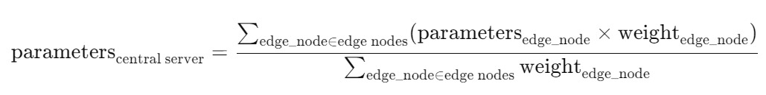
Model Implementation
Federated Averaging:
Aggregation at the Edge Node Level
Notes:
After you’ve done your research, it’s time to put your presentation together. The first step in the process is to introduce the topic. This is a great time to connect your topic to something that your audience can relate. In other words, why should they listen to all the information you will be sharing in your research presentation? What is in it for them? You may also want to include a graphic or image to grab their attention.
Feel free to duplicate this slide by right-clicking on this slide in the slides pane to the left and select Duplicate Slide.
The next step in your presentation is to state your claim or topic clearly. Your teacher may even call this your thesis. As you state your thesis, you may find that this layout is not the best layout for your claim or topic. You can change the layout by clicking the drop-down menu next to the Layout in the Slides menu section. You can choose Two Content, Comparison, or Picture with Caption. Note: A different layout might change the look of the icons on this page.
You will also want to state your facts. You have done the research now share some of the interesting facts with your audience. Facts do not have to be boring; you can communicate facts in a variety of ways by going to the Insert Tab. In the Insert tab you can:
Insert pictures from your computer or online.
Add a chart
Create some SmartArt
Insert a variety of icons to help your facts come to life. Note: You can change the color of the icons by selecting the icon and then click on the Format tab and then Graphics Fill. From there, you will choose a color from the list or choose More Fill Colors to give you more options.
Since this research presentation is a result of your hard work and searching, you want to make sure you support the claims or points in your presentation with facts from your research findings. Make sure you give the author proper credit for helping you share your ideas. If one of your sources has a video that is relevant to your topic, you can add the video as added support. Keep in mind the length of the video and the amount of time you have for your presentation. For a 5 minute speech, the video should be no longer than 30 seconds.
Questions to consider:
How will you state the author of the source?
Will you need to cite the source on the slide?
What are some ways you can engage your audience so they feel like they are a part of the presentation? Some ideas to consider is by taking a quick poll like: by a show of hands, how many of you think school uniforms are a way to cut down on bullying? Another suggestion is to have them hold up a certain number of fingers to see if they agree or disagree. Finally, you can share a story that the audience can relate to that makes them laugh.
After all the applause, your audience may have some questions. Be prepared to answer some of their questions by making a list of questions you think they might ask. You may also want to share the presentation with them by providing the link to your presentation, if they want more information.

Slide 17
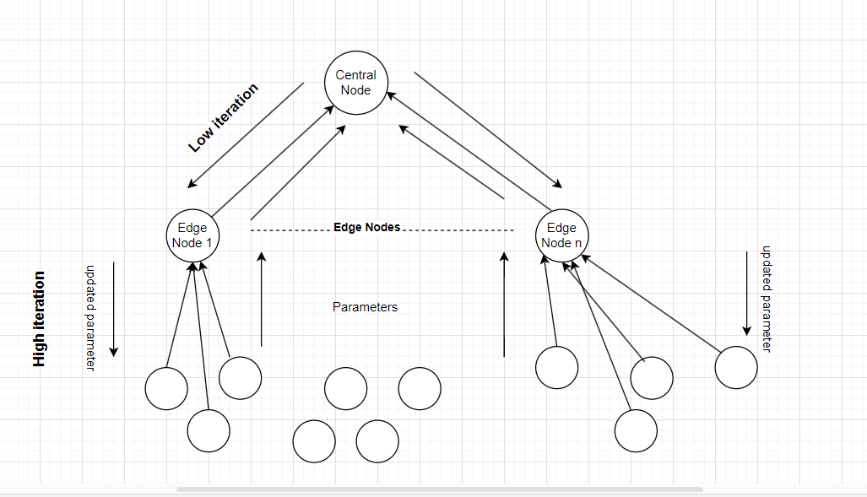
Model Implementation
Overall Federated learning with edge computing model:
Notes:
After you’ve done your research, it’s time to put your presentation together. The first step in the process is to introduce the topic. This is a great time to connect your topic to something that your audience can relate. In other words, why should they listen to all the information you will be sharing in your research presentation? What is in it for them? You may also want to include a graphic or image to grab their attention.
Feel free to duplicate this slide by right-clicking on this slide in the slides pane to the left and select Duplicate Slide.
The next step in your presentation is to state your claim or topic clearly. Your teacher may even call this your thesis. As you state your thesis, you may find that this layout is not the best layout for your claim or topic. You can change the layout by clicking the drop-down menu next to the Layout in the Slides menu section. You can choose Two Content, Comparison, or Picture with Caption. Note: A different layout might change the look of the icons on this page.
You will also want to state your facts. You have done the research now share some of the interesting facts with your audience. Facts do not have to be boring; you can communicate facts in a variety of ways by going to the Insert Tab. In the Insert tab you can:
Insert pictures from your computer or online.
Add a chart
Create some SmartArt
Insert a variety of icons to help your facts come to life. Note: You can change the color of the icons by selecting the icon and then click on the Format tab and then Graphics Fill. From there, you will choose a color from the list or choose More Fill Colors to give you more options.
Since this research presentation is a result of your hard work and searching, you want to make sure you support the claims or points in your presentation with facts from your research findings. Make sure you give the author proper credit for helping you share your ideas. If one of your sources has a video that is relevant to your topic, you can add the video as added support. Keep in mind the length of the video and the amount of time you have for your presentation. For a 5 minute speech, the video should be no longer than 30 seconds.
Questions to consider:
How will you state the author of the source?
Will you need to cite the source on the slide?
What are some ways you can engage your audience so they feel like they are a part of the presentation? Some ideas to consider is by taking a quick poll like: by a show of hands, how many of you think school uniforms are a way to cut down on bullying? Another suggestion is to have them hold up a certain number of fingers to see if they agree or disagree. Finally, you can share a story that the audience can relate to that makes them laugh.
After all the applause, your audience may have some questions. Be prepared to answer some of their questions by making a list of questions you think they might ask. You may also want to share the presentation with them by providing the link to your presentation, if they want more information.

Slide 18
Model Implementation
The implementation of federated learning and edge computing in fraud detection not only advances the capability to combat fraud but also sets a precedent for privacy-preserving technologies in financial services.
Also, due to incorporating edge layer, the load on the central server is reduced largely.
Notes:
After you’ve done your research, it’s time to put your presentation together. The first step in the process is to introduce the topic. This is a great time to connect your topic to something that your audience can relate. In other words, why should they listen to all the information you will be sharing in your research presentation? What is in it for them? You may also want to include a graphic or image to grab their attention.
Feel free to duplicate this slide by right-clicking on this slide in the slides pane to the left and select Duplicate Slide.
The next step in your presentation is to state your claim or topic clearly. Your teacher may even call this your thesis. As you state your thesis, you may find that this layout is not the best layout for your claim or topic. You can change the layout by clicking the drop-down menu next to the Layout in the Slides menu section. You can choose Two Content, Comparison, or Picture with Caption. Note: A different layout might change the look of the icons on this page.
You will also want to state your facts. You have done the research now share some of the interesting facts with your audience. Facts do not have to be boring; you can communicate facts in a variety of ways by going to the Insert Tab. In the Insert tab you can:
Insert pictures from your computer or online.
Add a chart
Create some SmartArt
Insert a variety of icons to help your facts come to life. Note: You can change the color of the icons by selecting the icon and then click on the Format tab and then Graphics Fill. From there, you will choose a color from the list or choose More Fill Colors to give you more options.
Since this research presentation is a result of your hard work and searching, you want to make sure you support the claims or points in your presentation with facts from your research findings. Make sure you give the author proper credit for helping you share your ideas. If one of your sources has a video that is relevant to your topic, you can add the video as added support. Keep in mind the length of the video and the amount of time you have for your presentation. For a 5 minute speech, the video should be no longer than 30 seconds.
Questions to consider:
How will you state the author of the source?
Will you need to cite the source on the slide?
What are some ways you can engage your audience so they feel like they are a part of the presentation? Some ideas to consider is by taking a quick poll like: by a show of hands, how many of you think school uniforms are a way to cut down on bullying? Another suggestion is to have them hold up a certain number of fingers to see if they agree or disagree. Finally, you can share a story that the audience can relate to that makes them laugh.
After all the applause, your audience may have some questions. Be prepared to answer some of their questions by making a list of questions you think they might ask. You may also want to share the presentation with them by providing the link to your presentation, if they want more information.

Slide 19
Results
Our results indicate that the Federated Averaging model outperforms traditional centralized models in accuracy and efficiency, providing a scalable solution to fraud detection with enhanced privacy protections.
Notes:
Once you find your sources, you will want to evaluate your sources using the following questions:
Author:
Who is the author?
Why should I believe what he or she has to say on the topic?
Is the author seen as an expert on the topic? How do you know?
Current:
How current is the information in the source?
When was the source published?
Is the information out-of-date?
Accuracy:
Is the content accurate?
Is the information presented objectively? Do they share the pros and cons?

Slide 20
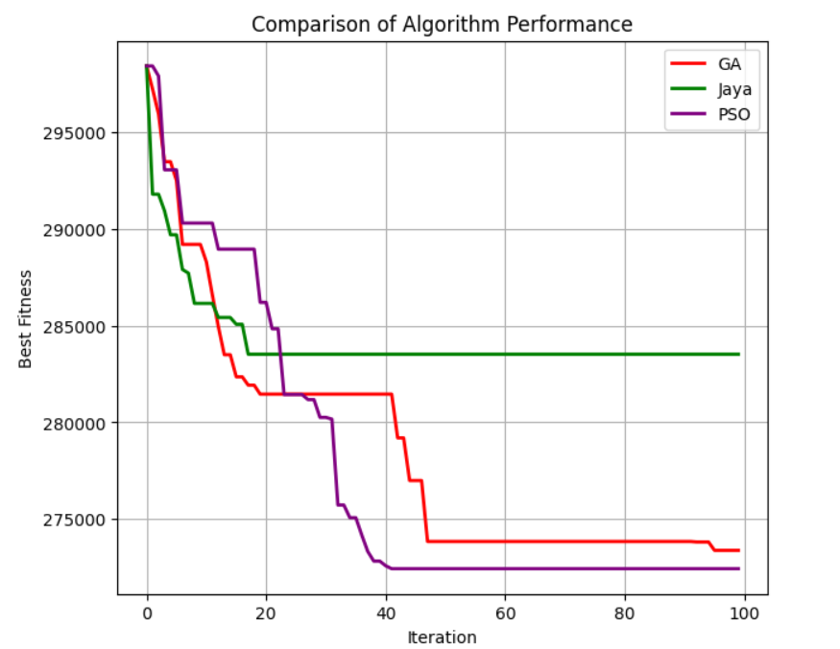
Results
Banks Grouping : The PSO is compared with other meta heuristic approaches. The performance result is shown below:
Notes:
Once you find your sources, you will want to evaluate your sources using the following questions:
Author:
Who is the author?
Why should I believe what he or she has to say on the topic?
Is the author seen as an expert on the topic? How do you know?
Current:
How current is the information in the source?
When was the source published?
Is the information out-of-date?
Accuracy:
Is the content accurate?
Is the information presented objectively? Do they share the pros and cons?

Slide 21
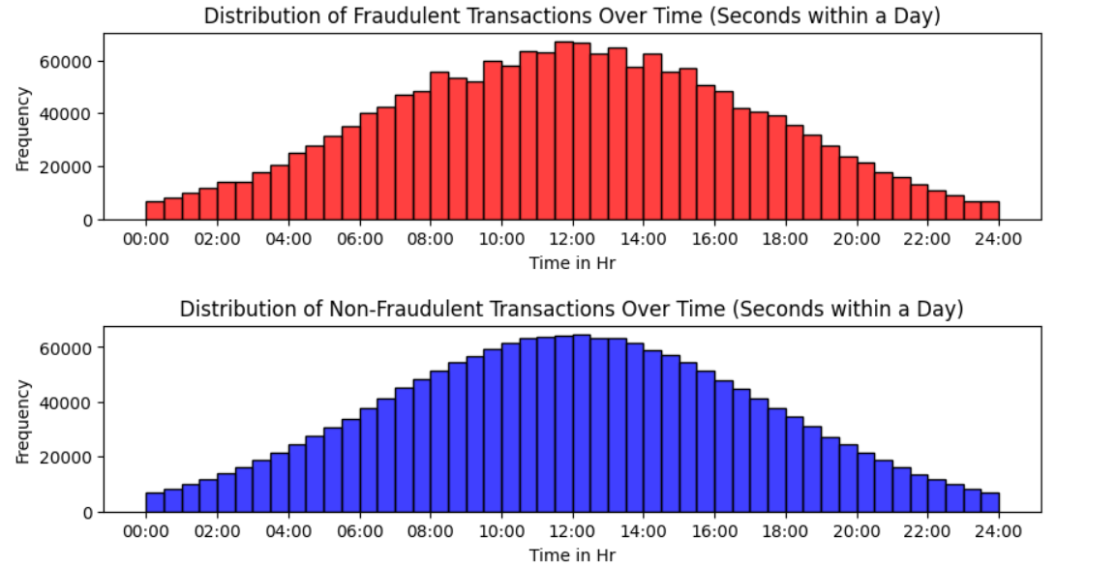
Results
Performance Evaluation of Models with SMOTE: The impact of SMOTE on model performance was evaluated by training various classification models on both the original and the SMOTE-enhanced datasets
Dataset Distribution after SMOTE w.r.t. time
Notes:
Once you find your sources, you will want to evaluate your sources using the following questions:
Author:
Who is the author?
Why should I believe what he or she has to say on the topic?
Is the author seen as an expert on the topic? How do you know?
Current:
How current is the information in the source?
When was the source published?
Is the information out-of-date?
Accuracy:
Is the content accurate?
Is the information presented objectively? Do they share the pros and cons?

Slide 22
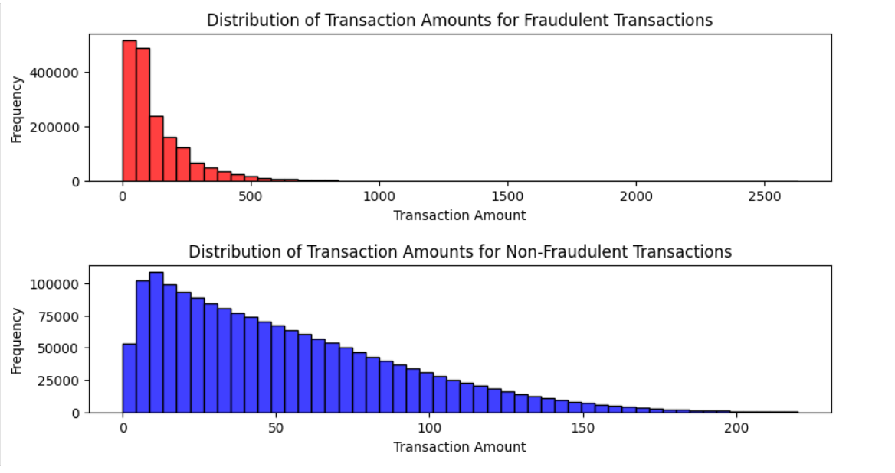
Results
Dataset Distribution after SMOTE wrt to Amount
Notes:
Once you find your sources, you will want to evaluate your sources using the following questions:
Author:
Who is the author?
Why should I believe what he or she has to say on the topic?
Is the author seen as an expert on the topic? How do you know?
Current:
How current is the information in the source?
When was the source published?
Is the information out-of-date?
Accuracy:
Is the content accurate?
Is the information presented objectively? Do they share the pros and cons?

Slide 23
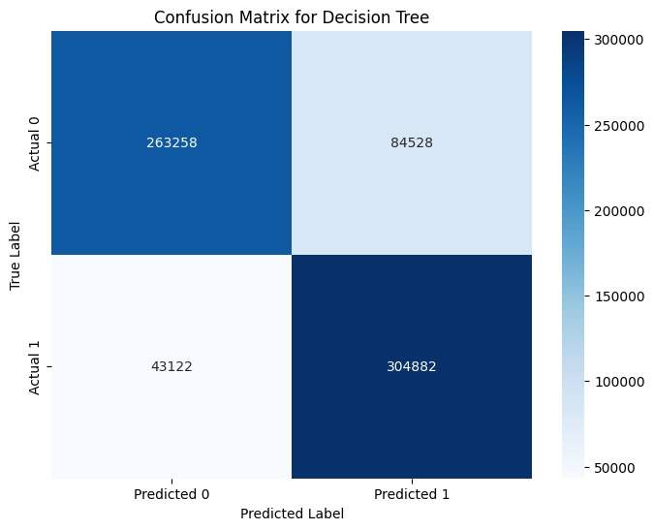
Results
Multilayer perceptron vs Decision Tree:
The performance of MLP is much better than the decision tree model, hence the MLP (DL) is selected for final implementation. the result metric is shown below:
Notes:
Once you find your sources, you will want to evaluate your sources using the following questions:
Author:
Who is the author?
Why should I believe what he or she has to say on the topic?
Is the author seen as an expert on the topic? How do you know?
Current:
How current is the information in the source?
When was the source published?
Is the information out-of-date?
Accuracy:
Is the content accurate?
Is the information presented objectively? Do they share the pros and cons?

Slide 24
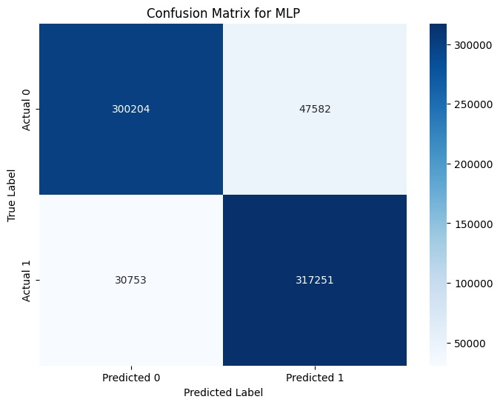
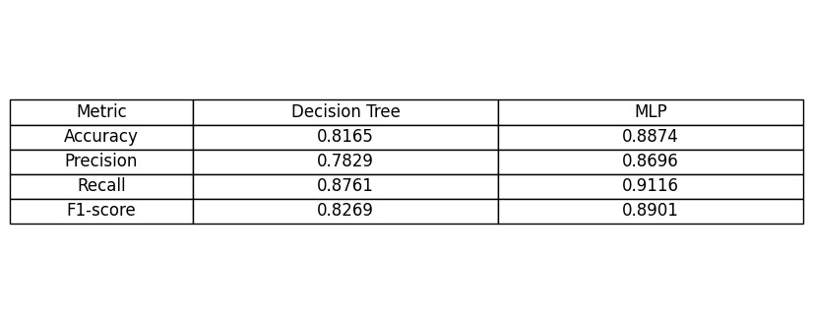
Results
Notes:
Once you find your sources, you will want to evaluate your sources using the following questions:
Author:
Who is the author?
Why should I believe what he or she has to say on the topic?
Is the author seen as an expert on the topic? How do you know?
Current:
How current is the information in the source?
When was the source published?
Is the information out-of-date?
Accuracy:
Is the content accurate?
Is the information presented objectively? Do they share the pros and cons?

Slide 25

Results
Federated Learning with Edge Computing :
The result for overall federated learning model is as shown below
Notes:
Once you find your sources, you will want to evaluate your sources using the following questions:
Author:
Who is the author?
Why should I believe what he or she has to say on the topic?
Is the author seen as an expert on the topic? How do you know?
Current:
How current is the information in the source?
When was the source published?
Is the information out-of-date?
Accuracy:
Is the content accurate?
Is the information presented objectively? Do they share the pros and cons?

Slide 26
Results
Performance Metric | Value
Accuracy | 0.8784
Precision | 0.8618
Recall | 0.9010
F1 Score | 0.8810
Notes:
Once you find your sources, you will want to evaluate your sources using the following questions:
Author:
Who is the author?
Why should I believe what he or she has to say on the topic?
Is the author seen as an expert on the topic? How do you know?
Current:
How current is the information in the source?
When was the source published?
Is the information out-of-date?
Accuracy:
Is the content accurate?
Is the information presented objectively? Do they share the pros and cons?

Slide 27
Acknowledgments and Thanks
We again thank all who supported this project, especially our project guide Prof. Prasanta K. Jana. Your expertise and dedication were crucial to our project's success.
Notes:
After consulting a variety of sources, you will need to narrow your topic. For example, the topic of internet safety is huge, but you could narrow that topic to include internet safety in regards to social media apps that teenagers are using heavily. A topic like that is more specific and will be relevant to your peers. Some questions to think about to help you narrow your topic:
What topics of the research interest me the most?
What topics of the research will interest my audience the most?
What topics will the audience find more engaging? Shocking? Inspiring?

Slide 28
Thank You
Notes:
You can use this slide as your opening or closing slide. Should you choose to use it as a closing, make sure you review the main points of your presentation. One creative way to do that is by adding animations to the various graphics on a slide. This slide has 4 different graphics, and, when you view the slideshow, you will see that you can click to reveal the next graphic. Similarly, as you review the main topics in your presentation, you may want each point to show up when you are addressing that topic.
Add animation to images and graphics:
Select your image or graphic.
Click on the Animations tab.
Choose from the options. The animation for this slide is “Split”. The drop-down menu in the Animation section gives even more animations you can use.
If you have multiple graphics or images, you will see a number appear next to it that notes the order of the animations.
Note: You will want to choose the animations carefully. You do not want to make your audience dizzy from your presentation.

