Slide 1
PROJECT TITLE
Study and Improvisation of Clustering Based Routing Protocol in FANET
Name : Avinesh Pratap Singh
Guide : Dr. Chiranjeev Kumar

Slide 2
Content
1. Introduction
2. Background & Literature Survey
3. Problem Statement
4. Methodology
5. Results
6. Conclusion
7. Acknowledge and Thanks
8. References

Slide 3
Introduction
Routing Protocol: Routing protocols are used in computer networks, including wireless networks like FANETs (Flying Ad Hoc Networks), to enable efficient and effective communication.
2) Wireless Networks: Wireless networks provide flexible communication without physical constraints, but traditional setups have limitations in coverage and adaptability.
3) What is FANET: Flying Ad Hoc Networks (FANETs) use drones for wireless communication.FANETs create a network not only on the ground but also in the sky

Slide 4
Introduction
3) Why We Need FANET: FANETs are crucial for reliable communication in disasters and surveillance, using drones to overcome the limitations of ground-based networks in dynamic environments.
4) Applications of FANET: FANETs are like communication champions, especially in tough situations like disasters, surveillance, and rescue missions. They make things work more efficiently when it really matters.
Our study focuses on optimizing routing protocols in FANETs, aiming to enhance communication efficiency in dynamic and resource-constrained environments.

Slide 5
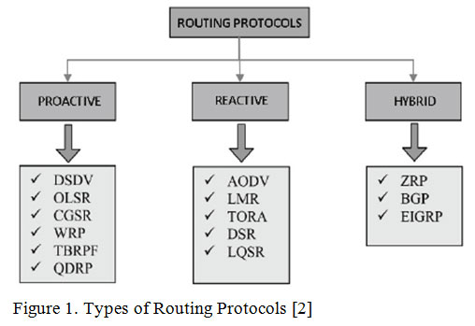
Background

Slide 6
Routing Protocol in Manet For in 3 Category
1.Proactive Routing protocol: These are also known as table-driven routing protocols. Each mobile node maintains a separate routing table which contains the information of the routes to all the possible destination mobile nodes.
Example are: Destination Sequenced Distance Vector Routing Protocol (DSDV),Global State Routing (GSR)
2. Reactive Routing Protocol: These are also known as on-demand routing protocol. In this type of routing, the route is discovered only when it is required/needed.
Example are Ad-Hoc On Demand Vector Routing protocol (AODV),Dynamic Source Routing protocol (DSR)
3. Hybrid Routing protocol: It basically combines the advantages of both, reactive and proactive routing protocols.

Slide 7
Clustering Routing Protocol
Definitions: Clustering Routing protocols organize wireless network node into clusters for efficiency.
Benefits: thet enhance energy efficiency , Scalability,and Network Organisation
Use Cases: used in wireless sensor networks and mobile ad hoc networks
Examples: Leach and CBRP are popular clustering routing protocols
Challenges: Cluster head Selection and Adaptation to dynamic environments can be Complex.

Slide 8
Particle Swarm Optimization(PSO)
Introduction: PSO is a bio-inspired optimization method.
How It works: Particles in a swarm adjust their positions based on their own experience and their neighbors, seeking optimal solutions
Advantages : Simple implementation and efficiency in continuous optimization.
Challenges: Not guaranteed to find the global best solution; sensitivity to parameters.
Relevance: PSO enhances clustering routing protocols by optimizing various aspects.

Slide 9
Improved Particle Swarm Optimization(IPSO)
IPSO Algorithm Definition: The Improved PSO algorithm (IPSO) is introduced to address the limitation of standard PSO in finding the global best. The IPSO algorithm incorporates the VNS algorithm into the PSO search process.
IPSO Algorithm Principle:
The IPSO algorithm dynamically changes the neighborhood structure set to expand the search range. This allows the algorithm to jump out of local optima and approach the global optimum.

Slide 10
Literature Survey
01
Clustering schemes for mobile adhoc networks: A review
Research on Clustering Routing Protocol Based on Improved PSO in FANET
An efficient routing protocol for FANET based on hybrid optimization algorithm
02
03
A New Routing Scheme for Multi-cluster Flying Ad hoc Networks
04
A Survey of UAV Clustering Algorithm

Slide 11
Problem Statement
For communication purposes UAVs use the routing protocols but due to its limited resources, high mobility and frequently changing topology it become very challenging task to form a stable network.
Therefore, an efficient routing protocol is required to intelligently use the limited resources while at the same time being is adaptable to the challenging network environment.

Slide 12
Proposed Solution
The main objective is to study and analyze a suitable routing protocol that will help in stabilizing the communication networks for disaster scenarios by minimizing the overall delay and Energy Utilization.
Note: Delay here refers to minimizing the time between data sending and receiving.

Slide 13
Methodology
Network and Energy Model
Our network and energy model for FANETs optimally balances communication efficiency and power consumption. By integrating dynamic node clustering and energy-efficient routing, we ensure minimal energy expenditure while maintaining robust network connectivity. This model serves as a foundational step towards developing sustainable UAV networks capable of enduring prolonged operations in diverse operational scenarios.

Slide 14
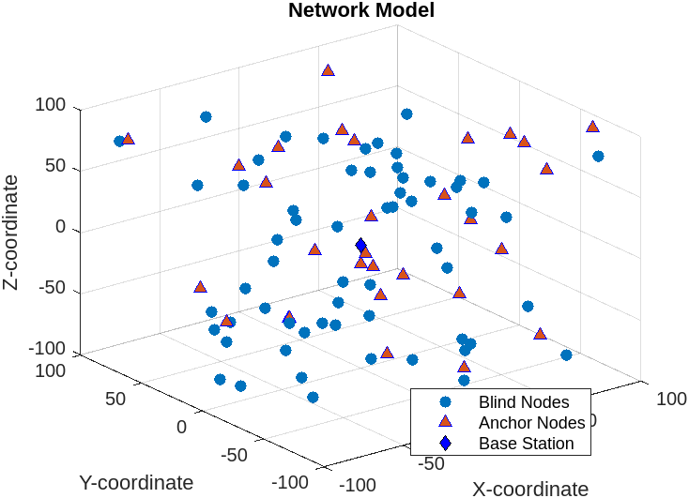
Methodology
Network and Energy Model

Slide 15
Methodology
UAV Positioning
Our UAV positioning approach utilizes an Improved Particle Swarm Optimization (IPSO) algorithm to accurately estimate the positions of UAVs within a dynamic 3D space. This method ensures high precision in localization, crucial for maintaining effective communication and operational coordination among UAVs in complex environments. The positioning accuracy achieved is pivotal for enhancing UAV network reliability and functionality.

Slide 16
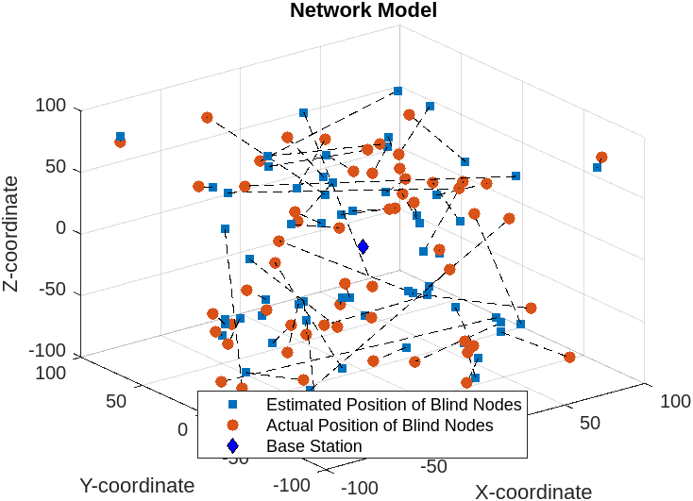
Methodology
UAV Positioning

Slide 17
Methodology
cluster formation
Our cluster formation strategy leverages K-means clustering to efficiently organize UAVs into optimal groups based on their spatial proximity. This method enhances network manageability and communication efficiency, ensuring that UAVs operate cohesively as a unit. The strategic clustering not only improves data transfer rates but also extends the network's operational range and resilience.

Slide 18
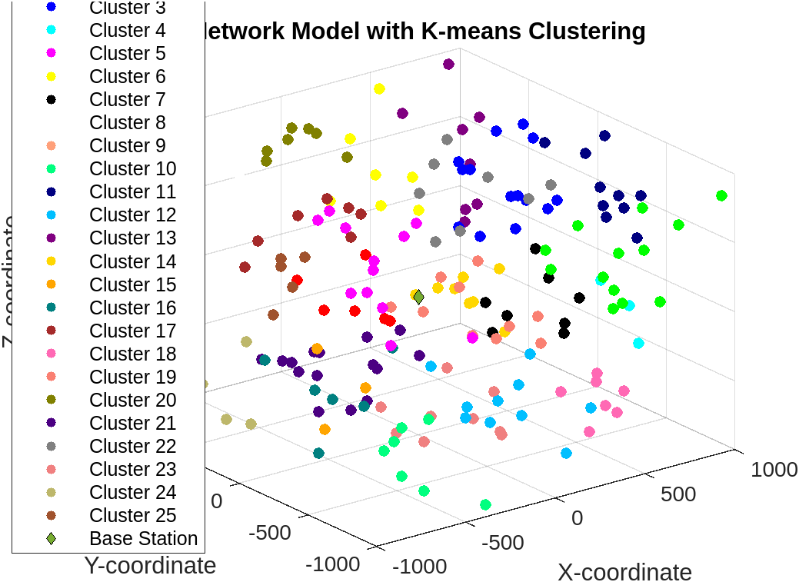
Methodology
cluster formation

Slide 19
Methodology
Cluster head selection
Our cluster head selection process employs a modified Particle Swarm Optimization (PSO) algorithm, incorporating both spatial and energy considerations. This ensures the selection of the most capable UAVs as cluster heads, optimizing network efficiency and longevity. The approach strategically enhances communication reliability and energy utilization, crucial for maintaining robust network performance in dynamic environments.

Slide 20
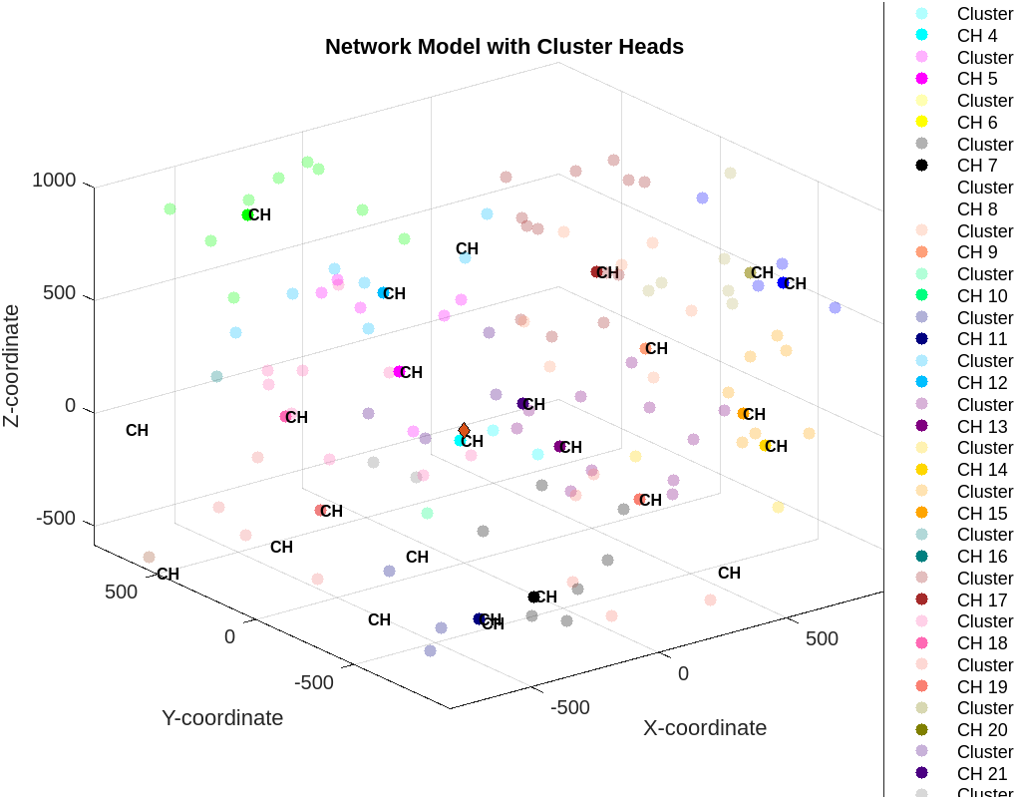
Methodology
Cluster head selection

Slide 21
Methodology
Cluster Maintenance
Our cluster maintenance methodology ensures stability and robustness in UAV networks by dynamically managing cluster heads and members based on real-time data on node mobility and energy levels. Utilizing timely hello and ACK packet exchanges, the system efficiently handles node departures and arrivals, maintaining optimal network integrity and performance even under frequently changing conditions.

Slide 22
Methodology
Next Hope selection
Our next-hop selection technique integrates advanced Particle Swarm Optimization (PSO) that considers both position and velocity dimensions, ensuring seamless and efficient routing decisions in FANETs. This approach allows for dynamic adaptation to the rapid changes in UAV configurations, optimizing data forwarding paths for enhanced communication reliability and network throughput.

Slide 23
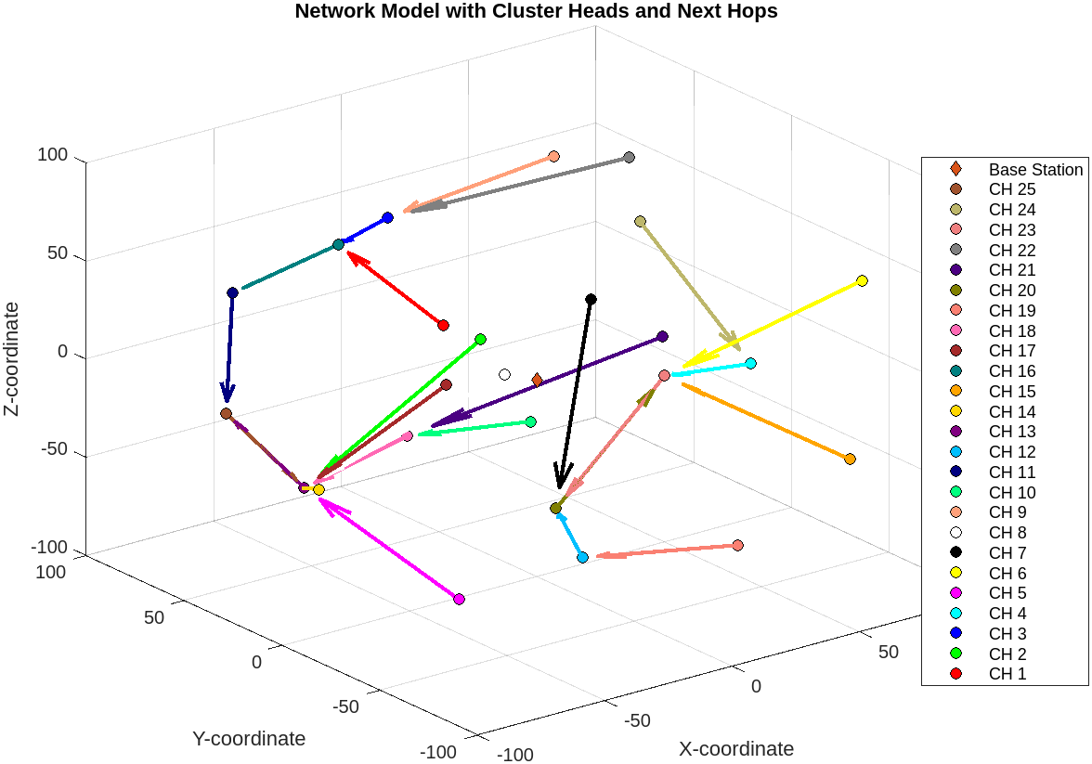
Methodology
Next Hope selection

Slide 24

Results
Throughput : In the context of FANETs, high throughput is indicative of a reliable and robust communication protocol, especially under varying operational conditions. Mathematically, throughput is quantified as the total number of bits received successfully by all destinations per unit of time, calculated using the formula:

Slide 25
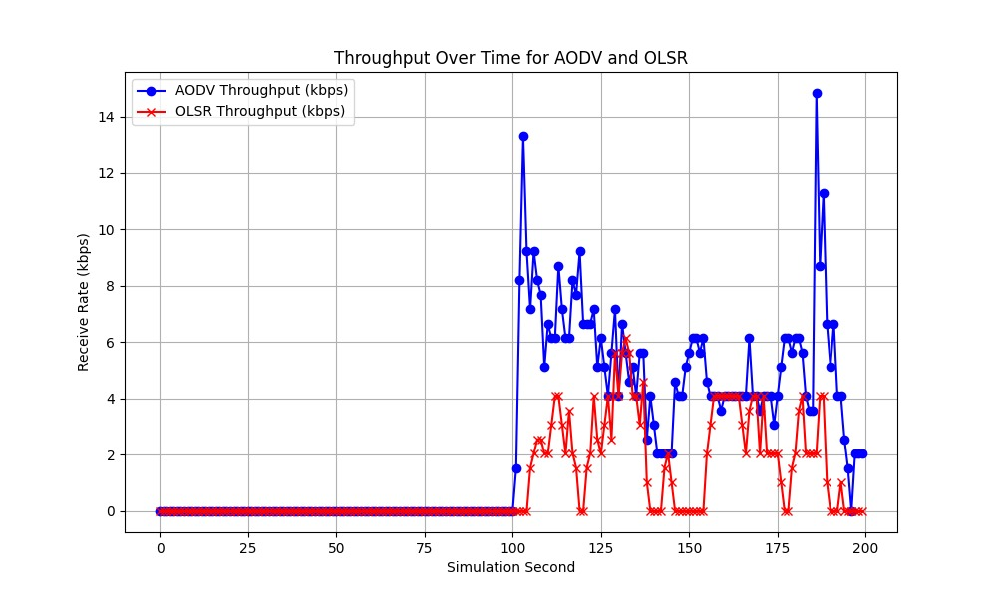
Results
where 𝑁𝑝​ represents the total number of packets successfully received. This measure helps in assessing the capability of the network to handle dense data traffic, which is crucial for applications requiring real-time data exchange such as surveillance or coordinated maneuvers

Slide 26

Results
2) End-to-End Delay (E2ED): End-to-End Delay is another critical metric, especially for real-time applications within FANETs. It measures the total time taken for a data packet to travel from the source to the destination. This delay includes all forms of latency encountered during the packet's journey, including processing delays at intermediate nodes, buffering delays, and propagation delays. The average E2ED is represented as:

Slide 27
Results
where 𝑇𝑟 is the time when the packet is received and 𝑇𝑠 is the time when the packet is sent. Minimizing E2ED is vital for enhancing the responsiveness of the network, thereby improving operational efficiency and effectiveness in time-sensitive scenarios.

Slide 28

Results
3) The Packet Delivery Ratio (PDR) : The Packet Delivery Ratio (PDR) is a measure of the reliability and efficiency of the packet delivery over a network. It is defined as the ratio of the number of packets successfully delivered to the destination to the total number of packets sent by the sender, expressed as a percentage:

Slide 29
Results
A high PDR indicates a reliable network, where most of the transmitted data reaches its intended destination without being lost or dropped. It is particularly important in FANETs, where the dynamic topology and potential for frequent disconnections pose challenges to data delivery.

Slide 30
Conclusion
This project has significantly advanced the optimization of Flying Ad Hoc Networks (FANETs) for disaster response scenarios, employing Nature-Inspired Algorithms (NIAs) to enhance node clustering and routing. Our methods have successfully reduced delays and improved the efficiency of data transmission, critical for timely disaster management. By refining cluster management and routing protocols to adapt dynamically to network changes, we've set the groundwork for future integrations of real-time adaptation and advanced machine learning, promising to further enhance UAV resilience and operational efficacy in critical conditions. This study not only enhances FANET reliability in dynamic environments but also opens avenues for more autonomous UAV applications in emergency response.

Slide 31
Acknowledgment and Thanks
We again thank all who supported this project, especially our project guide Dr. Cheeranjeev Kumar. Your expertise and dedication were crucial to our project's success.

Slide 32
References
1) Sun, G., Qin, D., Lan, T., & Ma, L. (2021). Research on clustering routing protocol based on improved PSO in FANET. IEEE Sensors Journal, 21(23), 27168-27185.
2)Hogie, L., Bouvry, P., & Guinand, F. (2006). An overview of manets simulation. Electronic notes in theoretical computer science, 150(1), 81-101.
3)Bekmezci, I., Sahingoz, O. K., & Temel, Ş. (2013). Flying ad-hoc networks (FANETs): A survey. Ad Hoc Networks, 11(3), 1254-1270.
4)Abolhasan, M., Wysocki, T., & Dutkiewicz, E. (2004). A review of routing protocols for mobile ad hoc networks. Ad hoc networks, 2(1), 1-22.

Slide 33


