Slide 1
Automatic Extraction of Medication Information from a Pill Bottle

Slide 2
Team Members
Avinesh Pratap Singh 20JE0219
Sanskar Bansal 20JE0857
Tirth Rami 20JE0768
Priyanshu Maurya 20JE0728
Asharam Meena 20JE0202

Slide 3
Requirement Analysis Requirement Gathering

Slide 4
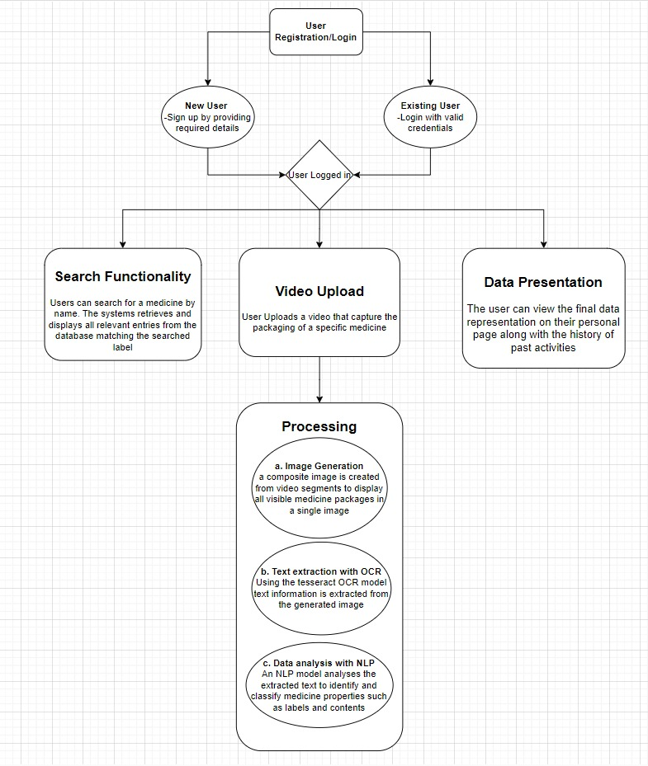
Workflow

Slide 5
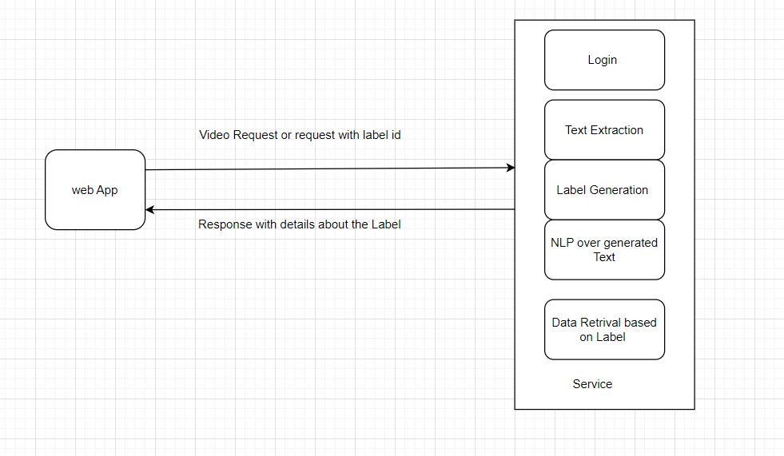
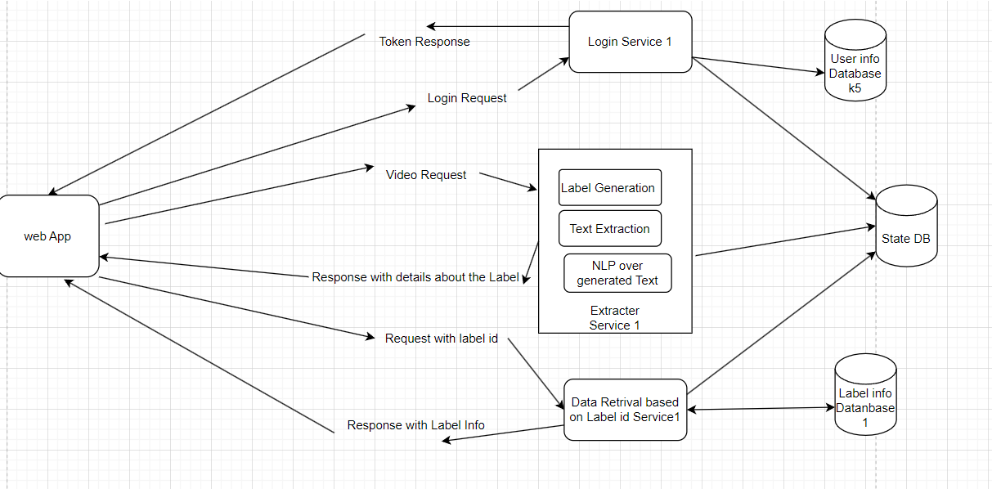
High Level System Design:
Splitting Services

Slide 6
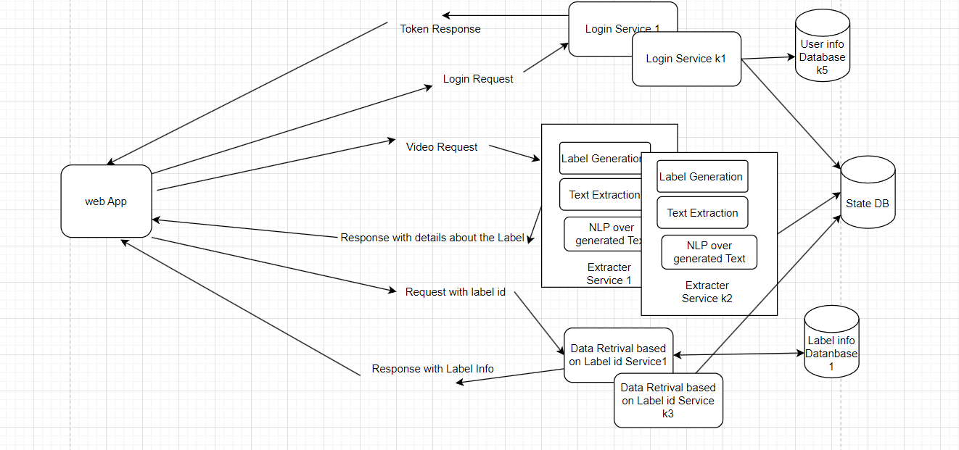
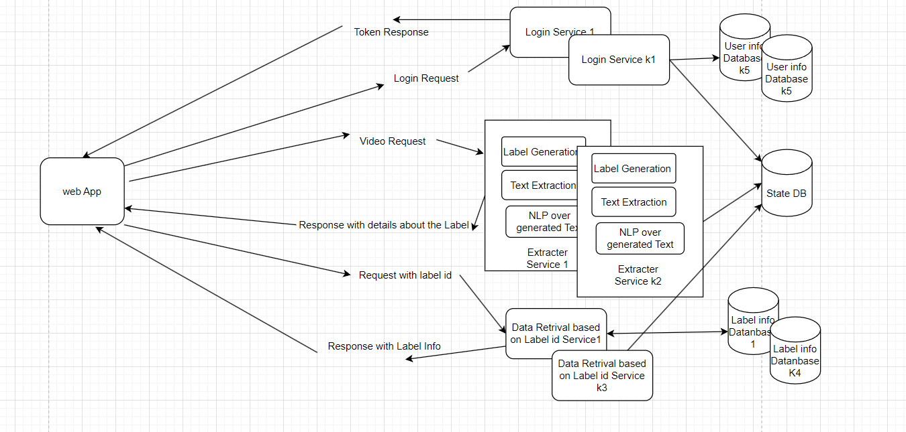
High Level System Design:
Multiple Servers
DB
Replica

Slide 7
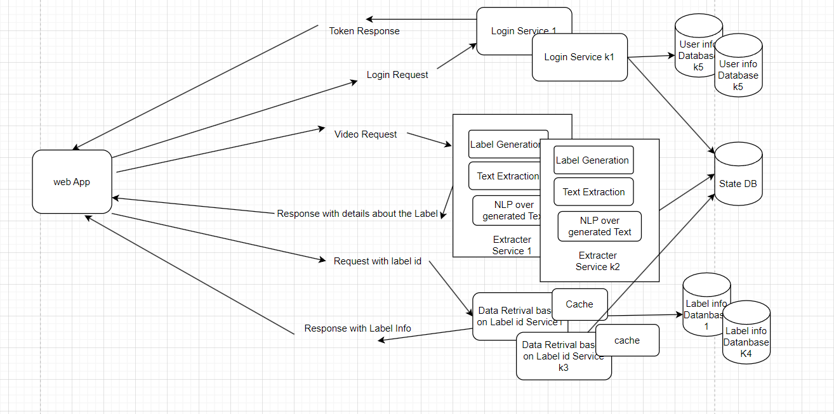
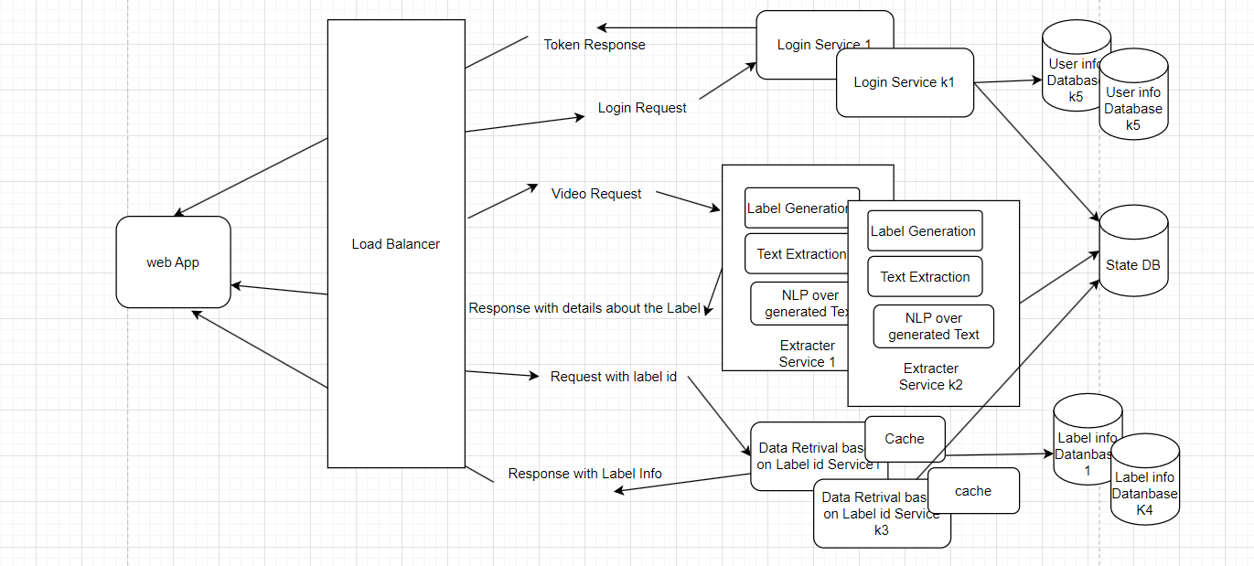
High Level System Design:
Caching
Load
Balancing

Slide 8
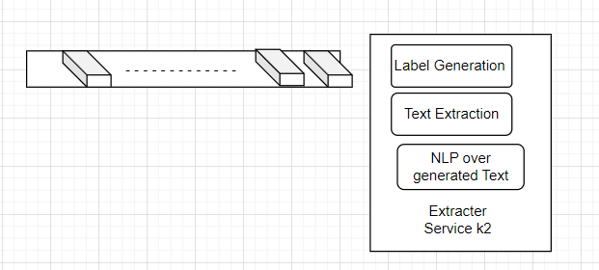
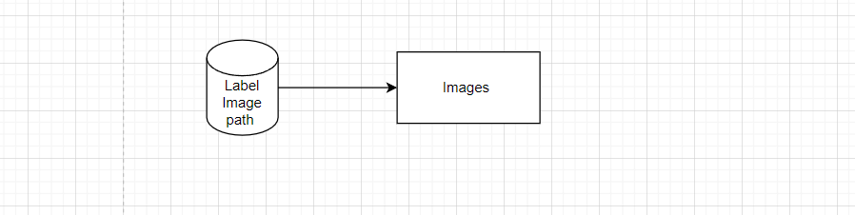
Low Level System Design:
Handling video requests asynchronously
Implementing a First-In-First-Out (FIFO) queue based on time
Database for Paths
File System for Images

Slide 9
Implementation:
User Authentication using Py-JWT python library:
PyJWT is a Python library that allows you to encode and decode JWTs. It provides functions for creating JWTs with custom claims, signing them using various algorithms (such as HS256), and verifying the integrity of received JWTs.
User Login/ Signup:
React - for frontend development for login and signup page
MongoDB NoSQL - user credentials are saved in MongoDB NoSQL database
Label Extraction:
Creating a single image representation of the uploaded video that encapsulates its content using OpenCV
Text Extraction:
Extraction of Text from the image using an OCR model called Tesseract OCR
Label Name Extraction:
Integration of a Pre trained NLP models to extract medicine names and contents from the text extracted by the Tesseract OCR using spaCy module.
"en_core_web_sm" is a small English model trained on written web text (blogs, news, comments), which includes part-of-speech tags, syntactic dependencies, and named entities.

Slide 10
Implementation:
storing label information:
The information extracted in previous steps such as Label Name, content, image (we will store its path only) and the username of the user in MongoDB NoSQL database.
The extracted medicine information obtained from the NLP Model is structured into JSON-like documents.
Image Storage on Amazon AWS S3:
The stitched image, which contains frames from the video, is saved on AWS S3. S3 is chosen for its scalability, reliability, quick accessibility and ease of use.
Search functionality Implementation:
user can search labels previously added by other users or same user by their label names.
First, we queried MongoDB database with the label name and then retrieve list of label information (content, image paths).
In next steps we retrieve images from s3 buckets with the help given image path.

Slide 11
Project Demonstration

Slide 12
Challenges Faced :
AWS S3 setup
Deployment over Aws EB
Central Service development

Slide 13
Thank you

