Slide 1
Amazon Web Services (AWS)
Prepared by:
Sumeet Muchhal

Slide 2
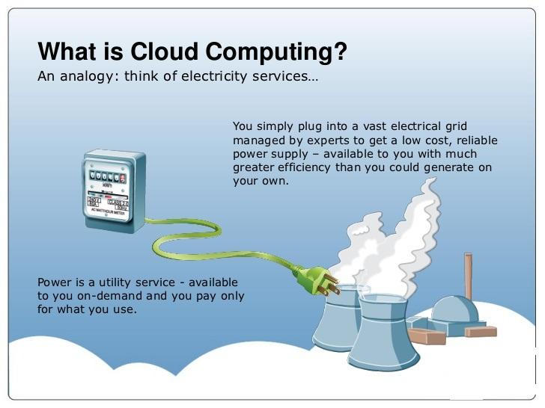
Cloud Computing

Slide 3
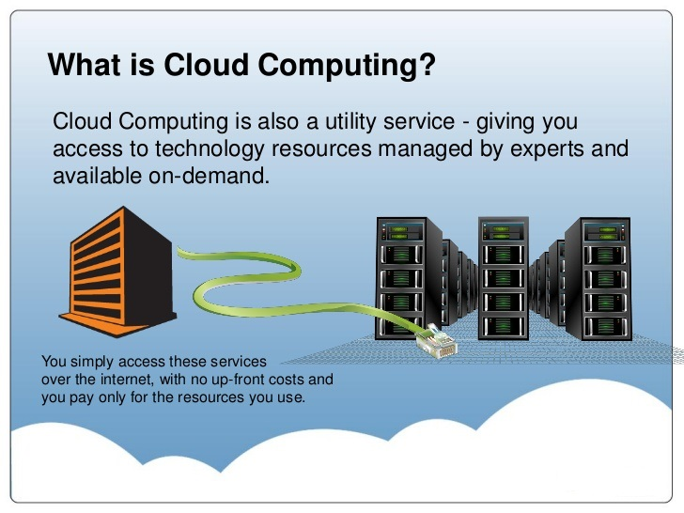
Cloud Computing

Slide 4
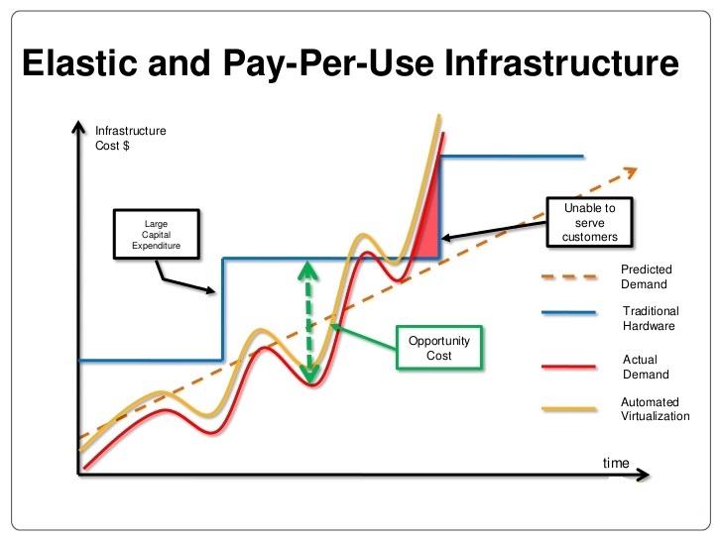
Cloud Computing

Slide 5
Cloud Computing
Advantages and Benefits of Cloud Computing
Trade capital expense for variable expense Instead of having to invest heavily in data centers and servers before you know how you’re going to use them, you can only pay when you consume computing resources, and only pay for how much you consume.
Benefit from massive economies of scale By using cloud computing, you can achieve a lower variable cost than you can get on your own. Because usage from hundreds of thousands of customers are aggregated in the cloud, providers such as Amazon Web Services can achieve higher economies of scale which translates into lower pay as you go prices.
Stop guessing capacity Eliminate guessing on your infrastructure capacity needs. When you make a capacity decision prior to deploying an application, you often either end up sitting on expensive idle resources or dealing with limited capacity. With cloud computing, these problems go away. You can access as much or as little as you need, and scale up and down as required with only a few minutes notice.

Slide 6
Cloud Computing
Advantages and Benefits of Cloud Computing
Increase speed and agility In a cloud computing environment, new IT resources are only ever a click away, which means you reduce the time it takes to make those resources available to your developers from weeks to just minutes. This results in a dramatic increase in agility for the organization, since the cost and time it takes to experiment and develop is significantly lower.
Stop spending money on running and maintaining data centers Focus on projects that differentiate your business, not the infrastructure. Cloud computing lets you focus on your own customers, rather than on the heavy lifting of racking, stacking and powering servers.
Go global in minutes Easily deploy your application in multiple regions around the world with just a few clicks. This means you can provide a lower latency and better experience for your customers simply and at minimal cost.

Slide 7
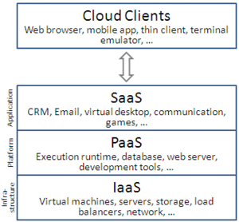
Cloud Computing
Service models
Service-oriented architecture advocates "everything as a service" (with the acronyms EaaS), cloud-computing providers offer their "services" according to different models, of which the three standard models per NIST (National Institute of Standards and Technology) are:
Infrastructure as a Service (IaaS)
Platform as a Service (PaaS)
Software as a Service (SaaS)

Slide 8
Cloud Computing
Software as a service (SaaS)
Cloud-based applications—or software as a service—run on distant computers “in the cloud” that are owned and operated by others and that connect to user’s computers via the internet and, usually, a web browser. The benefits of SaaS
You can sign up and rapidly start using innovative business apps.
Apps and data are accessible from any connected computer.
No data is lost if your computer breaks, as data is in the cloud.
The service is able to dynamically scale to usage needs.

Slide 9
Cloud Computing
Platform as a service (PaaS)
Platform as a service provides a cloud-based environment with everything required to support the complete lifecycle of building and delivering web-based (cloud) applications—without the cost and complexity of buying and managing the underlying hardware, software, provisioning, and hosting. The benefits of PaaS
Develop applications and get to market faster
Deploy new web applications to the cloud in minutes
Reduce complexity with middleware as a service

Slide 10
Cloud Computing
Infrastructure as a service (IaaS)
Infrastructure as a service provides companies with computing resources including servers, networking, storage, and data centre space on a pay-per-use basis.
The benefits of IaaS
No need to invest in your own hardware
Infrastructure scales on demand to support dynamic workloads
Flexible, innovative services available on demand

Slide 11
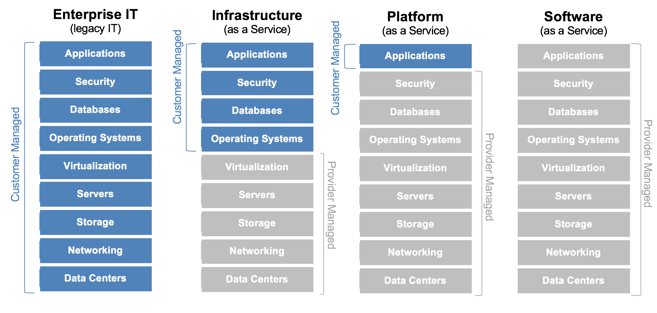
Cloud Computing

Slide 12
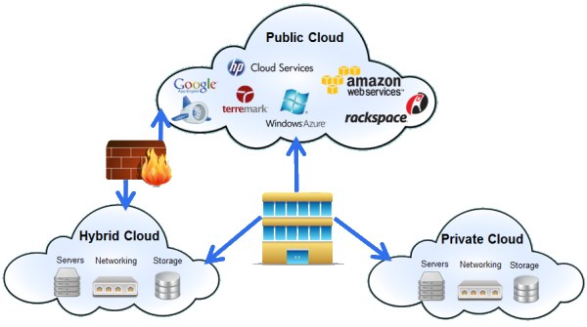
Cloud Computing
Deployment models

Slide 13
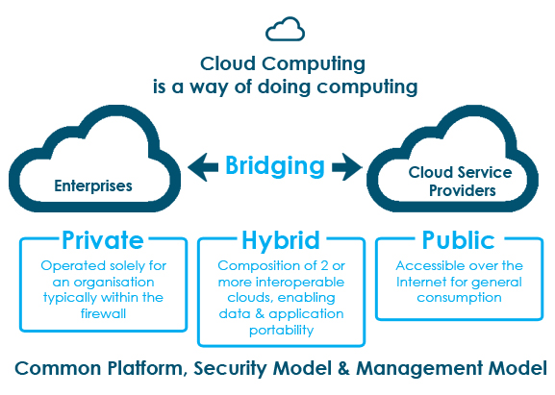
Cloud Computing
Deployment models

Slide 14
Cloud Computing
Deployment models
Delivery Model | Benefits | Risks | Best Fit
Public | Costs Time-to-market Elasticity Self-service Simplicity | Lack of control Security Regulatory & Compliance Data Migration Applications Development Software Licensing Vendor Lock-In Limitations | Application and data that can be publicly hosted Application that can be easily moved or ported to commodity
Private | Control Security Compliance | Scale Management Tools Charge-back Adoption ROI | Applications and data that can not be hosted publicly for security and compliance reasons. Application and data that require high level of control
Hybrid | Flexibility Security Efficiencies | Multiple Points of Failure Sample risks as public and private clouds | When it is required to separate applications of data between private and public cloud When public cloud can not accommodate requirements When public cloud resources are only required temporarily and workloads can be migrating between clouds.

Slide 15

Cloud Computing
Cloud Computing with Amazon Web Services (AWS)
Amazon Web Services (AWS) is a secure cloud services platform, offering compute power, database storage, content delivery and other functionality to help businesses scale and grow.

Slide 16
Cloud Computing
AWS Global Infrastructure
The AWS Cloud operates 44 Availability Zones within 16 geographic Regions around the world, with announced plans for 14 more Availability Zones and five more Regions in China, France, Hong Kong, Sweden, and a second AWS GovCloud Region in the US. AWS Regions and Availability Zones
The AWS Cloud infrastructure is built around Regions and Availability Zones (“AZs”). A Region is a physical location in the world where we have multiple Availability Zones. Availability Zones consist of one or more discrete data centers, each with redundant power, networking and connectivity, housed in separate facilities. These Availability Zones offer you the ability to operate production applications and databases which are more highly available, fault tolerant and scalable than would be possible from a single data center.

Slide 17
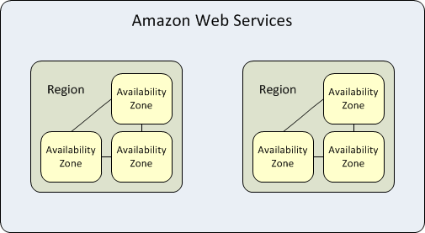
Cloud Computing
Region and Availability Zone Concepts
Each region is completely independent. Each Availability Zone is isolated, but the Availability Zones in a region are connected through low-latency links. The following diagram illustrates the relationship between regions and Availability Zones.
Amazon EC2 resources are either global, tied to a region, or tied to an Availability Zone.

Slide 18
Cloud Computing
Regions
Each Amazon EC2 region is designed to be completely isolated from the other Amazon EC2 regions. This achieves the greatest possible fault tolerance and stability.
When you view your resources, you'll only see the resources tied to the region you've specified. This is because regions are isolated from each other, and AWS don't replicate resources across regions automatically.
When you launch an instance, you must select an AMI that's in the same region. If the AMI is in another region, you can copy the AMI to the region you're using.
Note that there is a charge for data transfer between regions.

Slide 19
Cloud Computing
Regions
The following table lists the regions provided by an AWS.
Code | Name
us-east-1 | US East (N. Virginia)
us-east-2 | US East (Ohio)
us-west-1 | US West (N. California)
us-west-2 | US West (Oregon)
ca-central-1 | Canada (Central)
eu-west-1 | EU (Ireland)
eu-central-1 | EU (Frankfurt)
eu-west-2 | EU (London)
ap-northeast-1 | Asia Pacific (Tokyo)
ap-northeast-2 | Asia Pacific (Seoul)
ap-southeast-1 | Asia Pacific (Singapore)
ap-southeast-2 | Asia Pacific (Sydney)
ap-south-1 | Asia Pacific (Mumbai)
sa-east-1 | South America (São Paulo)

Slide 20
Cloud Computing
Availability Zones
When you launch an instance, you can select an Availability Zone or let AWS choose one for you. If you distribute your instances across multiple Availability Zones and one instance fails, you can design your application so that an instance in another Availability Zone can handle requests.
You can also use Elastic IP addresses to mask the failure of an instance in one Availability Zone by rapidly remapping the address to an instance in another Availability Zone.
An Availability Zone is represented by a region code followed by a letter identifier; for example, us-east-1a. To ensure that resources are distributed across the Availability Zones for a region, AWS independently map Availability Zones to identifiers for each account. For example, your Availability Zone us-east-1a might not be the same location as us-east-1a for another account. There's no way for you to coordinate Availability Zones between accounts.

Slide 21
Cloud Computing
AWS Products and Services
Amazon Web Services offers a broad set of global cloud-based products including compute, storage, databases, analytics, networking, mobile, developer tools, management tools, IoT, security and enterprise applications.
Details for these services are available at:
https://aws.amazon.com/products/

Slide 22
Cloud Computing
Virtualization
Virtualization is a technique, which allows to share single physical instance of an application or resource among multiple organizations or tenants (customers). It does this by assigning a logical name to a physical resource and providing a pointer to that physical resource when demanded.
The Multitenant architecture offers virtual isolation among the multiple tenants. Hence, the organizations can use and customize their application as though they each have their instances running.

Slide 23
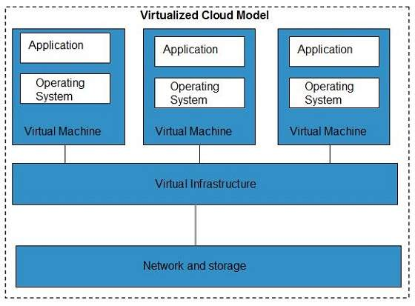
Cloud Computing
Virtualization

Slide 24

Identity and Access Management (IAM)

Slide 25
Identity and Access Management (IAM)
AWS Identity and Access Management (IAM) is a web service that helps you securely control access to AWS resources for your users. You use IAM to control who can use your AWS resources (authentication) and what resources they can use and in what ways (authorization).

Slide 26
Identity and Access Management (IAM)
IAM Features
Shared access to your AWS account You can grant other people permission to administer and use resources in your AWS account without having to share your password or access key.
Granular permissions You can grant different permissions to different people for different resources. For example, you might allow some users complete access to Amazon Elastic Compute Cloud (Amazon EC2), Amazon Simple Storage Service (Amazon S3), Amazon DynamoDB, Amazon Redshift, and other AWS services. For other users, you can allow read-only access to just some S3 buckets, or permission to administer just some EC2 instances, or to access your billing information but nothing else.
Secure access to AWS resources for applications that run on Amazon EC2You can use IAM features to securely give applications that run on EC2 instances the credentials that they need in order to access other AWS resources, like S3 buckets and RDS or DynamoDB databases.

Slide 27
Identity and Access Management (IAM)
IAM Features
Multi-factor authentication (MFA) You can add two-factor authentication to your account and to individual users for extra security. With MFA you or your users must provide not only a password or access key to work with your account, but also a code from a specially configured device.
Identity federation You can allow users who already have passwords elsewhere—for example, in your corporate network or with an Internet identity provider—to get temporary access to your AWS account.
Integrated with many AWS services: http://docs.aws.amazon.com/IAM/latest/UserGuide/reference_aws-services-that-work-with-iam.html
Free to use AWS Identity and Access Management is a feature of your AWS account offered at no additional charge. You will be charged only for use of other AWS products by your IAM users.

Slide 28
Identity and Access Management (IAM)
First-Time Access Only: Your Root Account Credentials
When you create an AWS account, you create an account (or "root") identity, which you use to sign in to AWS.
You can sign in to the AWS Management Console using this root identity—that is, the email address and password that you provided when creating the account.
This combination of your email address and password is also called your root account credentials.
When you use your root account credentials, you have complete, unrestricted access to all resources in your AWS account, including access to your billing information and the ability to change your password.

Slide 29
Identity and Access Management (IAM)
IAM Users
The "identity" aspect of AWS Identity and Access Management (IAM) helps you with the question "Who is that user?", often referred to as authentication
Instead of sharing your root account credentials with others, you can create individual IAM users within your account that correspond to users in your organization.
IAM users are not separate accounts; they are users within your account. Each user can have its own password for access to the AWS Management Console.
You can also create an individual access key for each user so that the user can make programmatic requests to work with resources in your account.

Slide 30
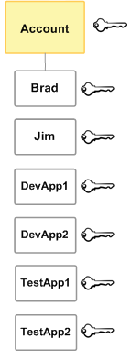
Identity and Access Management (IAM)
IAM Users
In the following figure, the users Brad, Jim, DevApp1, DevApp2, TestApp1, and TestApp2 have been added to a single AWS account. Each user has its own credentials.
Notice that some of the users are actually applications (for example, DevApp1). An IAM user doesn't have to represent an actual person; you can create an IAM user in order to generate an access key for an application that runs in your corporate network and needs AWS access.

Slide 31
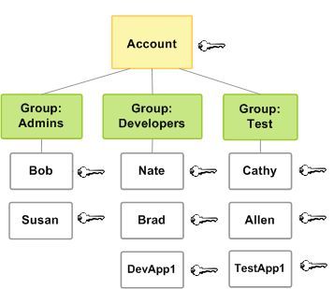
Identity and Access Management (IAM)
IAM Group
You can organize IAM users into IAM groups and attach a policy to a group. In that case, individual users still have their own credentials, but all the users in a group have the permissions that are attached to the group. Use groups for easier permissions management.

Slide 32
Identity and Access Management (IAM)
IAM Policy
Policy defines permissions
A policy lets you to specify (among others):
Action
Resource
Effect
Conditions
Use AWS Policy Generator tool (optional) http://awspolicygen.s3.amazonaws.com/policygen.html
Policies are JSON-formatted strings
Composed of one or more statements
A statement describes one set of permission
Can contain wildcards (*)

Slide 33
Identity and Access Management (IAM)
Example Policy
Allow listing of the bucket named “example_bucket”
{
"Version":"2012-­‐10-­‐17", "Statement":[{
"Effect":"Allow",
"Action":"s3:ListBucket",
"Resource":"arn:aws:s3:::example_bucket"
}

Slide 34
Identity and Access Management (IAM)
Amazon Resources Names (ARNs)
Used to uniquely identify AWS resources in places where ambiguity is not tolerated, such as in IAM policy.
Example - DynamoDB table:
arn:aws:dynamodb:us-­‐west-­‐2:123456789012:table/accounts
Example - S3 bucket contents:
arn:aws:s3:::my_corporate_bucket/* Let’s look more closely at Amazon Resource Names (ARNs). They allow us to uniquely identify AWS resources or groups of resources. The first example provides a full ARN. The second has a few fields missing. In many cases, a partial ARN is sufficient. In the S3 example, the partial ARN is still able to provide an unambiguous reference because bucket names are globally unique, therefore, the region and account portions are unnecessary. We’ll see how the ARN is composed next.
Only one wildcard can be used in an ARN.

Slide 35
Identity and Access Management (IAM)
Amazon Resources Names (ARNs)
Example - DynamoDB table: arn:aws:dynamodb:us-­west-2:123456789012:table/accounts
All ARNs begin with the same prefix.

Slide 36
Identity and Access Management (IAM)
Amazon Resources Names (ARNs)
Example - DynamoDB table: arn:aws:dynamodb:us-­west-2:123456789012:table/accounts
The namespace that identifies the product.

Slide 37
Identity and Access Management (IAM)
Amazon Resources Names (ARNs)
Example - DynamoDB table: arn:aws:dynamodb:us-­west-2:123456789012:table/accounts
region the resource resides in. Can be omitted if the resource doesn’t require a region.

Slide 38
Identity and Access Management (IAM)
Amazon Resources Names (ARNs)
Example - DynamoDB table: arn:aws:dynamodb:us-­west-2:123456789012:table/accounts
The ID of the AWS account that owns the resource, without hyphens. Can be omitted for globally unique resources.
This shows the account number portion of the ARN. When you see your account number listed (in the AWS Management Console, for example) it usually contains hyphens. The hyphens are omitted from the ARN.

Slide 39
Identity and Access Management (IAM)
Amazon Resources Names (ARNs)
Example - DynamoDB table: arn:aws:dynamodb:us-­west-2:123456789012:table/accounts
The resource identification. The format varies by service. Often contains the type of resource and resource name.

Slide 40

Amazon Simple Storage Service (S3)

Slide 41
Amazon Simple Storage Service (S3)
Amazon Simple Storage Service (S3) is storage for the Internet. It is designed to make web-scale computing easier for developers. It is intentionally built with a minimal feature set to keep it simple to use and to keep its usage application independent.

Slide 42
Amazon Simple Storage Service (S3)
Service Features
No storage limit (5TB max per object)
Highly durable and reliable
Designed for 99.999999999% durability and 99.99% availability of objects over a given year
Designed to sustain the concurrent loss of data in two facilities
Multiple access control mechanism
Identity and Access Management(IAM) Policies
Access Control Lists(ACLs)
Bucket Policies

Slide 43
Amazon Simple Storage Service (S3)
S3 Usage Scenario – Storage
As general Internet storage
Scalability and pay-as-you-go pricing allow S3 to handle your growing storage needs
For data to be analysed
Store logs for analysis by application on Amazon Elastic Compute Cloud (EC2) or Amazon Elastic MapReduce (EMR)
Use Reduced Redundancy Storage (RRS) for cost savings
As durable and secure backup location
For static web assets
Store HTML, images, videos, and client-side scripts

Slide 44
Amazon Simple Storage Service (S3)
S3 Usage Scenario – Content Distribution
As origin for Amazon CloudFront edge locations
As static web host
Highly available (designed for 99.99% availability)
Highly durable (designed for 99.999999999% durability)
Scales automatically for peak work loads
For sharing data between AWS services
No data transfer cost is incurred for transport of data between AWS services
As BitTorrent host for high-scale distribution

Slide 45
Amazon Simple Storage Service (S3)
Cost Considerations
No minimum fee
You pay for:
Storage (per gigabyte per month)
Requests (per 1,000 requests)
Data transfer out (per gigabyte)
Prices vary by region
Bulk transfer cost savings with AWS Import/Export
Pricing details at
http://aws.amazon.com/s3/pricing/

Slide 46
Amazon Simple Storage Service (S3)
S3 Terms
Bucket
Top-level container for S3 folders and objects
Bucket names are globally unique
Object
File container within an S3 bucket
Stored regionally
Key
Identifier for an object in a bucket
Flat address space
S3 isn’t a file system. However, there are still some analogous concepts. Buckets are like drives or partitions. Objects are like files. Keys are like file names (that contain folder information).

Slide 47

Amazon Simple Storage Service (S3)
Demonstration – S3 with the AWS Explorer

Slide 48
Amazon Simple Storage Service (S3)
S3 Developer Topics
Now we will look at how to interact with the S3 service using the AWS Java SDK.

Slide 49
Amazon Simple Storage Service (S3)
Object Model Concepts
Client interface
Named AmazonS3 in Java
Used to make service requests
Request classes
Container for service request parameters
Response classes
Contains responses from the services
No generalized base class for responses in Java
Bucket class
Used to describe an existing bucket
Named Bucket in Java
Object class
Used to describe an existing S3 Object
Named S3Object in Java

Slide 50
Amazon Simple Storage Service (S3)
Code Examples – Create S3 Client
AmazonS3 client = AmazonS3ClientBuilder.standard() .withRegion(Regions.US_EAST_1) .build();
// or
AmazonS3 client = AmazonS3ClientBuilder.standard() .withRegion(Regions.US_EAST_1) .withCredentials(AWSCredentialsProvider)
// We will learn more about how AWS find the credentials in next slide .build();

Slide 51
Amazon Simple Storage Service (S3)
Code Examples – Default Credential Provider Chain
When you initialize a new service client without supplying any arguments, the AWS SDK for Java attempts to find AWS credentials by using the default credential provider chain implemented by the DefaultAWSCredentialsProviderChain class. The default credential provider chain looks for credentials in this order:
Environment variables–AWS_ACCESS_KEY_ID and AWS_SECRET_ACCESS_KEY. The AWS SDK for Java uses the EnvironmentVariableCredentialsProvider class to load these credentials.
Java system properties – aws.accessKeyId and aws.secretKey. The AWS SDK for Java uses the SystemPropertiesCredentialsProvider to load these credentials.
The default credential profiles file– typically located at ~/.aws/credentials (location can vary per platform), and shared by many of the AWS SDKs and by the AWS CLI. The AWS SDK for Java uses the ProfileCredentialsProvider to load these credentials.

Slide 52
Amazon Simple Storage Service (S3)
Code Examples – Default Credential Provider Chain
Amazon ECS container credentials– loaded from the Amazon ECS if the environment variable AWS_CONTAINER_CREDENTIALS_RELATIVE_URI is set. The AWS SDK for Java uses the ContainerCredentialsProvider to load these credentials.
Instance profile credentials– used on EC2 instances, and delivered through the Amazon EC2 metadata service. The AWS SDK for Java uses the InstanceProfileCredentialsProvider to load these credentials.

Slide 53
Amazon Simple Storage Service (S3)
Code Examples – Create Bucket
Bucket bucket = client.createBucket("myUniqueBucket");

Slide 54
Amazon Simple Storage Service (S3)
Code Examples – List Buckets
for (Bucket bucket:client.listBuckets()) {
System.out.println(bucket.getName());
}
The list buckets operation enumerates the buckets in your account. This is one of the very few operations that doesn’t require you to create a request object first.

Slide 55
Amazon Simple Storage Service (S3)
Code Examples – Delete Bucket
client.deleteBucket("bucket-­‐name");
The delete bucket operation is used to delete a bucket. This will fail if the bucket is not empty.

Slide 56
Amazon Simple Storage Service (S3)
Code Examples – Add/Upload Object
File file = new File("somefile.jpg");
PutObjectRequest request = new PutObjectRequest(
"bucket-­‐name", "object-­‐key",
file);
PutObjectResult result = client.putObject(request);
Files are uploaded to S3 using a put object operation. In the AWS SDK for Java, files can be uploaded from a file object (shown above) or from an input stream. You must specify the bucket name and key for the object.

Slide 57
Amazon Simple Storage Service (S3)
Code Examples – Delete Object
client.deleteObject("bucket-­‐name", "object-­‐key");
This example shows how to delete an object. If you are deleting multiple objects, use a delete objects operation instead. Batching multiple operations into one call is much more efficient and cost effective.

Slide 58
Amazon Simple Storage Service (S3)
Code Examples – List Objects
ListObjectsRequest request = new ListObjectsRequest().withBucketName ("bucket-­‐name");
ObjectListing objList = client.listObjects(request);
This example demonstrates the method for listing the objects inside a bucket. Since the number of objects that can be stored in a bucket is unconstrained, the response will be paged in chunks of 1000 objects by default. In the request you can specify a lower limit if desired. When the results are paged, the response will have a “next marker” token. To get the next batch of results, add that token to your request object and resubmit it.

Slide 59
Amazon Simple Storage Service (S3)
AWS S3 Java example

Slide 60
Amazon Simple Storage Service (S3)
Setting Up Your Project
Create new maven project in eclipse / IntelliJ.
Add “AWS SDK for Java ” as maven dependency. <dependency> <groupId>com.amazonaws</groupId> <artifactId>aws-java-sdk</artifactId> <version>1.11.163</version> </dependency>
Make sure your “Access key” and “Secret Access Key” are set properly.

Slide 61
Amazon Simple Storage Service (S3)
Setting Up Your Project
Create package “com.yash.training.aws”
Copy the provided S3Demo.java in the package.
Open the S3Demo.java.
Code related to input command handling is provided.
Please implements the method using AWS S3 Java SDK to make the program working.

Slide 62
Amazon Simple Storage Service (S3)
AWS Command Line Interface
The AWS Command Line Interface (AWS CLI) is a unified tool that provides a consistent interface for interacting with all parts of AWS.
Installer - Windows
The AWS CLI is supported on Microsoft Windows XP or later. For Windows users, the MSI installation package offers a familiar and convenient way to install the AWS CLI without installing any other prerequisites.
Download the appropriate MSI installer.
Run the downloaded MSI installer.
Follow the instructions that appear.

Slide 63
Amazon Simple Storage Service (S3)
AWS Command Line Interface
Go to CLI Installation directory. For example “C:\Program Files\Amazon\AWSCLI”
Open command prompt and go to CLI Installation Directory.

Slide 64
Amazon Simple Storage Service (S3)
AWS Command Line Interface – S3 command
This section describes how you can manage Amazon S3 buckets and objects using high-level aws s3 commands.
Creating Buckets
$ aws s3 mb s3://bucket-name
Removing Buckets
$ aws s3 rb s3://bucket-name
Listing Buckets
$ aws s3 ls
More command and details are available at
http://docs.aws.amazon.com/cli/latest/userguide/using-s3-commands.html

Slide 65

Amazon Simple Queue Service (SQS)

Slide 66
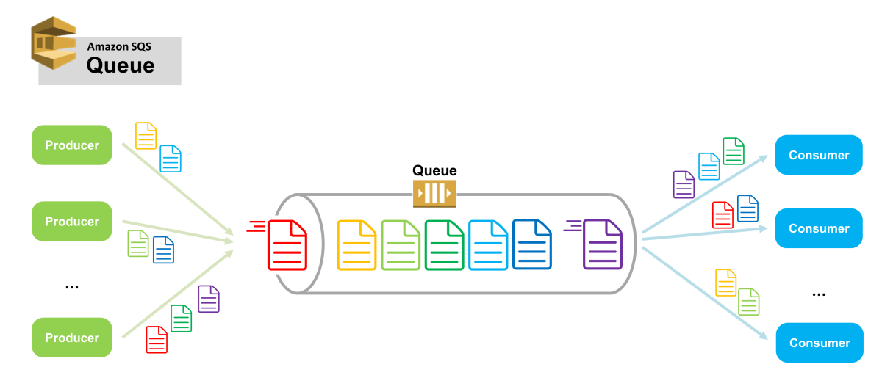
Amazon Simple Queue Service (SQS)
Amazon Simple Queue Service (SQS) is a reliable and scalable solution for hosting queues that store messages as they travel between computers and software components. It uses a pull-based mechanism to deliver messages. Amazon SQS supports both standard and FIFO queues.

Slide 67
Amazon Simple Queue Service (SQS)
Service Features
Redundant infrastructure – Standard queues support at-least-once message delivery, while FIFO queues support exactly-once message processing. Amazon SQS provides highly-concurrent access to messages and high availability for producing and consuming messages.
Multiple producers and consumers – Multiple parts of your system can send or receive messages at the same time. Amazon SQS locks the message during processing, keeping other parts of your system from processing the message simultaneously.
Configurable settings per queue – All of your queues don't have to be exactly alike. For example, you can optimize one queue for messages that require a longer processing time than others.
Variable message size – Your messages can be up to 262,144 bytes (256 KB) in size. You can store the contents of larger messages using the Amazon Simple Storage Service (Amazon S3) or Amazon DynamoDB, with Amazon SQS holding a pointer to the Amazon S3 object.

Slide 68
Amazon Simple Queue Service (SQS)
Service Features
Access control – You control who can send messages to a queue, and who can receive messages from a queue.
Delay queues – You can set a default delay on a queue, so that delivery of all enqueued messages is postponed for the specified duration. You can set the delay value when you create a queue with CreateQueue, and you can update the value with SetQueueAttributes. If you update the value, the new value affects only messages enqueued after the update.

Slide 69
Amazon Simple Queue Service (SQS)
Usage Scenarios
Work queues - Decouple components of distributed applications.
Buffer and batch operations - Smooth out temporary volume spikes.
Request offloading - Move slow operations off of the interactive request path.
Fan-out target - Use with SNS to send message copies to multiple queues in parallel for simultaneous processing.

Slide 70
Amazon Simple Queue Service (SQS)
Standard v/s FIFO Queue
Standard | FIFO
Available in all regions. | Available in the US East (N. Virginia), US East (Ohio), US West (Oregon), and EU (Ireland) regions.
High Throughput – Standard queues have nearly-unlimited transactions per second (TPS). | First-In-First-Out Delivery – The order in which messages are sent and received is strictly preserved.
At-Least-Once Delivery – A message is delivered at least once, but occasionally more than one copy of a message is delivered. | Exactly-Once Processing – A message is delivered once and remains available until a consumer processes and deletes it. Duplicates are not introduced into the queue.
Best-Effort Ordering – Occasionally, messages might be delivered in an order different from which they were sent. | Limited Throughput – 300 transactions per second (TPS).

Slide 71
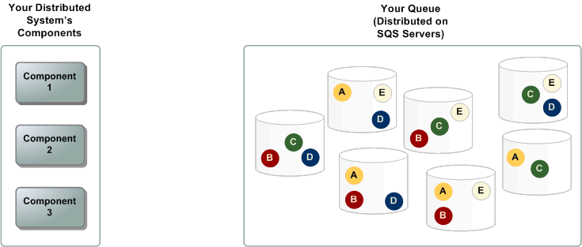
Amazon Simple Queue Service (SQS)
Architecture of Amazon SQS

Slide 72
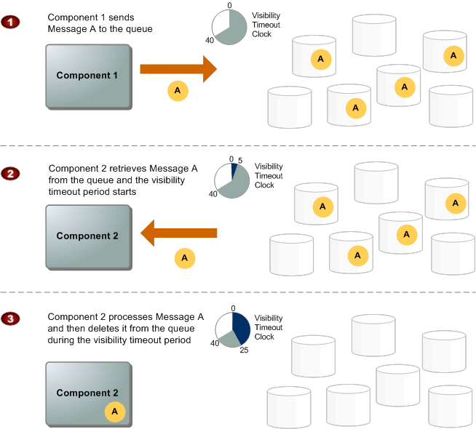
Amazon Simple Queue Service (SQS)
Message Lifecycle

Slide 73
Amazon Simple Queue Service (SQS)
Message Lifecycle
Component 1 sends Message A to a queue, and the message is distributed across the Amazon SQS servers redundantly.
When Component 2 is ready to process a message, it consumes messages from the queue, and Message A is returned. While Message A is being processed, it remains in the queue and isn't returned to subsequent receive requests for the duration of the visibility timeout.
Component 2 deletes Message A from the queue to prevent the message from being received and processed again once the visibility timeout expires.
Amazon SQS automatically deletes messages that have been in a queue for more than maximum message retention period. The default message retention period is 4 days. However, you can set the message retention period to a value from 60 seconds to 1,209,600 seconds (14 days) using the SetQueueAttributes action.

Slide 74
Amazon Simple Queue Service (SQS)
Cost Considerations
No minimum fee
You pay for:
API requests (per million)
Data transfer out (per gigabyte)
Prices vary by region.
Pricing details at
http://aws.amazon.com/sqs/pricing/

Slide 75
Amazon Simple Queue Service (SQS)
Demonstration – SQS with the AWS Explorer

Slide 76
Amazon Simple Queue Service (SQS)
SQS Developer Topics
Now we will look at how to interact with the SQS using the AWS Java SDK.

Slide 77
Amazon Simple Queue Service (SQS)
Code Examples – Create SQS Client
AmazonSQS client = AmazonSQSClientBuilder.standard() .withRegion(Regions.US_EAST_1) .build();

Slide 78
Amazon Simple Queue Service (SQS)
Create Queue and Get Queue URL
CreateQueueRequest req = new CreateQueueRequest("MyQueue");
String queueUrl = client.createQueue(req).getQueueUrl();

Slide 79
Amazon Simple Queue Service (SQS)
Get URLs for Existing Queues
List<String> queueUrls = client.listQueues().getQueueUrls();
for (String queueUrl : queueUrls) { System.out.println(queueUrl); }

Slide 80
Amazon Simple Queue Service (SQS)
Send Message
client.sendMessage( new SendMessageRequest(queueUrl,"message body"));

Slide 81
Amazon Simple Queue Service (SQS)
Receive Message
ReceiveMessageRequest req = new ReceiveMessageRequest(queueUrl);
List<Message> messages = client.receiveMessage(req) .getMessages();
for(Message message : messages) { System.out.println(message.getBody()); }

Slide 82
Amazon Simple Queue Service (SQS)
Delete Queue Message
DeleteMessageRequest deleteMessageRequest =
new DeleteMessageRequest(queueUrl, message.getReceiptHandle());
client.deleteMessage(deleteMessageRequest);

Slide 83

Amazon Simple Notification Service (SNS)

Slide 84
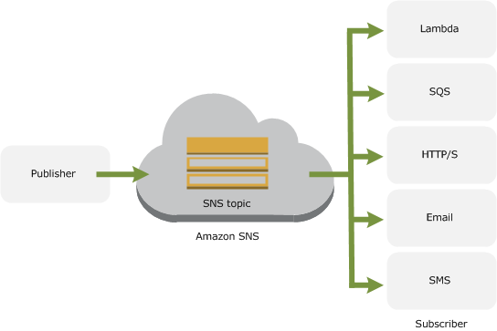
Amazon Simple Notification Service (SNS)
Amazon Simple Notification Service (Amazon SNS) is a web service that coordinates and manages the delivery or sending of messages to subscribing endpoints or clients.

Slide 85
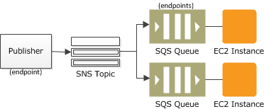
Amazon Simple Notification Service (SNS)
Usage Scenarios
Fan-out: The "fanout" scenario is when an Amazon SNS message is sent to a topic and then replicated and pushed to multiple Amazon SQS queues, HTTP endpoints, or email addresses.
This allows for parallel asynchronous processing.
For example, you could develop an application that sends an Amazon SNS message to a topic whenever an order is placed for a product. Then, the Amazon SQS queues that are subscribed to that topic would receive identical notifications for the new order. The Amazon EC2 server instance attached to one of the queues could handle the processing or fulfilment of the order while the other server instance could be attached to a data warehouse for analysis of all orders received.

Slide 86
Amazon Simple Notification Service (SNS)
Usage Scenarios
Application and System Alerts: Application and system alerts are notifications, triggered by predefined thresholds, sent to specified users by SMS and/or email. For example, since many AWS services use Amazon SNS, you can receive immediate notification when an event occurs, such as a specific change to your AWS Auto Scaling group.
Push Email and Text Messaging: Push email and text messaging are two ways to transmit messages to individuals or groups via email and/or SMS. For example, you could use Amazon SNS to push targeted news headlines to subscribers by email or SMS.

Slide 87
Amazon Simple Notification Service (SNS)
SNS Terms
Topic
Communication channel
Region-based
Identified by ARN
Subscribe
Connect an endpoint to a topic
Publish
Post topic message
Pushed to all subscribers
Message can contain different content for each subscriber protocol

Slide 88
Amazon Simple Notification Service (SNS)
Cost Considerations
No minimum fee
You pay for:
API requests (per million)
Data transfer out (per gigabyte)
Notifications (per 64KB payload)
Notification cost varies by endpoint
Prices vary by region
Pricing details at:
http://aws.amazon.com/sns/pricing/

Slide 89
Amazon Simple Notification Service (SNS)
Demonstration – SNS with the AWS Explorer

Slide 90
Amazon Simple Notification Service (SNS)
SNS Developer Topics
Now we will look at how to interact with the SNS using the AWS Java SDK.

Slide 91
Amazon Simple Notification Service (SNS)
Code Examples – Create SNS Client
AmazonSNS client = AmazonSNSClientBuilder.standard() .withRegion(Regions.US_WEST_2) .build();

Slide 92
Amazon Simple Notification Service (SNS)
Create SNS Topic
CreateTopicRequest req = new CreateTopicRequest().withName("MyTopic"); CreateTopicResult res = client.createTopic(req); String topicArn = res.getTopicArn();

Slide 93
Amazon Simple Notification Service (SNS)
Create SNS Subscription
SubscribeRequest req = new SubscribeRequest() .withEndpoint("user@company.com") .withProtocol("email") .withTopicArn(topicArn); client.subscribe(req);

Slide 94
Amazon Simple Notification Service (SNS)
Publish Notification
PublishRequest req = new PublishRequest() .withSubject("My Subject") .withMessage("My Message") .withTopicArn(topicArn);
client.publish(req);

Slide 95
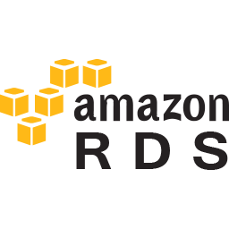
Amazon Relational Database Service (RDS)

Slide 96
Amazon Relational Database Service (RDS)
Amazon Relational Database Service (Amazon RDS) is a web service that makes it easier to set up, operate, and scale a relational database in the cloud. It provides cost-efficient, resizable capacity for an industry-standard relational database and manages common database administration tasks.

Slide 97






Amazon Relational Database Service (RDS)
Choice of database engines

Slide 98
Amazon Relational Database Service (RDS)
When you buy a server, you get CPU, memory, storage, and IOPS, all bundled together. With Amazon RDS, these are split apart so that you can scale them independently. So, for example, if you need more CPU, less IOPS, or more storage, you can easily allocate them.
Amazon RDS manages backups, software patching, automatic failure detection, and recovery.
In order to deliver a managed service experience, Amazon RDS does not provide shell access to DB instances, and it restricts access to certain system procedures and tables that require advanced privileges.
You can have automated backups performed when you need them, or create your own backup snapshot. These backups can be used to restore a database, and the Amazon RDS restore process works reliably and efficiently.

Slide 99
Amazon Relational Database Service (RDS)
You can get high availability with a primary instance and a synchronous secondary instance that you can failover to when problems occur. You can also use MySQL, MariaDB, or PostgreSQL Read Replicas to increase read scaling.
You can use the database products you are already familiar with: MySQL, MariaDB, PostgreSQL, Oracle, Microsoft SQL Server, and the new, MySQL-compatible Amazon Aurora DB engine.
In addition to the security in your database package, you can help control who can access your RDS databases by using AWS IAM to define users and permissions. You can also help protect your databases by putting them in a virtual private cloud.

Slide 100
Amazon Relational Database Service (RDS)
DB Instance
The basic building block of Amazon RDS is the DB instance. A DB instance is an isolated database environment in the cloud. A DB instance can contain multiple user-created databases, and you can access it by using the same tools and applications that you use with a stand-alone database instance.
Each DB instance runs a DB engine. Each DB engine has its own supported features, and each version of a DB engine may include specific features. Additionally, each DB engine has a set of parameters in a DB parameter group that control the behavior of the databases that it manages.
The computation and memory capacity of a DB instance is determined by its DB instance class. You can select the DB instance that best meets your needs. If your needs change over time, you can change DB instances.
DB instance storage comes in three types: Magnetic, General Purpose (SSD), and Provisioned IOPS (SSD).

Slide 101
Amazon Relational Database Service (RDS)
Regions and Availability Zones
You can run your DB instance in several Availability Zones, an option called a Multi-AZ deployment.
When you select this option, Amazon automatically provisions and maintains a synchronous standby replica of your DB instance in a different Availability Zone.
The primary DB instance is synchronously replicated across Availability Zones to the standby replica to provide data redundancy, failover support, eliminate I/O freezes, and minimize latency spikes during system backups.

Slide 102
Amazon Relational Database Service (RDS)
Security Groups
A security group controls the access to a DB instance. It does so by allowing access to IP address ranges or Amazon EC2 instances that you specify.
Amazon RDS uses DB security groups, VPC security groups, and EC2 security groups.
DB security group controls access to a DB instance that is not in a VPC, a VPC security group controls access to a DB instance inside a VPC, and an Amazon EC2 security group controls access to an EC2 instance and can be used with a DB instance.

Slide 103
Amazon Relational Database Service (RDS)
DB Parameter Group
You manage the configuration of a DB engine by using a DB parameter group.
A DB parameter group contains engine configuration values that can be applied to one or more DB instances of the same instance type.
Amazon RDS applies a default DB parameter group if you don’t specify a DB parameter group when you create a DB instance.
The default group contains defaults for the specific database engine and instance class of the DB instance

Slide 104
Amazon Relational Database Service (RDS)
Demonstration – RDS with the AWS Explorer

Slide 105

Amazon Elastic Compute Cloud (EC2)

Slide 106
Amazon Elastic Compute Cloud (EC2)
Amazon Elastic Compute Cloud (Amazon EC2) is a web service that provides secure, resizable compute capacity in the cloud. It is designed to make web-scale cloud computing easier for developers.
Instances are available in different sizes and configurations, this allows AWS to provide different instance types that you can use to meet specific needs.

Slide 107
Amazon Elastic Compute Cloud (EC2)
Amazon EC2 Benefits
Elastic Web-Scale Computing: Amazon EC2 enables you to increase or decrease capacity within minutes, not hours or days. You can commission one, hundreds, or even thousands of server instances simultaneously. You can also use Auto Scaling to maintain availability of your EC2 fleet and automatically scale your application up and down depending on its needs in order to maximize performance and minimize cost.
Completely Controlled: You have complete control of your instances including root access and the ability to interact with them as you would any machine. You can stop any instance while retaining the data on the boot partition, and then subsequently restart the same instance using web service APIs. Instances can be rebooted remotely using web service APIs, and you also have access to their console output.
Flexible Cloud Hosting Services: You have the choice of multiple instance types, operating systems, and software packages. Amazon EC2 allows you to select a configuration of memory, CPU, instance storage, and the boot partition size that is optimal for your choice of operating system and application.

Slide 108
Amazon Elastic Compute Cloud (EC2)
Amazon EC2 Benefits
Integrated: Amazon EC2 is integrated with most AWS services such as Amazon Simple Storage Service (Amazon S3), Amazon Relational Database Service (Amazon RDS), and Amazon Virtual Private Cloud (Amazon VPC) to provide a complete, secure solution for computing, query processing, and cloud storage across a wide range of applications.
Secure: Cloud security at AWS is the highest priority. As an AWS customer, you will benefit from a data centre and network architecture built to meet the requirements of the most security-sensitive organizations. Amazon EC2 works in conjunction with Amazon VPC to provide security and robust networking functionality for your compute resources.
Inexpensive: Amazon EC2 passes on to you the financial benefits of Amazon’s scale. You pay a very low rate for the compute capacity you actually consume.
Easy to Start: There are several ways to get started with Amazon EC2. You can use the AWS Management Console, the AWS Command Line Tools (CLI), or AWS SDKs.

Slide 109
Amazon Elastic Compute Cloud (EC2)
EC2 Storage Option
Amazon Elastic Block Store: Amazon EBS provides durable, block-level storage volumes that you can attach to a running instance. You can use Amazon EBS as a primary storage device for data that requires frequent and granular updates. For example, Amazon EBS is the recommended storage option when you run a database on an instance. An EBS volume behaves like a raw, unformatted, external block device that you can attach to a single instance. The volume persists independently from the running life of an instance. After an EBS volume is attached to an instance, you can use it like any other physical hard drive. Multiple volumes can be attached to an instance. You can also detach an EBS volume from one instance and attach it to another instance. You can dynamically change the configuration of a volume attached to an instance. To keep a backup copy of your data, you can create a snapshot of an EBS volume, which is stored in Amazon S3. You can create an EBS volume from a snapshot, and attach it to another instance.

Slide 110
Amazon Elastic Compute Cloud (EC2)
EC2 Storage Option
Amazon EC2 Instance Store: Many instances can access storage from disks that are physically attached to the host computer. This disk storage is referred to as instance store. Instance store provides temporary block-level storage for instances. The data on an instance store volume persists only during the life of the associated instance; if you stop or terminate an instance, any data on instance store volumes is lost.
Amazon Elastic File System: Amazon EFS provides scalable file storage for use with Amazon EC2. You can create an EFS file system and configure your instances to mount the file system. You can use an EFS file system as a common data source for workloads and applications running on multiple instances.

Slide 111
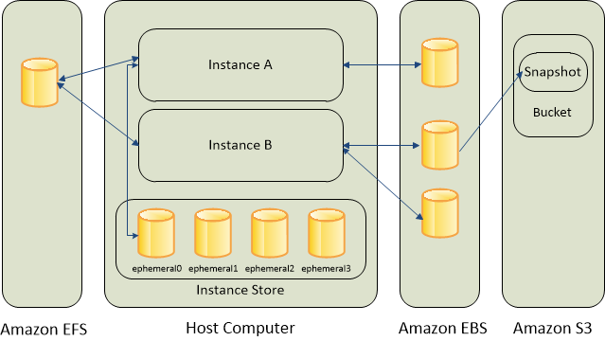
Amazon Elastic Compute Cloud (EC2)
EC2 Storage Option

Slide 112
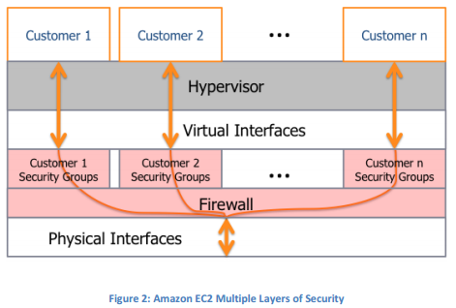
Amazon Elastic Compute Cloud (EC2)
Instance Isolation
Different instances running on the same physical machine are isolated from each other via the Xen hypervisor. AWS firewall resides within the hypervisor layer, between the physical network interface and the instance’s virtual interface.
All packets must pass through this layer, thus an instance’s neighbours have no more access to that instance than any other host on the Internet and can be treated as if they are on separate physical hosts.
The physical RAM is separated using similar mechanisms.
Customer instances have no access to raw disk devices, but instead are presented with virtualized disks.

Slide 113
Amazon Elastic Compute Cloud (EC2)
Amazon EC2 Instance Types
https://aws.amazon.com/ec2/instance-types/

Slide 114
Amazon Elastic Compute Cloud (EC2)
Demonstration – EC2 with the AWS Explorer

Slide 115
Amazon Elastic Compute Cloud (EC2)
Deploy Node.js application on Windows EC2 instance
Things to remember
Enable required port in Security Group
Inbound
80 is for HTTP
Use TCP 3000 for Node.js application
Open RDP for Remote Desktop
Outbound
80 for HTTP

Slide 116
Amazon Elastic Compute Cloud (EC2)
Deploy Node.js application on Windows EC2 instance
Things to remember
On EC2 instance
Open Start Menu -> Administrative Tools -> Windows Firewall with Advanced Security.
Click "Inbound Rules" from the left window
Click "New Rule..." in the Actions window on the right side
follow the prompts to customize the rule and be sure to add the port that your Node.js application is using. Make sure to name the rule so that you recognize it later.
In the Inbound Rules window find and double click the rule you just created. Under Programs and Services, select "This Program:" and browse to your node.exe file.

Slide 117
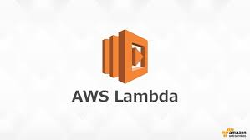
AWS Lambda

Slide 118
AWS Lambda
A compute service where you don’t have to think about:
Servers
Being over/under capacity
Deployments
Scaling and fault tolerance
OS or language updates
Metrics and logging
…but where you can easily
Bring your own code… even native libraries
Run code in parallel
Create backbends, event handlers, and data processing systems
Never pay for idle!

Slide 119
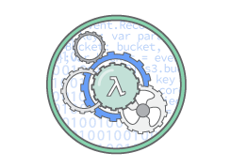
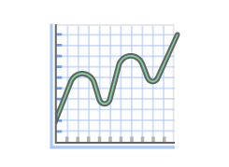
AWS Lambda
AWS Lambda – Benefits
No Servers to Manage: AWS Lambda automatically runs your code without requiring you to provision or manage servers. Just write the code and upload it to Lambda.
Continuous Scaling: AWS Lambda automatically scales your application by running code in response to each trigger. Your code runs in parallel and processes each trigger individually, scaling precisely with the size of the workload.

Slide 120
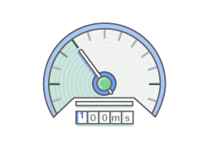
AWS Lambda
AWS Lambda – Benefits
Sub-second Metering: With AWS Lambda, you are charged for every 100ms your code executes and the number of times your code is triggered. You don't pay anything when your code isn't running.

Slide 121
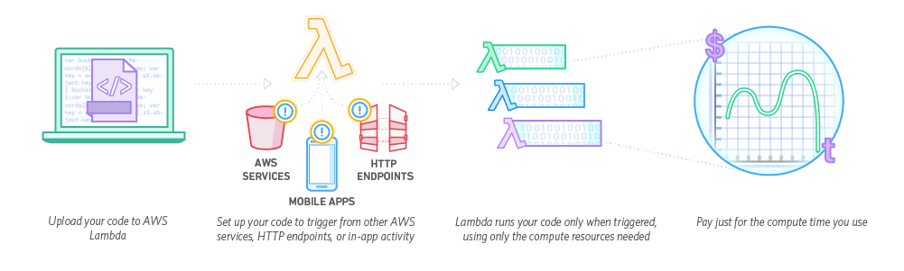
AWS Lambda
How It Works

Slide 122
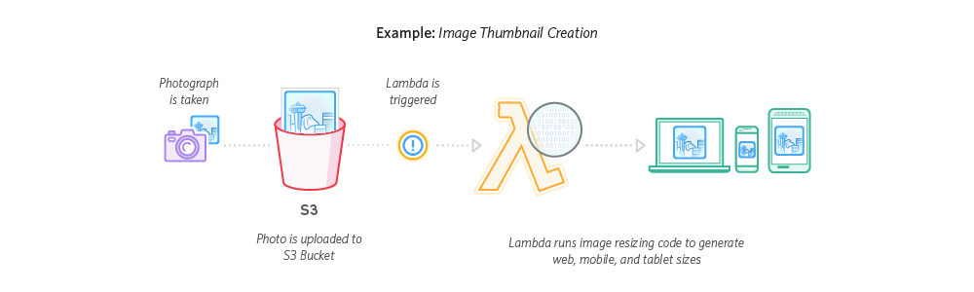
AWS Lambda
How It Works

Slide 123
AWS Lambda
Example - Using AWS Lambda with Amazon S3
Suppose you want to create a thumbnail for each image (.jpg and .png objects) that is uploaded to a bucket. You can create a Lambda function (CreateThumbnail) that Amazon S3 can invoke when objects are created. Then, the Lambda function can read the image object from the source bucket and create a thumbnail image target bucket (in this tutorial, it's called the sourceresized bucket).
Important
You must use two buckets. If you use the same bucket as the source and the target, each thumbnail uploaded to the source bucket triggers another object-created event, which then invokes the Lambda function again, creating an unwanted recursion.

Slide 124
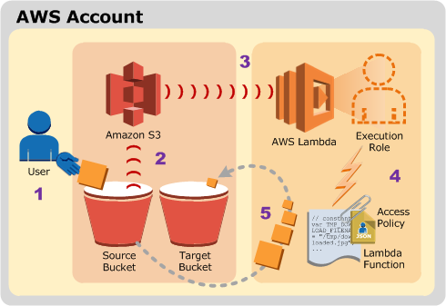
AWS Lambda
Implementation Summary
A user uploads an object to the source bucket in Amazon S3 (object-created event).
Amazon S3 detects the object-created event.
Amazon S3 publishes the s3:ObjectCreated:* event to AWS Lambda by invoking the Lambda function and passing event data as a function parameter.
AWS Lambda executes the Lambda function by assuming the execution role that you specified at the time you created the Lambda function.
From the event data it receives, the Lambda function knows the source bucket name and object key name. The Lambda function reads the object and creates a thumbnail using graphics libraries, and saves it to the target bucket.

Slide 125
AWS Lambda
Steps
Login to AWS account using root / admin user.
Go to IAM and select the appropriate user.
Add S3 Full Access.
Logout and Login to AWS using the IAM User Sign-in URL.
Create two buckets. The target bucket name must be source followed by resized, where source is the name of the bucket you want to use for the source. For example, mybucket and mybucketresized.
Upload HappyFace.jpg in source bucket.

Slide 126
AWS Lambda
Create new Maven Project and add following dependency
<dependency> <groupId>com.amazonaws</groupId> <artifactId>aws-lambda-java-core</artifactId> <version>1.1.0</version> </dependency> <dependency> <groupId>com.amazonaws</groupId> <artifactId>aws-lambda-java-events</artifactId> <version>1.3.0</version> </dependency> <dependency> <groupId>com.amazonaws</groupId> <artifactId>aws-lambda-java-log4j</artifactId> <version>1.0.0</version> </dependency> <dependency> <groupId>com.amazonaws</groupId> <artifactId>aws-lambda-java-log4j2</artifactId> <version>1.0.0</version> </dependency>

Slide 127
AWS Lambda
Create package “com.yash.training.aws”
Add “S3EventProcessorCreateThumbnail.java” to above package.

Slide 128
AWS Lambda
Update pom.xml to include packaging.
Run – mvn clean install
<build> <plugins> <plugin> <groupId>org.apache.maven.plugins</groupId> <artifactId>maven-shade-plugin</artifactId> <version>2.3</version> <configuration> <createDependencyReducedPom>false</createDependencyReducedPom> </configuration> <executions> <execution> <phase>package</phase> <goals> <goal>shade</goal> </goals> </execution> </executions> </plugin> </plugins> </build>

Slide 129
AWS Lambda
Login to AWS using root / admin user.
Create New Role
In Role Name, use a name that is unique within your AWS account (for example, lambda-s3-execution-role).
In Select Role Type, choose AWS Service Roles, and then choose AWS Lambda. This grants the AWS Lambda service permissions to assume the role.
In Attach Policy, choose AWSLambdaExecute.
Write down the role ARN. You will need it in the next step when you create your Lambda function.

Slide 130
AWS Lambda
Go to Services → Lambda
Click on “Create a Lambda function”
Choose “Blank Function” from blueprint list.
On “Configure triggers” Page click “Next”
“Configure function”
Name → CreateThumbnail
Runtime → Select Java 8
Upload jar file which we created using maven.

Slide 131
AWS Lambda
Handler → com.yash.training.aws.S3EventProcessorCreateThumbnail
Role → Select “Choose an existing role”
Existing Role → Select “lambda-s3-execution-role”
Click “Next”
Click “Create Function”
Test!
For the sample event for testing, choose S3 Put in Sample event template.
Update Source bucket and image name
Run
Verify that the thumbnail was created in the target bucket.

Slide 132
AWS Lambda
Add an Event Source (Configure Amazon S3 to Publish Events)
Select Lambda Function “CreateThumbnail” and go to “Triggers” Tab.
Click on “Add trigger”
Select “S3” as trigger type.
Bucket → sourcebucket
Event Type → PUT
Click Submit
Test it by uploading image to “sourcebucket”

Slide 133
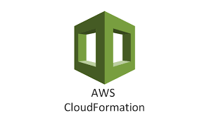
AWS CloudFormation

Slide 134
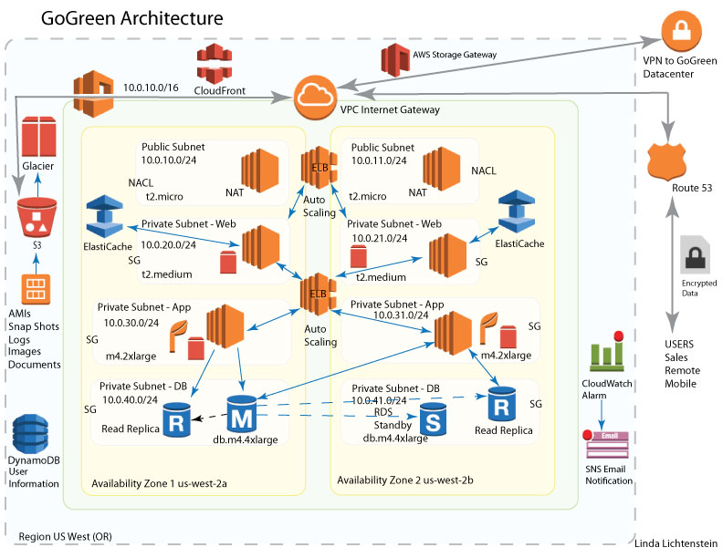
AWS CloudFormation

Slide 135
AWS CloudFormation
Manual Configuration Challenges
Create and configure AWS services and resources through management console. → Manual Process
What are the challenges and concerns for a manual process ?
Reliability
Reproducibility
DEV
QUAL
CERT
PROD
Documentation needs
Solution is to automate the process!

Slide 136
AWS CloudFormation
AWS is API-Driven
Do It Yourself (DIY) Solution
Create everything with script
Issues
Dependency
Parallelization
Works but may require some effort, and could be fragile
Benefits
You have full control

Slide 137
AWS CloudFormation
What is the alternative to a DIY solution? AWS CloudFormation

Slide 138
AWS CloudFormation
An easy way to create & manage a collection of AWS resources.
Allows orderly and predictable provisioning and updating of resources
Allows you to version control your AWS infrastructure
Deploy and update stacks using console, command line or API
You only pay for the resources you create.

Slide 139
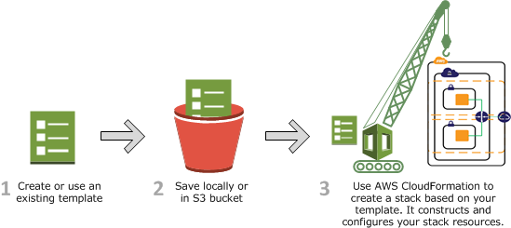
AWS CloudFormation
How Does AWS CloudFormation Work?

Slide 140
AWS CloudFormation
CloudFormation Template
A template is a declaration of the AWS resources that make up a stack. The template is stored as a text file whose format complies with the JavaScript Object Notation (JSON) or YAML standard. Because they are just text files, you can create and edit them in any text editor and manage them in your source control system with the rest of your source code.
Resources
Contains a list of resource objects.
Resource declaration has the resource’s attributes, which are themselves declared as child objects.
A resource must have a Type attribute, which defines the kind of AWS resource you want to create. The Type attribute has a special format:
AWS::ProductIdentifier::ResourceType

Slide 141
AWS CloudFormation
Example Let's take a look at a very basic template. The following template declares a single resource of type AWS::S3::Bucket: with the name MyFirstS3Bucket.
{ "Resources":{ “MyFirstS3Bucket ":{ "Type":"AWS::S3::Bucket“ } } } If you use this template to create a stack, AWS CloudFormation will create an Amazon S3 bucket. Creating a bucket is simple, because AWS CloudFormation can create a bucket with default settings. For other resources, such as an Auto Scaling group or EC2 instance, AWS CloudFormation requires more information. Resource declarations use a Properties attribute to specify the information used to create a resource.

Slide 142
AWS CloudFormation
Example { "Resources":{ "HelloBucket":{ "Type":"AWS::S3::Bucket", "Properties":{ "AccessControl":"PublicRead“,
“BucketName” : “MyFirstS3Bucket” } } } }

Slide 143
Amazon CloudFormation
Let’s try this

Slide 144
Amazon CloudFormation
Create CloudFormation Stack for Photo Thumbnail Project

Slide 145
Amazon CloudFormation
Application Flow

Slide 146
Amazon CloudFormation
Identifying the required AWS resources
Create Source Bucket.
Lambda Execution Role
Lambda Function
Trigger / Notification
SNS Topic

Slide 147
Amazon CloudFormation
Step 1: S3 buckets
{
"Resources":{
"S3BucketMS":{
"Type":"AWS::S3::Bucket",
"Properties":{
"BucketName":"muchhalsumeet",
"AccessControl":"PublicReadWrite"
},
"DeletionPolicy":"Retain"
},
"S3BucketMSR":{
"Type":"AWS::S3::Bucket",
"Properties":{
"BucketName":"muchhalsumeetresized",
"AccessControl":"PublicReadWrite"
},
"DeletionPolicy":"Retain"
}
}
}

Slide 148
Amazon CloudFormation
Step 2: Execution Role
"LambdaExecutionRole":{
"Type":"AWS::IAM::Role",
"Properties":{
"RoleName":"lambda-s3-execution-role",
"AssumeRolePolicyDocument":{
"Version":"2012-10-17",
"Statement":[
{
"Effect":"Allow",
"Principal":{
"Service":[
"lambda.amazonaws.com"
]
},
"Action":[
"sts:AssumeRole"
]
}
]
},
"ManagedPolicyArns":[
"arn:aws:iam::aws:policy/AWSLambdaExecute"
]
}
}

Slide 149
Amazon CloudFormation
Step 3: Lambda
"AWSLambda":{
"Type":"AWS::Lambda::Function",
"Properties":{
"FunctionName":"CreateThumbnail",
"Handler":"com.yash.training.aws.S3EventProcessorCreateThumbnail",
"Role":{
"Fn::GetAtt":[
"LambdaExecutionRole",
"Arn"
]
},
"Code":{
"S3Bucket":"sm-lambda-functions",
"S3Key":"aws-training-1.0-SNAPSHOT.jar"
},
"Runtime":"java8",
"MemorySize": 512,
"Timeout": 15
}
}

Slide 150
Amazon CloudFormation
Step 4: combine all of them and execute.
Step 5: Identify what is missing.

Slide 151
Amazon CloudFormation
Add Permission and update stack
“AWSLambdaPermission":{
"Type":"AWS::Lambda::Permission",
"Properties":{
"Action":"lambda:InvokeFunction",
"FunctionName":{
"Ref":"AWSLambda"
},
"Principal":"s3.amazonaws.com",
"SourceAccount":{
"Ref":"AWS::AccountId"
},
"SourceArn":{
"Fn::Join":[
":",
[
"arn",
"aws",
"s3",
"",
"",
{
"Ref":"S3BucketMS"
}
]
]
}
}
}

Slide 152
Amazon CloudFormation
Add Notification and update stack
"S3BucketMS":{
"Type":"AWS::S3::Bucket",
"Properties":{
"BucketName":"muchhalsumeet",
"AccessControl":"PublicReadWrite",
"NotificationConfiguration":{
"LambdaConfigurations":[
{
"Function":{
"Fn::GetAtt":[
"AWSLambda",
"Arn"
]
},
"Event":"s3:ObjectCreated:*"
}
]
}
}
}

Slide 153
Amazon CloudFormation
Test system by uploading image to source bucket.

Slide 154
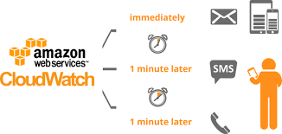
Amazon CloudWatch

Slide 155

Amazon CloudWatch
You are flying blind without instrumentation
To leverage AWS in an efficient way, you need insight to your AWS resources.
Not everything can be self-directed.
There are dependencies that needs to be expressed before an action is taken.
How do you capture this information?

Slide 156
Amazon CloudWatch
What is CloudWatch?

Slide 157
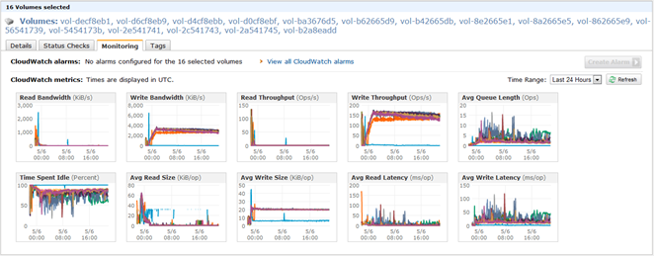
Amazon CloudWatch
At it most basic – AWS instrumentation

Slide 158
Amazon CloudWatch
Every AWS Service has “Metrics”:
SQS Queue Length
Amazon EBS volumes
RDS DB instance
Amazon EC2 instance
………………
Metrics are data about the performance of your system.

Slide 159
Amazon CloudWatch
Metrics are grouped first by namespace, and then by the various dimension combinations within each namespace. For example, you can view all EC2 metrics, EC2 metrics grouped by instance, or EC2 metrics grouped by Auto Scaling group.
Only the AWS services that you're using send metrics to Amazon CloudWatch.
Dimension: is a name/value pair that you can use to filter metrics.

Slide 160
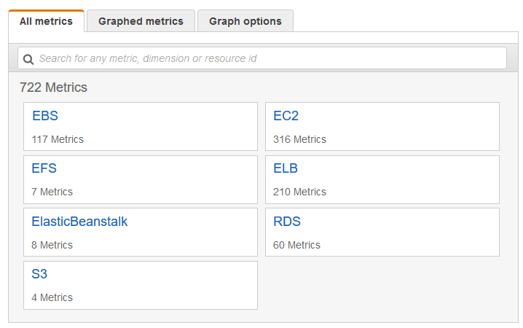
Amazon CloudWatch
To view available metrics by namespace and dimension using the console
Open the CloudWatch console
In the navigation pane, choose Metrics.
Select a metric namespace (for example, EC2).

Slide 161
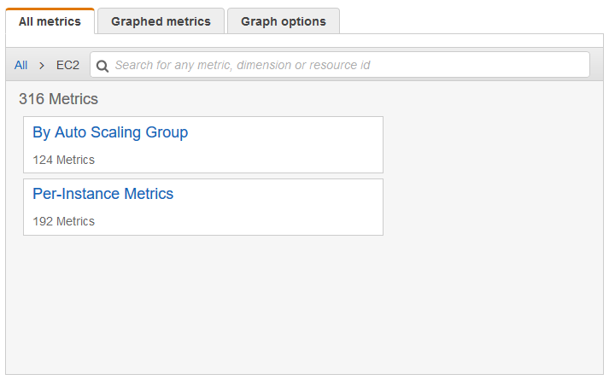
Amazon CloudWatch
Select a metric dimension (for example, Per-Instance Metrics).

Slide 162
Amazon CloudWatch
The All metrics tab displays all metrics for that dimension in the namespace. You can do the following:
To sort the table, use the column heading.
To graph a metric, select the check box next to the metric. To select all metrics, select the check box in the heading row of the table.
To filter by resource, choose the resource ID and then choose Add to search.
To filter by metric, choose the metric name and then choose Add to search.

Slide 163
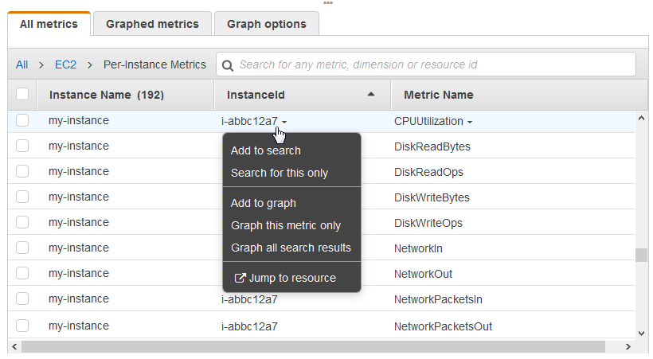
Amazon CloudWatch

Slide 164
Amazon CloudWatch
Every Metric can be converted to Alarm
To create an alarm
Open the CloudWatch console
In the navigation pane, choose Alarms, Create Alarm
For the Select Metric step, do the following:
Choose a metric category (for example, EC2 Metrics).
Select an instance and metric (for example, CPUUtilization).
For the statistic, choose one of the statistics (for example, Average) or predefined percentiles, or specify a custom percentile (for example, p95.45).
Choose a period (for example, 1 Hour).
Choose Next.

Slide 165
Amazon CloudWatch
To create an alarm
Under Alarm Threshold, type a unique name for the alarm and a description of the alarm. For Whenever, specify a threshold (for example, 80 percent of CPU utilization) and the number of periods.
Under Actions, select the type of action to have the alarm to perform when the alarm is triggered.
Choose Create Alarm.

Slide 166
Amazon CloudWatch

Slide 167
Thank you!

