Slide 1

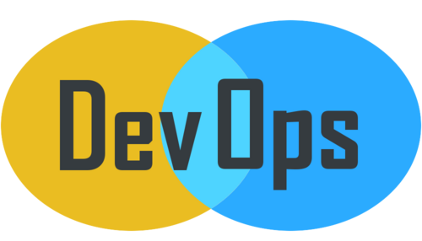
© Copyright, Intellipaat Software Solutions Pvt. Ltd. All rights reserved.
Continous Integration - Jenkins

Slide 2
Overview of Jenkins
Continuous Integration is a development practice in which the developers are required to commit changes to the source code in a shared repository several times a day or more frequently.
Every commit made in the repository is then built. This allows the teams to detect the problems early.
Apart from this, depending on the Continuous Integration tool, there are several other functions like deploying the build application on the test server, providing the concerned teams with the build and test results etc.
Jenkins is an open source automation tool written in Java with plugins built for Continuous Integration purpose. Jenkins is used to build and test your software projects continuously making it easier for developers to integrate changes to the project, and making it easier for users to obtain a fresh build. It also allows you to continuously deliver your software by integrating with a large number of testing and deployment technologies.
With Jenkins, organizations can accelerate the software development process through automation. Jenkins integrates development life-cycle processes of all kinds, including build, document, test, package, stage, deploy, static analysis and much more.
Jenkins achieves Continuous Integration with the help of plugins. Plugins allows the integration of Various DevOps stages. If you want to integrate a particular tool, you need to install the plugins for that tool. For example: Git, Maven 2 project, Amazon EC2, HTML publisher etc.

Slide 3
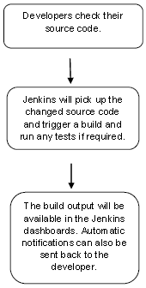
Why Jenkins ?
Jenkins is a software that allows continuous integration. Jenkins will be installed on a server where the central build will take place. The following flowchart demonstrates a very simple workflow of how Jenkins works.

Slide 4
Benefits of using Jenkins
Advantages of Jenkins include:
It is an open source tool with great community support.
It is easy to install.
It has 1000+ plugins to ease your work. If a plugin does not exist, you can code it and share with the community.
It is free of cost.
It is built with Java and hence, it is portable to all the major platforms.
Following are some facts about Jenkins that makes it better than other Continuous Integration tools:
Adoption: Jenkins is widespread, with more than 147,000 active installations and over 1 million users around the world.
Plugins: Jenkins is interconnected with well over 1,000 plugins that allow it to integrate with most of the development, testing and deployment tools.

Slide 5
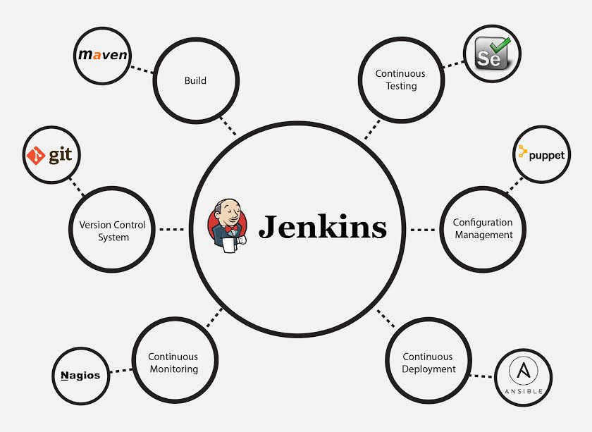
Jenkins Integration

Slide 6
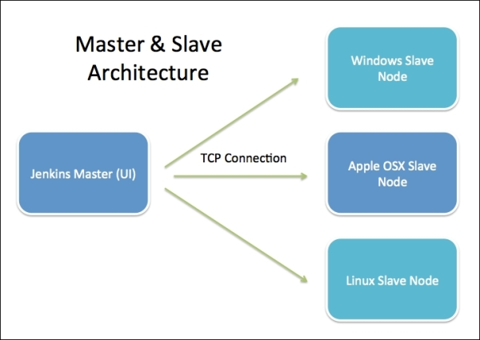
Jenkins Distributed Architecture

Slide 7
Jenkins Distributed Architecture
Jenkins Master
Main Jenkins server is the Master. The Master’s job is to handle:
Scheduling build jobs.
Dispatching builds to the slaves for the actual execution.
Monitor the slaves (possibly taking them online and offline as required).
Recording and presenting the build results.
A Master instance of Jenkins can also execute build jobs directly.
Jenkins Slave
A Slave is a Java executable that runs on a remote machine. Following are the characteristics of Jenkins Slaves:
It hears requests from the Jenkins Master instance.
Slaves can run on a variety of operating systems.
The job of a Slave is to do as they are told to, which involves executing build jobs dispatched by the Master.
You can configure a project to always run on a particular Slave machine, or a particular type of Slave machine, or simply let Jenkins pick the next available Slave.

Slide 8
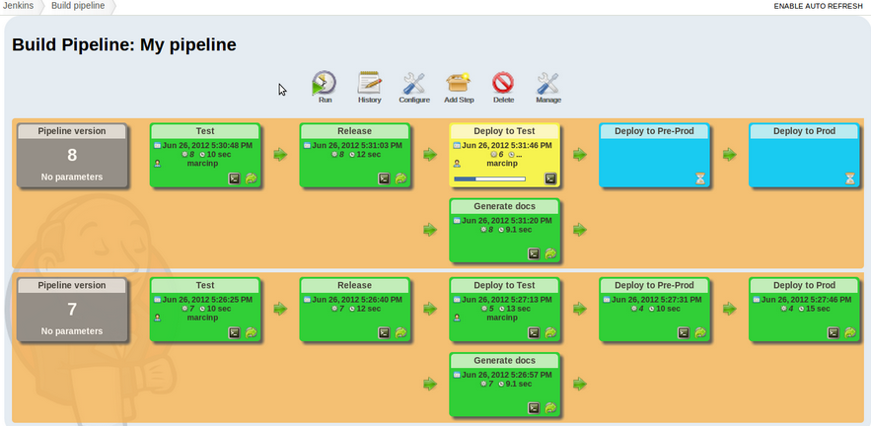
Jenkins Build Pipeline

Slide 9
Jenkins Build Pipeline
It is used to know which task Jenkins is currently executing.
Often several different changes are made by several developers at once, so it is useful to know which change is getting tested or which change is sitting in the queue or which build is broken. This is where pipeline comes into picture.
The Jenkins Pipeline gives you an overview of where tests are up to. In build pipeline the build as a whole is broken down into sections, such as the unit test, acceptance test, packaging, reporting and deployment phases.
The pipeline phases can be executed in series or parallel, and if one phase is successful, it automatically moves on to the next phase (hence the relevance of the name “pipeline”)

Slide 10
Thank You
Email us – support@intellipaat.com
Visit us - https://intellipaat.com

