Slide 1

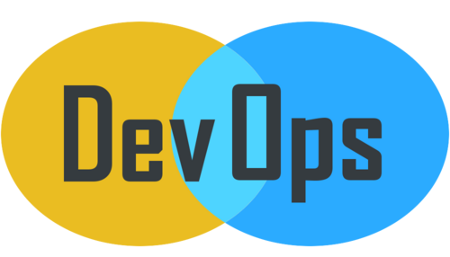
© Copyright, Intellipaat Software Solutions Pvt. Ltd. All rights reserved.
Nginx

Slide 2
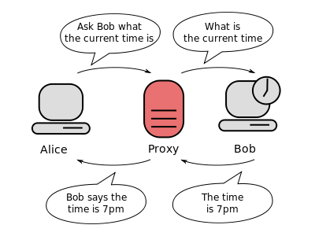
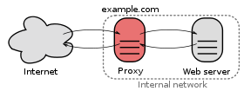
What is Web Proxy Server ?
Basically, a Web proxy acts as a shield between you and the site you're looking at; in other words, it's a way to access sites that give users a reason to keep their identity concealed. When you use a Web proxy, you are not actually connecting to your intended site, instead, the Web proxy is connecting to the site, therefore hiding any trace of your presence.
In computer networks, a reverse proxy is a type of proxy server that retrieves resources on behalf of a client from one or more servers. These resources are then returned to the client as if they originated from the Web server itself. Contrary to a forward proxy, which is an intermediary for its associated clients to contact any server, a reverse proxy is an intermediary for its associated servers to be contacted by any client.

Slide 3
Benefits of Reverse Proxies
Reverse proxies can hide the existence and characteristics of an origin server or servers.
· Application firewall features can protect against common web-based attacks, like DoS or DDoS. Without a reverse proxy, removing malware or initiating takedowns, for example, can become difficult.
In the case of secure websites, a web server may not perform SSL encryption itself, but instead offloads the task to a reverse proxy that may be equipped with SSL acceleration hardware.
A reverse proxy can distribute the load from incoming requests to several servers, with each server serving its own application area.
· A reverse proxy can reduce load on its origin servers by caching static content, as well as dynamic content Proxy caches of this sort can often satisfy a considerable number of website requests, greatly reducing the load on the origin server(s).
A reverse proxy can optimize content by compressing it in order to speed up loading times.
Reverse proxies can operate wherever multiple web-servers must be accessible via a single public IP address.

Slide 4
Overview of Nginx
Nginx (pronounced "Engine X") is a high performance web server.
It was originally developed to tackle the 10K problem which means serving 10.000 concurrent connections.
Nginx can be used as a standalone web server, or serve in front of other web servers as a reverse proxy.
When serving as a reverse proxy, Nginx is acting as a front web server which passes the incoming requests on to web servers on the back, on different ports etc. Nginx can then handle aspects like SSL / HTTPS, GZip, cache headers, load balancing and a lot of other stuff. The web servers on the back then do not need to know how to handle this. And - you only have one web server for which you need to learn how to configure SSL / HTTPS, GZip etc. - and that is Nginx.

Slide 5
Thank You
Email us – support@intellipaat.com
Visit us - https://intellipaat.com

