Slide 1
MiTH - Merchant Fraud Detection in E-commerce
Author: Sumanth William Lazarus
Student ID: 2856

Slide 2


Basic Libraries and Functions:
StandardScaler
OneHotEncoder
Pipeline
GridSearchCV
LogisticRegression
DecisionTreeClassifier
sklearn.metrics: confusion_matrix, f1_score, accuracy_score

Slide 3
Pre-Processing Data & Exploratory Data Analysis

Slide 4
Basic Steps:
1. Reading .csv files into pandas.DataFrame.
2. Merging Merchant & Order Data along ‘Merchant_ID’, X_train-X_test treatment.
3. Joining ‘y_train’ along ‘Merchant_ID’.
4. df.shape, df.describe( ) : uncovering insights into data spread/distribution.

Slide 5
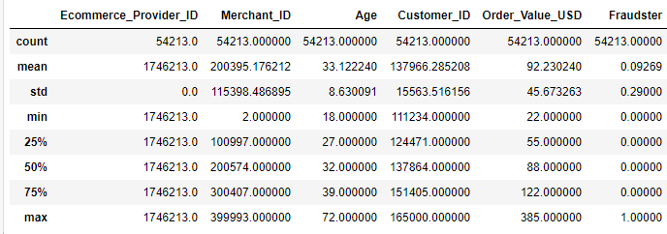
Description of Data:
1. 'Merchant_ID', 'Customer_ID' will be converted to dtype 'object’.
2. 'Ecommerce_Provider_ID' will be dropped due to No Information Gain.

Slide 6
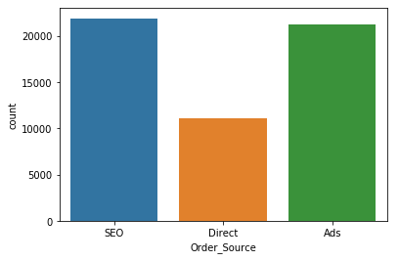
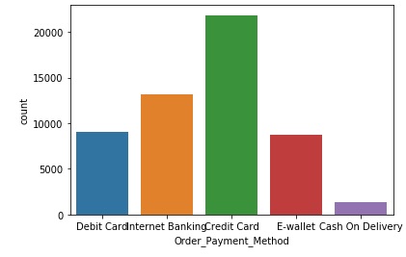
Exploration of Categorical Features
Bar Chart of ‘Order_Source’ & ‘Order_Payment_Method’

Slide 7
Feature Engineering

Slide 8
‘object’ Datatype to ‘categorical’
'Order_Source': Has 3 Levels - SEO, Ads, Direct
'Order_Payment_Method': Has 5 Levels - Credit Card, Internet Banking, Debit Card, E-wallet, Cash On Delivery
'Order_Source', 'Order_Payment_Method', 'Gender': Can be converted to 'category' dtype

Slide 9
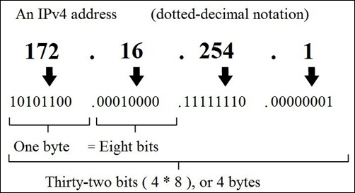
'IP_Address': Should be converted to Human readable format (Decimal)
Extraction of info store in ‘IP_Address’

Slide 10
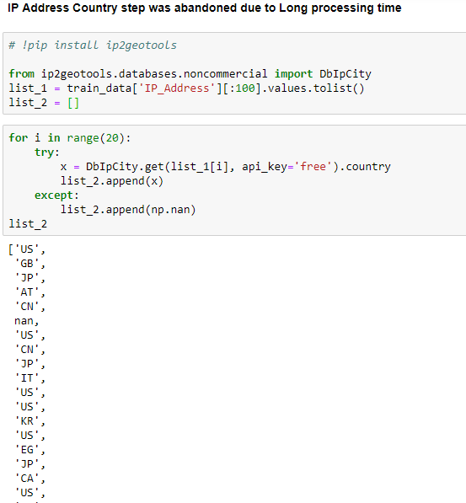
1. Extraction of Country label from ‘IP_Address’

Slide 11
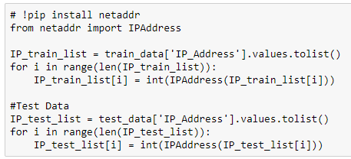
2. Extraction of Country Label using List Comprehension and embedded If-statement
Convert IP Address → Decimal

Slide 12
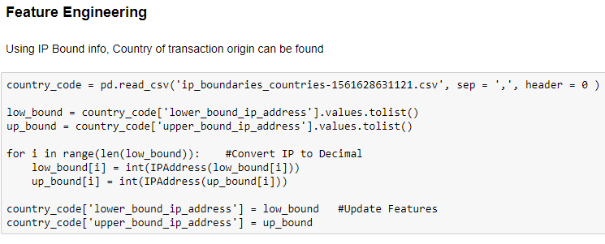
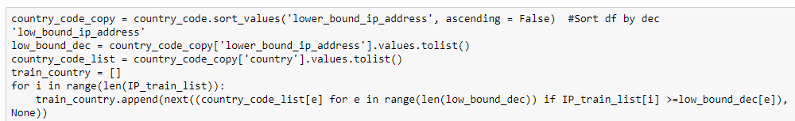
Extract ‘Country Label’ using Lookup/List Comprehension

Slide 13
Modelling Stage

Slide 14
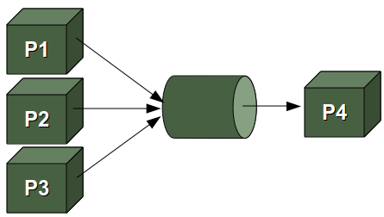
Introducing Pipeline Object
1. Grouped ‘Transformers’ applied on Data in a modular/streamlined fashion

Slide 15
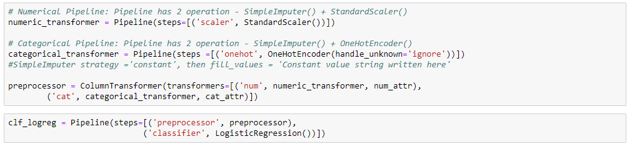
Model 1 : Logistic Regression (Linear)
1
Standardization of Num attr
2
Dummification of Cat attr
3
Fit & Predict/Transform of Model on X_test

Slide 16
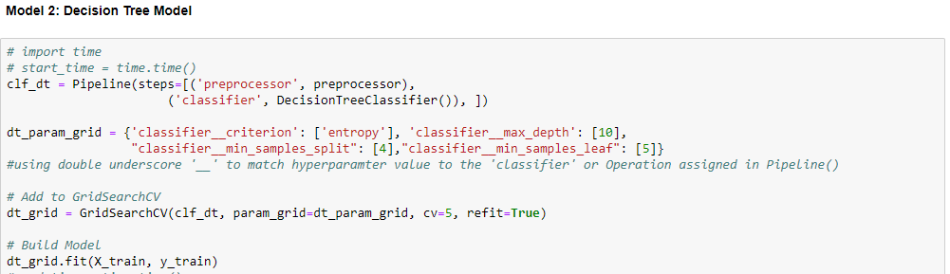
Model 2: Decision Tree Classifier with GridSearchCV
Pre-processing
Modeling
Hyperparameter Tuning
1
2
3

Slide 17
Evaluation and Performance

Slide 18
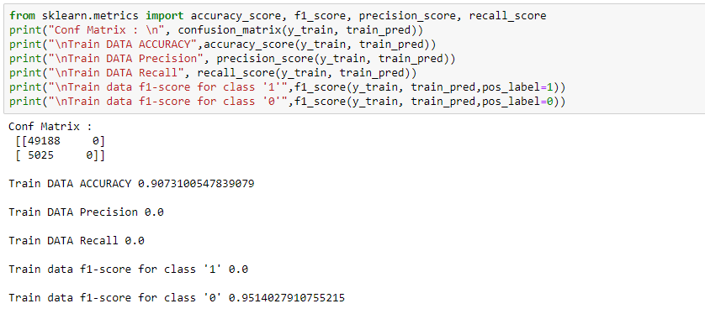
Evaluation Metrics used:
1. f1_score()
2. Precision & Recall
3. Accuracy
Model 1 : Logistic Regression (Linear)

Slide 19
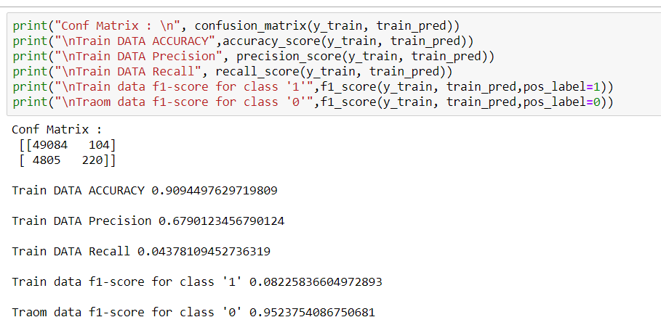
Model 2 : Decision Tree Classifier with GridSearchCV

