Slide 1
AWS serverless NLP workshop

Slide 2
Voice-of-the-Customer Application

Slide 3
Collect
Transform
Deliver
Gather customer feedback
Process Categorize and Score
Distill Actionable Insight and make it accessible
Internal
NLP
Reports & Validation
Email / Chat Transcripts
Online Return Center
Tickets
Ad Hoc Sources
Survey
Structured Data Joiner
Sentiment Scoring
Discovery & Exploration
External
Classification
Social Media
Forums
Customer Reviews
Analysis Preparation
Event Detection
Analysis Database

Slide 4
Serverless VOC Application

Slide 5
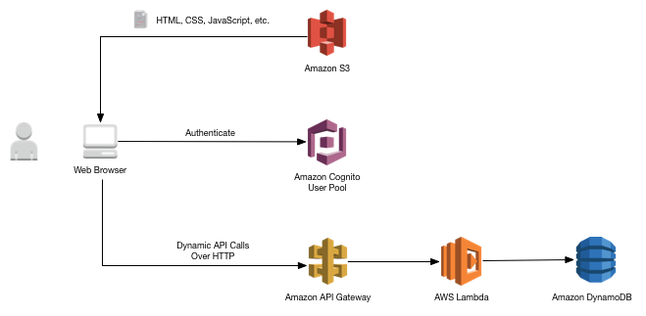
Scenario: Wild Rydes (AWS Workshop)
The Wild Rydes Serverless Web Application Workshop introduces the basics of building web applications using serverless infrastructure.
Notes:
This is what the completed architecture for our website will look like when complete.

Slide 6
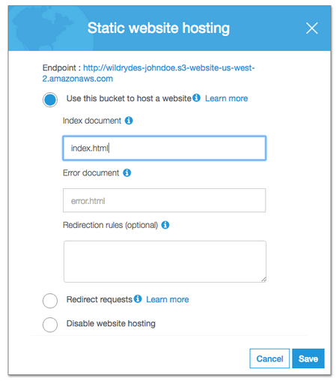
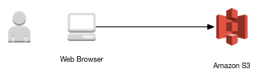
Step 1: Static Website Hosting
OBJECTIVE: Create a bucket in Amazon S3 and configure it for static website hosting. The static HTML, JS, and CSS will be served directly to user browsers from Amazon S3.

Slide 7
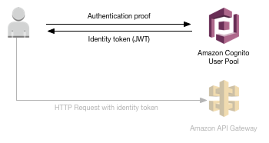
Step 2: User Management
OBJECTIVE: Allow visitors to register as a new user on Wild Rydes, by providing and validating their email address. Amazon Cognito will be used to manage the User Pool for Wild Rydes.

Slide 8
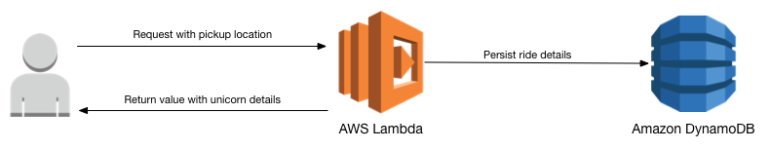
Step 3: Serverless Service Backend
OBJECTIVE: Create a service backend using AWS Lambda and Amazon DynamoDB to handle requests from your frontend static website content.

Slide 9
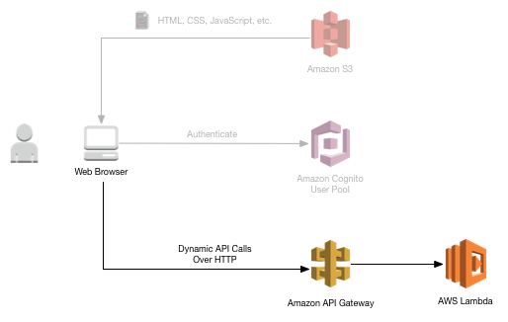
Step 4: Create RESTful API
OBJECTIVE: Use API Gateway to expose the Lambda function you built in the previous module as a RESTful API

Slide 10
Serverless NLP application

Slide 11
NLP on AWS
Application Services
Vision Services:
Amazon Rekognition Image
Amazon Rekognition Video
Language Services:
Amazon Comprehend, Amazon Lex, Amazon Polly, Amazon Translate, Amazon Transcribe
Platform Services
Amazon SageMaker
AWS DeepLens
Frameworks & Interfaces
AWS Deep Learning AMI
TensorFlow
Apache MXNet
Microsoft Cognitive Toolkit
Caffe2 & Caffe
PyTorch
Theano
Keras
Gluon

Slide 12





Serverless VOC architecture
Dynamo
Amazon Comprehend
API Gateway
Amazon Translate
Amazon Sagemaker

Slide 13
Sentiment analysis
I love my country.
I hate the flu.
positive sentiment
negative sentiment

Slide 14
Training NLP is Hard and Expensive
Data annotation
Data Collection and Prep
Training the model
NLP Model
Notes:
Call out OSS frameworks specifically. Stress more on our deep learning based approach. Statements on deep learning value over time. Finding the right algorithm is hard.
Whether you take a custom approach or start with an open source NLP model, training an NLP model for your use case and quality bar is time consuming and expensive. Let’s dive in…
Say you want to train a service to look for geopolitically sensitive events that could impact your regional offices or supply routes. This would take months of understanding the right data set, cleaning it, preparing it for processing. Annotating it will take expertise of going through the data to label what is an event vs a product vs a city. Then a single or team of data scientists has to pick the right ML platform, design a model, then continuously train that model – this is ongoing in perpetiuity.

Slide 15




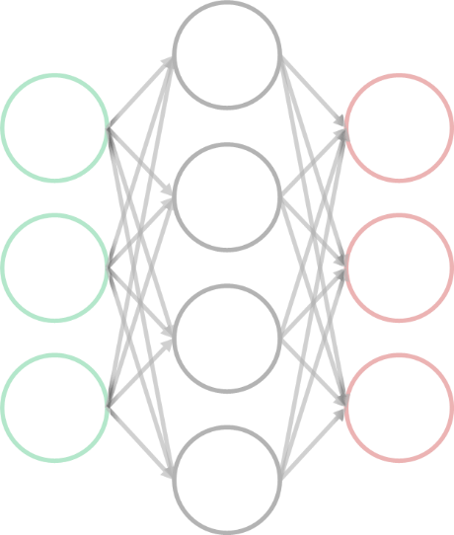
Amazon Comprehend: NLP
😃
Sentiment
Entities
Languages
Key phrases
Topic modeling
POWERED BY DEEP LEARNING
Notes:
Call out that we support english and spanish

Slide 16
Text Analysis
Named Entities
Amazon.com: Organization
Seattle, WA : Location
July 5th,1994: Date
Jeff Bezos : Person
Keyphrases
Our customers
books
blenders
great prices
Sentiment
Positive
Language
English
Amazon.com, Inc. is located in Seattle, WA and was founded July 5th, 1994 by Jeff Bezos. Our customers love buying everything from books to blenders at great prices

Slide 17
Topic Modeling
Keywords Topic Groups
Document Relationship to Topics
Topic | Term | Weight
0 | Washington | .89
1 | Silicon Valley | .67
2 | Roasting | .91
Document | Topic | Proportion
Doc.txt | 0 | .89
Doc.txt | 1 | .67
Doc.txt | 2 | .91
Notes:
Words buckets mapping to a topic cluster
Documents that contain a high proportion of words within a topic cluster, contained with that document

Slide 18
Lambda code for Comprehend (python)
import boto3
import json
comprehend = boto3.client(service_name='comprehend', \
region_name='us-east-1')
def lambda_handler(event, context):
text = format(event['review'])
jsonstr = json.dumps(comprehend.detect_sentiment(\
(Text=text, LanguageCode='en'), \
sort_keys=True, indent=4)
result = json.loads(jsonstr)
return result["Sentiment"]

Slide 19
In java…
AmazonComprehend client = AmazonComprehendClientBuilder.standard()
.withCredentials(new AWSStaticCredentialsProvider(awsCreds))
.withRegion("region")
.build();
String[] textList = {"I love Seattle", "Today is Sunday", "Tomorrow is Monday”};
// Call detectEntities API
BatchDetectEntitiesRequest batchDetectEntitiesRequest = new BatchDetectEntitiesRequest()
withTextList(textList)
withLanguageCode("en");
BatchDetectEntitiesResult batchDetectEntitiesResult = client.batchDetectEntities(batchDetectEntitiesRequest);
for(BatchDetectEntitiesItemResult item : batchDetectEntitiesResult.getResultList())
{
System.out.println(item);
}

Slide 20
Serverless VOC architecture
Sentiment Analysis
Amazon Comprehend
Entity
Recognition
API Gateway
Amazon Comprehend
Topic
Modeling
Amazon Comprehend

Slide 21



Amazon SageMaker
Build, train, and deploy machine learning models at scale
$
End-to-End Machine Learning Platform
Zero setup
Flexible Model Training
Pay by the second

Slide 22
Amazon SageMaker
Build
Pre-built notebook instances
Fully-managed hosting at scale
Highly-optimized machine learning algorithms
Deploy
Train
Deployment without engineering effort
One-click training for ML, DL, and custom algorithms
Easier training with hyperparameter optimization

Slide 23
Business Problem –
The Machine Learning Process
ML problem framing
Re-training
Data Collection
Data Integration
Data Preparation &
Cleaning
Feature Engineering
Monitoring &
Debugging
Data Augmentation
Model Training &
Parameter Tuning
Data Visualization &
Analysis
– Predictions
Model Evaluation
Model Deployment
Feature
Augmentation
No
Are Business
Goals met?
Yes

Slide 24
Serverless VOC architecture
Dynamo
Amazon Comprehend
API Gateway
Amazon Translate
Amazon Sagemaker

Slide 25
Cost estimate with Comprehend
Service | Pricing | Monthly estimate
Lambda | 0.00001667 per GB second | $16.67
API gateway | $3.50 per million calls | $3.500
S3 | $0.0245 per GB | $0.024
Comprehend | $0.0001 PER UNIT | $100.0
Dynamodb | $0.47 per WCU $0.09 per RCU $0.25 per GB | $0.810
Total |  | $121.0
( for 1 million sentences)

Slide 26
Thank you!
Get started with Amazon Comprehend:
https://aws.amazon.com/comprehend
Get started with Amazon Sagemaker:
https://aws.amazon.com/sagemaker

