Slide 1
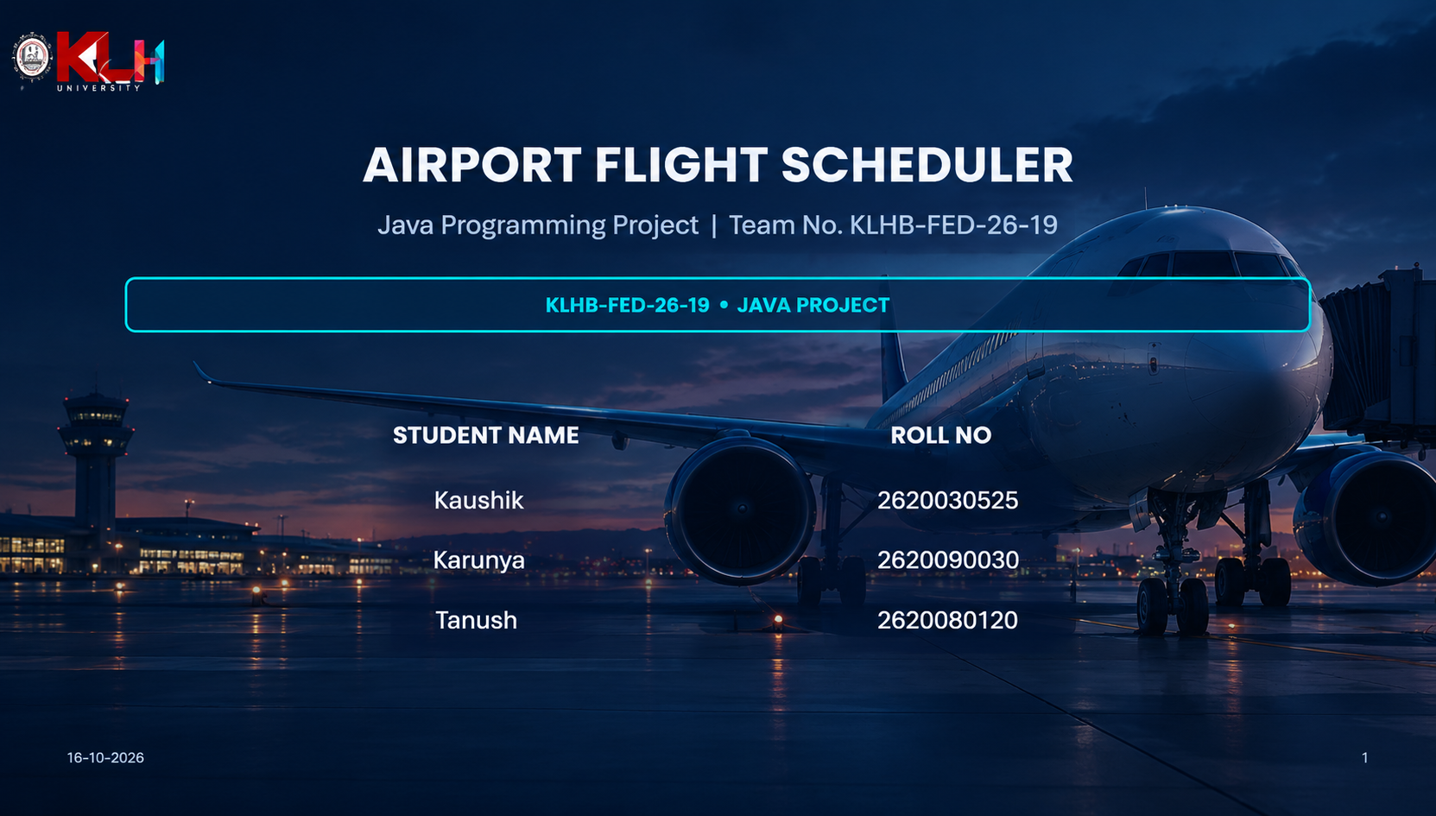

Slide 2
ABSTRACT
Airport Flight Scheduler is a console-based Java application for maintaining a simple departures board.
It registers flights with a flight number, airline, origin, destination and scheduled time.
The user can assign one of five gates (A1–A5), record delays and update flight status.
The departures board can be searched by flight number, destination or airline, and sorted by time, gate or status.
A report summarises total flights, delayed flights, gate usage, on-time performance and gate utilisation.
Flight records are saved to and loaded from the local text file flights.txt.

Slide 3
UNDERSTANDING THE PROBLEM STATEMENT
PROBLEM STATEMENT
Flight details, gate assignments and status changes need a consistent way to be recorded and reviewed. Manual tracking can make it harder to locate a flight or notice gate conflicts.
PROPOSED SOLUTION
The application provides a numbered menu to register, assign, delay, update, display, search and sort flights, then generate a basic operational report.
PROJECT OBJECTIVES
Validate key inputs, prevent assigning an occupied gate, enforce allowed status transitions, and preserve flight records between runs using flights.txt.

Slide 4
CO 1 — JAVA FOUNDATIONS & PROBLEM SOLVING
JAVA FOUNDATIONS
Java entry point: public static void main(String[] args) starts the application.
Imports java.io.* and java.util.* provide file, scanner, collection and utility classes.
Primitive types: int for flight numbers, menu choices and counters; double for percentages; boolean for search results.
Reference types: String for airline, route, time, gate and status; Flight and Gate objects hold related data.
Console input uses Scanner; System.out.println, print and printf display menus, tables and formatted percentages.
Numeric conversion is shown when calculating report percentages with an explicit double cast.
JAVA SYNTAX
import java.util.*;
public static void main(String[] args) {
Scanner sc = new Scanner(System.in);
int choice;
do {
showMenu();
choice = sc.nextInt();
// handle selected option
} while (choice != 9);
}

Slide 5
CO 2 — CONTROL FLOW: SELECTION & ITERATION
CONTROL FLOW & DECISION-MAKING
A while loop keeps the menu running until the user selects option 9 (Save and Exit).
switch(choice) dispatches menu options 1–9; each case uses break to finish that action.
if / else-if decisions validate choices, locate flights, check gate availability and enforce status transitions.
Enhanced for loops traverse flights and gates for duplicate checks, display, reports, search and loading.
Input validation checks numeric entries, HH:MM time format and positive delay values.
continue retries the menu after non-numeric menu input; return exits an action when input or lookup is invalid.
CONTROL FLOW SYNTAX
while (choice != 9) {
switch (choice) {
case 1: registerFlight(); break;
case 2: assignGate(); break;
case 3: delayFlight(); break;
case 9: saveData(); break;
default:
System.out.println("Invalid choice");
}
}

Slide 6
CO 3 — METHODS, MODULAR PROGRAMMING & DATA TRAVERSAL
METHODS & ALGORITHMS
The program is divided into static methods such as registerFlight, assignGate, delayFlight and updateStatus.
displayBoard, searchFlight, sortBoard and report each encapsulate a separate operation.
findFlight(int number) searches the flights collection and returns the matching Flight or null.
Searching traverses flight records and matches the number, destination or airline.
sortBoard uses Comparator.comparing with a lambda to order flights by time, gate or status.
No recursion or method overloading is implemented in the supplied source.
METHODS & SORTING
static Flight findFlight(int number) {
for (Flight f : flights) {
if (f.number == number)
return f;
}
return null;
}
flights.sort(Comparator
.comparing(f -> f.time));

Slide 7
CO 4 — OBJECT-ORIENTED DESIGN & EXCEPTION HANDLING
CO 4 | MODULE 4
OBJECT-ORIENTED PROGRAMMING
Flight and Gate are the two user-defined classes; Main coordinates the application.
Flight(int, String, String, String, String) and Gate(String) initialise new objects.
The this keyword assigns constructor parameters to the current Flight object's fields.
ArrayList<Flight> and ArrayList<Gate> are static members of Main and hold the active records.
try/catch handles InputMismatchException for numeric input and IOException during saving; loadData catches file/data errors.
Fields are package-private and no inheritance, interfaces, abstract classes or method overriding appear in this source.
CLASS & OBJECT SYNTAX
class Flight {
int number;
String airline, origin, destination;
String time, gate, status;
Flight(int number, String airline,
String origin, String destination,
String time) {
this.number = number;
this.airline = airline;
this.origin = origin;
this.destination = destination;
this.time = time;
}
}

Slide 8
CO 5 — STRINGS, SEARCHING & FILE I/O
CO 5 | MODULE 5
STRINGS & FILE HANDLING
String methods include matches for HH:MM validation, equals / equalsIgnoreCase for status and gate comparisons.
toLowerCase and contains support case-insensitive flight searches; String.valueOf converts a flight number for matching.
saveData writes comma-separated flight fields to flights.txt using FileWriter.
loadData checks for the file, reads lines with Scanner, and splits each line using line.split(",").
Integer.parseInt reconstructs the flight number; saved gate and status values are restored to each Flight.
File operations include IOException handling while loading also catches Exception; the code closes its writer and scanner explicitly.
STRING & FILE SYNTAX
if (time.matches("\\d{2}:\\d{2}")) {
// valid HH:MM format
}
String query = input.toLowerCase();
if (flight.destination
.toLowerCase().contains(query)) {
System.out.println(flight);
}
try (FileWriter fw =
new FileWriter("flights.txt")) {
fw.write(data);
} catch (IOException e) {
e.printStackTrace();
}

Slide 9
CO 6 — COLLECTIONS, GENERICS & FUNCTIONAL STYLE
CO 6 | MODULE 6
COLLECTIONS & FUNCTIONAL CONCEPTS
ArrayList<Flight> and ArrayList<Gate> demonstrate generic collections for storing project objects.
Collection operations include add, size and flights.sort; enhanced for loops traverse records.
Comparator.comparing(f -> f.time / f.gate / f.status) uses lambda expressions to select sort keys.
The report counts delayed flights and occupied gates, then computes percentage metrics from the counts.
No Set, Map, explicit generic method, method reference or Stream pipeline is used in the supplied source.
COLLECTIONS SYNTAX
ArrayList<Flight> flights =
new ArrayList<>();
flights.add(newFlight);
for (Flight f : flights) {
if (f.status.equalsIgnoreCase("Delayed"))
delayedCount++;
}
double percent =
(double) delayedCount / flights.size() * 100;

Slide 10
CONCLUSION
The project demonstrates a menu-driven flight scheduling workflow using core Java.
Flight registration, gate allocation, delay/status updates, searching, sorting and reporting are implemented.
Object-oriented classes, ArrayList collections, input validation, string processing and exception handling are applied.
The flights.txt file provides basic persistence so flight data can be restored on the next run.
Future extensions could include stronger file-format validation, richer scheduling rules and a graphical interface.

Slide 11
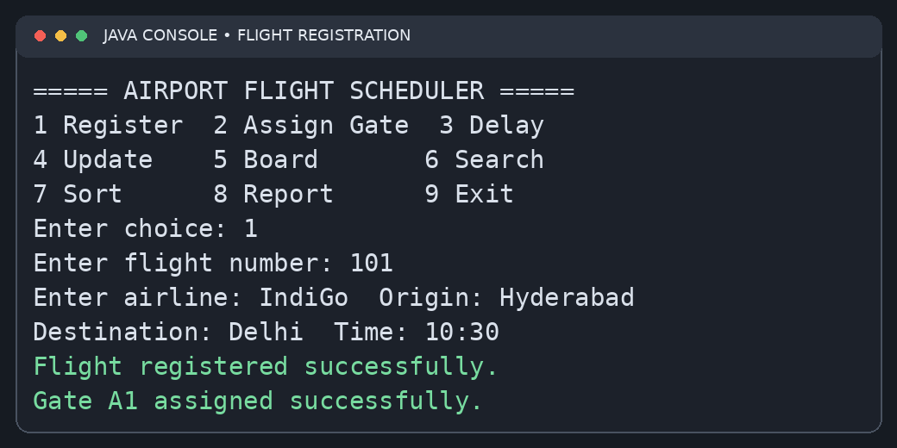
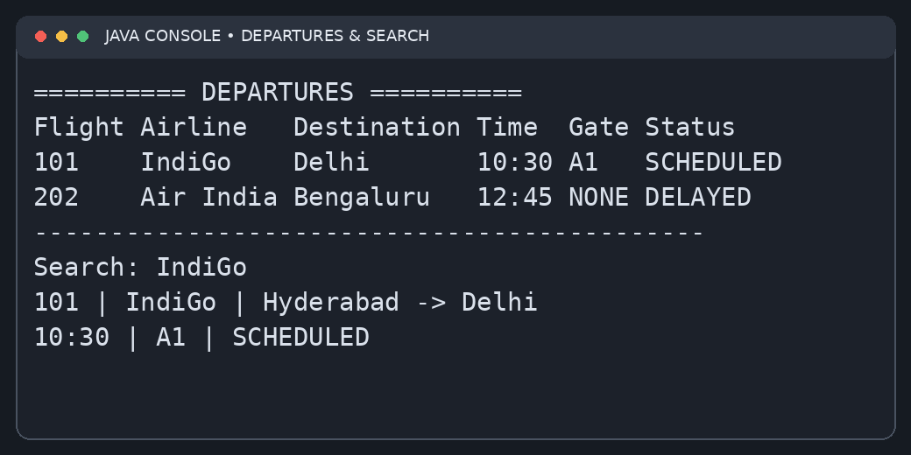
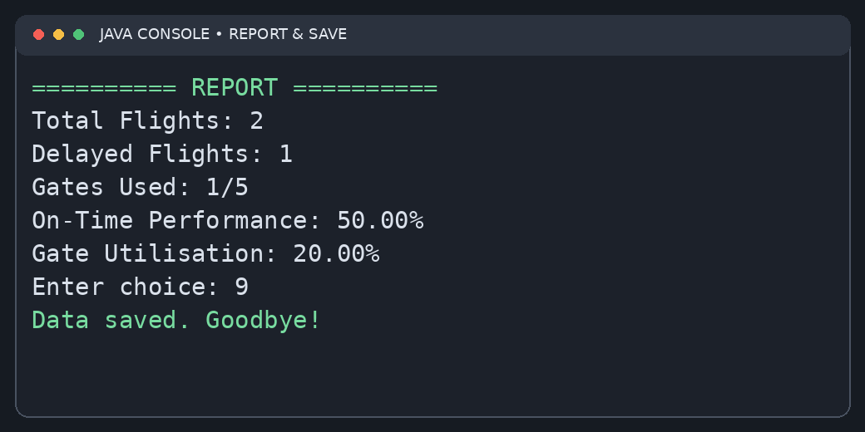
SCREENSHOTS OF THE RUNNING PROJECT
Registration and gate assignment
Departures board and search
Report and save/exit

