Slide 1


Slide 2

Welcome to Kidkonnect

Slide 3
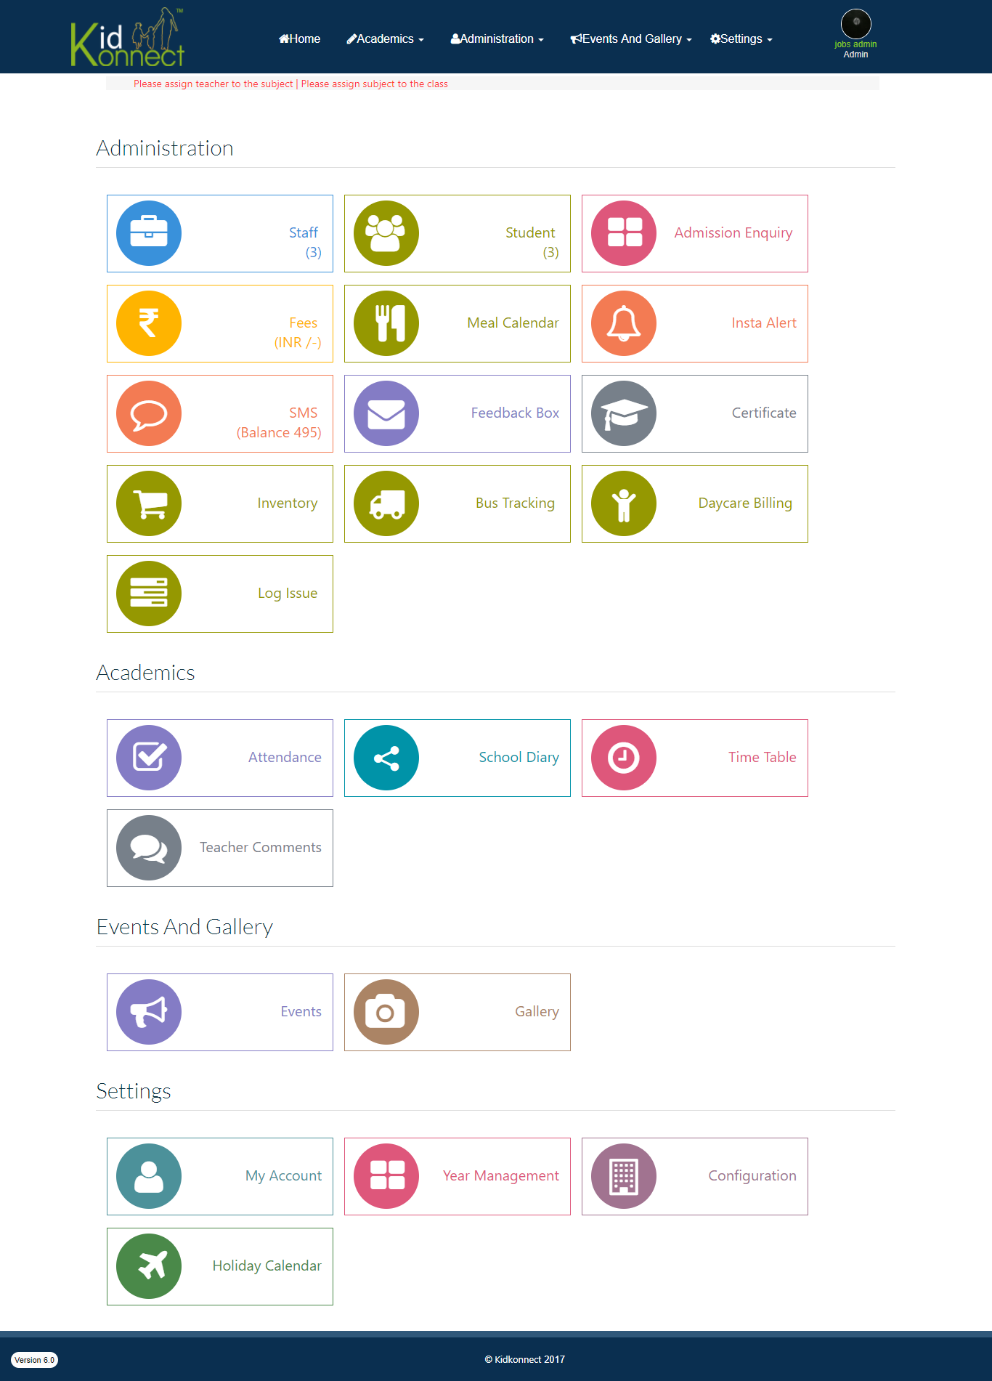
Administrative tools page

Slide 4
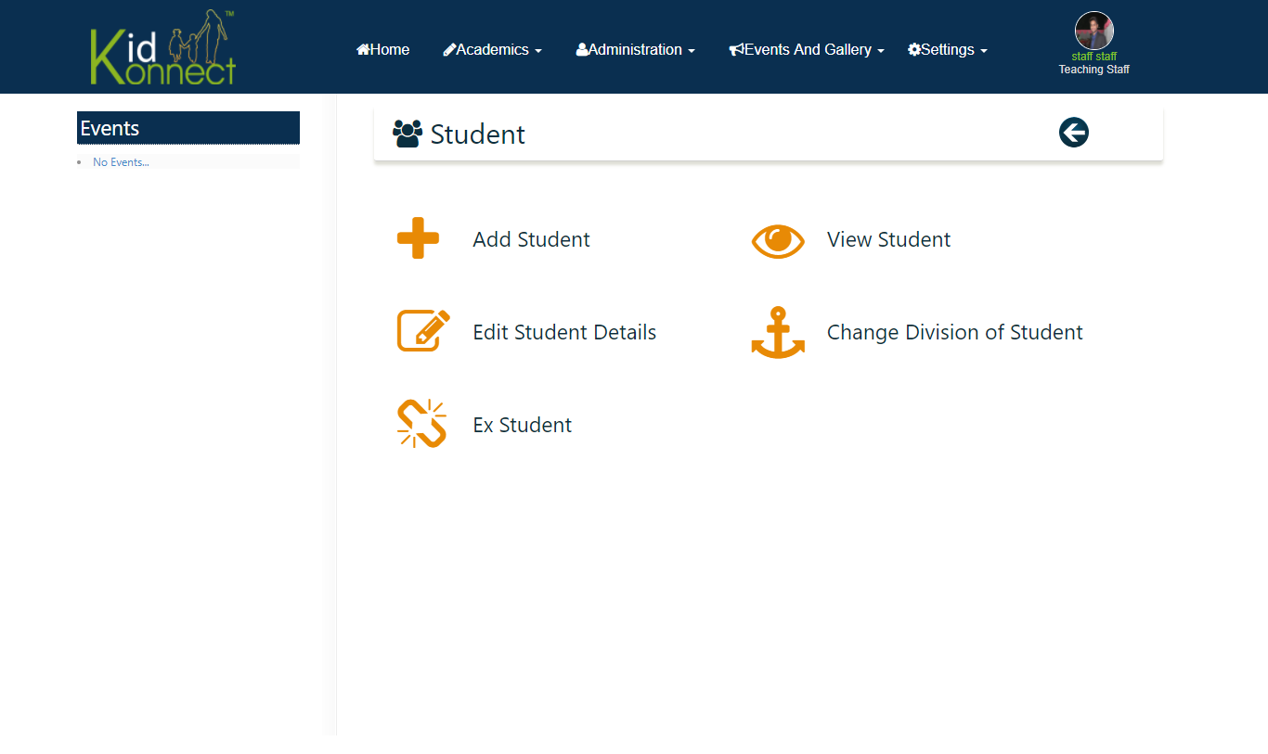
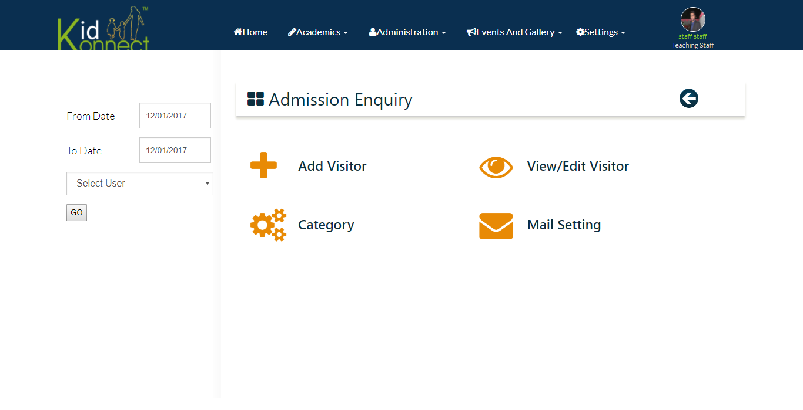
Inside Admin window

Slide 5
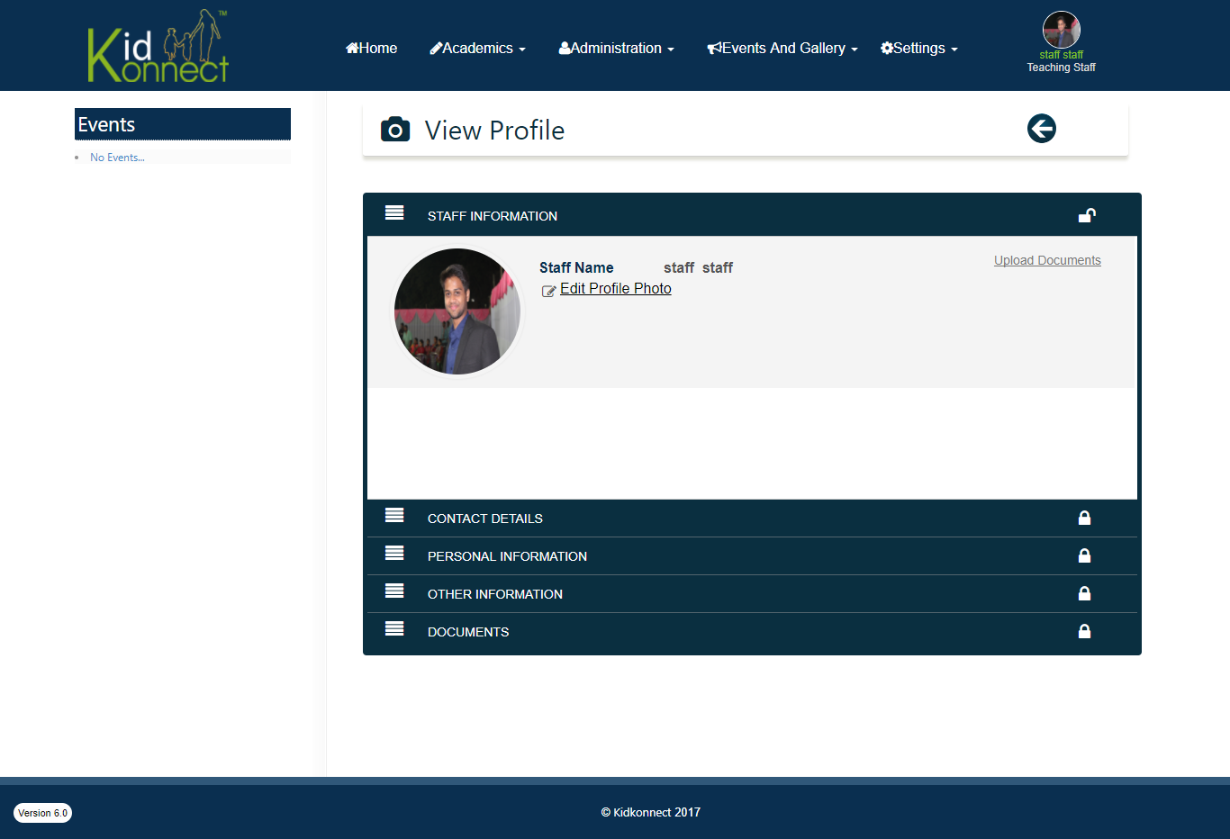
Staff Introductory page

Slide 6
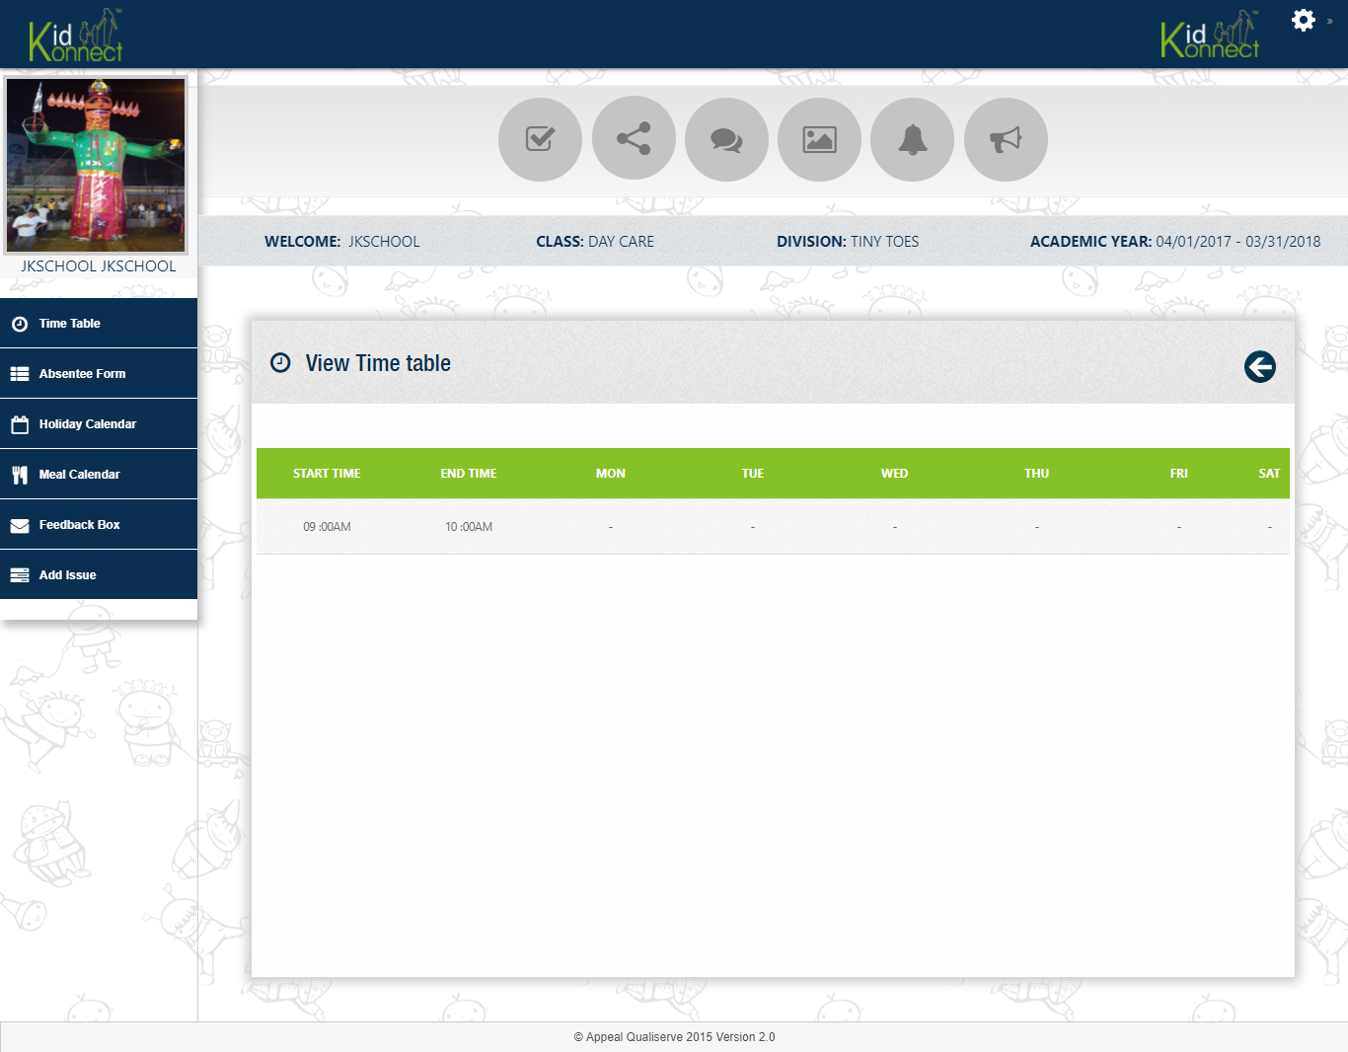
Parent’s interface tool page

Slide 7


