Slide 1



Olympic
View in Power BI
Last data refresh:
3/31/2023 5:53:48 AM UTC
Downloaded at:
3/31/2023 5:57:07 AM UTC

Slide 2
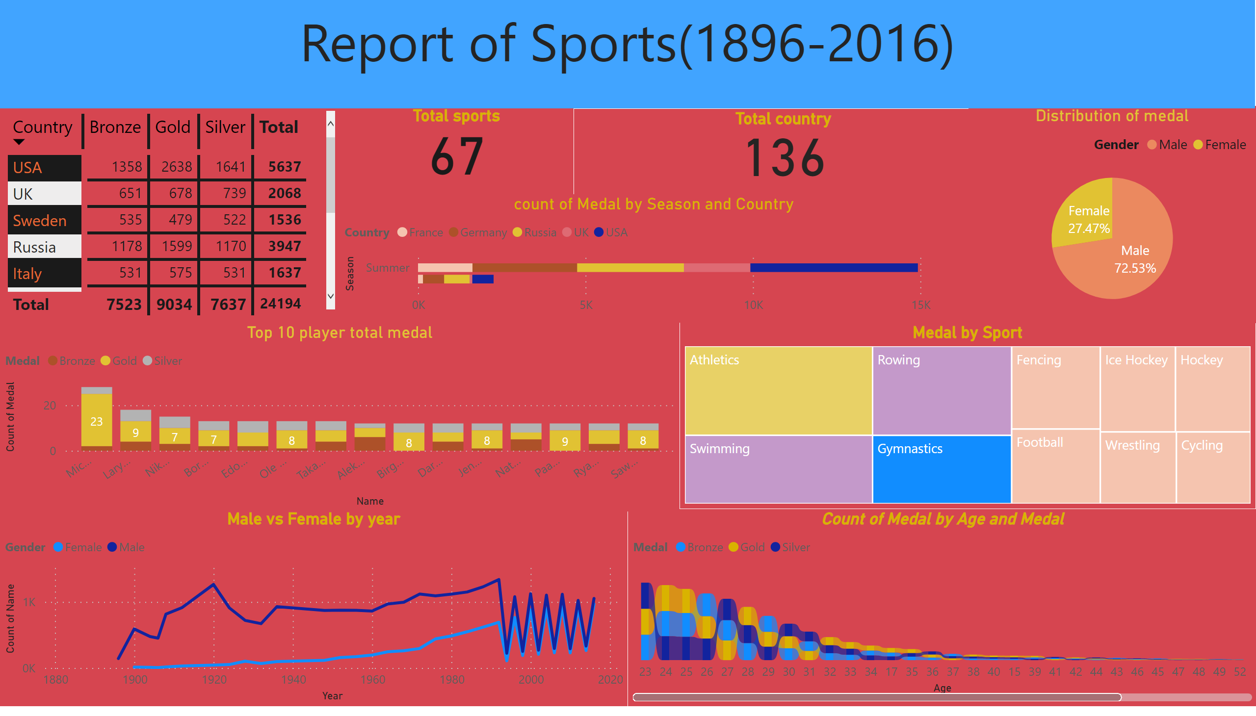
sports project
Notes:
Distribution of medal
No alt text provided
pivotTable
No alt text provided
Top 10 player total medal
No alt text provided
Medal by Sport
No alt text provided
Total country
No alt text provided
Total sports
No alt text provided
count of Medal by Season and Country
No alt text provided
ribbonChart
No alt text provided
Male vs Female by year
No alt text provided
textbox
No alt text provided

